Slide 1
Lecture 01 : Review of CS

Slide 2
Outline
1. EXPLAINATION of the Course Outline
2. Computer Systems:
  • Layers: hardware, software(OS & Applications), and users
  • What is OS ? Its roles
3. Computer Hardware
  • CPU
  • Memory/Storage
  • (I/O) devices
4. Computer Software:
  • Application Software
  • System Software
5. Architectures of Computer Systems
  • single-processor
  • multiprocessor
  • clustered
  • distributed systems
6. Computing Environments
  • Traditional
  • Mobile
  • Client-Server
  • Peer-to-Peer
  • Web-based
  • Cloud computing
  • Real-time
  • Embedded

Slide 3
Outline
KEYWORDS: Operating Systems, CPU, Memory, Storage, Devices, Bus, Processor (CPU), Registers, Instructions, Main Memory, Cache, Secondary Memory, DMA, I/O systems.
HOMEWORK:
1) Reading : Chapter 2, especially the summary.
2) Make sure to understand and be able to explain every keyword from the list here and the ones which are printed bold in the text book.
3) Important Questions:
  • List the main computer hardware components and describe their functions.
  • What is bootstrap program ?
  • What is cache ? Why do we need it ?
  • What is the difference between the Main memory and the Secondary memory ?
  • What is the difference between OS/system programs and Application programs ?
  • What is the difference between user view and system view ?

Slide 4
Outline
1. EXPLAINATION of the Course Outline
2. Computer Systems:
  • Layers: hardware, software(OS & Applications), and users
  • What is OS ? Its roles
3. Computer Hardware
  • CPU
  • Memory/Storage
  • (I/O) devices
4. Computer Software:
  • Application Software
  • System Software
5. Architectures of Computer Systems
  • single-processor
  • multiprocessor
  • clustered
  • distributed systems
6. Computing Environments
  • Traditional
  • Mobile
  • Client-Server
  • Peer-to-Peer
  • Web-based
  • Cloud computing
  • Real-time
  • Embedded

Slide 5
Layers of Computer Systems
Computer system can be divided into four layers:
  Hardware – provides basic computing resources
    CPU, memory, I/O devices
  Operating system
    Controls and coordinates use of hardware among various applications and users
  Application programs – define the ways in which the system resources are used to solve the computing problems of the users
    Word processors, compilers, web browsers, database systems, video games
  Users
    People, machines, other computers

Slide 6
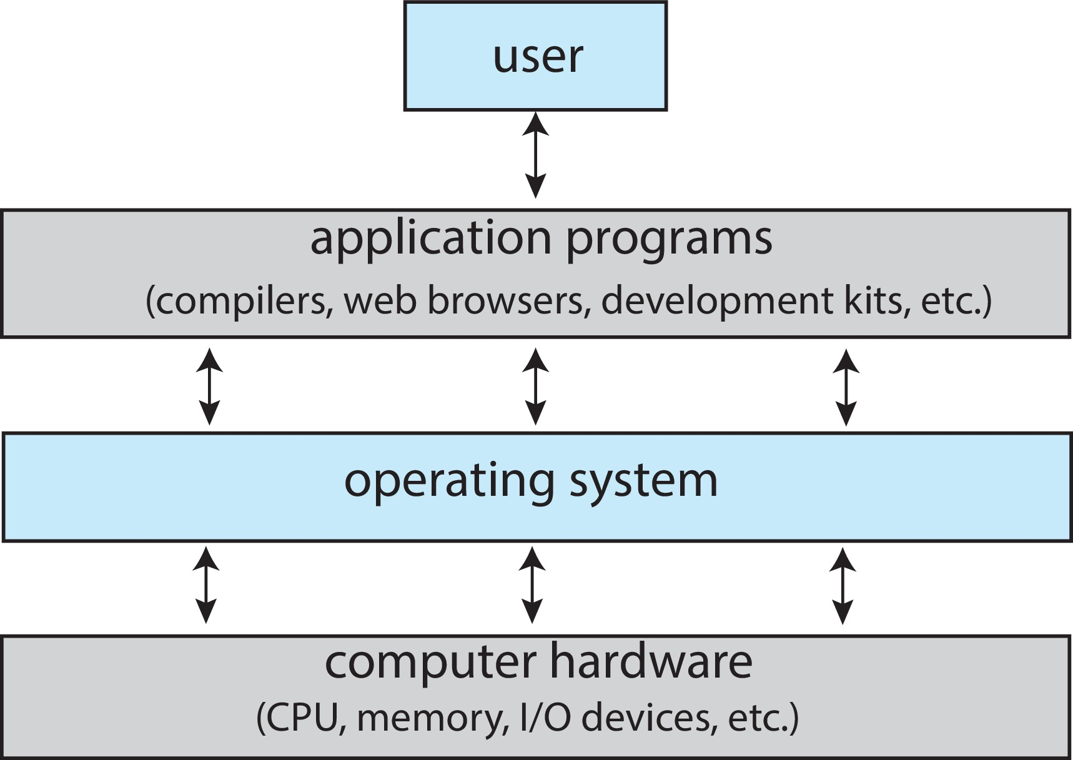
Abstract View of Computers

Slide 7
Outline
1. EXPLAINATION of the Course Outline
2. Computer Systems:
  • Layers: hardware, software(OS & Applications), and users
  • What is OS ? Its roles
3. Computer Hardware
  • CPU
  • Memory/Storage
  • (I/O) devices
4. Computer Software:
  • Applications
  • OS & System Programs
5. Architectures of Computer Systems
  • single-processor
  • multiprocessor
  • clustered
  • distributed systems
6. Computing Environments
  • Traditional
  • Mobile
  • Client-Server
  • Peer-to-Peer
  • Web-based
  • Cloud computing
  • Real-time
  • Embedded

Slide 8
What is an Operating System?
An Operating System (OS) = a software consisting of many programs
OS role: acts as an intermediary between the computer hardware and its users
Specifically:
  Help users use the computer: implement user commands and execute user programs
  Manage computer hardware

Slide 9
Outline
1. EXPLAINATION of the Course Outline
2. Computer Systems:
  • Layers: hardware, software(OS & Applications), and users
  • What is OS ? Its roles
3. Computer Hardware
  • CPU
  • Memory/Storage
  • (I/O) devices
4. Computer Software:
  • Application Software
  • System Software
5. Architectures of Computer Systems
  • single-processor
  • multiprocessor
  • clustered
  • distributed systems
6. Computing Environments
  • Traditional
  • Mobile
  • Client-Server
  • Peer-to-Peer
  • Web-based
  • Cloud computing
  • Real-time
  • Embedded

Slide 10
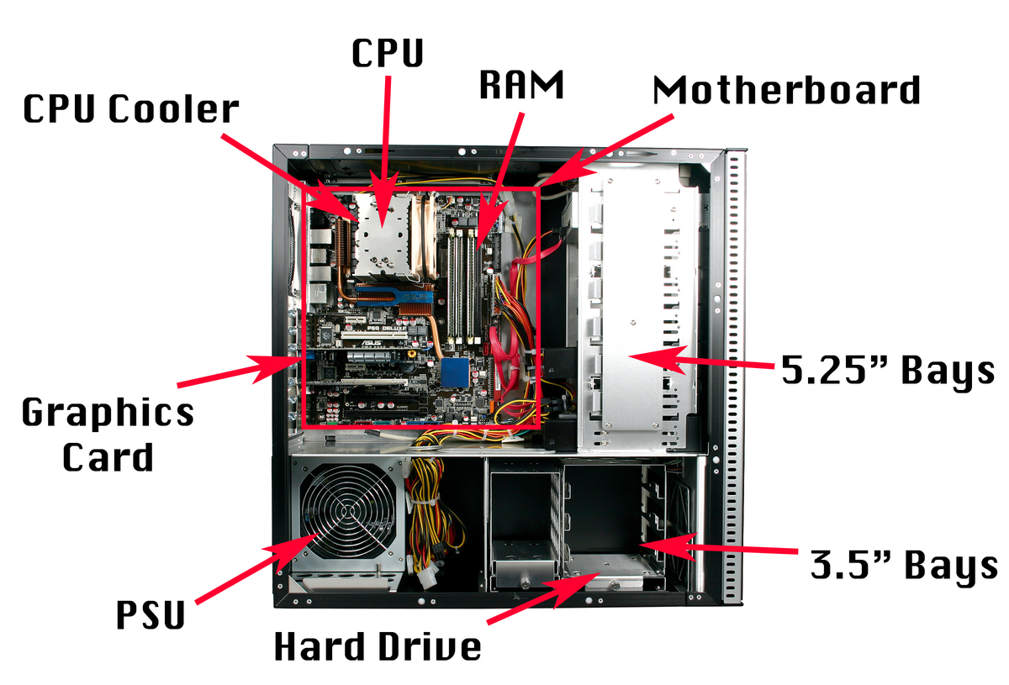
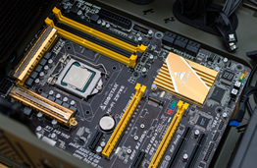
CPU/Processor
CPU/Processor = only component which can do calculations

Slide 11
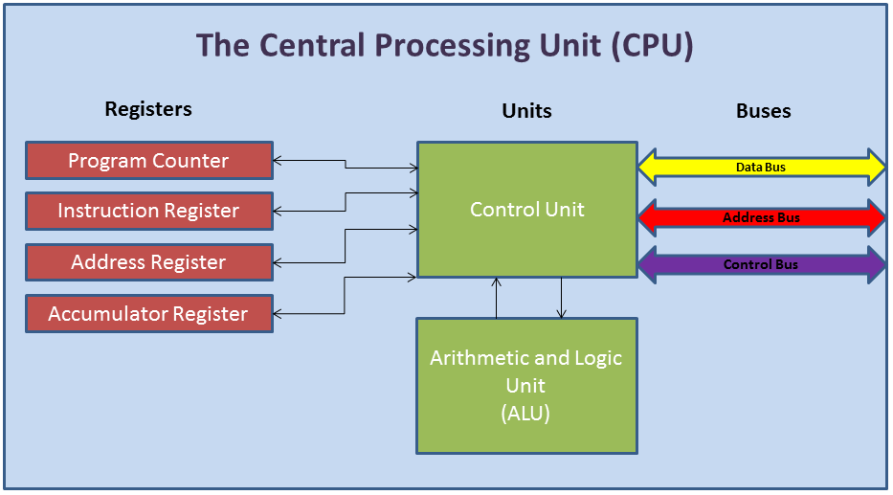
CPU/Processor
What are inside the CPU/Processor (CHIP) ?

Slide 12
Outline
1. EXPLAINATION of the Course Outline
2. Computer Systems:
  • Layers: hardware, software(OS & Applications), and users
  • What is OS ? Its roles
3. Computer Hardware
  • CPU
  • Memory/Storage
  • (I/O) devices
4. Computer Software:
  • Application Software
  • System Software
5. Architectures of Computer Systems
  • single-processor
  • multiprocessor
  • clustered
  • distributed systems
6. Computing Environments
  • Traditional
  • Mobile
  • Client-Server
  • Peer-to-Peer
  • Web-based
  • Cloud computing
  • Real-time
  • Embedded

Slide 13
Storage Structure
Main memory – only large storage media that the CPU can access directly
  Random access
  Typically volatile
  Typically random-access memory in the form of Dynamic Random-access Memory (DRAM)
Secondary storage – extension of main memory that provides large nonvolatile storage capacity

Slide 14
Storage Structure (Cont.)
Hard Disk Drives (HDD) – rigid metal or glass platters covered with magnetic recording material
  Disk surface is logically divided into tracks, which are subdivided into sectors
  The disk controller determines the logical interaction between the device and the computer
Non-volatile memory (NVM) devices– faster than hard disks, nonvolatile
  Various technologies
  Becoming more popular as capacity and performance increases, price drops

Slide 15
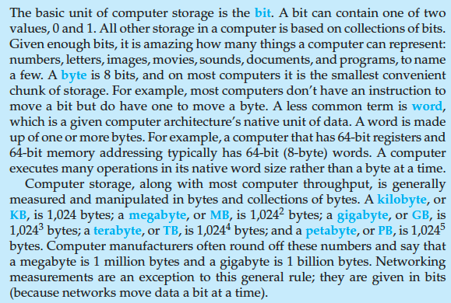
Storage Definitions and Notation Review
The basic unit of computer storage is the bit. A bit can contain one of two
values, 0 and 1. All other storage in a computer is based on collections of bits.
Given enough bits, it is amazing how many things a computer can represent:
numbers, letters, images, movies, sounds, documents, and programs, to name
a few. A byte is 8 bits, and on most computers it is the smallest convenient
chunk of storage. For example, most computers don’t have an instruction to
move a bit but do have one to move a byte. A less common term is word,
which is a given computer architecture’s native unit of data. A word is made
up of one or more bytes. For example, a computer that has 64-bit registers and
64-bit memory addressing typically has 64-bit (8-byte) words. A computer
executes many operations in its native word size rather than a byte at a time.
Computer storage, along with most computer throughput, is generally
measured and manipulated in bytes and collections of bytes. A kilobyte, or
KB , is 1,024 bytes; a megabyte, or MB, is 1,024² bytes; a gigabyte, or GB, is
1,024³ bytes; a terabyte, or TB, is 1,024⁴ bytes; and a petabyte, or PB, is 1,024⁵
bytes. Computer manufacturers often round off these numbers and say that
a megabyte is 1 million bytes and a gigabyte is 1 billion bytes. Networking
measurements are an exception to this general rule; they are given in bits
(because networks move data a bit at a time).

Slide 16
Storage Hierarchy
Storage systems organized in hierarchy
  Speed
  Cost
  Volatility
Caching – copying information into faster storage system; main memory can be viewed as a cache for secondary storage
Device Driver for each device controller to manage I/O
  Provides uniform interface between controller and kernel

Slide 17
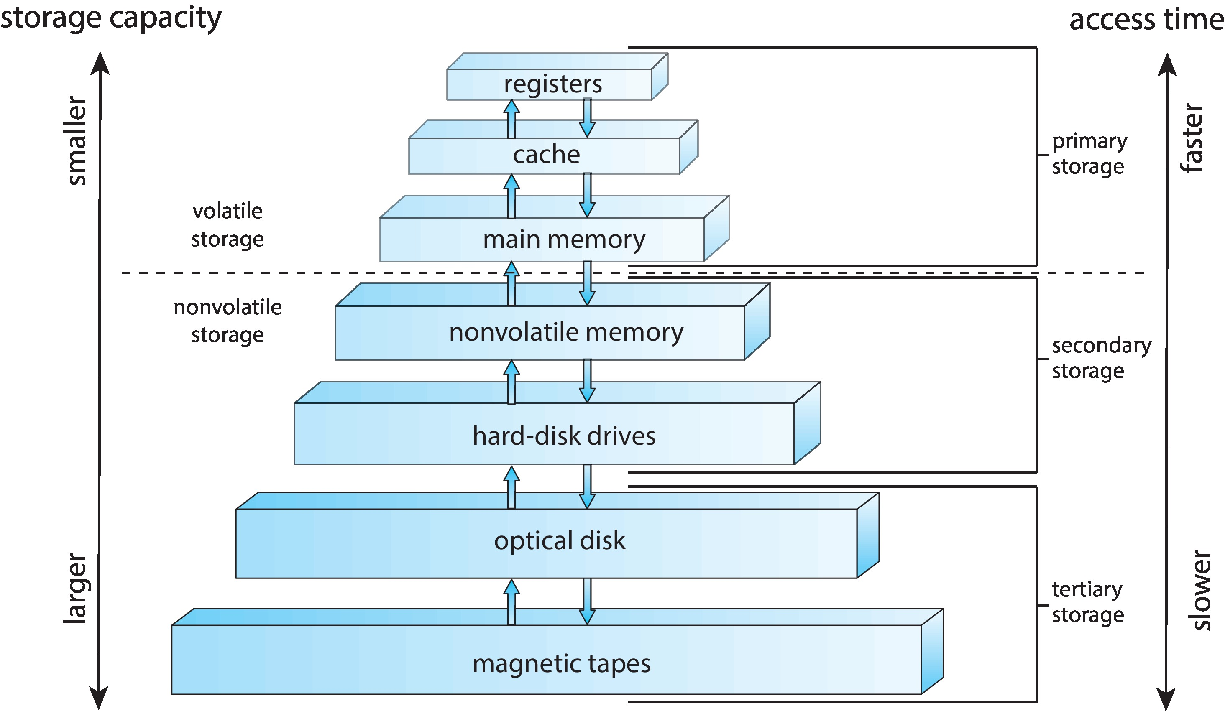
Storage-Device Hierarchy

Slide 18
Caching
Important principle, performed at many levels in a computer (in hardware, operating system, software)
Information in use copied from slower to faster storage temporarily
Faster storage (cache) checked first to determine if information is there
  If it is, information used directly from the cache (fast)
  If not, data copied to cache and used there
Cache smaller than storage being cached
  Cache management important design problem
  Cache size and replacement policy

Slide 19
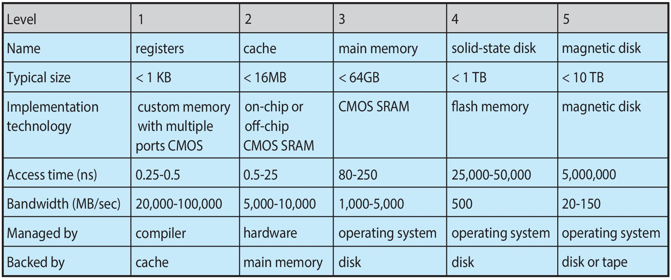
Characteristics of Various Types of Storage
Movement between levels of storage hierarchy can be explicit or implicit

Slide 20
Outline
1. EXPLAINATION of the Course Outline
2. Computer Systems:
  • Layers: hardware, software(OS & Applications), and users
  • What is OS ? Its roles
3. Computer Hardware
  • CPU
  • Memory/Storage
  • (I/O) devices
4. Computer Software:
  • Application Software
  • System Software
5. Architectures of Computer Systems
  • single-processor
  • multiprocessor
  • clustered
  • distributed systems
6. Computing Environments
  • Traditional
  • Mobile
  • Client-Server
  • Peer-to-Peer
  • Web-based
  • Cloud computing
  • Real-time
  • Embedded

Slide 21
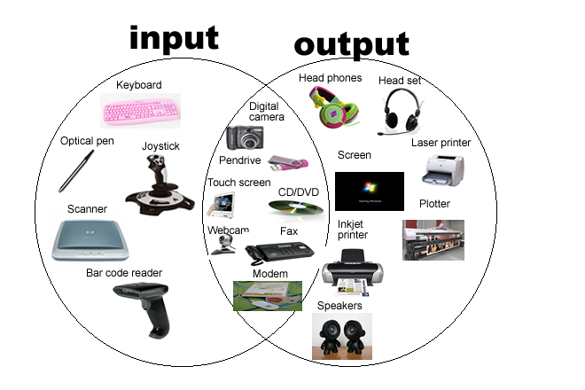
I/O Devices

Slide 22
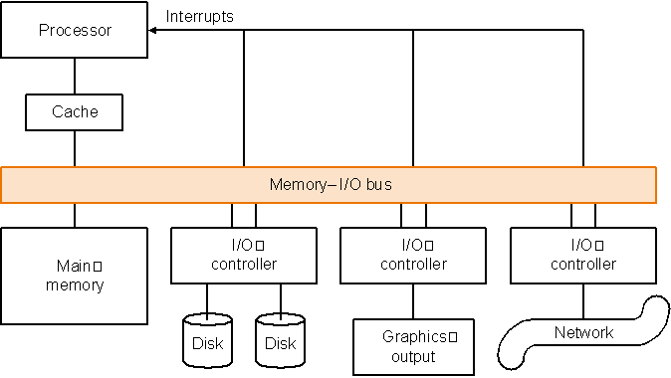
I/O Devices

Slide 23
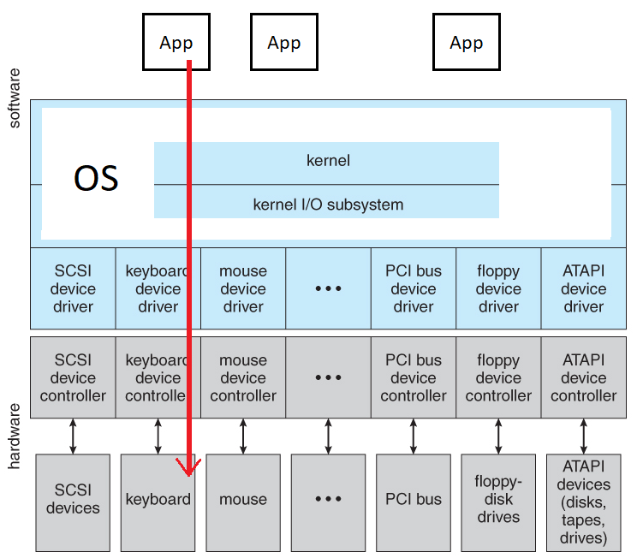
I/O Devices

Slide 24
Outline
1. EXPLAINATION of the Course Outline
2. Computer Systems:
  • Layers: hardware, software(OS & Applications), and users
  • What is OS ? Its roles
3. Computer Hardware
  • CPU
  • Memory/Storage
  • (I/O) devices
4. Computer Software:
  • Application Software
  • System Software
5. Architectures of Computer Systems
  • single-processor
  • multiprocessor
  • clustered
  • distributed systems
6. Computing Environments
  • Traditional
  • Mobile
  • Client-Server
  • Peer-to-Peer
  • Web-based
  • Cloud computing
  • Real-time
  • Embedded

Slide 25
Computer Software
Computer software, or simply software, is a set of instructions and data that tell the computer what to do to .
TYPES:
Application software: for user tasks which are beyond the basic operations of the computer (games, web, doc edit, …)
System software: for managing computer hardware and supporting other (app) software. It includes:
  Operating systems: a collections of software that manage resources and provide common services.
  Utilities (System Programs): independent programs designed to assist users in the maintenance and care of their computers.
  Device drivers: programs which operate or control a particular type of device that is attached to a computer. Each device needs at least one corresponding device driver.
Middleware software: is package/framework that provide additional services to applications such as databases, multimedia, or graphics. It makes it easier and faster for developers to build applications with prebuilt codes from its library. It supports applications but doesn’t have the OS/System software’s privileges.
(games, web, doc edit, …)

Slide 26
Outline
1. EXPLAINATION of the Course Outline
2. Computer Systems:
  • Layers: hardware, software(OS & Applications), and users
  • What is OS ? Its roles
3. Computer Hardware
  • CPU
  • Memory/Storage
  • (I/O) devices
4. Computer Software:
  • Application Software
  • System Software
5. Architectures of Computer Systems
  • single-processor
  • multiprocessor
  • clustered
  • distributed systems
6. Computing Environments
  • Traditional
  • Mobile
  • Client-Server
  • Peer-to-Peer
  • Web-based
  • Cloud computing
  • Real-time
  • Embedded

Slide 27
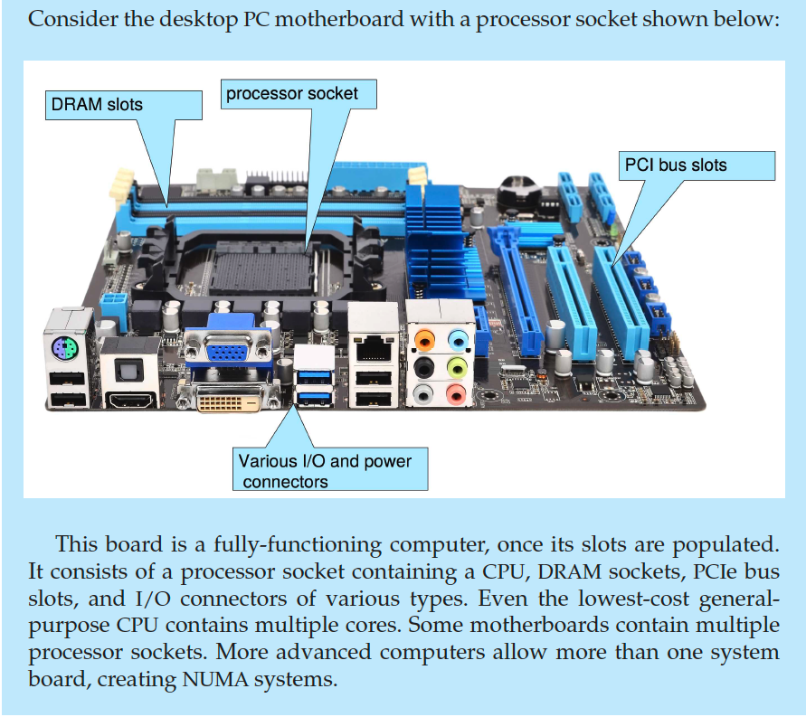
PC Motherboard

Slide 28
Computer-System Architecture
Most systems use a single general-purpose processor
  Most systems have special-purpose processors as well
Multiprocessors systems growing in use and importance
  Also known as parallel systems, tightly-coupled systems
  Advantages include:
    Increased throughput
    Economy of scale
    Increased reliability – graceful degradation or fault tolerance
  Two types:
    Asymmetric Multiprocessing – each processor is assigned a specie task.
    Symmetric Multiprocessing – each processor performs all tasks

Slide 29
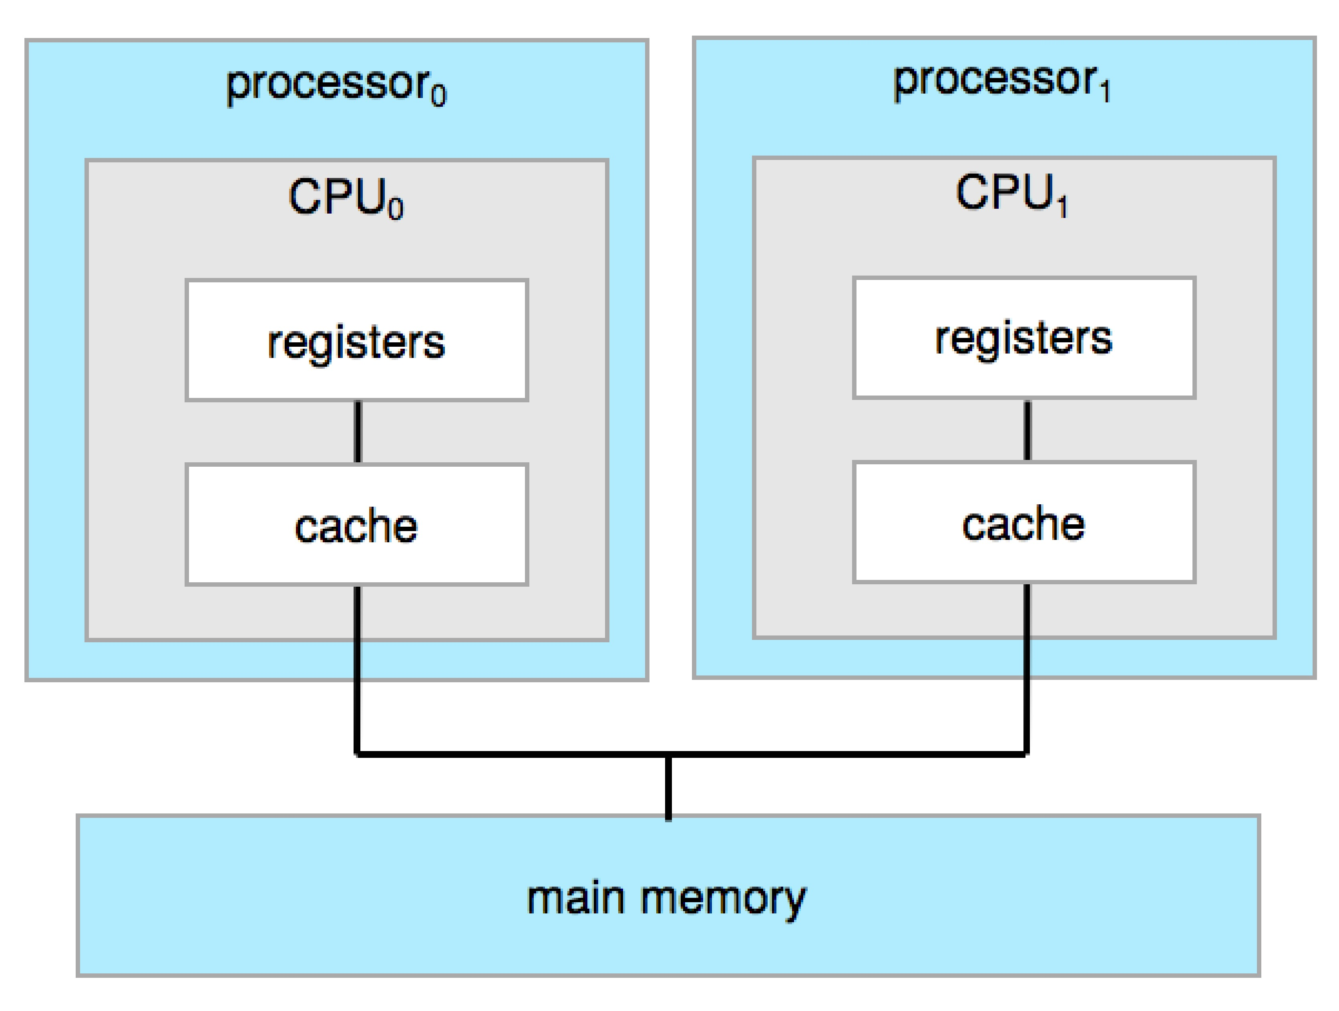
Symmetric Multiprocessing Architecture

Slide 30
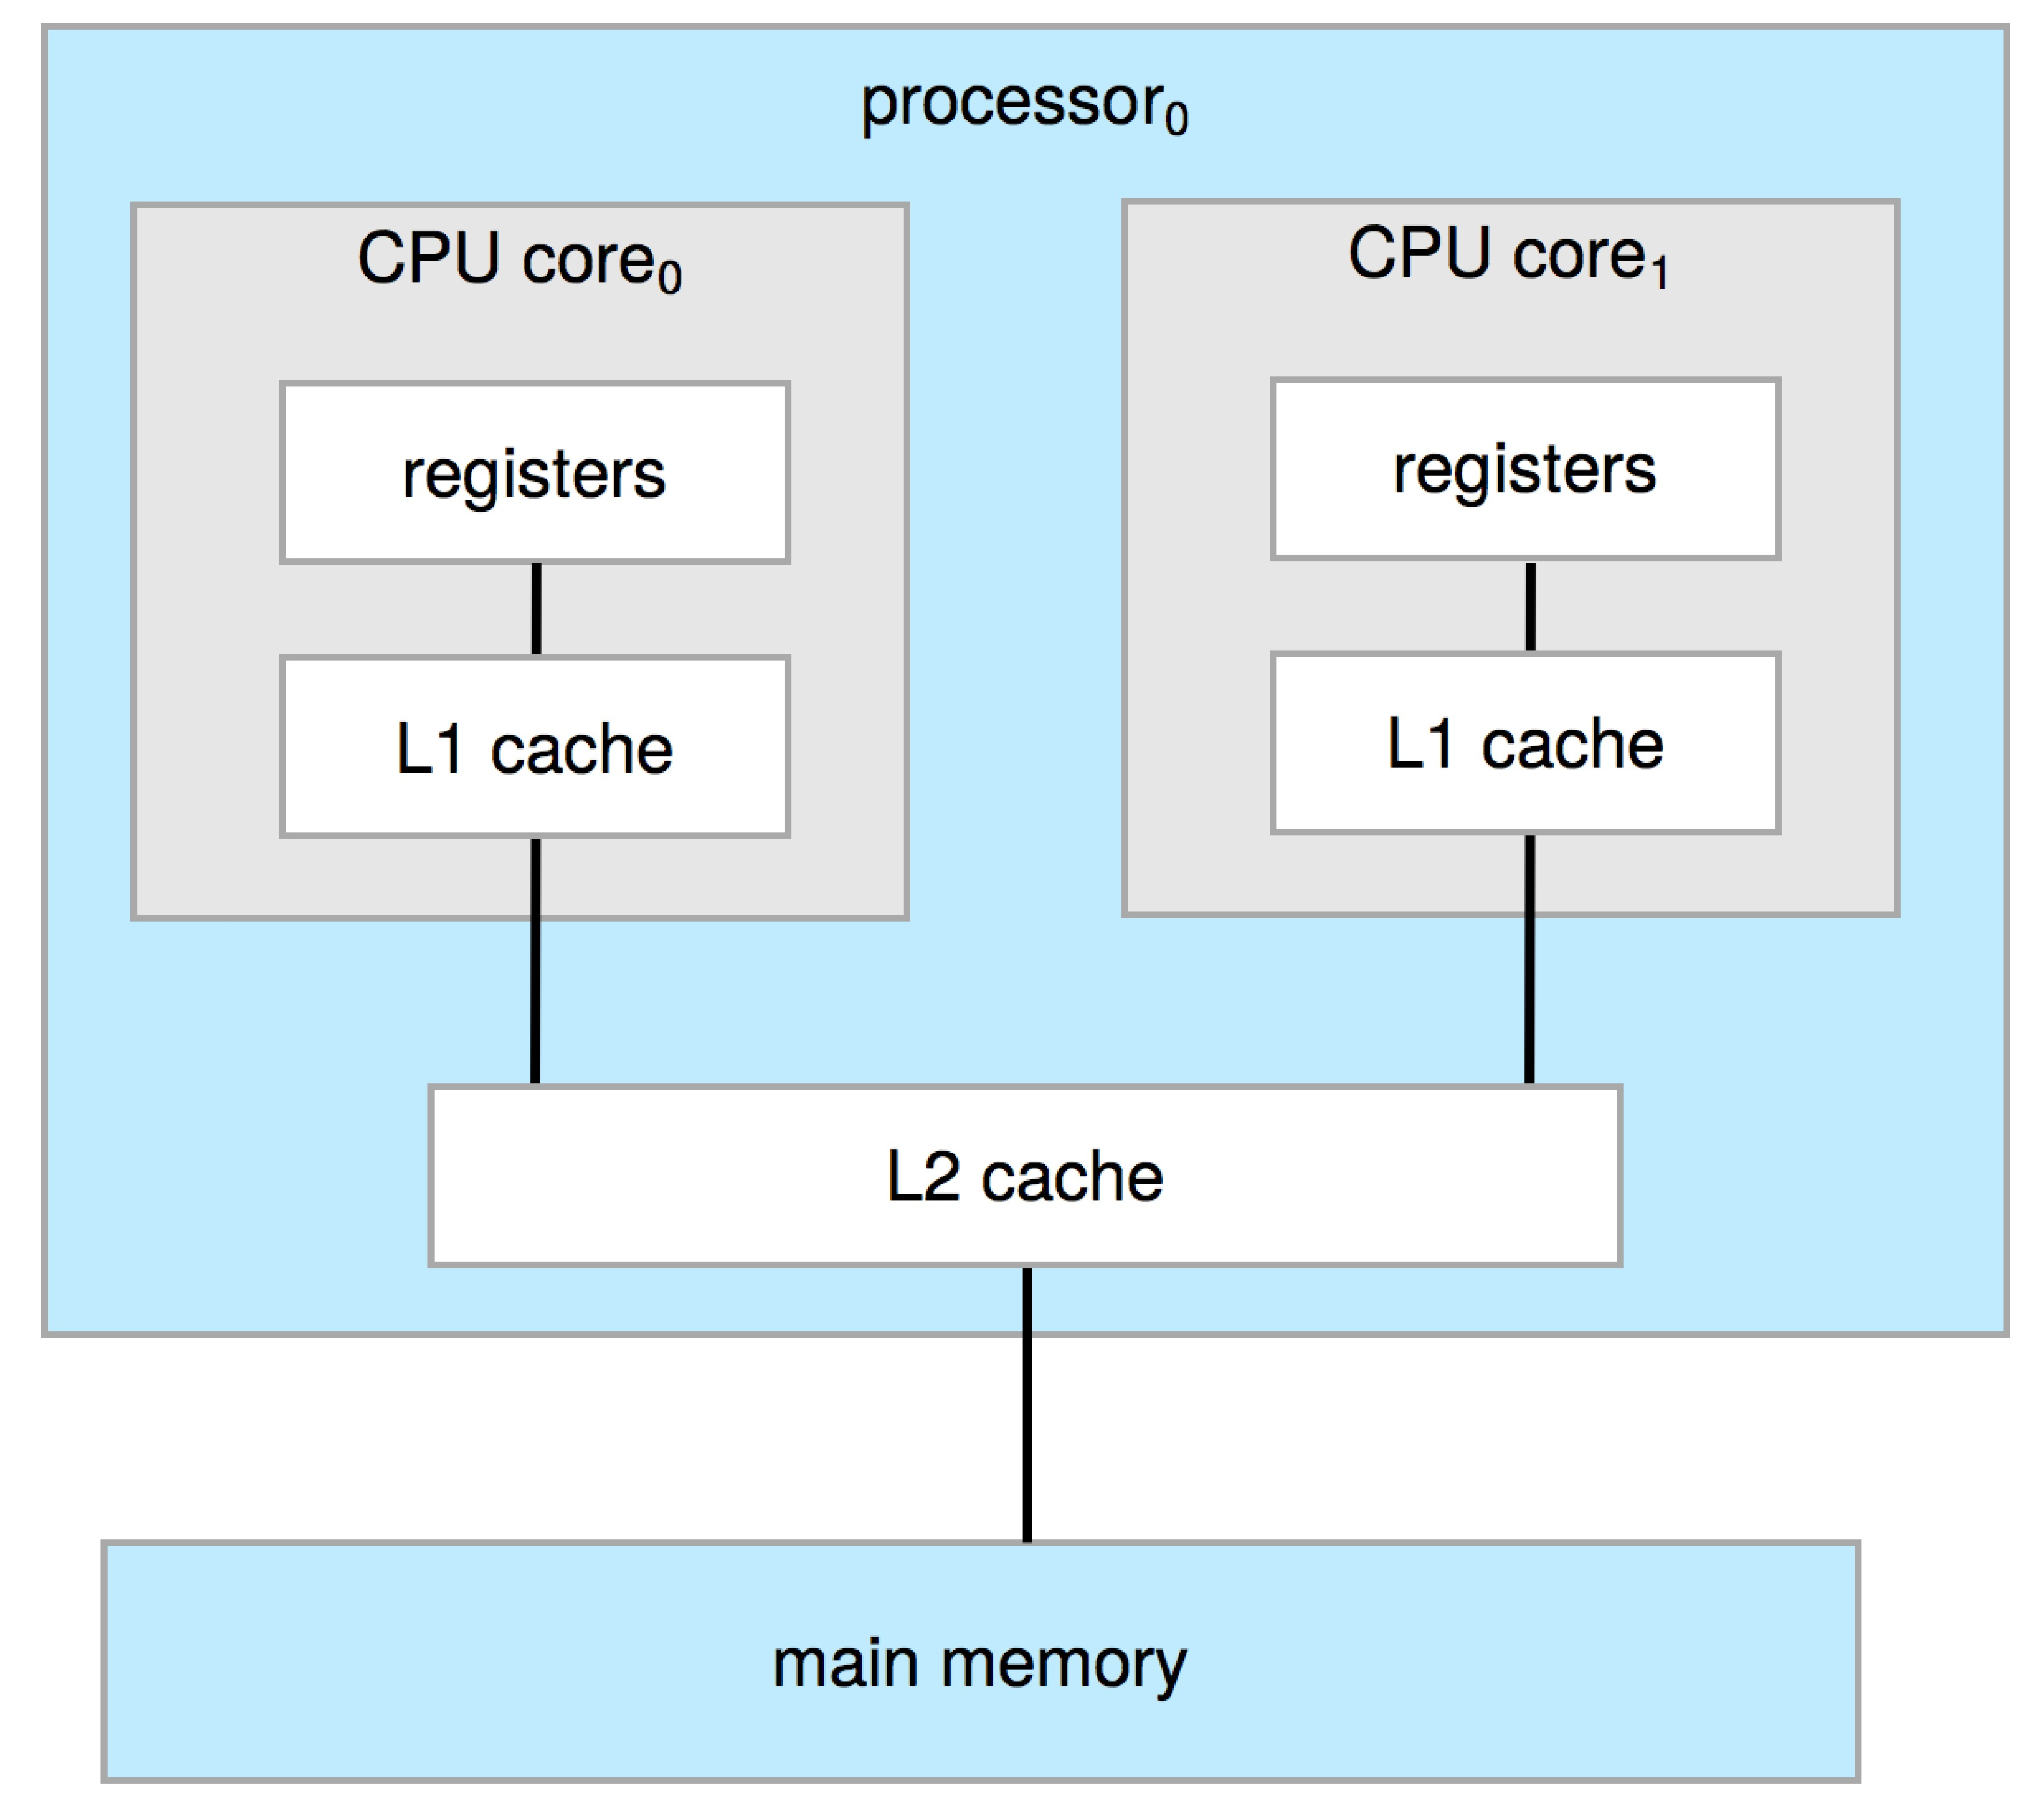
Dual-Core Design
Multi-chip and multicore
Systems containing all chips
  Chassis containing multiple separate systems

Slide 31
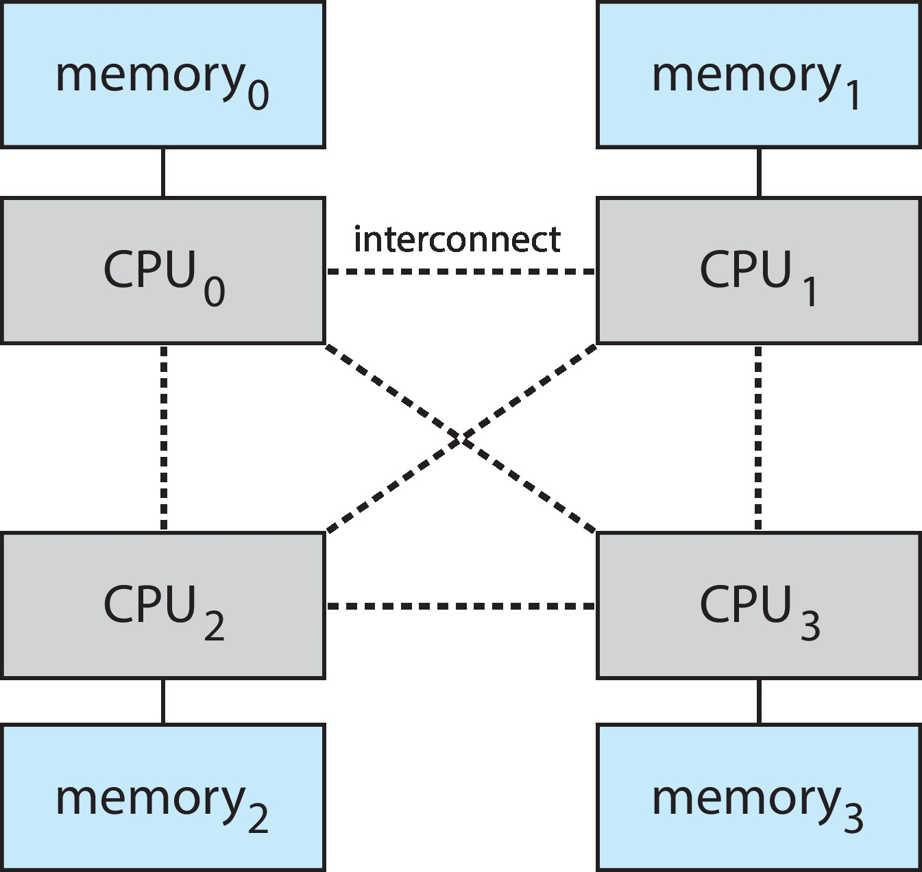
Non-Uniform Memory Access System

Slide 32
Clustered Systems
Like multiprocessor systems, but multiple systems working together
  Usually sharing storage via a storage-area network (SAN)
  Provides a high-availability service which survives failures
    Asymmetric clustering has one machine in hot-standby mode
    Symmetric clustering has multiple nodes running applications, monitoring each other
  Some clusters are for high-performance computing (HPC)
    Applications must be written to use parallelization
  Some have distributed lock manager (DLM) to avoid conflicting operations

Slide 33
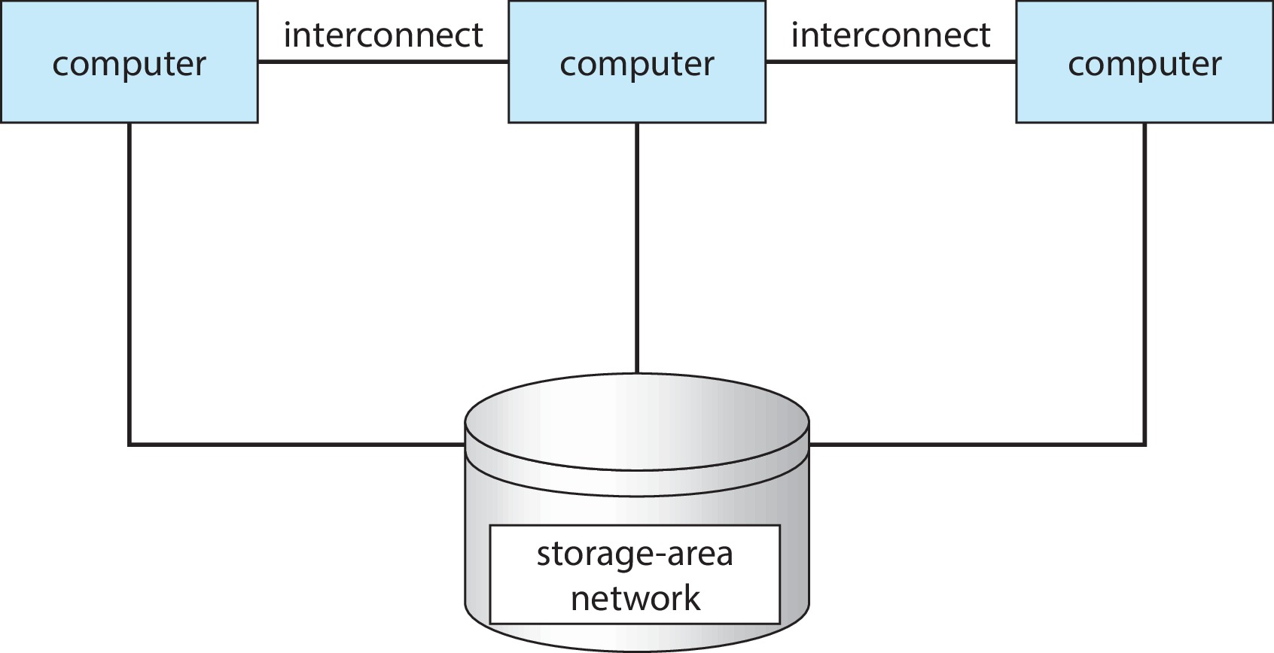
Clustered Systems

Slide 34
Distributed Systems
Collection of separate, possibly heterogeneous, systems networked together
  Network is a communications path, TCP/IP most common
    Local Area Network (LAN)
    Wide Area Network (WAN)
    Metropolitan Area Network (MAN)
    Personal Area Network (PAN)
Network Operating System provides features between systems across network
  Communication scheme allows systems to exchange messages
  Illusion of a single system

Slide 35
Outline
1. EXPLAINATION of the Course Outline
2. Computer Systems:
  • Layers: hardware, software(OS & Applications), and users
  • What is OS ? Its roles
3. Computer Hardware
  • CPU
  • Memory/Storage
  • (I/O) devices
4. Computer Software:
  • Application Software
  • System Software
5. Architectures of Computer Systems
  • single-processor
  • multiprocessor
  • clustered
  • distributed systems
6. Computing Environments
  • Traditional
  • Mobile
  • Client-Server
  • Peer-to-Peer
  • Web-based
  • Cloud computing
  • Real-time
  • Embedded

Slide 36
Traditional
Stand-alone general-purpose machines
But blurred as most systems interconnect with others (i.e., the Internet)
Portals provide web access to internal systems
Network computers (thin clients) are like Web terminals
Mobile computers interconnect via wireless networks
Networking becoming ubiquitous – even home systems use firewalls to protect home computers from Internet attacks

Slide 37
Mobile
Handheld smartphones, tablets, etc.
What is the functional difference between them and a “traditional” laptop?
Extra feature – more OS features (GPS, gyroscope)
Allows new types of apps like augmented reality
Use IEEE 802.11 wireless, or cellular data networks for connectivity
Leaders are Apple iOS and Google Android

Slide 38
Client Server
Client-Server Computing
  Dumb terminals supplanted by smart PCs
  Many systems now servers, responding to requests generated by clients
    Compute-server system provides an interface to client to request services (i.e., database)
    File-server system provides interface for clients to store and retrieve files

Slide 39
Peer-to-Peer
Another model of distributed system
P2P does not distinguish clients and servers
  Instead all nodes are considered peers
  May each act as client, server or both
  Node must join P2P network
    Registers its service with central lookup service on network, or
    Broadcast request for service and respond to requests for service via discovery protocol
  Examples include Napster and Gnutella, Voice over IP (VoIP) such as Skype

Slide 40
Cloud Computing
Delivers computing, storage, even apps as a service across a network
Logical extension of virtualization because it uses virtualization as the base for it functionality.
  Amazon EC2 has thousands of servers, millions of virtual machines, petabytes of storage available across the Internet, pay based on usage

Slide 41
Cloud Computing (Cont.)
Many types
  Public cloud – available via Internet to anyone willing to pay
  Private cloud – run by a company for the company’s own use
  Hybrid cloud – includes both public and private cloud components
  Software as a Service (SaaS) – one or more applications available via the Internet (i.e., word processor)
  Platform as a Service (PaaS) – software stack ready for application use via the Internet (i.e., a database server)
  Infrastructure as a Service (IaaS) – servers or storage available over Internet (i.e., storage available for backup use)

Slide 42
Cloud Computing (cont.)
Cloud computing environments composed of traditional OSes, plus VMMs, plus cloud management tools
  Internet connectivity requires security like firewalls
  Load balancers spread traffic across multiple applications

Slide 43
Special-Purpose Systems
A general purpose computer is used for different (any kind of) programs for different functions. It can be used to do many tasks. Its chip/cpu is general-purpose.
Examples: our laptop, desktop, …
A special-purpose computer is designed for specific tasks/programs only. Its chip/cpu is usually also special-purpose.
Examples: smart TV, ATM, Traffic Lights, …

Slide 44
Real-Time Systems
Real-time OS has well-defined fixed time constraints
  Processing must be done within constraint (deadline)
  Correct operation only if constraints met
TYPES:
Hard – missing a deadline is a total system failure.
Firm – infrequent deadline misses are tolerable, but may degrade the system's quality of service. The usefulness of a result is zero after its deadline.
Soft – the usefulness of a result degrades after its deadline, thereby degrading the system's quality of service.
EXAMPLES:
  Car engine control systems, heart pacemakers are hard real-time systems.
  Video games are usually soft real-time.

Slide 45
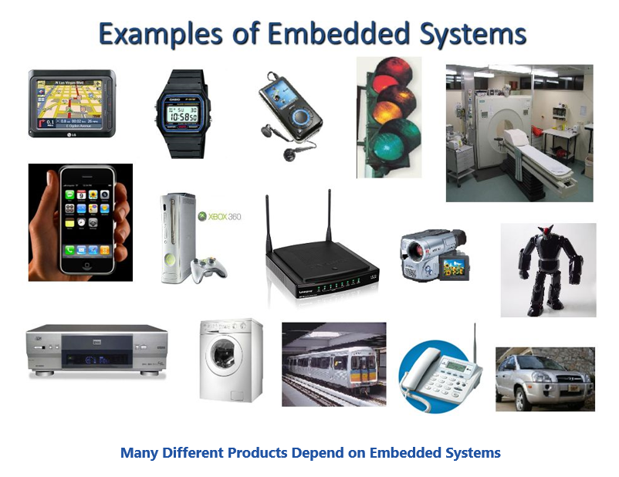
Embedded Systems
An embedded system is a microprocessor- or microcontroller-based system of hardware and software designed to perform dedicated functions within a larger usually mechanical or electrical system.

Slide 46
Free and Open-Source Operating Systems
Operating systems made available in source-code format rather than just binary closed-source and proprietary
Counter to the copy protection and Digital Rights Management (DRM) movement
Started by Free Software Foundation (FSF), which has “copyleft” GNU Public License (GPL)
  Free software and open-source software are two different ideas championed by different groups of people
    http://gnu.org/philosophy/open-source-misses-the-point.html/
Examples include GNU/Linux and BSD UNIX (including core of Mac OS X), and many more
Can use VMM like VMware Player (Free on Windows), Virtualbox (open source and free on many platforms - http://www.virtualbox.com)
  Use to run guest operating systems for exploration

Slide 47
The Study of Operating Systems
There has never been a more interesting time to study operating systems, and it has never been
easier. The open-source movement has overtaken operating systems, causing many of them to be
made available in both source and binary (executable) format. The list of operating
systems available in both formats includes Linux, BUSD UNIX, Solaris, and part of macOS.
The availability of source code allows us to study operating systems from the inside out.
Questions that we could once answer only by looking at documentation or the behavior of an
operating system we can now answer by examining the code itself.
Operating systems that are no longer commercially viable have been open-sourced as well, enabling
us to study how systems operated in a time of fewer CPU, memory, and storage resources.
An extensive but incomplete list of open-source operating-system projects is available
from https://curlie.org/Computers/Software/Operating_Systems/Open_Source/
In addition, the rise of virtualization as a mainstream (and frequently free) computer function
makes it possible to run many operating systems on top of one core system. For example, VMware
(http://www.vmware.com) providesa free “player” for Windows on which hundreds of free
“virtual appliances” can run. Virtualbox (http://www.virtualbox.com) provides a free, open-source
virtual machine manager on many operating systems. Using such tools, students can try out
hundreds of operating systems without dedicated hardware.
The advent of open-source operating systems has also made it easier to make the move from
student to operating-system developer. With some knowledge, some effort, and an Internet
connection, a student can even create a new operating-system distribution. Just a few years ago,
it was difficult or impossible to get access to source code. Now, such access is limited only by
how much interest, time, and disk space a student has.

