Slide 1
Lecture 02: OS Introduction

Slide 2
Outline
1. OS Introduction
  What is OS ?
  Goals in designing OS
  OS Activities
2. OS/Computer Operations:
  Interrupt-driven
  Multiprogramming & Time sharing
  Dual Mode
3. OS Components:
  • Process management
  • Memory management
  • I/O and Storage management
  • Protection & Security
  • User Interface (GUI and Command Interpreter)

Slide 3
Outline
KEYWORDS: Dual Mode, System Mode, User Mode, Mode bit, Privileged Instructions, multiprogramming, time sharing, Timer, CPU time, interrupt, trap, exception.
HOMEWORK:
  1) Reading : Chapter 1, especially the summary.
  2) Make sure to understand and be able to explain every keyword from the list here and the ones which are printed bold in the text book.
  3) Important Questions:
    • What are OS and its main functions ?
    • What are interrupt-driven and trap ?
    • How can the OS maintain control over the CPU ?
    • What are the five main OS tasks ?
    • What is dual-mode concept? Its purpose ?
    • Compare multiprogramming and time sharing.

Slide 4
Outline
1. OS Introduction
  What is OS ?
  Goals in designing OS
  OS Activities
2. OS/Computer Operations:
  Interrupt-driven
  Multiprogramming & Time sharing
  Dual Mode
3. OS Components:
  • Process management
  • Memory management
  • I/O and Storage management
  • Protection & Security
  • User Interface (GUI and Command Interpreter)

Slide 5
Defining Operating Systems
Term OS covers many roles
  Because of myriad designs and uses of OSes
  Present in toasters through ships, spacecraft, game machines, TVs and industrial control systems
  Born when fixed use computers for military became more general purpose and needed resource management and program control

Slide 6
What is an Operating System?
An Operating System (OS) = a software consisting of many programs
OS role: acts as an intermediary between the computer hardware and its users
Specifically:
  Help users use the computer: implement user commands and execute user programs
  Manage computer hardware

Slide 7
Goals of Operating Systems
Depends on the point of view
USER VIEW:
Users want convenience, ease of use and good performance
  Don’t care about resource utilization
But shared computer such as mainframe or minicomputer must keep all users happy
  Operating system is a resource allocator and control program making efficient use of HW and managing execution of user programs
Users of dedicate systems such as workstations have dedicated resources but frequently use shared resources from servers
Mobile devices like smartphones and tables are resource poor, optimized for usability and battery life
  Mobile user interfaces such as touch screens, voice recognition
Some computers have little or no user interface, such as embedded computers in devices and automobiles
  Run primarily without user intervention

Slide 8
Goals of Operating Systems
SYSTEM VIEW:
Operating system (OS) is the bridge between applications and hardware. The system views the operating system as:
OS is a resource allocator. There are many resources such as CPU time, memory space, file storage space, I/O devices etc. that are required by processes for execution. OS allocates these resources judiciously to the processes.
OS works as a control program. It manages all the processes and I/O devices so that the computer system works smoothly and there are no errors. It makes sure that the I/O devices work in a proper manner without creating problems.
OS helps users to use hardware easier.
OS is/has a program running at all times in the background of a computer system (known as the kernel) and handling all the application programs.

Slide 9
Activities of Operating Systems
OS Activities
  • Set up the computer system (in the beginning)
  • Interact with users
  • Help run the software/programs
  • Control the hardware/devices

Slide 10
Outline
1. OS Introduction
  What is OS ?
  Goals in designing OS
  OS Activities
2. OS/Computer Operations:
  Interrupt-driven
  Multiprogramming & Time sharing
  Dual Mode
3. OS Components:
  • Process management
  • Memory management
  • I/O and Storage management
  • Protection & Security
  • User Interface (GUI and Command Interpreter)

Slide 11
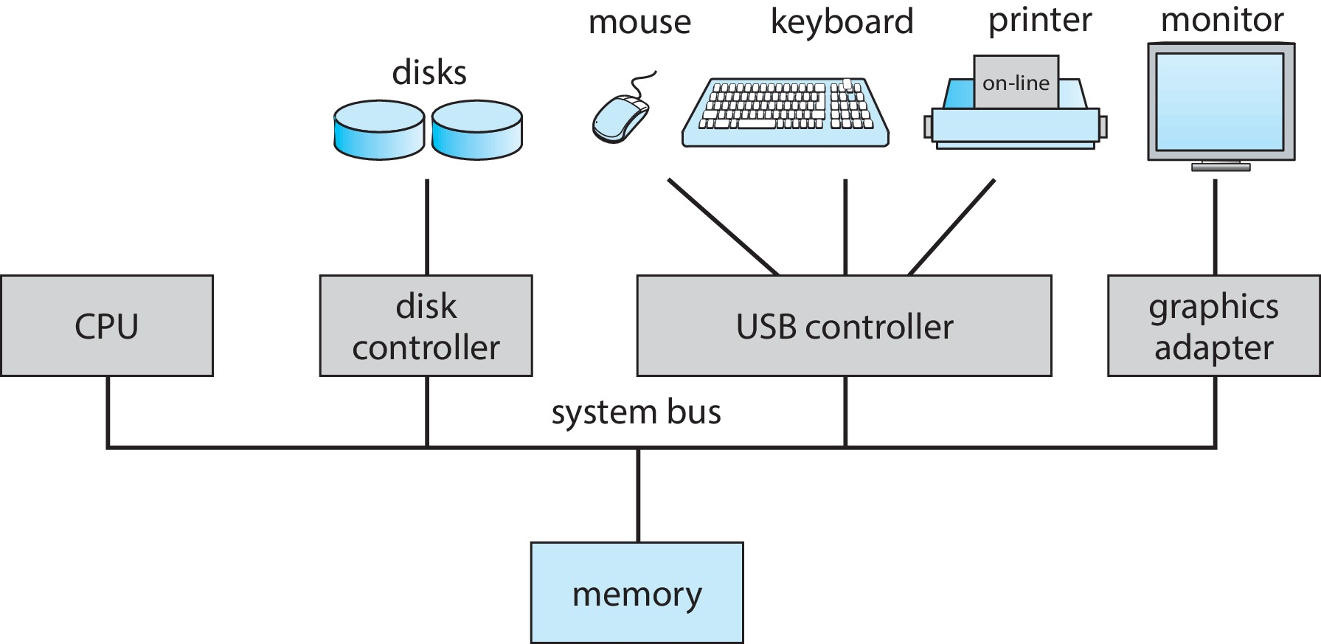
Computer System Organization
Computer-system operation
  One or more CPUs, device controllers connect through common bus providing access to shared memory
  Concurrent execution of CPUs and devices competing for memory cycles

Slide 12
Computer-System Operation
I/O devices and the CPU can execute concurrently
Each device controller is in charge of a particular device type
Each device controller has a local buffer
Each device controller type has an operating system device driver to manage it
CPU moves data from/to main memory to/from local buffers
I/O is from the device to local buffer of controller
Device controller informs CPU that it has finished its operation by causing an interrupt

Slide 13
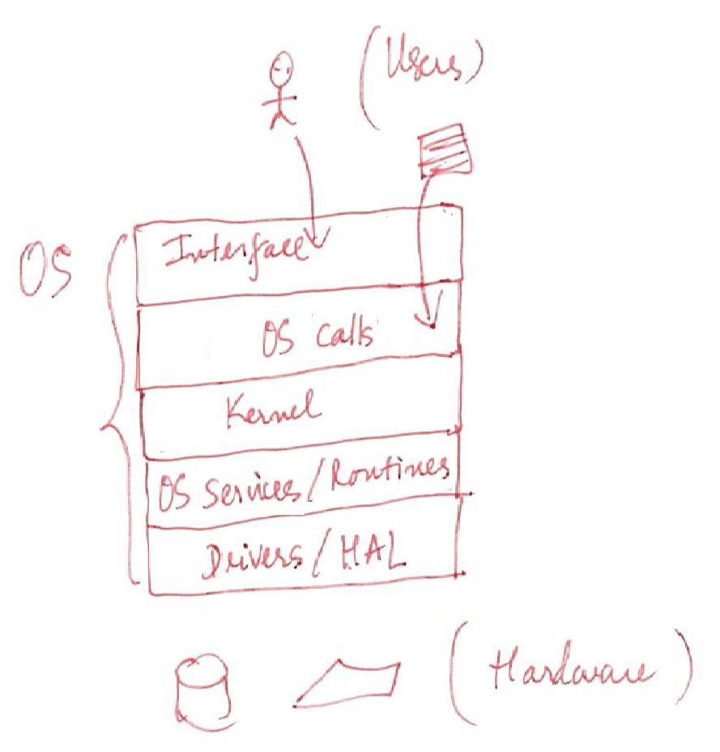
Inside Operating Systems

Slide 14
Outline
1. OS Introduction
  What is OS ?
  Goals in designing OS
  OS Activities
2. OS/Computer Operations:
  Interrupt-driven
  Multiprogramming & Time sharing
  Dual Mode
3. OS Components:
  • Process management
  • Memory management
  • I/O and Storage management
  • Protection & Security
  • User Interface (GUI and Command Interpreter)

Slide 15
Common Functions of Interrupts
Interrupt transfers control to the interrupt service routine generally, through the interrupt vector, which contains the addresses of all the service routines
Interrupt architecture must save the address of the interrupted instruction
A trap or exception is a software-generated interrupt caused either by an error or a user request
An operating system is interrupt driven

Slide 16
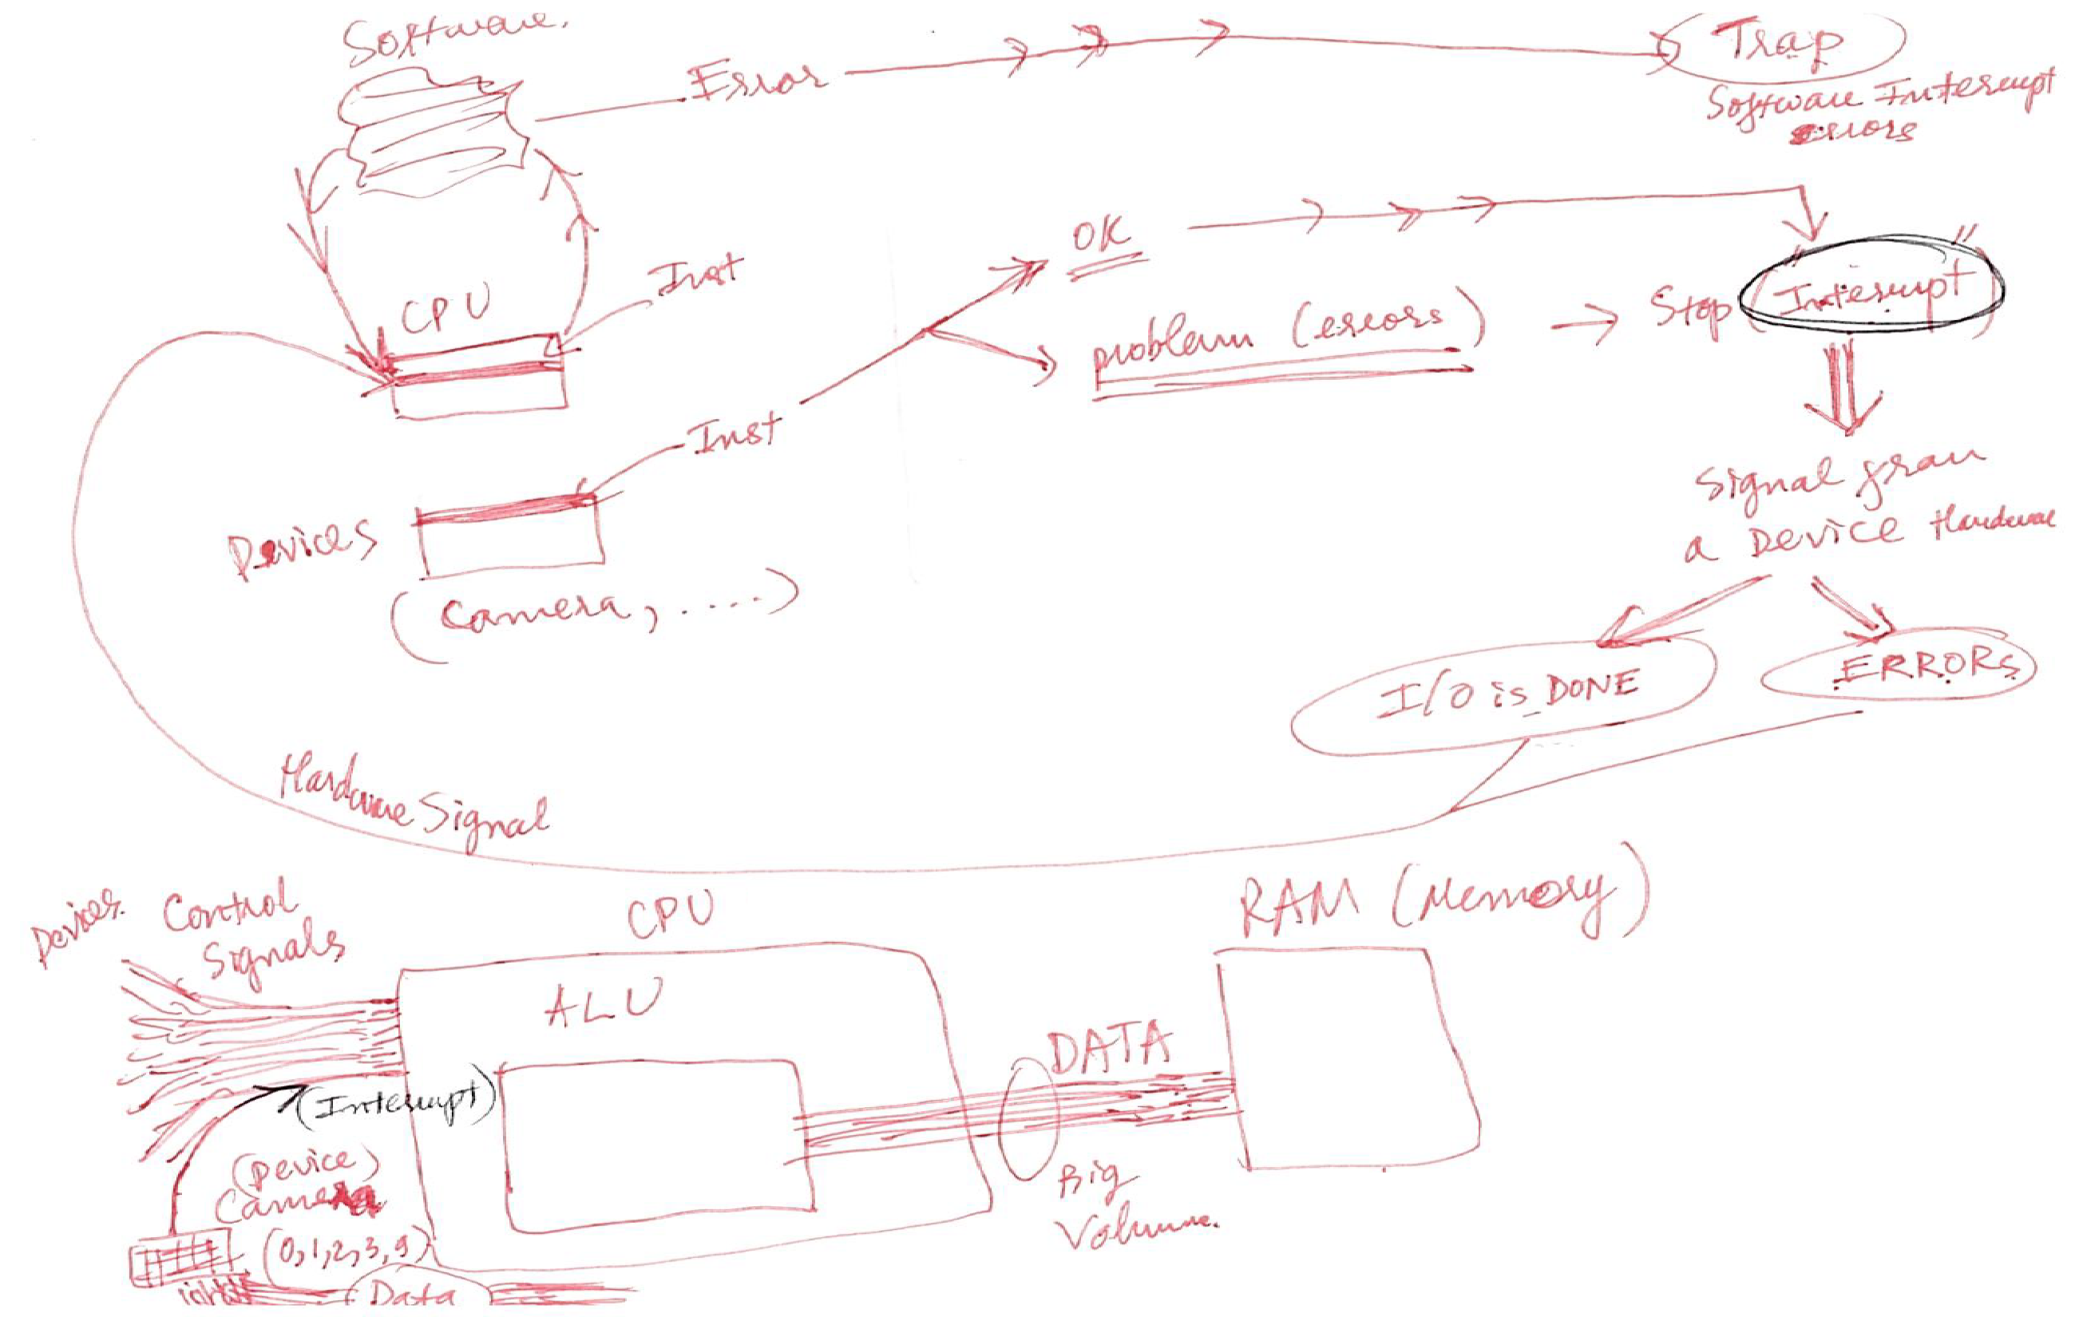
Common Functions of Interrupts

Slide 17
Operating-System Operations
Bootstrap program – simple code to initialize the system, load the kernel
Kernel loads
Starts system daemons (services provided outside of the kernel)
Kernel interrupt driven (hardware and software)
  Hardware interrupt by one of the devices
  Software interrupt (exception or trap):
    Software error (e.g., division by zero)
    Request for operating system service – system call
    Other process problems include infinite loop, processes modifying each other or the operating system

Slide 18
Interrupt Handling
The operating system preserves the state of the CPU by storing the registers and the program counter
Determines which type of interrupt has occurred:
Separate segments of code determine what action should be taken for each type of interrupt

Slide 19
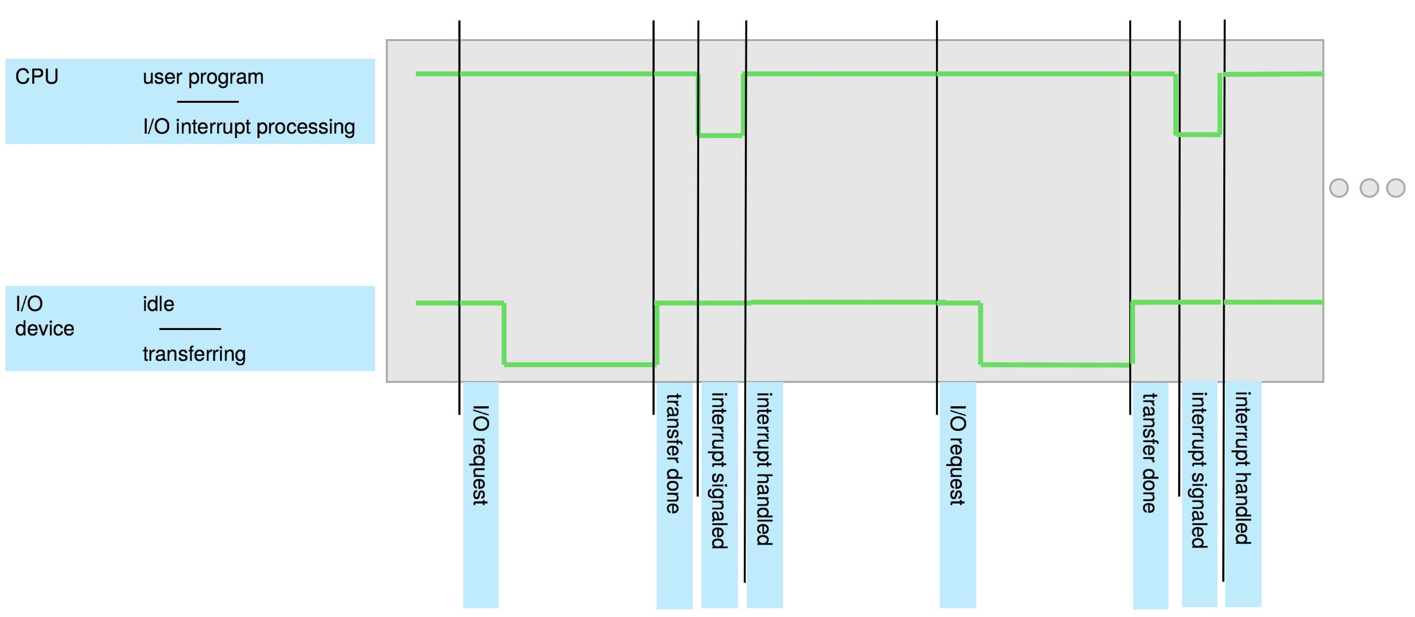
Interrupt Timeline

Slide 20
Interrupt-drive I/O Cycle

Slide 21
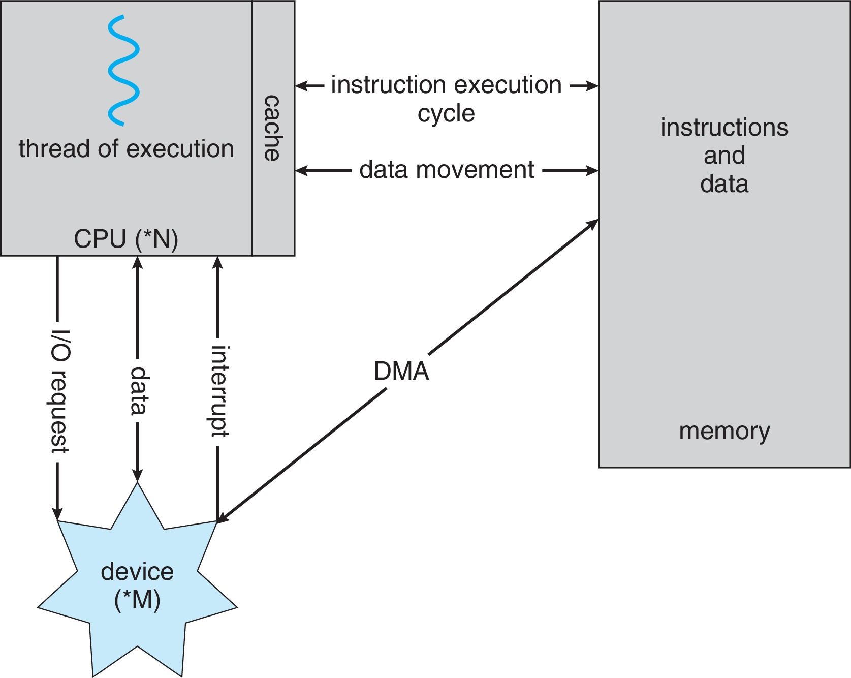
How a Modern Computer Works
A von Neumann architecture

Slide 22
Direct Memory Access Structure
Used for high-speed I/O devices able to transmit information at close to memory speeds
Device controller transfers blocks of data from buffer storage directly to main memory without CPU intervention
Only one interrupt is generated per block, rather than the one interrupt per byte

Slide 23
Outline
1. OS Introduction
  What is OS ?
  Goals in designing OS
  OS Activities
2. OS/Computer Operations:
  Interrupt-driven
  Multiprogramming & Time sharing
  Dual Mode
3. OS Components:
  • Process management
  • Memory management
  • I/O and Storage management
  • Protection & Security
  • User Interface (GUI and Command Interpreter)

Slide 24
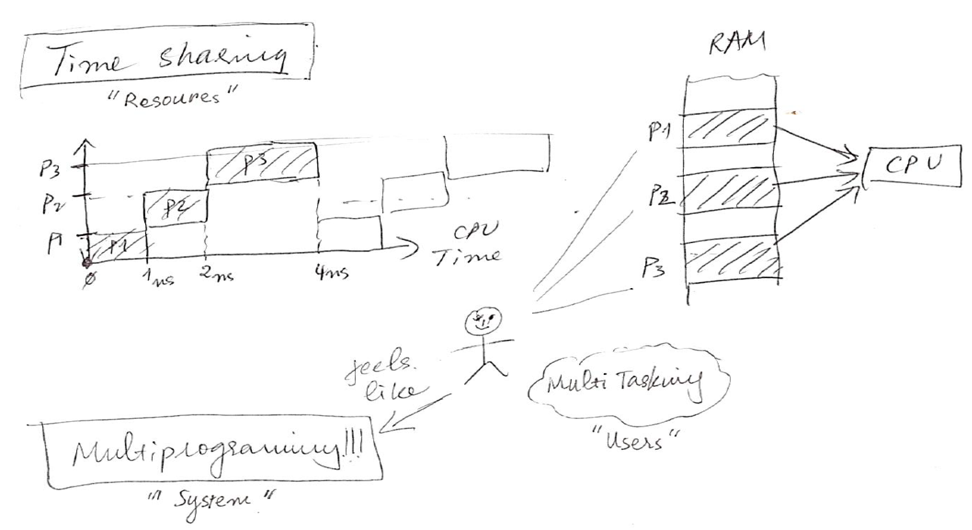
Multiprogramming/Multitasking & Timesharing

Slide 25
Multiprogramming (Batch system)
Single user cannot always keep CPU and I/O devices busy
Multiprogramming organizes jobs (code and data) so CPU always has one to execute
A subset of total jobs in system is kept in memory
One job selected and run via job scheduling
When job has to wait (for I/O for example), OS switches to another job

Slide 26
Multitasking & Timesharing
A logical extension of Batch systems– the CPU switches jobs so frequently that users can interact with each job while it is running, creating interactive computing
  Response time should be < 1 second
  Each user has at least one program executing in memory  process
  If several jobs ready to run at the same time  CPU scheduling
  If processes don’t fit in memory, swapping moves them in and out to run
  Virtual memory allows execution of processes not completely in memory

Slide 27
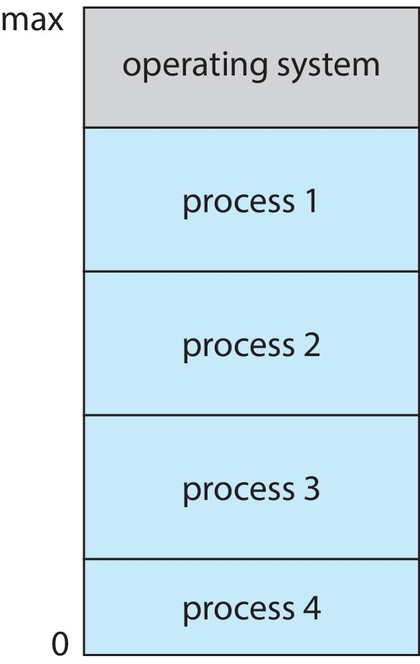
Memory Layout for Multiprogrammed System

Slide 28
Outline
1. OS Introduction
  What is OS ?
  Goals in designing OS
  OS Activities
2. OS/Computer Operations:
  Interrupt-driven
  Multiprogramming & Time sharing
  Dual Mode
3. OS Components:
  • Process management
  • Memory management
  • I/O and Storage management
  • Protection & Security
  • User Interface (GUI and Command Interpreter)

Slide 29
Dual-mode Operation
Dual-mode operation allows OS to protect itself and other system components
  User mode and kernel mode
Mode bit provided by hardware
  Provides ability to distinguish when system is running user code or kernel code.
  When a user is running  mode bit is “user”
  When kernel code is executing  mode bit is “kernel”
How do we guarantee that user does not explicitly set the mode bit to “kernel”?
  System call changes mode to kernel, return from call resets it to user
Some instructions designated as privileged, only executable in kernel mode
All IO instructions are privileged to protect IO devices.

Slide 30
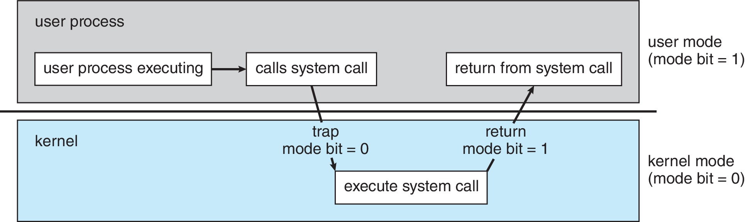
Transition from User to Kernel Mode

Slide 31
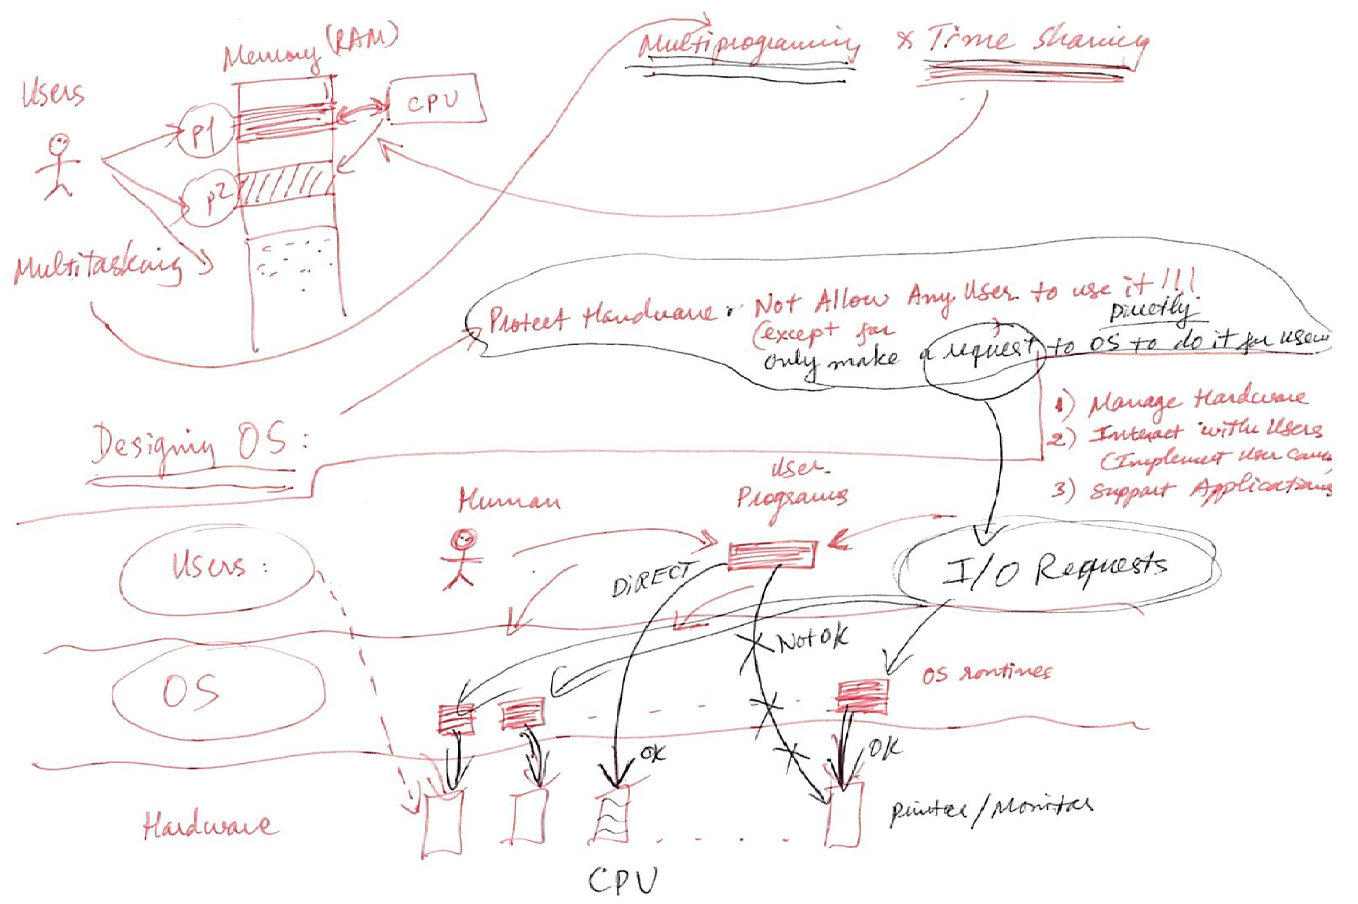
Transition from User to Kernel Mode

Slide 32
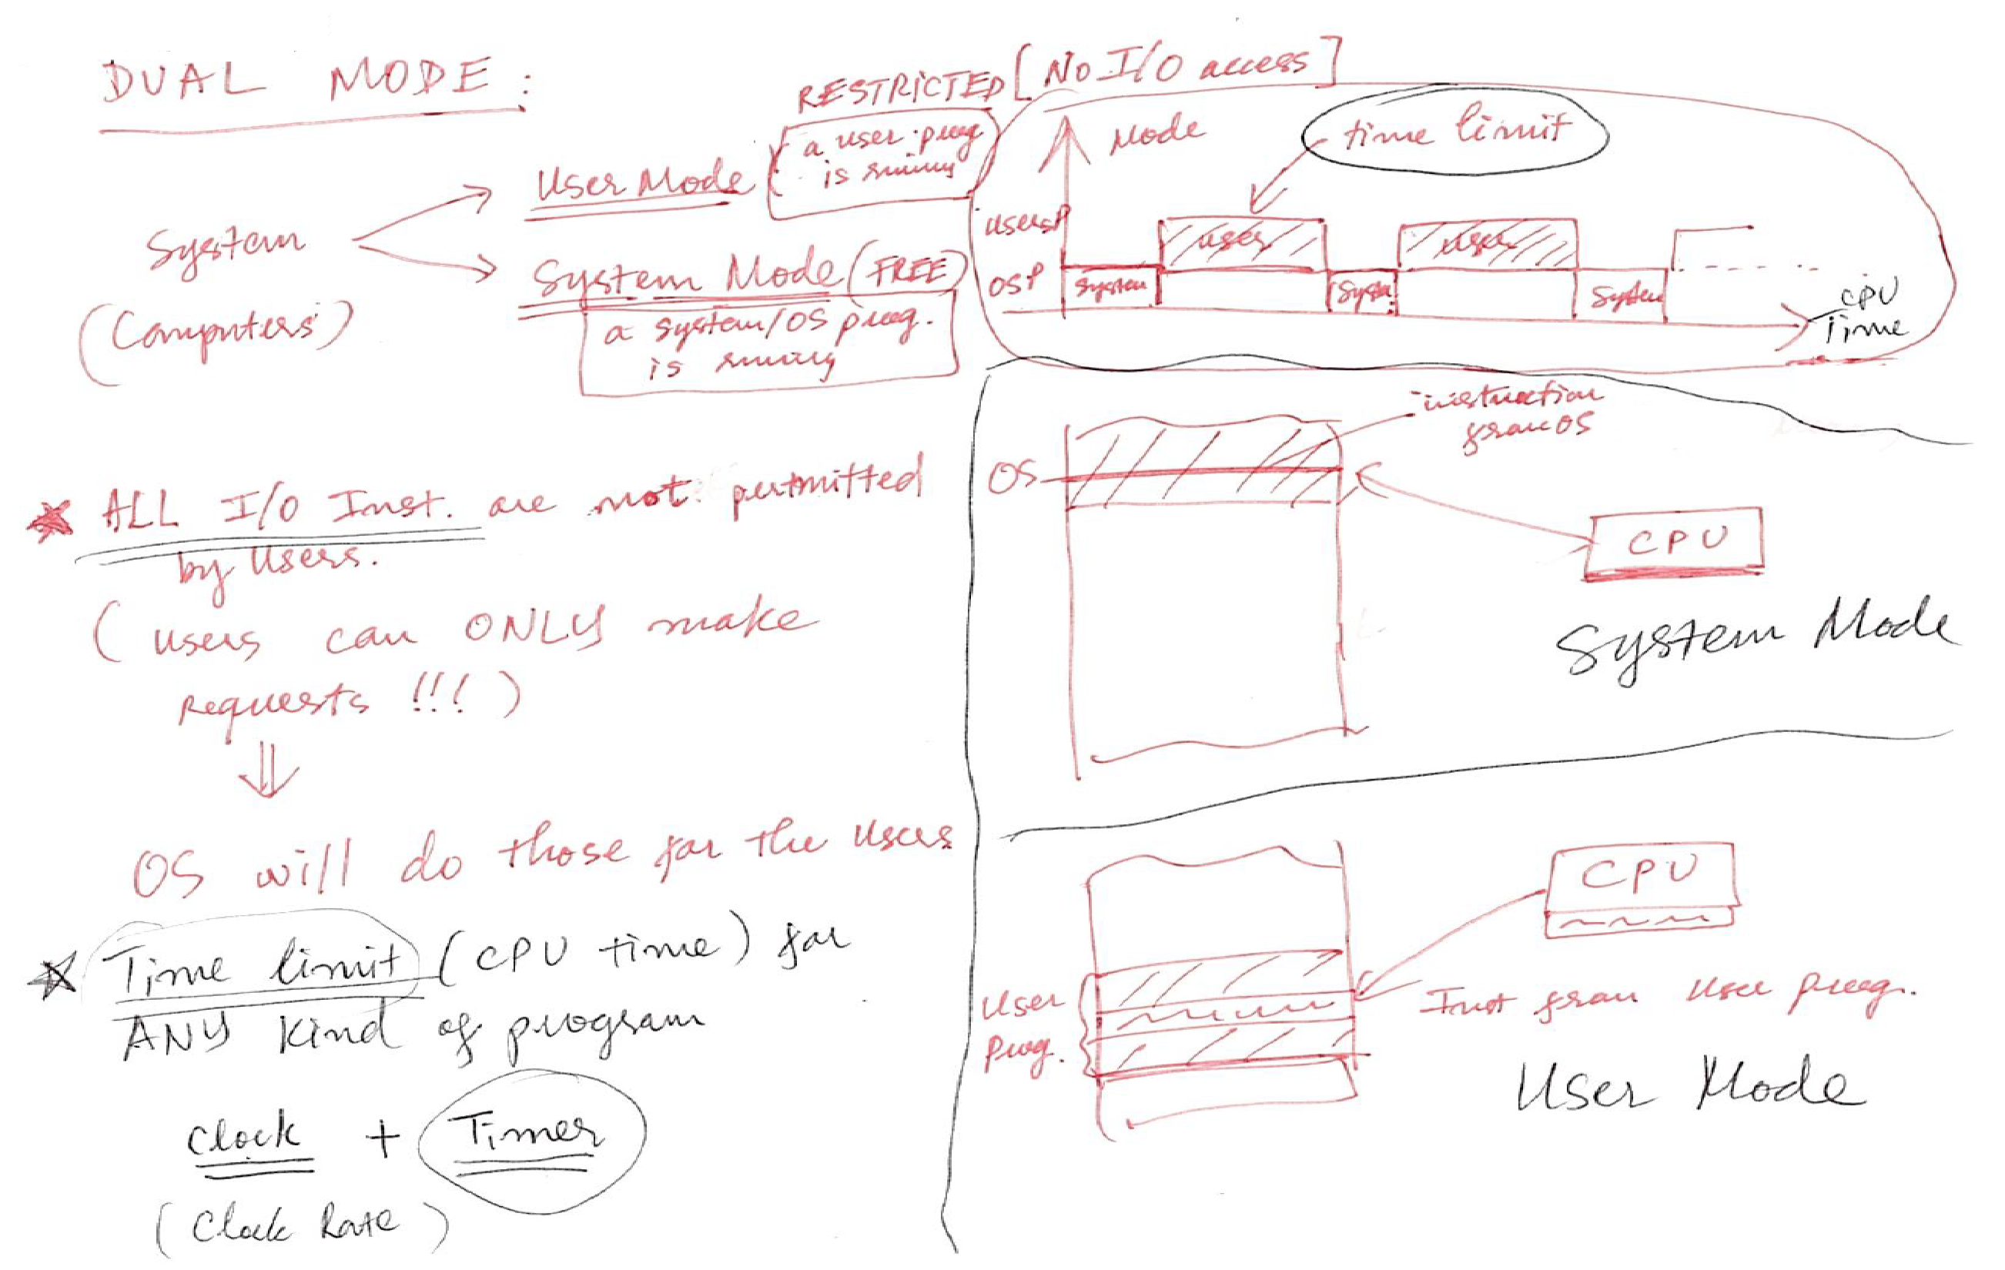
Transition from User to Kernel Mode

Slide 33
Timer
Timer to prevent infinite loop (or process hogging resources)
  Timer is set to interrupt the computer after some time period
  Keep a counter that is decremented by the physical clock
  Operating system set the counter (privileged instruction)
  When counter zero generate an interrupt
  Set up before scheduling process to regain control or terminate program that exceeds allotted time
  So, CPU is protected by the timer (make sure that no process/program can occupy it forever)

Slide 34
Outline
1. OS Introduction
  What is OS ?
  Goals in designing OS
  OS Activities
2. OS/Computer Operations:
  Interrupt-driven
  Multiprogramming & Time sharing
  Dual Mode
  Direct Memory Access
3. OS Components:
  • Process management
  • Memory management
  • I/O and Storage management
  • Protection & Security
  • User Interface (GUI and Command Interpreter)

Slide 35
Process Management
A process is a program in execution. It is a unit of work within the system. Program is a passive entity; process is an active entity.
Process needs resources to accomplish its task
  CPU, memory, I/O, files
  Initialization data
Process termination requires reclaim of any reusable resources
Single-threaded process has one program counter specifying location of next instruction to execute
  Process executes instructions sequentially, one at a time, until completion
Multi-threaded process has one program counter per thread
Typically system has many processes, some user, some operating system running concurrently on one or more CPUs
  Concurrency by multiplexing the CPUs among the processes / threads

Slide 36
Process Management Activities
The operating system is responsible for the following activities in connection with process management:
Creating and deleting both user and system processes
Suspending and resuming processes
Providing mechanisms for process synchronization
Providing mechanisms for process communication
Providing mechanisms for deadlock handling

Slide 37
Memory Management
To execute a program all (or part) of the instructions must be in memory
All (or part) of the data that is needed by the program must be in memory
Memory management determines what is in memory and when
  Optimizing CPU utilization and computer response to users
Memory management activities
  Keeping track of which parts of memory are currently being used and by whom
  Deciding which processes (or parts thereof) and data to move into and out of memory
  Allocating and deallocating memory space as needed

Slide 38
Outline
1. OS Introduction
  What is OS ?
  Goals in designing OS
  OS Activities
2. OS/Computer Operations:
  Interrupt-driven
  Multiprogramming & Time sharing
  Dual Mode
  Direct Memory Access
3. OS Components:
  • Process management
  • Memory management
  • I/O and Storage management
  • Protection & Security
  • User Interface (GUI and Command Interpreter)

Slide 39
File-system Management
OS provides uniform, logical view of information storage
  Abstracts physical properties to logical storage unit - file
  Each medium is controlled by device (i.e., disk drive, tape drive)
    Varying properties include access speed, capacity, data-transfer rate, access method (sequential or random)
File-System management
  Files usually organized into directories
  Access control on most systems to determine who can access what
  OS activities include
    Creating and deleting files and directories
    Primitives to manipulate files and directories
    Mapping files onto secondary storage
    Backup files onto stable (non-volatile) storage media

Slide 40
Mass-Storage Management
Usually disks used to store data that does not fit in main memory or data that must be kept for a “long” period of time
Proper management is of central importance
Entire speed of computer operation hinges on disk subsystem and its algorithms
OS activities
  Mounting and unmounting
  Free-space management
  Storage allocation
  Disk scheduling
  Partitioning
  Protection

Slide 41
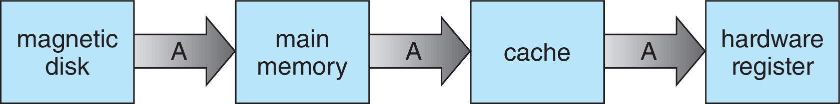
Migration of data “A” from Disk to Register
Multitasking environments must be careful to use most recent value, no matter where it is stored in the storage hierarchy
Multiprocessor environment must provide cache coherency in hardware such that all CPUs have the most recent value in their cache
Distributed environment situation even more complex
  Several copies of a datum can exist
  Various solutions covered in Chapter 19

Slide 42
I/O Subsystem
One purpose of OS is to hide peculiarities of hardware devices from the user
I/O subsystem responsible for
  Memory management of I/O including buffering (storing data temporarily while it is being transferred), caching (storing parts of data in faster storage for performance), spooling (the overlapping of output of one job with input of other jobs)
  General device-driver interface
  Drivers for specific hardware devices

Slide 43
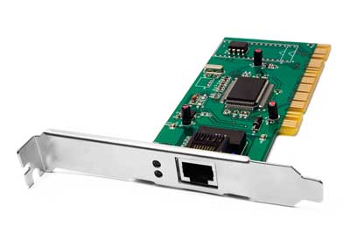
Network Management
These days computers connect to a network (of other computers)
OS must have a component to manage network connections
Computer devices for networking are network card and wireless adaptor
In modern OS these network devices are treated as IO devices
And therefore are managed by the same OS component
Which manages all IO devices.

Slide 44
Outline
1. OS Introduction
  What is OS ?
  Goals in designing OS
  OS Activities
2. OS/Computer Operations:
  Interrupt-driven
  Multiprogramming & Time sharing
  Dual Mode
  Direct Memory Access
3. OS Components:
  • Process management
  • Memory management
  • I/O and Storage management
  • Protection & Security
  • User Interface (GUI and Command Interpreter)

Slide 45
Protection and Security
Protection – any mechanism for controlling access of processes or users to resources defined by the OS
Security – defense of the system against internal and external attacks
  Huge range, including denial-of-service, worms, viruses, identity theft, theft of service
Systems generally first distinguish among users, to determine who can do what
  User identities (user IDs, security IDs) include name and associated number, one per user
  User ID then associated with all files, processes of that user to determine access control
  Group identifier (group ID) allows set of users to be defined and controls managed, then also associated with each process, file
  Privilege escalation allows user to change to effective ID with more rights

Slide 46
Outline
1. OS Introduction
  What is OS ?
  Goals in designing OS
  OS Activities
2. OS/Computer Operations:
  Interrupt-driven
  Multiprogramming & Time sharing
  Dual Mode
  Direct Memory Access
3. OS Components:
  • Process management
  • Memory management
  • I/O and Storage management
  • Protection & Security
  • User Interface (GUI and Command Interpreter)

Slide 47
OS User Interface
User interface (UI) facilitates communication between an entity (program/device) and its user by acting as an intermediary between them.
Basic functions of a user interface:
  to take the inputs (different types/forms) from the user and
  to provide the output (different types/forms) to the users.
User interface of any operating system can be:
  Graphical user interface (GUI)
  Command line user interface (CLI)
A component of OS creates and manages its user interface.

Slide 48
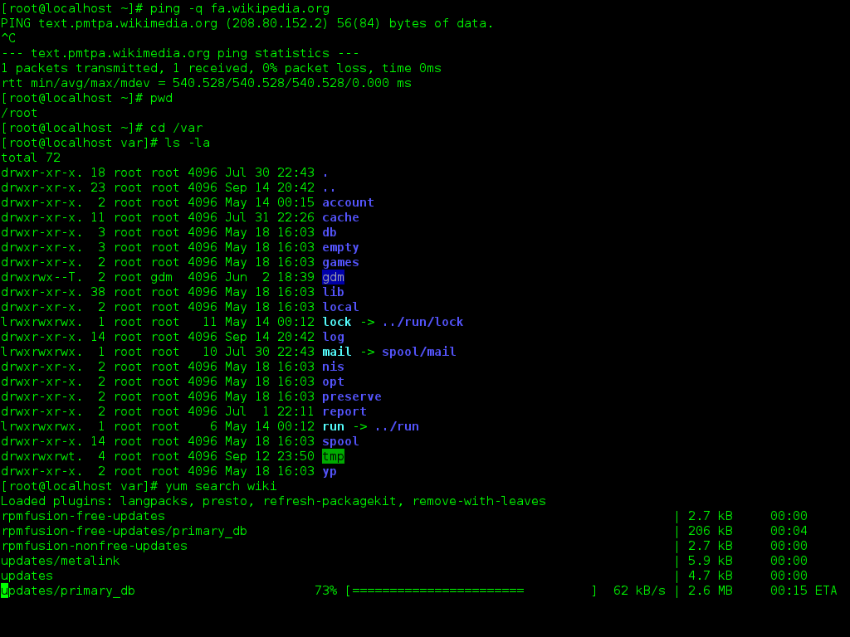
OS Command Line Interpreter (CLI)

Slide 49
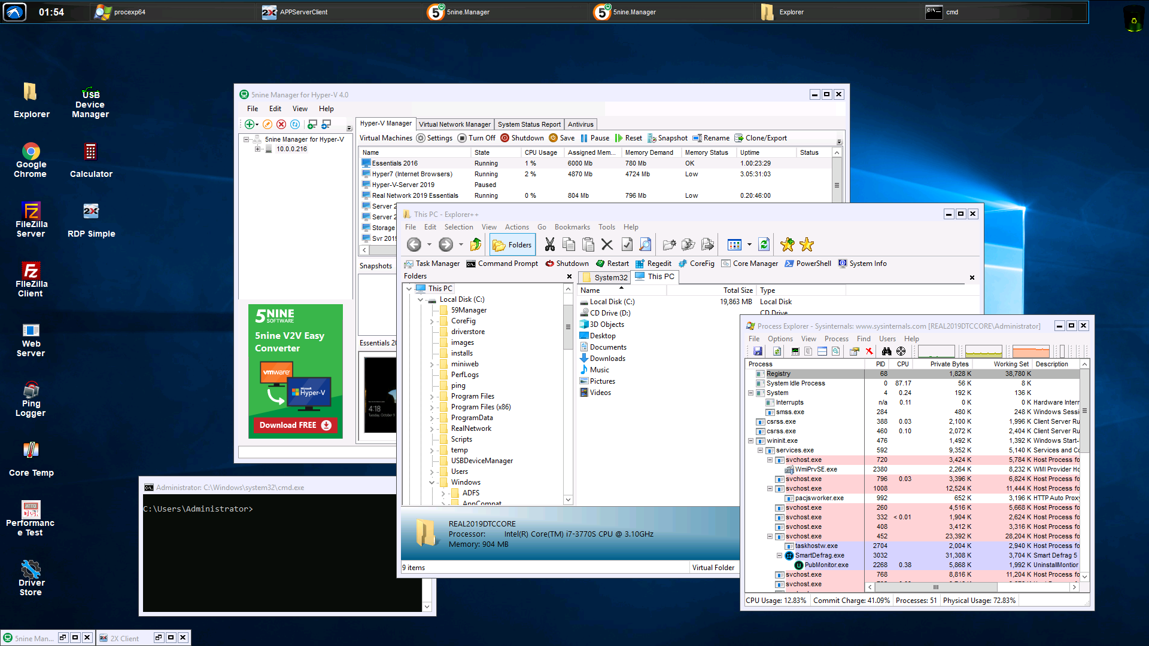
Operating System GUI

