Slide 1
Lecture 03 : OS UI, Services, Calls, Programs

Slide 2
Outline
1. OS Services
2. OS User Interface
  • Command Interpreter
  • GUI
3. System Calls
  • Overview: API, system call interface, parameter passing
  • Types of Calls:
    o Process Control
    o File Manipulation
    o Device Manipulation
    o Information Maintenance
    o Communications
4. System Programs

Slide 3
Outline
KEYWORDS: System services, System calls, System Programs, Program execution, File manipulation, Resource allocation, Accounting, Information maintenance.
HOMEWORK:
1) Reading : Chapter 2, especially the summary.
2) Make sure to understand and be able to explain every keyword from the list here and the ones which are printed bold in the text book.
3) Important Questions:
• What is the purpose of system calls ?
• Compare system services, system calls, and system programs. • Draw a diagram to show a handling of user applications in invoking a system call (Fig. 2.3)
• Explain the advantages and disadvantages of the three parameter passing methods: using registers, using table, and using stack.

Slide 4
Outline
1. OS Services
2. OS User Interface
  • Command Interpreter
  • GUI
3. System Calls
  • Overview: API, system call interface, parameter passing
  • Types of Calls:
    o Process Control
    o File Manipulation
    o Device Manipulation
    o Information Maintenance
    o Communications
4. System Programs

Slide 5
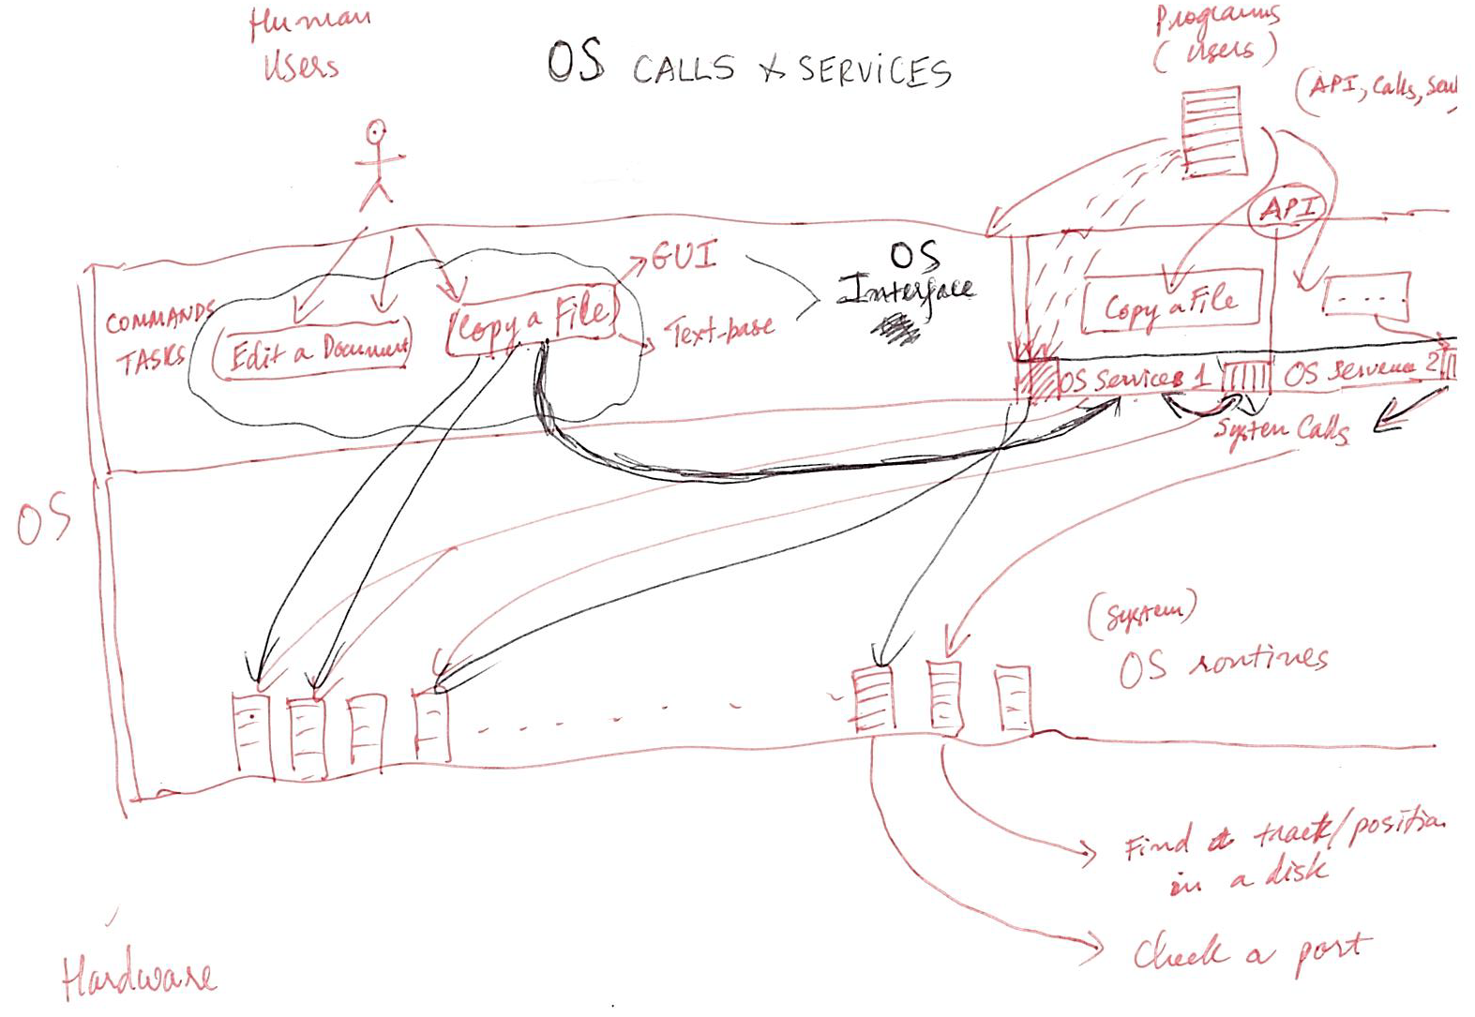
A View of Operating System Services

Slide 6
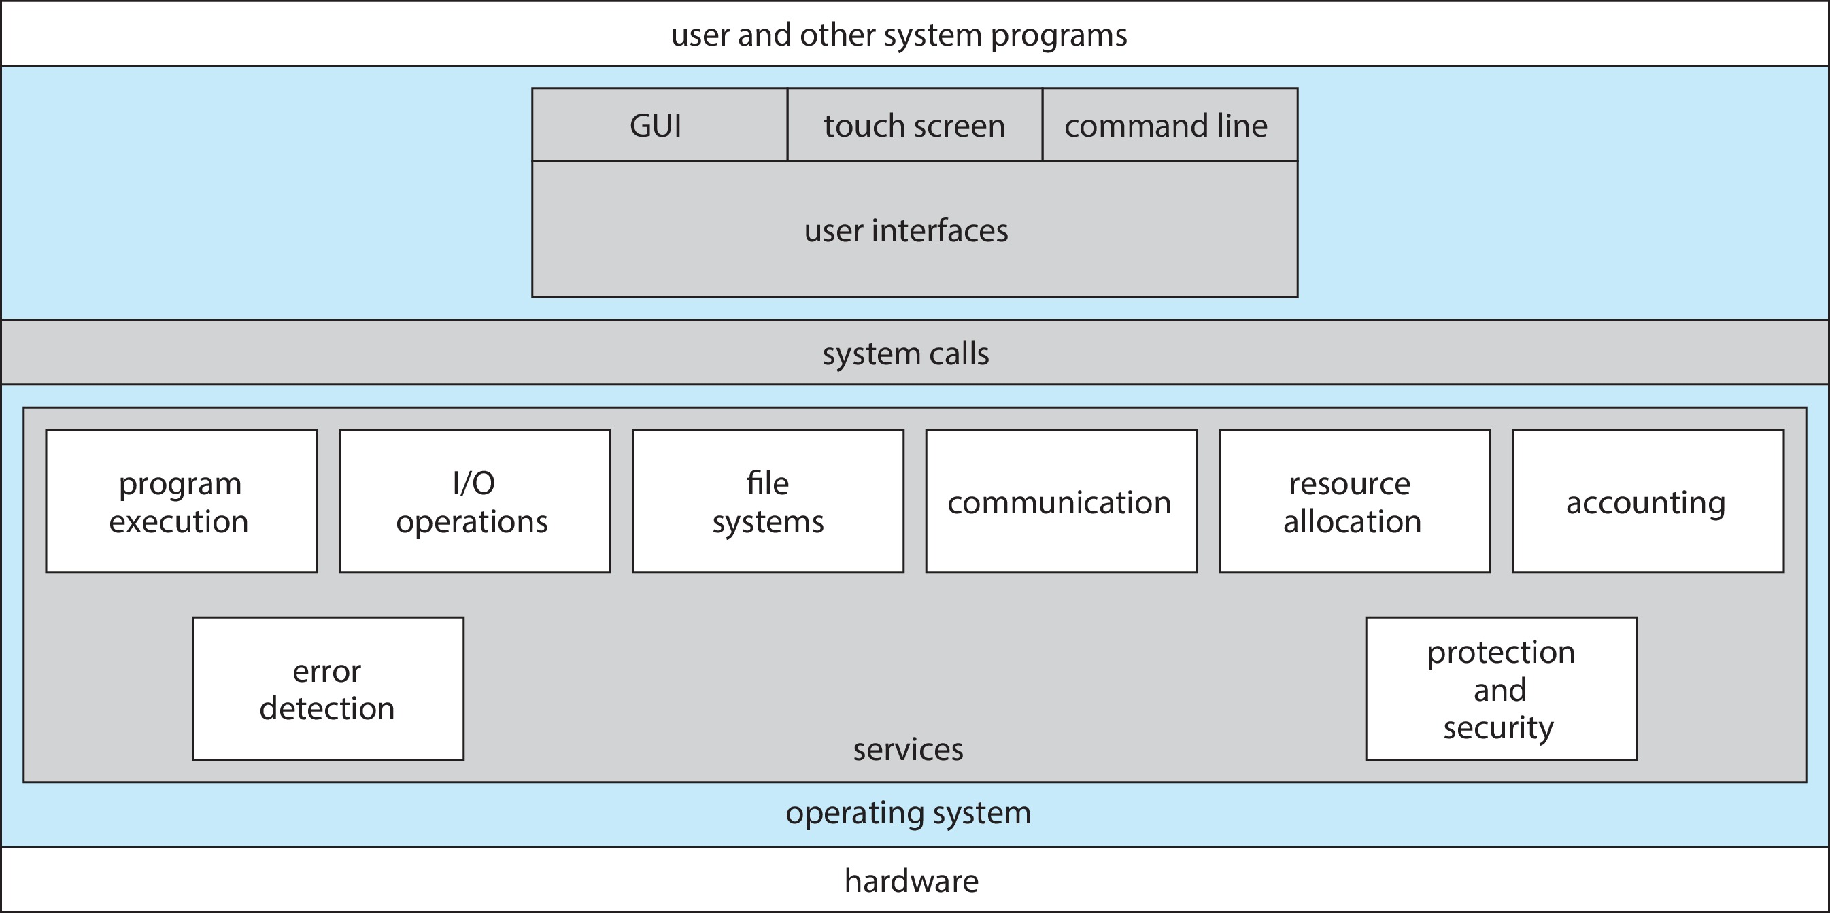
A View of Operating System Services

Slide 7
Operating System Services
Operating systems provide an environment for execution of programs and services to programs and users
One set of operating-system services provides functions that are helpful to the user:
  User interface - Almost all operating systems have a user interface (UI).
    Varies between Command-Line (CLI), Graphics User Interface (GUI), touch-screen, Batch
  Program execution - The system must be able to load a program into memory and to run that program, end execution, either normally or abnormally (indicating error)
  I/O operations - A running program may require I/O, which may involve a file or an I/O device
  File-system manipulation - The file system is of particular interest. Programs need to read and write files and directories, create and delete them, search them, list file Information, permission management.

Slide 8
Operating System Services (Cont.)
One set of operating-system services provides functions that are helpful to the user (Cont.):
  Communications – Processes may exchange information, on the same computer or between computers over a network
    Communications may be via shared memory or through message passing (packets moved by the OS)
  Error detection – OS needs to be constantly aware of possible errors
    May occur in the CPU and memory hardware, in I/O devices, in user program
    For each type of error, OS should take the appropriate action to ensure correct and consistent computing
    Debugging facilities can greatly enhance the user’s and programmer’s abilities to efficiently use the system

Slide 9
Operating System Services (Cont.)
Another set of OS functions exists for ensuring the efficient operation of the system itself via resource sharing
  Resource allocation - When multiple users or multiple jobs running concurrently, resources must be allocated to each of them
    Many types of resources - CPU cycles, main memory, file storage, I/O devices.
  Logging - To keep track of which users use how much and what kinds of computer resources
  Protection and security - The owners of information stored in a multiuser or networked computer system may want to control use of that information, concurrent processes should not interfere with each other
    Protection involves ensuring that all access to system resources is controlled
    Security of the system from outsiders requires user authentication, extends to defending external I/O devices from invalid access attempts

Slide 10
Outline
1. OS Services
2. OS User Interface
  • Command Interpreter
  • GUI
3. System Calls
  • Overview: API, system call interface, parameter passing
  • Types of Calls:
    o Process Control
    o File Manipulation
    o Device Manipulation
    o Information Maintenance
    o Communications
4. System Programs

Slide 11
UI: Command Line interpreter
CLI allows direct command entry
Sometimes implemented in kernel, sometimes by systems program
Sometimes multiple flavors implemented – shells
Primarily fetches a command from user and executes it
Sometimes commands built-in, sometimes just names of programs
  If the latter, adding new features doesn’t require shell modification

Slide 12
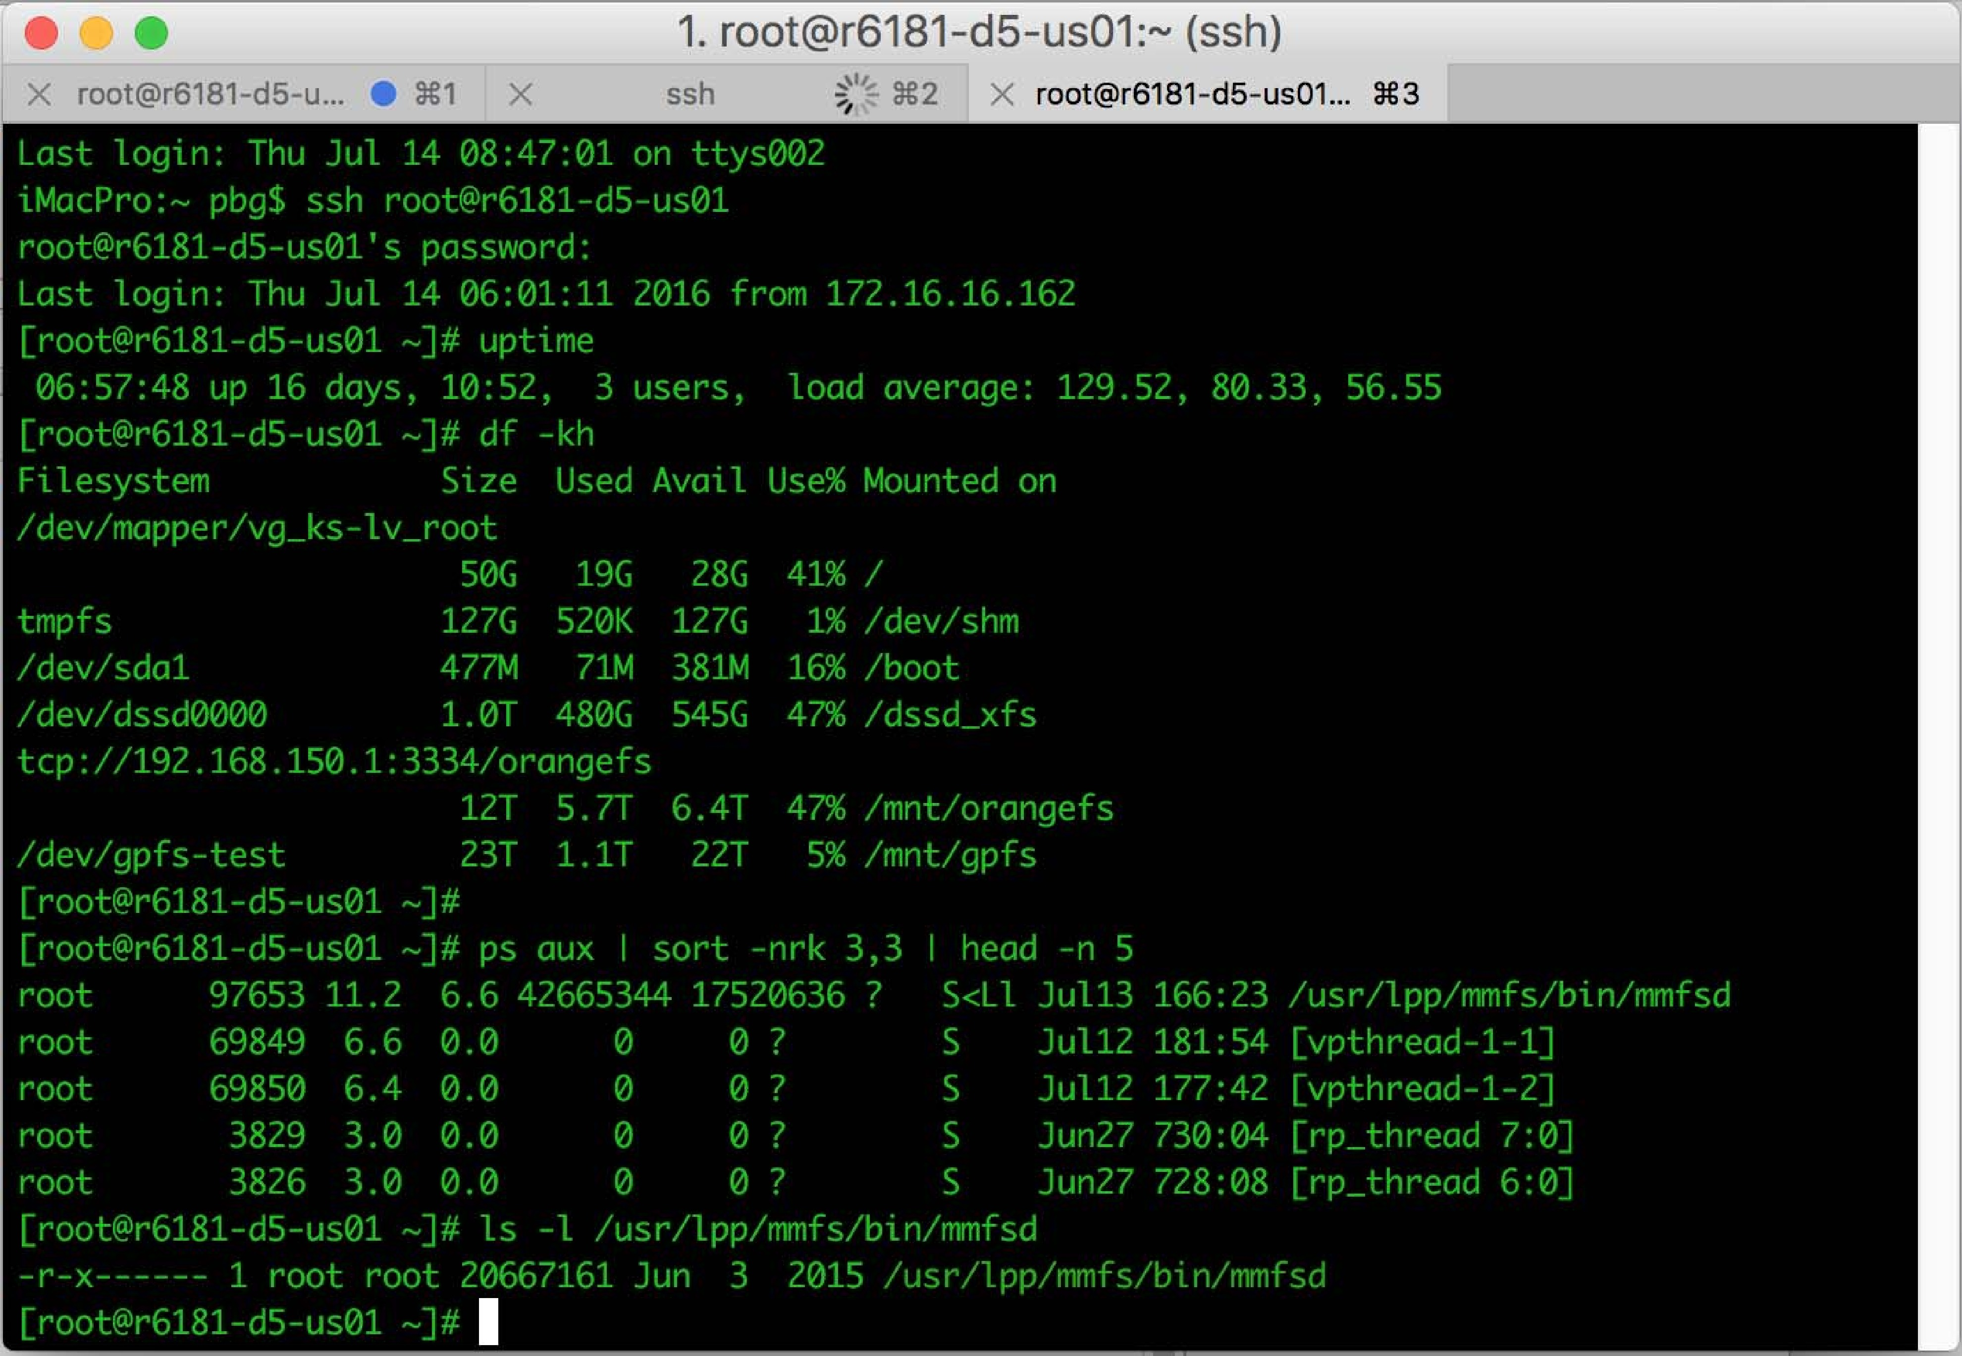
Bourne Shell Command Interpreter

Slide 13
User Operating System Interface - GUI
User-friendly desktop metaphor interface
  Usually mouse, keyboard, and monitor
  Icons represent files, programs, actions, etc
  Various mouse buttons over objects in the interface cause various actions (provide information, options, execute function, open directory (known as a folder)
  Invented at Xerox PARC
Many systems now include both CLI and GUI interfaces
  Microsoft Windows is GUI with CLI “command” shell
  Apple Mac OS X is “Aqua” GUI interface with UNIX kernel underneath and shells available
  Unix and Linux have CLI with optional GUI interfaces (CDE, KDE, GNOME)

Slide 14
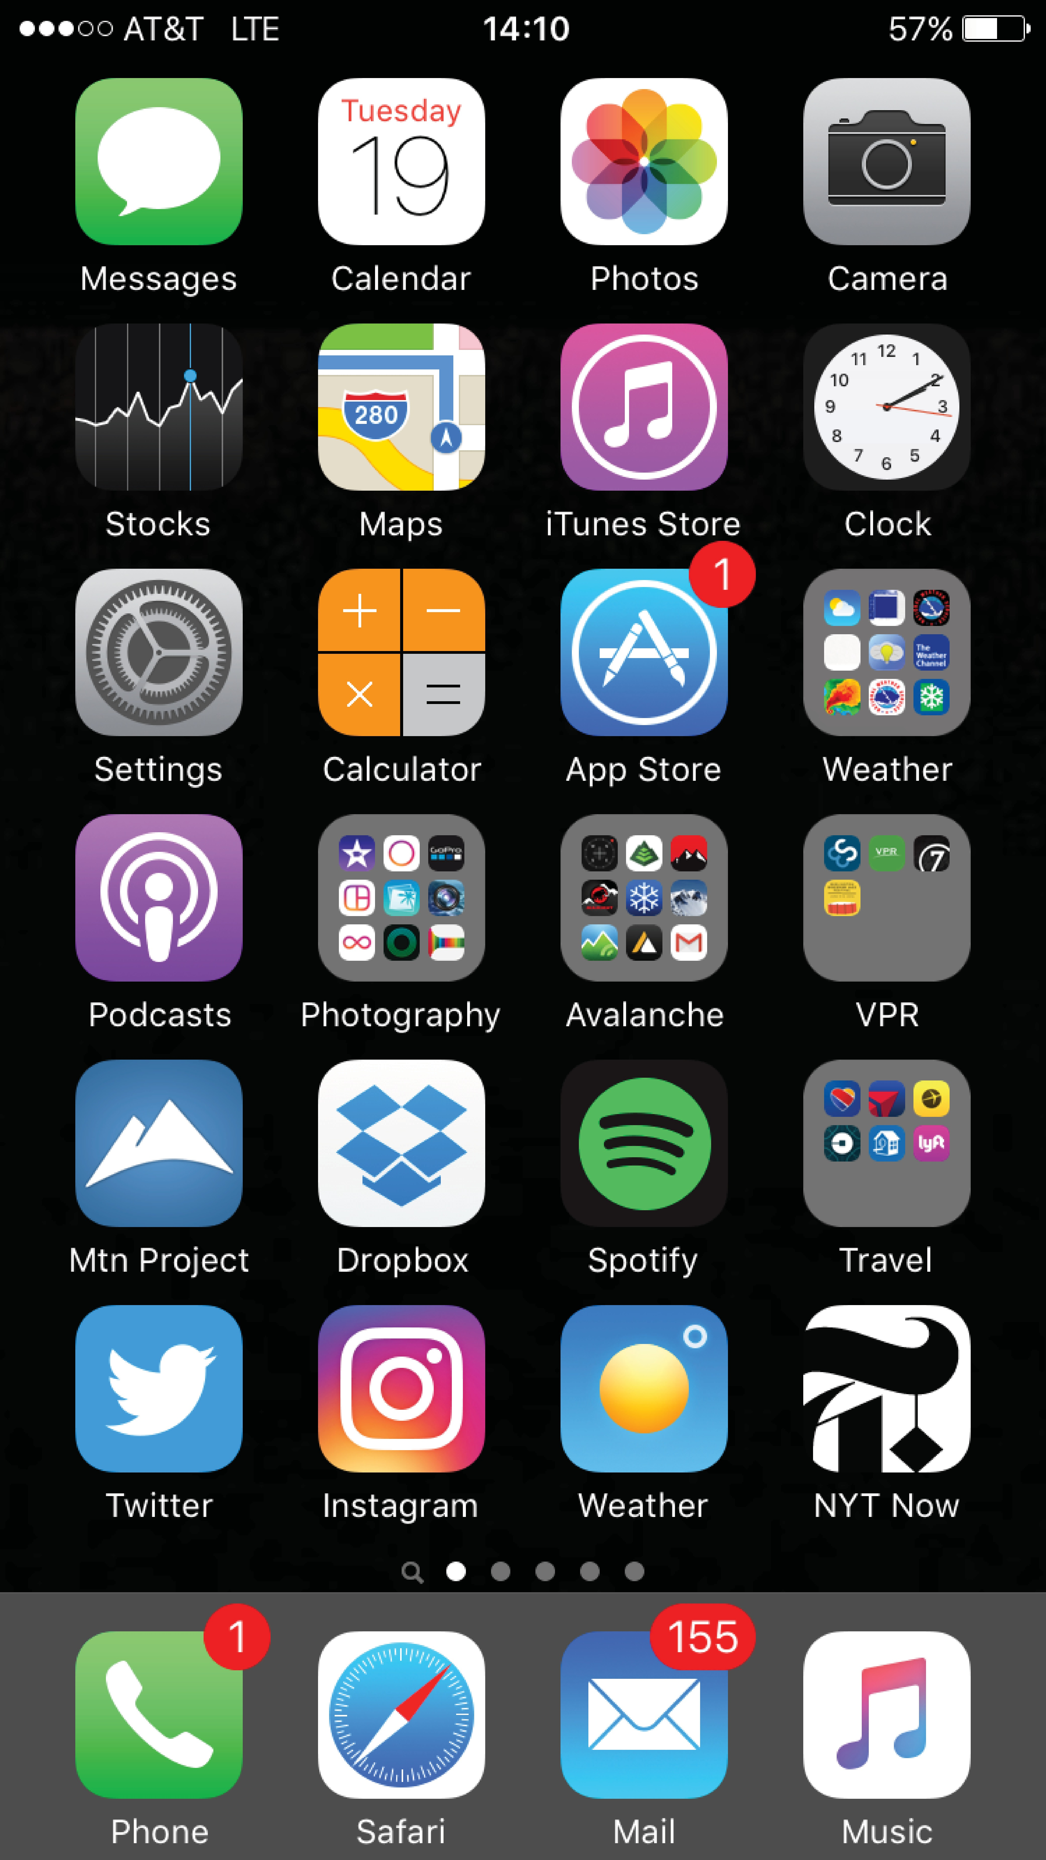
Touchscreen Interfaces
Touchscreen devices require new interfaces
  Mouse not possible or not desired
  Actions and selection based on gestures
  Virtual keyboard for text entry
Voice commands

Slide 15
The Mac OS X GUI

Slide 16
Outline
1. OS Services
2. OS User Interface
  • Command Interpreter
  • GUI
3. System Calls
  • Overview: API, system call interface, parameter passing
  • Types of Calls:
    o Process Control
    o File Manipulation
    o Device Manipulation
    o Information Maintenance
    o Communications
4. System Programs

Slide 17
System Calls
Programming interface to the services provided by the OS
Typically written in a high-level language (C or C++)
Mostly accessed by programs via a high-level Application Programming Interface (API) rather than direct system call use
Three most common APIs are Win32 API for Windows, POSIX API for POSIX-based systems (including virtually all versions of UNIX, Linux, and Mac OS X), and Java API for the Java virtual machine (JVM)
Note that the system-call names used throughout this text are generic

Slide 18
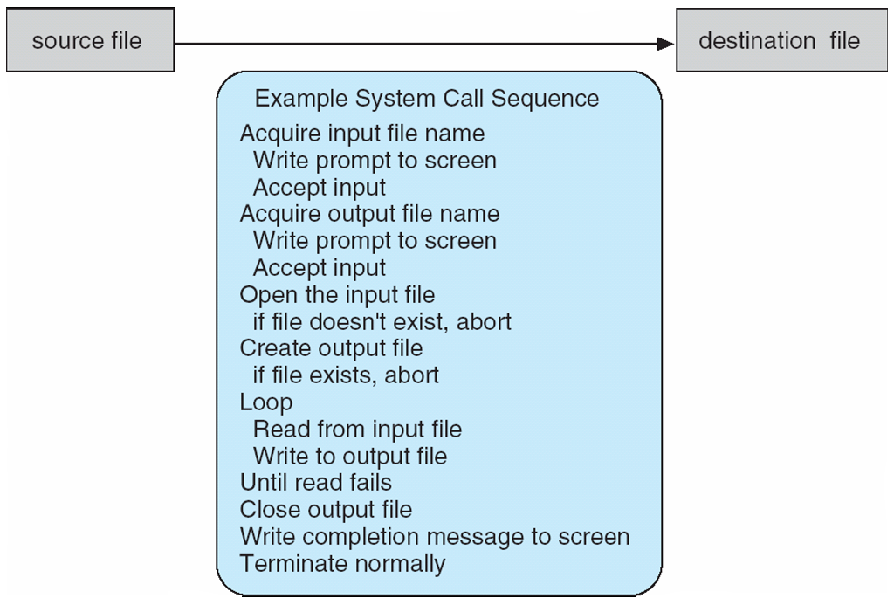
Example of System Calls
System call sequence to copy the contents of one file to another file

Slide 19
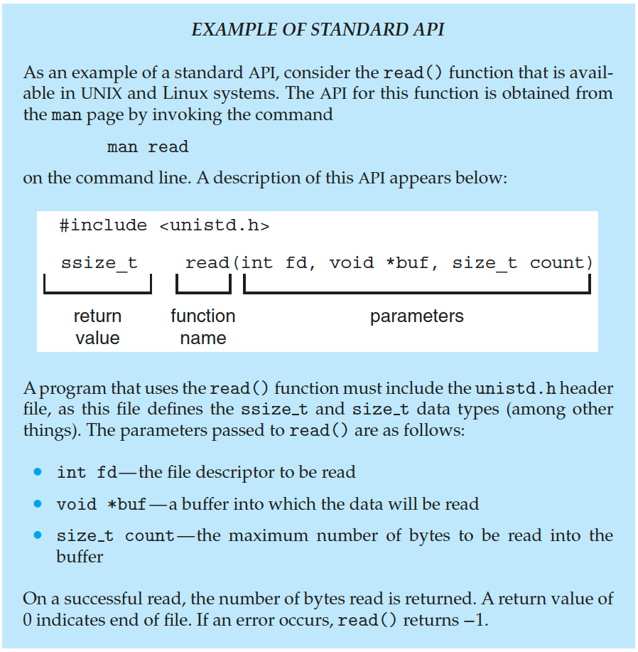
Example of Standard API

Slide 20
System Call Implementation
Typically, a number is associated with each system call
  System-call interface maintains a table indexed according to these numbers
The system call interface invokes the intended system call in OS kernel and returns status of the system call and any return values
The caller need know nothing about how the system call is implemented
  Just needs to obey API and understand what OS will do as a result call
  Most details of OS interface hidden from programmer by API
    Managed by run-time support library (set of functions built into libraries included with compiler)

Slide 21
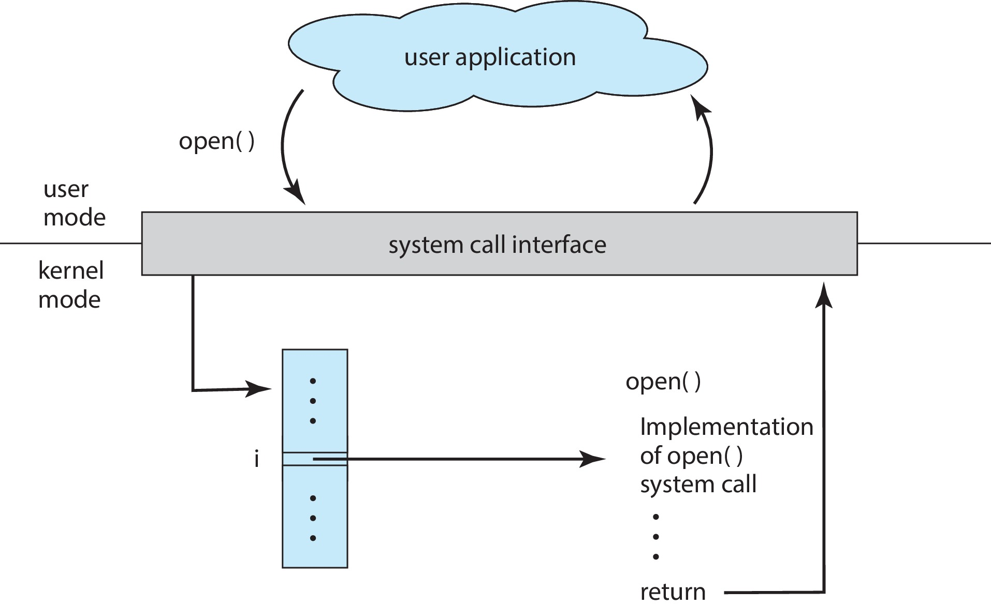
API – System Call – OS Relationship

Slide 22
Outline
1. OS Services
2. OS User Interface
  • Command Interpreter
  • GUI
3. System Calls
  • Overview: API, system call interface, parameter passing
  • Types of Calls:
    o Process Control
    o File Manipulation
    o Device Manipulation
    o Information Maintenance
    o Communications
4. System Programs

Slide 23
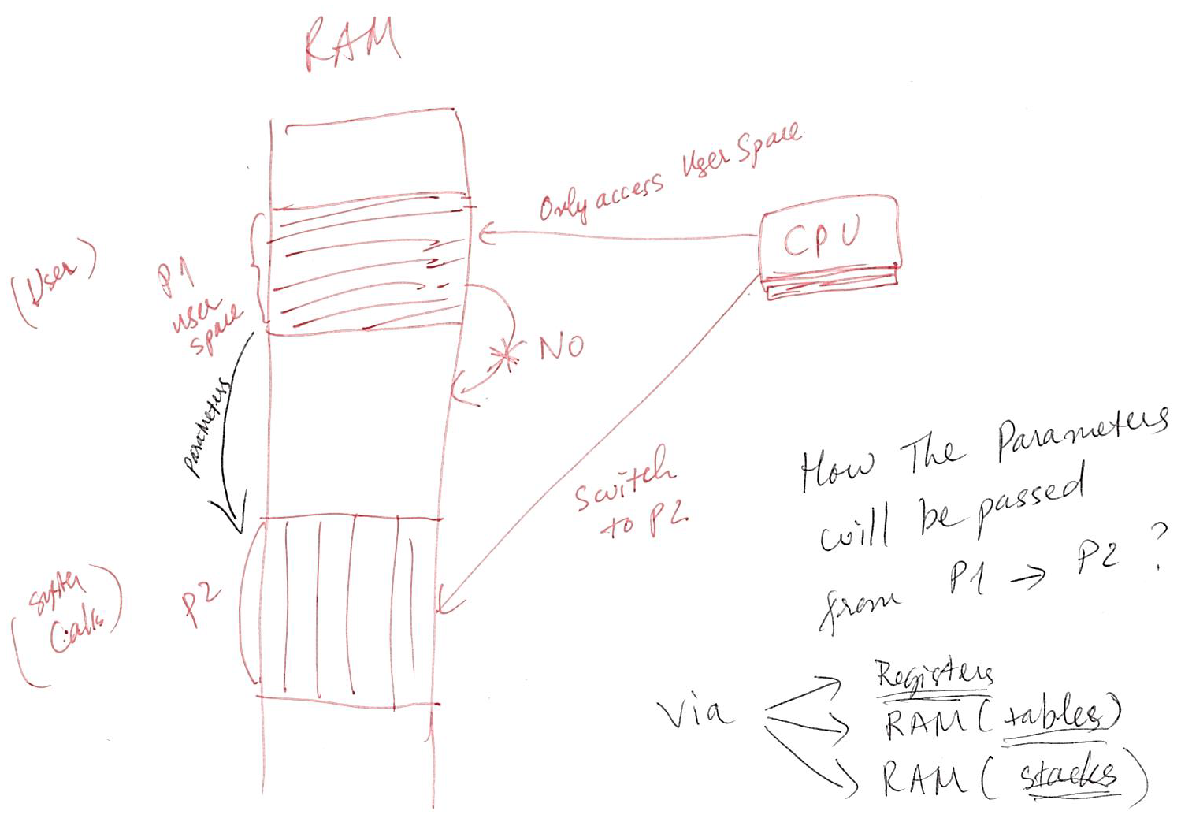
System Call Parameter Passing

Slide 24
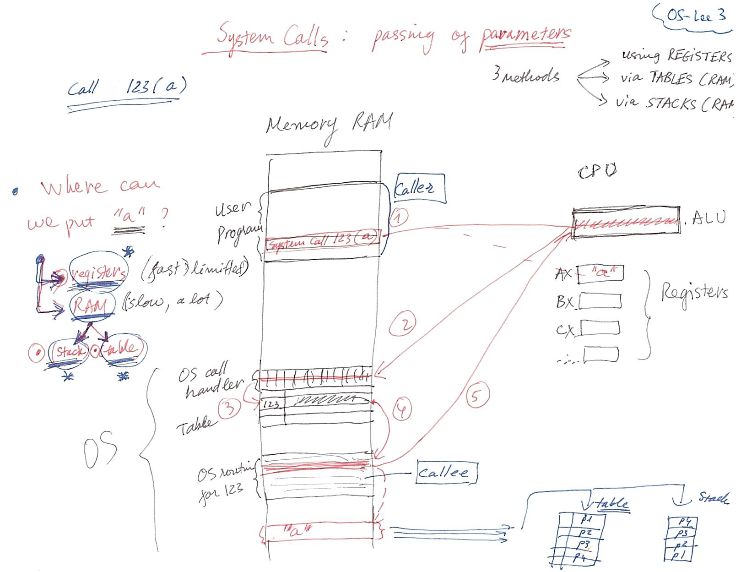
System Call Parameter Passing

Slide 25
System Call Parameter Passing
Often, more information is required than simply identity of desired system call
  Exact type and amount of information vary according to OS and call
Three general methods used to pass parameters to the OS
  Simplest: pass the parameters in registers
    In some cases, may be more parameters than registers
  Parameters stored in a block, or table, in memory, and address of block passed as a parameter in a register
    This approach taken by Linux and Solaris
  Parameters placed, or pushed, onto the stack by the program and popped off the stack by the operating system
  Block and stack methods do not limit the number or length of parameters being passed

Slide 26
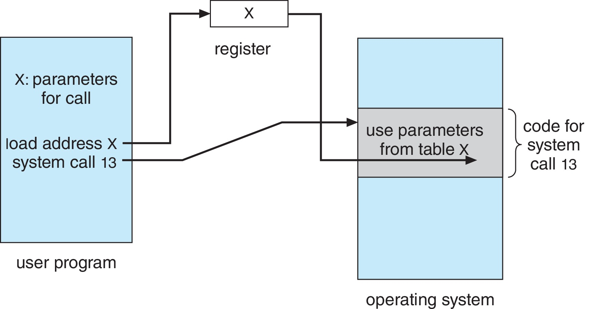
Parameter Passing via Table

Slide 27
Outline
1. OS Services
2. OS User Interface
  • Command Interpreter
  • GUI
3. System Calls
  • Overview: API, system call interface, parameter passing
  • Types of Calls:
    o Process Control
    o File Manipulation
    o Device Manipulation
    o Information Maintenance
    o Communications
4. System Programs

Slide 28
Types of System Calls
Process control
  create process, terminate process
  end, abort
  load, execute
  get process attributes, set process attributes
  wait for time
  wait event, signal event
  allocate and free memory
  Dump memory if error
  Debugger for determining bugs, single step execution
  Locks for managing access to shared data between processes

Slide 29
Types of System Calls (Cont.)
File management
  create file, delete file
  open, close file
  read, write, reposition
  get and set file attributes
Device management
  request device, release device
  read, write, reposition
  get device attributes, set device attributes
  logically attach or detach devices

Slide 30
Types of System Calls (Cont.)
Information maintenance
  get time or date, set time or date
  get system data, set system data
  get and set process, file, or device attributes
Communications
  create, delete communication connection
  send, receive messages if message passing model to host name or process name
    From client to server
  Shared-memory model create and gain access to memory regions
  transfer status information
  attach and detach remote devices

Slide 31
Types of System Calls (Cont.)
Protection
  Control access to resources
  Get and set permissions
  Allow and deny user access

Slide 32
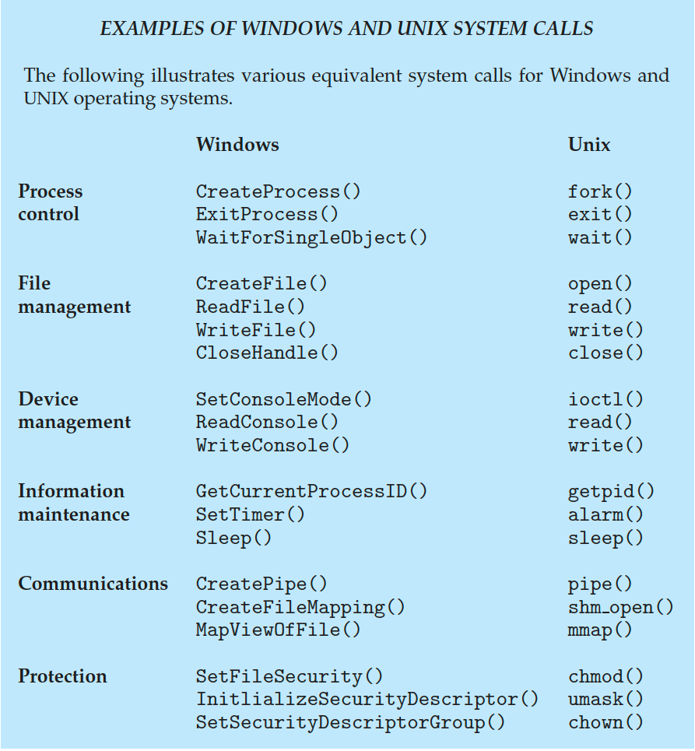
Examples of Windows and Unix System Calls

Slide 33
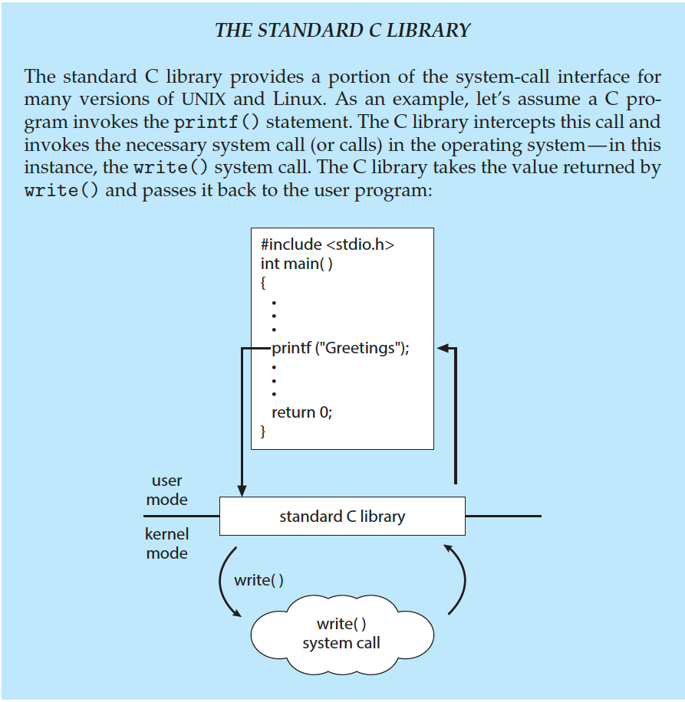
Standard C Library Example
C program invoking printf() library call, which calls write() system call

Slide 34
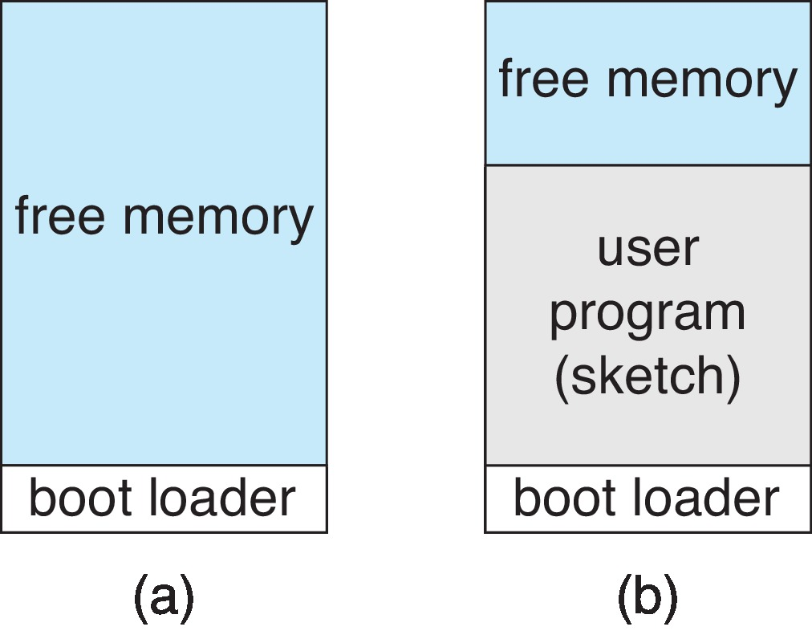
Example: Arduino
Single-tasking
No operating system
Programs (sketch) loaded via USB into flash memory
Single memory space
Boot loader loads program
Program exit -> shell reloaded
At system startup running a program

Slide 35
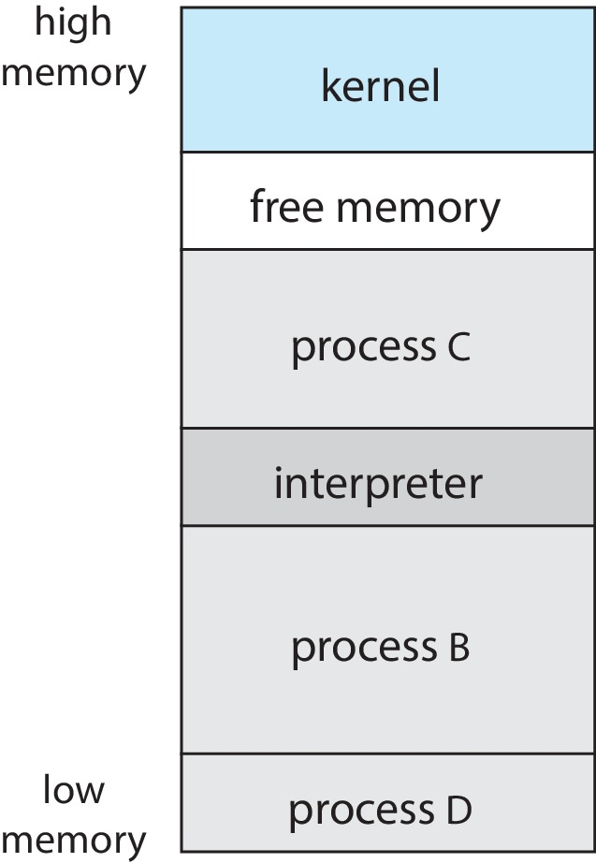
Example: FreeBSD
Unix variant
Multitasking
User login -> invoke user’s choice of shell
Shell executes fork() system call to create process
  Executes exec() to load program into process
  Shell waits for process to terminate or continues with user commands
Process exits with:
  code = 0 – no error
  code > 0 – error code

Slide 36
Outline
1. OS Services
2. OS User Interface
  • Command Interpreter
  • GUI
3. System Calls
  • Overview: API, system call interface, parameter passing
  • Types of Calls:
    o Process Control
    o File Manipulation
    o Device Manipulation
    o Information Maintenance
    o Communications
4. System Programs

Slide 37
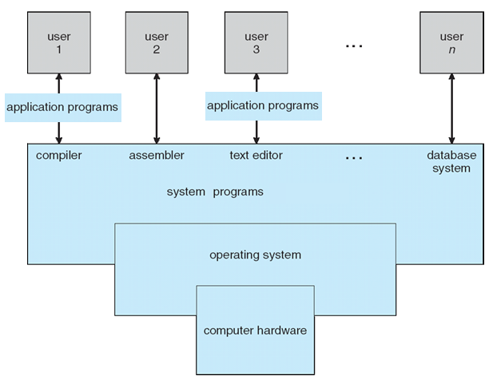
System Programs/Utilities
System programs = codes which can provide tools for applications and users to manage the computer, they run separately from the OS

Slide 38
System Programs/Utilities
System programs = codes which can run separately from the OS
System programs provide a convenient environment for program development and execution. They can be divided into:
  File manipulation
  Status information sometimes stored in a file
  Programming language support
  Program loading and execution
  Communications
  Background services
  Application programs
Most users’ view of the operation system is defined by system programs, not the actual system calls

Slide 39
System Programs/Utilities(Cont.)
Provide a convenient environment for program development and execution
  Some of them are simply user interfaces to system calls; others are considerably more complex
File management - Create, delete, copy, rename, print, dump, list, and generally manipulate files and directories
Status information
  Some ask the system for info - date, time, amount of available memory, disk space, number of users
  Others provide detailed performance, logging, and debugging information
  Typically, these programs format and print the output to the terminal or other output devices
  Some systems implement a registry - used to store and retrieve configuration information

Slide 40
System Programs/Utilities(Cont.)
File modification
  Text editors to create and modify files
  Special commands to search contents of files or perform transformations of the text
Programming-language support - Compilers, assemblers, debuggers and interpreters sometimes provided
Program loading and execution- Absolute loaders, relocatable loaders, linkage editors, and overlay-loaders, debugging systems for higher-level and machine language
Communications - Provide the mechanism for creating virtual connections among processes, users, and computer systems
  Allow users to send messages to one another’s screens, browse web pages, send electronic-mail messages, log in remotely, transfer files from one machine to another

Slide 41
System Programs/Utilities(Cont.)
Background Services
  Launch at boot time
    Some for system startup, then terminate
    Some from system boot to shutdown
  Provide facilities like disk checking, process scheduling, error logging, printing
  Run in user context not kernel context
  Known as services, subsystems, daemons
Application programs
  Don’t pertain to system
  Run by users
  Not typically considered part of OS
  Launched by command line, mouse click, finger poke

Slide 42
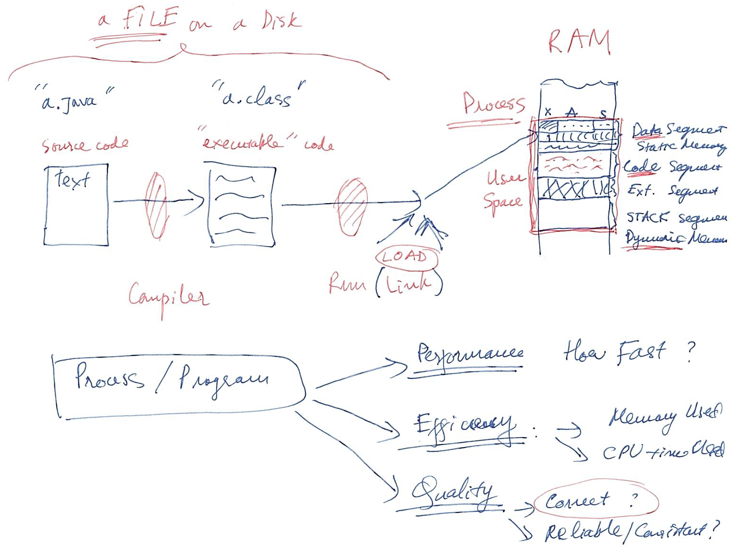
Stages in Creating & Running Programs

Slide 43
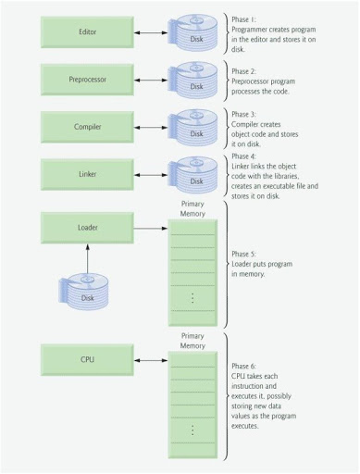
Stages in Creating & Running Programs

Slide 44
Linkers and Loaders
Source code compiled into object files designed to be loaded into any physical memory location – relocatable object file
Linker combines these into single binary executable file
  Also brings in libraries
Program resides on secondary storage as binary executable
Must be brought into memory by loader to be executed
  Relocation assigns final addresses to program parts and adjusts code and data in program to match those addresses
Modern general purpose systems don’t link libraries into executables
  Rather, dynamically linked libraries (in Windows, DLLs) are loaded as needed, shared by all that use the same version of that same library (loaded once)
Object, executable files have standard formats, so operating system knows how to load and start them

Slide 45
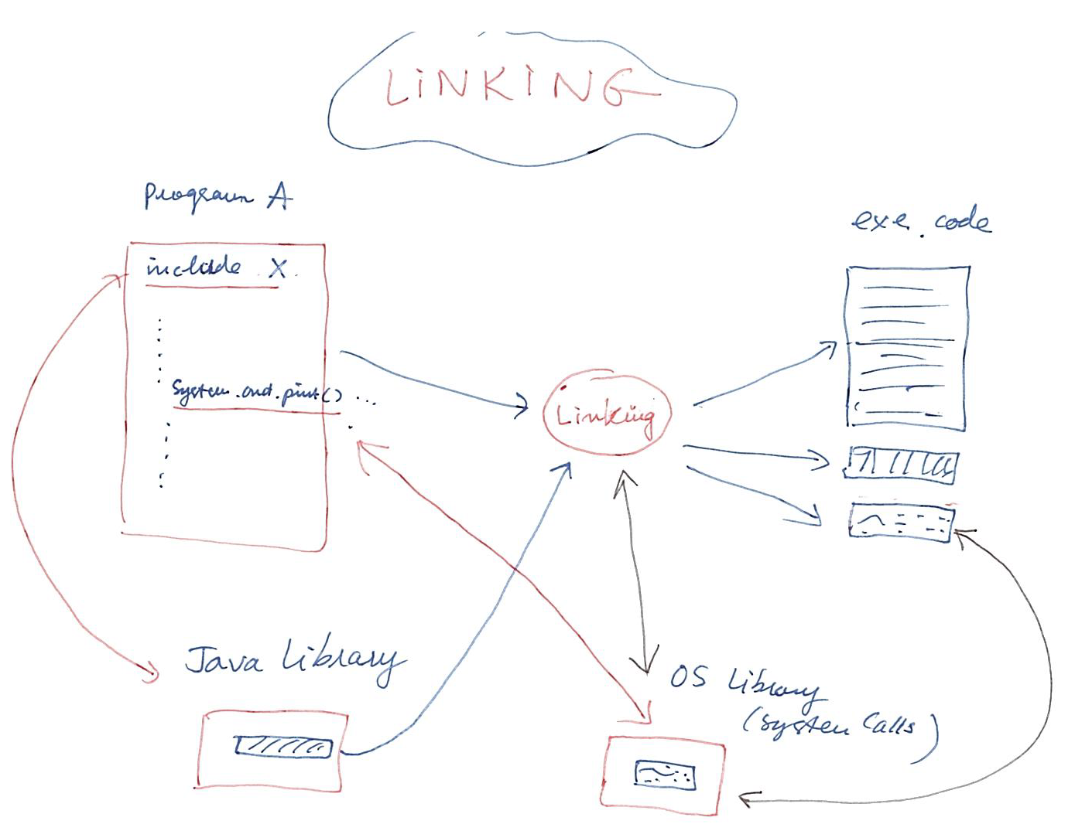
Stages in Creating & Running Programs

Slide 46
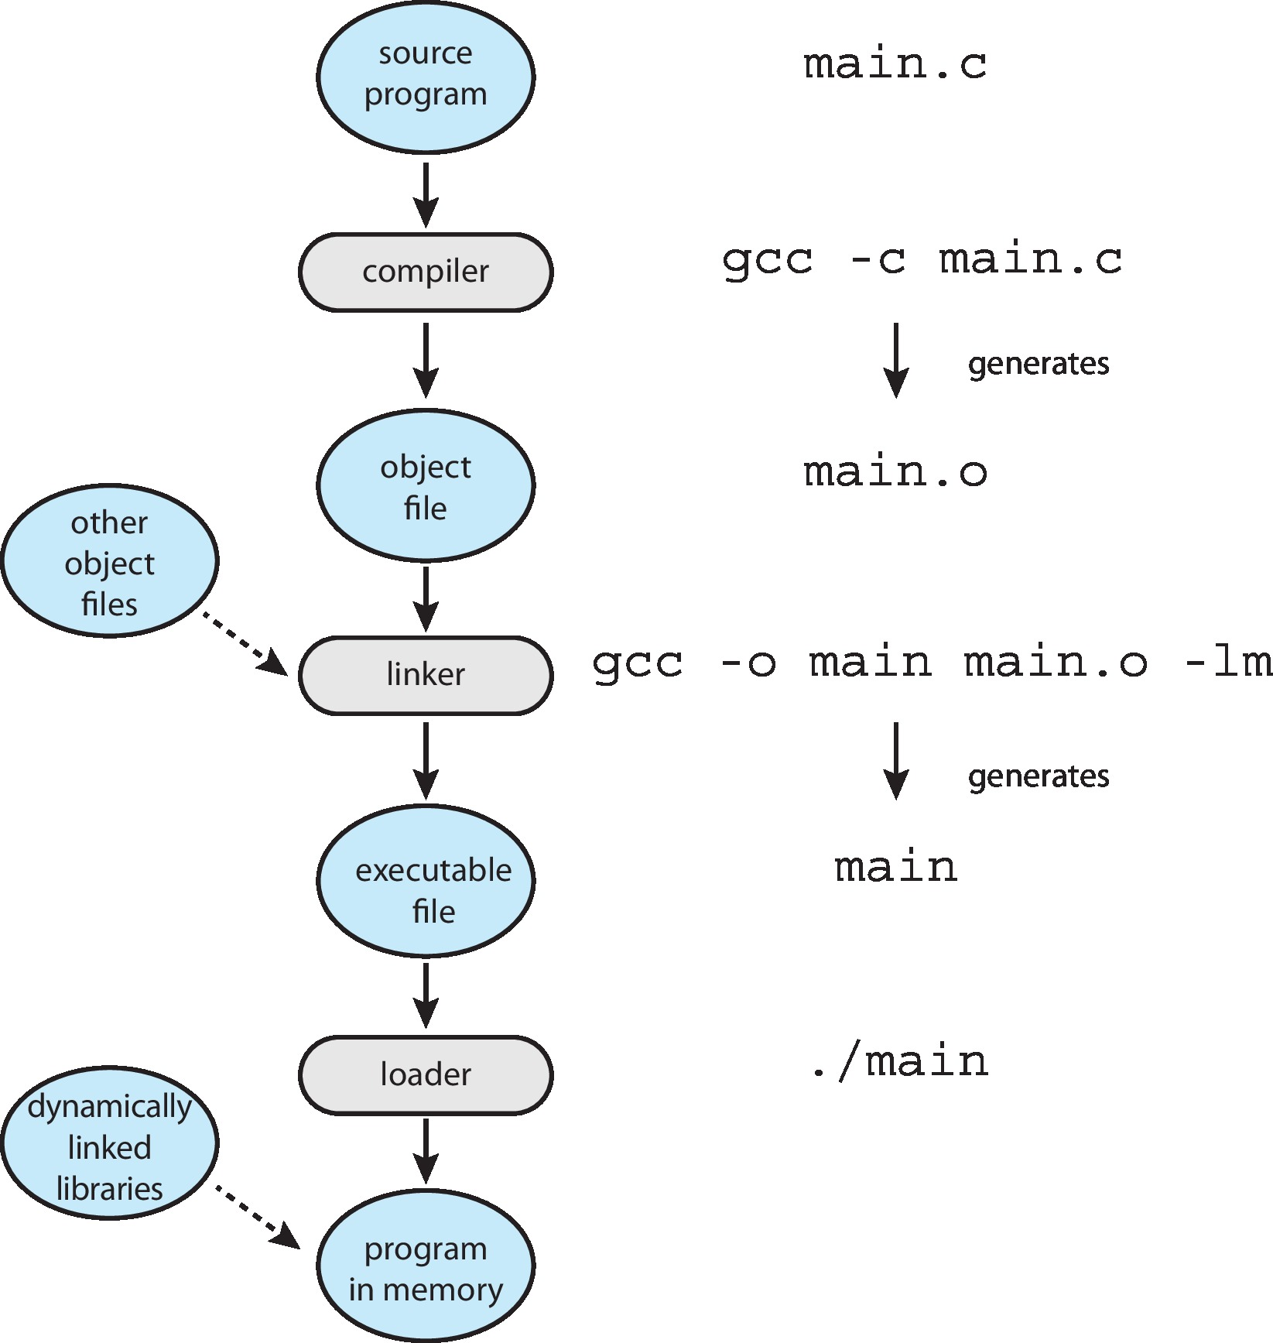
The Role of the Linker and Loader

Slide 47
Why Applications are Operating System Specific
Apps compiled on one system usually not executable on other operating systems
Each operating system provides its own unique system calls
  Own file formats, etc.
Apps can be multi-operating system
  Written in interpreted language like Python, Ruby, and interpreter available on multiple operating systems
  App written in language that includes a VM containing the running app (like Java)
  Use standard language (like C), compile separately on each operating system to run on each
Application Binary Interface (ABI) is architecture equivalent of API, defines how different components of binary code can interface for a given operating system on a given architecture, CPU, etc.

