Slide 1
Lecture 04 : OS Structures, Design, & Implementation

Slide 2
Outline
1. OS Design & Implementation
  • Design: user goal, system goal
  • Mechanism & Policy
  • Implementation
2. OS Structures
  • Simple
  • Monolithic
  • Layered
  • Microkernels
  • Modules
3. Computer Booting (+ Debugging, Tuning, Tracing)

Slide 3
Outline
KEYWORDS: Simple structure, Layered structure, Microkernels, Monolithic, Mechanism, Policy, User goal, System goal, Booting, BIOS, ROM, RAM.
HOMEWORK:
1) Reading : Chapter 2, especially the summary.
2) Make sure to understand and be able to explain every keyword from the list here and the ones which are printed bold in the text book.
3) Important Questions:
  • What is the main advantage of the layered approach to system design ? (3.9)
  • Compare user goal and system goal.
  • What is the advantages and disadvantages of writing an OS using a high-level programming language ? a low-level programming language ?
  • Why should we separate mechanism and policy ?
  • What is microkernel ? its advantage and disadvantage ? What is its opposite approach ?
  • Draw a diagram to show system boot step by step

Slide 4
Outline
1. OS Design & Implementation
  • Design: user goal, system goal
  • Mechanism & Policy
  • Implementation
2. OS Structures
  • Simple
  • Monolithic
  • Layered
  • Microkernels
  • Modules
3. Computer Booting (+ Debugging, Tuning, Tracing)

Slide 5
Design and Implementation
Design and Implementation of OS is not “solvable”, but some approaches have proven successful
Internal structure of different Operating Systems can vary widely
Start the design by defining goals and specifications
Affected by choice of hardware, type of system
User goals and System goals
  User goals – operating system should be convenient to use, easy to learn, reliable, safe, and fast
  System goals – operating system should be easy to design, implement, and maintain, as well as flexible, reliable, error-free, and efficient
Specifying and designing an OS is highly creative task of software engineering

Slide 6
Policy and Mechanism
Policy: What needs to be done?
  Example: Interrupt after every 100 seconds
Mechanism: How to do something?
  Example: timer
Important principle: separate policy from mechanism
The separation of policy from mechanism is a very important principle, it allows maximum flexibility if policy decisions are to be changed later.
  Example: change 100 to 200
POLICY:
1.Find space for file B
2.Find file A
3.Copy contents of A to B
Method Y();
Method X();
Method Z();
MECHANISMS:
1.Method X (Find file A)
2.Method Y(Find space for file B)
3.Method Z(Copy contents of A to B)

Slide 7
Implementation
Much variation
  Early OSes in assembly language
  Then system programming languages like Algol, PL/1
  Now C, C++
Actually usually a mix of languages
  Lowest levels in assembly
  Main body in C
  Systems programs in C, C++, scripting languages like PERL, Python, shell scripts
More high-level language easier to port to other hardware
  But slower
Emulation can allow an OS to run on non-native hardware

Slide 8
Outline
1. OS Design & Implementation
  • Design: user goal, system goal
  • Mechanism & Policy
  • Implementation
2. OS Structures
  • Simple
  • Monolithic
  • Layered
  • Microkernels
  • Modules
3. Computer Booting (+ Debugging, Tuning, Tracing)

Slide 9
Operating System Structure
General-purpose OS is very large program
Various ways to structure ones
  Simple structure – MS-DOS
  Monolithic Structure
  More complex – UNIX
  Layered – an abstraction
  Microkernel – Mach

Slide 10
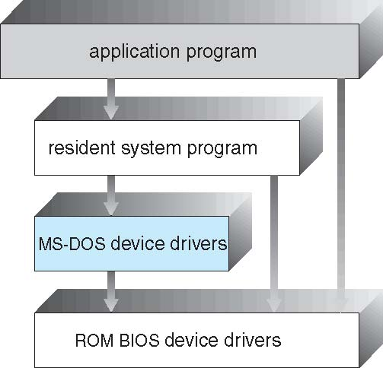
Simple Structure -- MS-DOS
OS with simple structure
do not have well defined structure and are small, simple and limited systems.
Not divided into modules
the interfaces and levels of functionality are not well separated.
MS-DOS is an example of such operating system: application programs are able to access the basic I/O routines.
written to provide the most functionality with the least space

Slide 11
Outline
1. OS Design & Implementation
  • Design: user goal, system goal
  • Mechanism & Policy
  • Implementation
2. OS Structures
  • Simple
  • Monolithic
  • Layered
  • Microkernels
  • Modules
3. Computer Booting (+ Debugging, Tuning, Tracing)

Slide 12
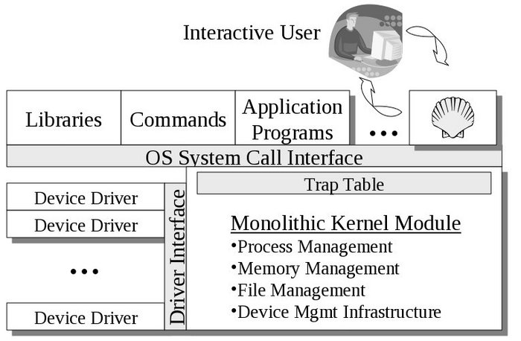
Monolithic Structure
Monolithic Structure = OS has more complex structuring (compared with simple OS) but still limited.
Functionality of the OS is invoked with simple function calls within the kernel, which is one large program.
Device drivers are loaded into the running kernel and become part of the kernel.

Slide 13
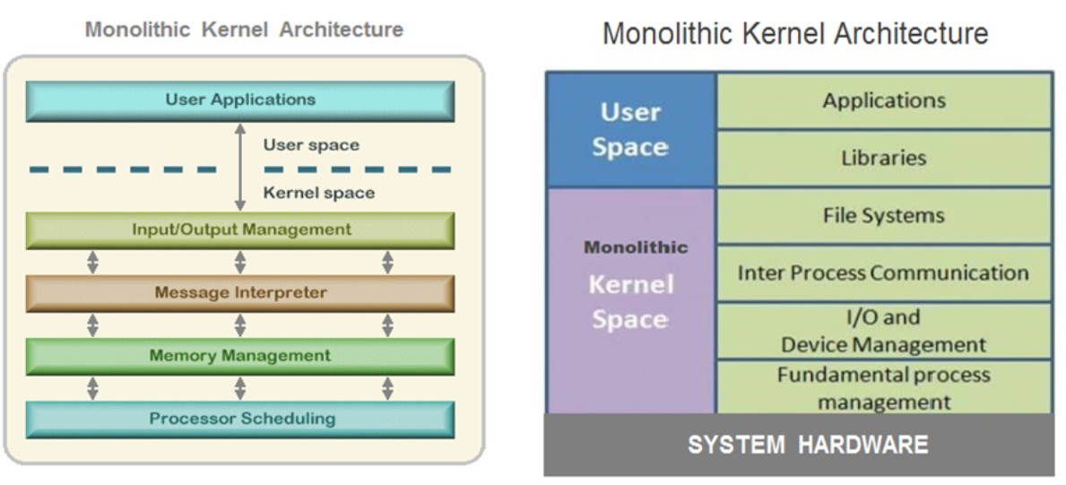
Monolithic Structure Kernel

Slide 14
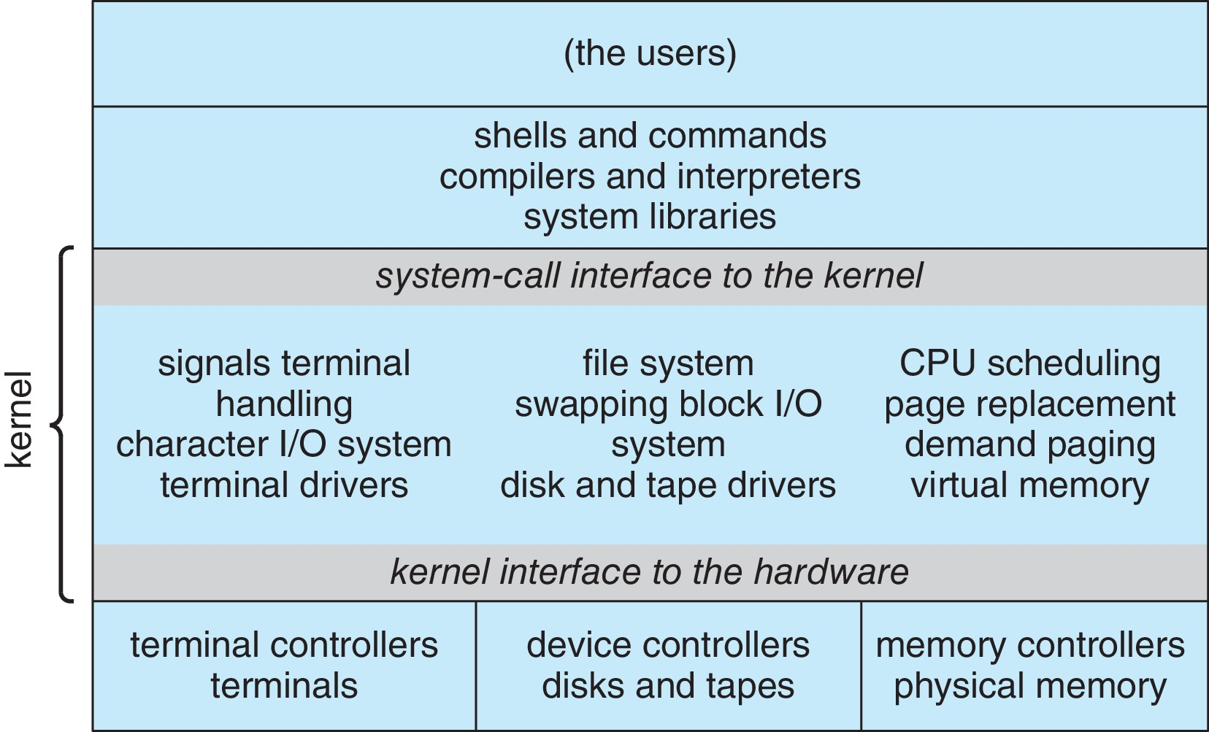
Monolithic Structure: Unix
Example = UNIX, beyond simple but not fully layered, has two separable parts
  Systems programs
  The kernel
    Consists of everything below the system-call interface and above the physical hardware
    Provides the file system, CPU scheduling, memory management, and other operating-system functions; a large number of functions for one level

Slide 15
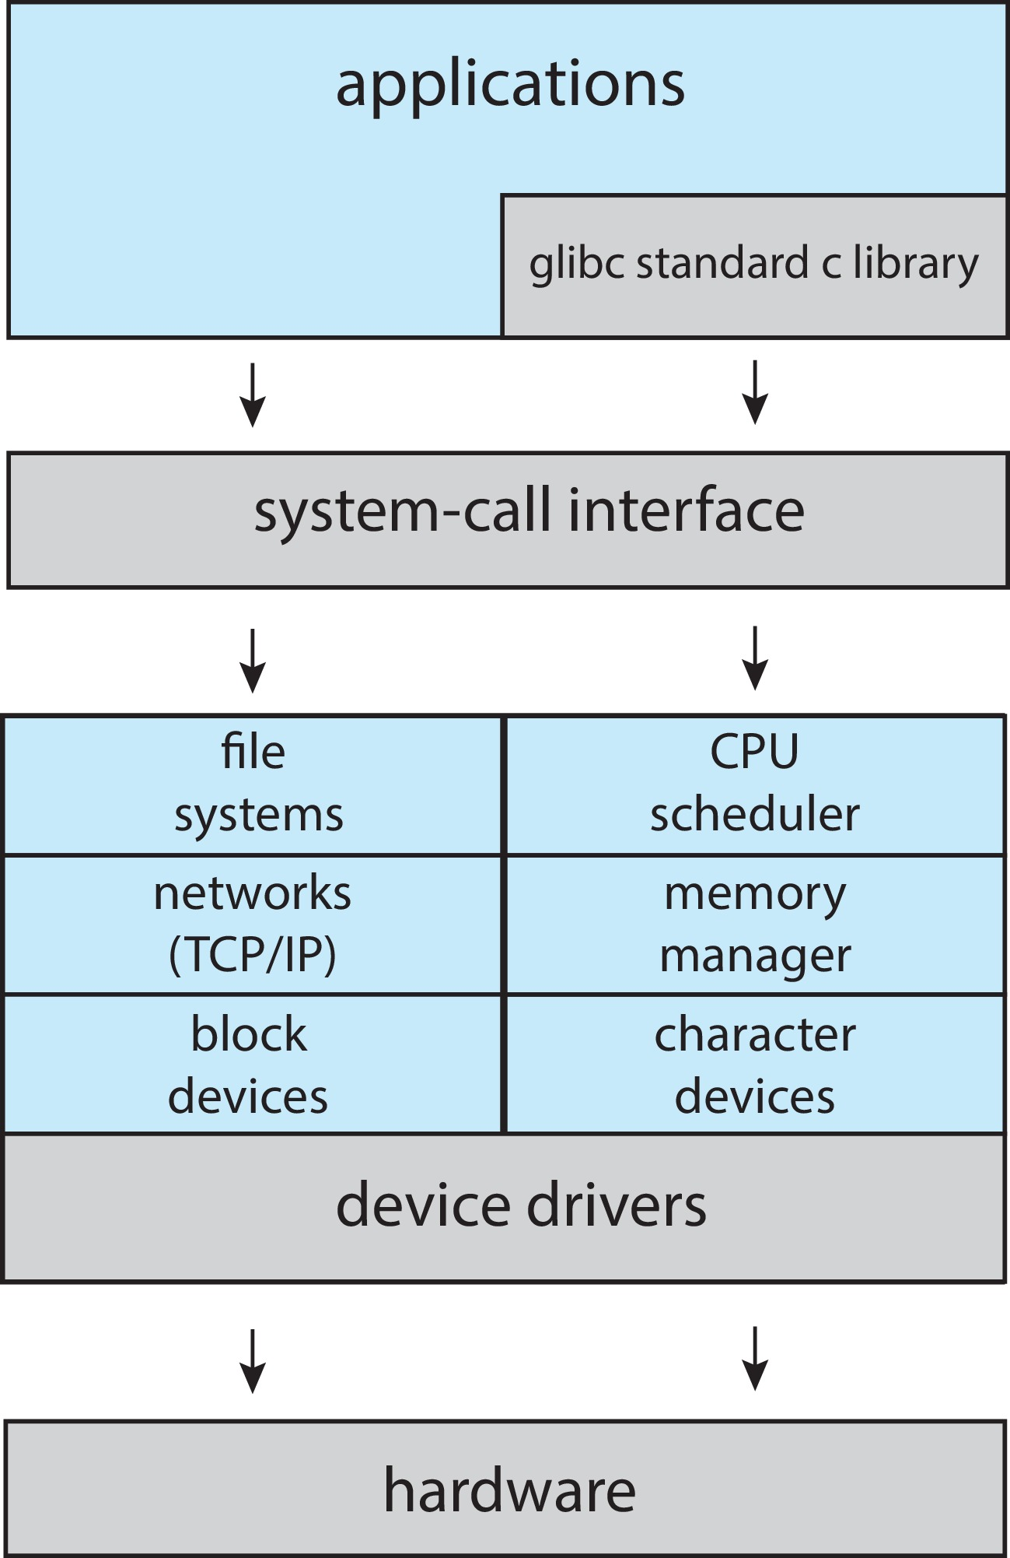
Monolithic Structure: Linux
Monolithic plus modular design

Slide 16
Outline
1. OS Design & Implementation
  • Design: user goal, system goal
  • Mechanism & Policy
  • Implementation
2. OS Structures
  • Simple
  • Monolithic
  • Layered
  • Microkernels
  • Modules
3. Computer Booting (+ Debugging, Tuning, Tracing)

Slide 17
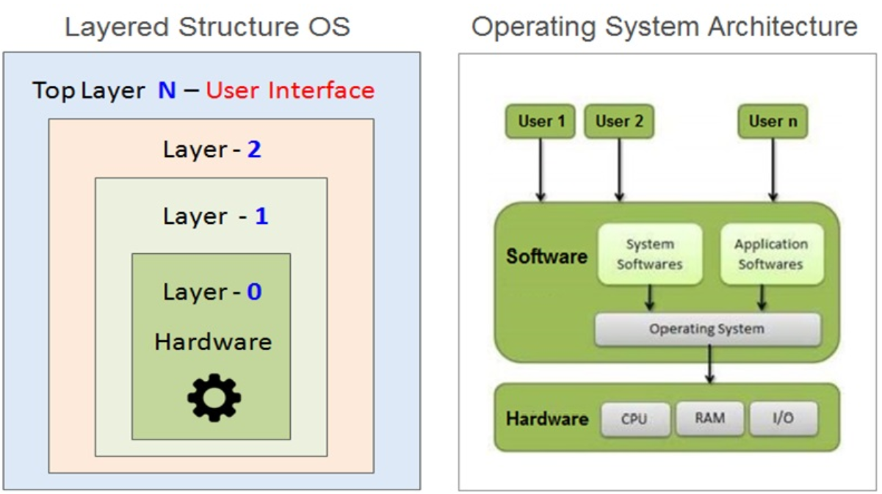
Layered Approach
This approach breaks up the operating system into different layers.
The operating system is divided into a number of layers (levels), each built on top of lower layers. The bottom layer (layer 0), is the hardware; the highest (layer N) is the user interface.
With modularity, layers are selected such that each uses functions (operations) and services of only lower-level layers

Slide 18
Layered Approach
This approach breaks up the operating system into different layers.
It allows implementers to change the inner workings, and increases modularity.
As long as the external interface of the routines don’t change, developers have more freedom to change the inner workings of the routines.
With the layered approach, the bottom layer is the hardware, while the highest layer is the user interface.
  The main advantage is simplicity of construction and debugging.
  The main difficulty is defining the various layers.
  The main disadvantage is that the OS tends to be less efficient than other implementations.

Slide 19
Outline
1. OS Design & Implementation
  • Design: user goal, system goal
  • Mechanism & Policy
  • Implementation
2. OS Structures
  • Simple
  • Monolithic
  • Layered
  • Microkernels
  • Modules
3. Computer Booting (+ Debugging, Tuning, Tracing)

Slide 20
Microkernels
Moves as much from the kernel into user space
Mach is an example of microkernel
  Mac OS X kernel (Darwin) partly based on Mach
Communication takes place between user modules using message passing
Benefits:
  Easier to extend a microkernel
  Easier to port the operating system to new architectures
  More reliable (less code is running in kernel mode)
  More secure
Detriments:
  Performance overhead of user space to kernel space communication

Slide 21
Microkernel System Structure

Slide 22
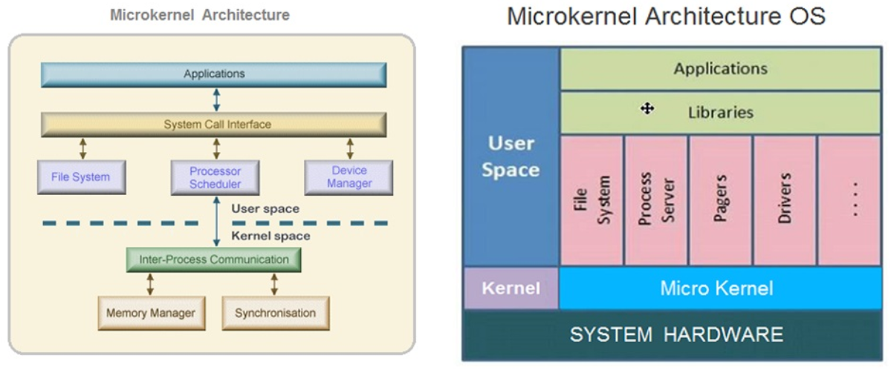
Microkernel System Structure

Slide 23
Modules (Modular Structure)
Many modern operating systems implement loadable kernel modules (LKMs)
  Uses object-oriented approach
  Each core component is separate
  Each talks to the others over known interfaces
  Each is loadable as needed within the kernel
Overall, similar to layers but with more flexible
  Linux, Solaris, etc.

Slide 24
Hybrid Systems
Most modern operating systems are not one pure model
  Hybrid combines multiple approaches to address performance, security, usability needs
  Linux and Solaris kernels in kernel address space, so monolithic, plus modular for dynamic loading of functionality
  Windows mostly monolithic, plus microkernel for different subsystem personalities
Apple Mac OS X hybrid, layered, Aqua UI plus Cocoa programming environment
  Below is kernel consisting of Mach microkernel and BSD Unix parts, plus I/O kit and dynamically loadable modules (called kernel extensions)

Slide 25
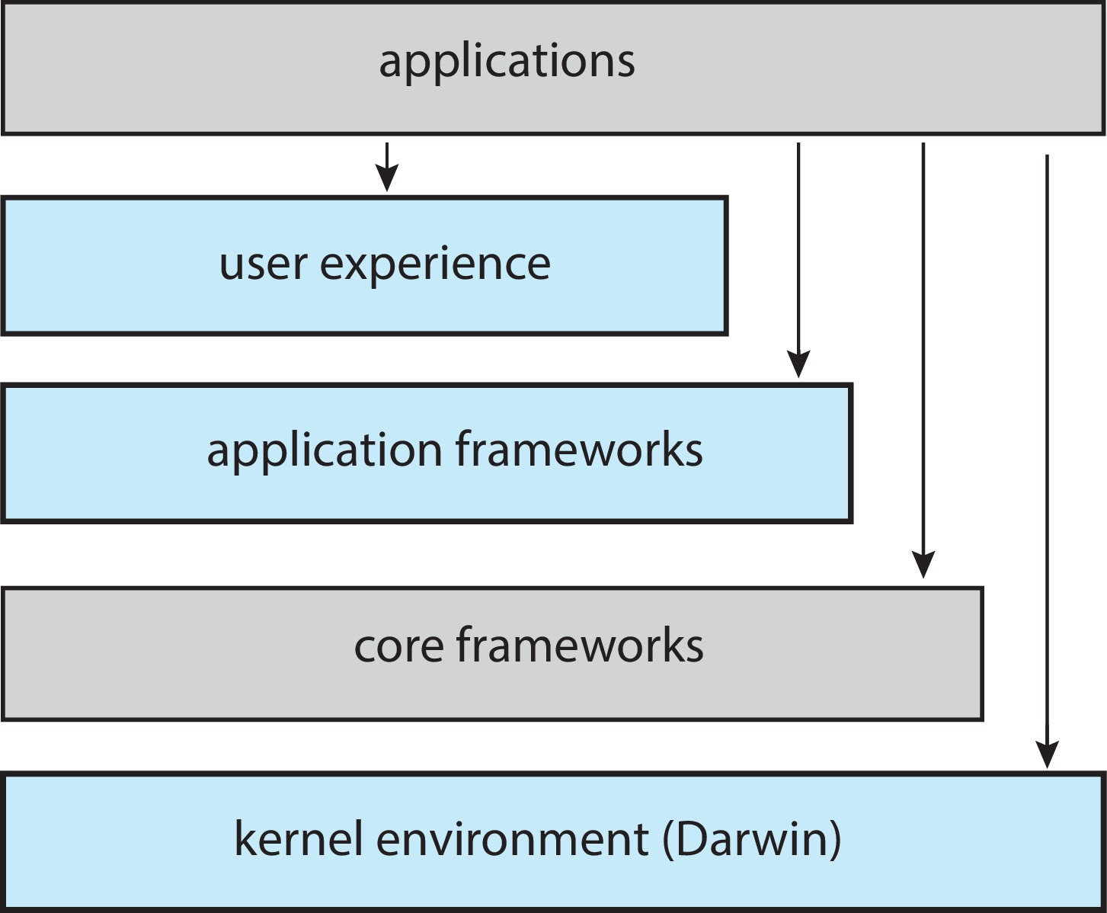
macOS and iOS Structure

Slide 26
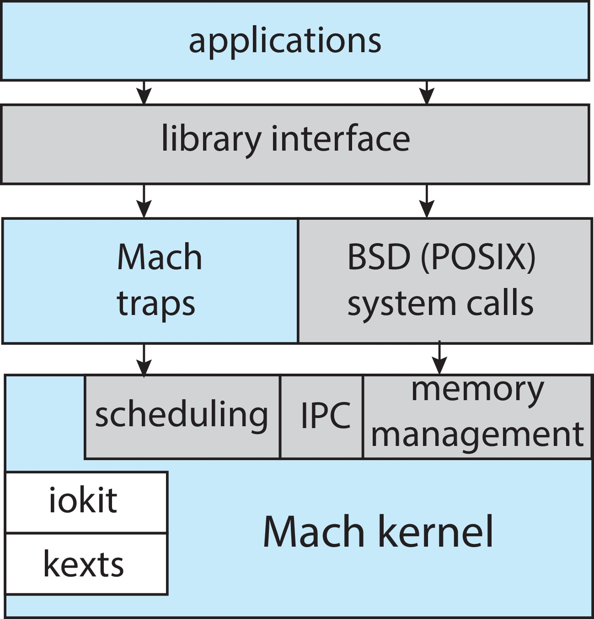
Darwin

Slide 27
iOS
Apple mobile OS for iPhone, iPad
  Structured on Mac OS X, added functionality
  Does not run OS X applications natively
    Also runs on different CPU architecture (ARM vs. Intel)
  Cocoa Touch Objective-C API for developing apps
  Media services layer for graphics, audio, video
  Core services provides cloud computing, databases
  Core operating system, based on Mac OS X kernel

Slide 28
Android
Developed by Open Handset Alliance (mostly Google)
  Open Source
Similar stack to IOS
Based on Linux kernel but modified
  Provides process, memory, device-driver management
  Adds power management
Runtime environment includes core set of libraries and Dalvik virtual machine
  Apps developed in Java plus Android API
    Java class files compiled to Java bytecode then translated to executable than runs in Dalvik VM
Libraries include frameworks for web browser (webkit), database (SQLite), multimedia, smaller libc

Slide 29
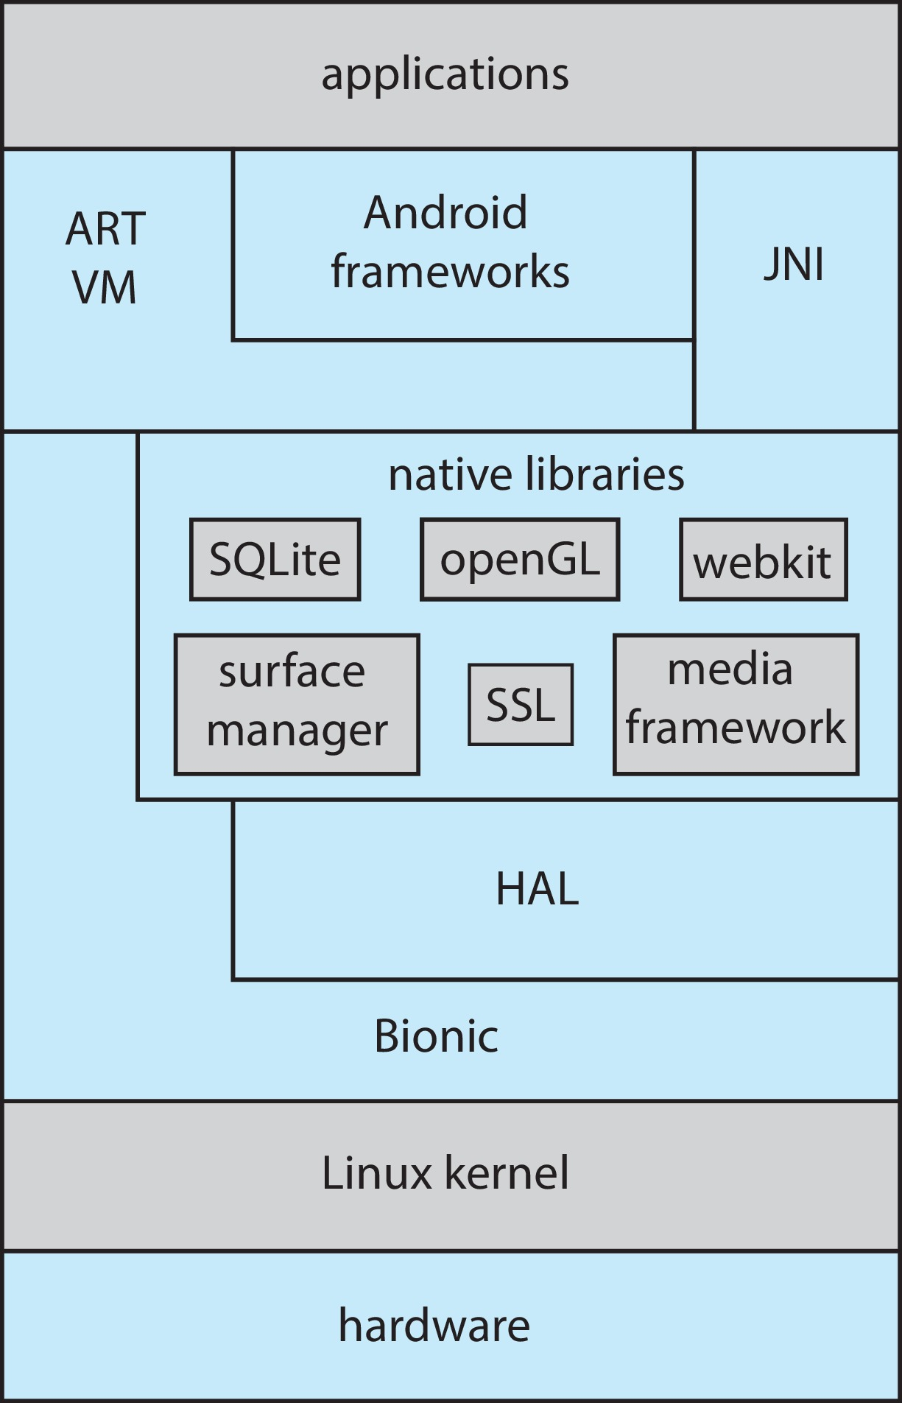
Android Architecture

Slide 30
Outline
1. OS Design & Implementation
  • Design: user goal, system goal
  • Mechanism & Policy
  • Implementation
2. OS Structures
  • Simple
  • Monolithic
  • Layered
  • Microkernels
  • Modules
3. Computer Booting (+ Debugging, Tuning, Tracing)

Slide 31
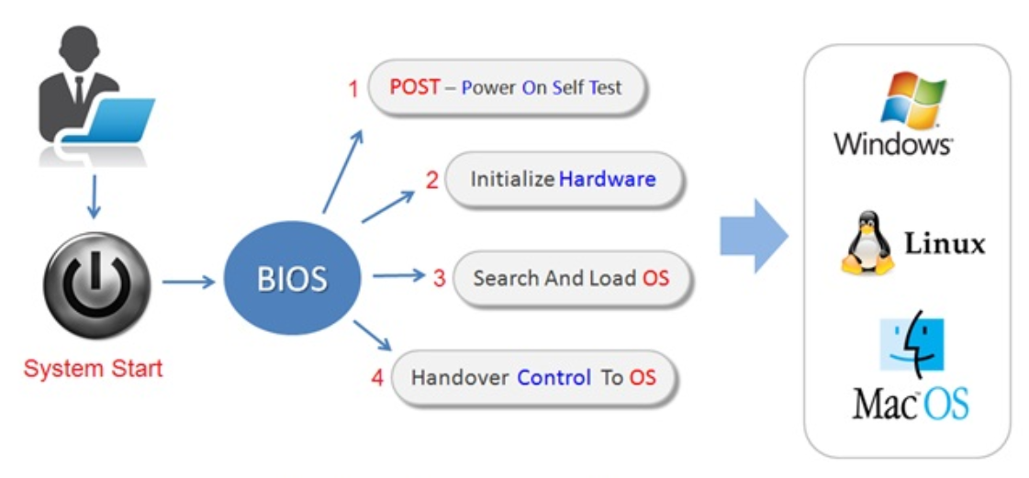
System Booting

Slide 32
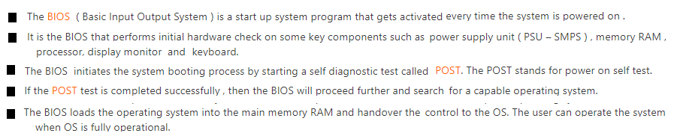
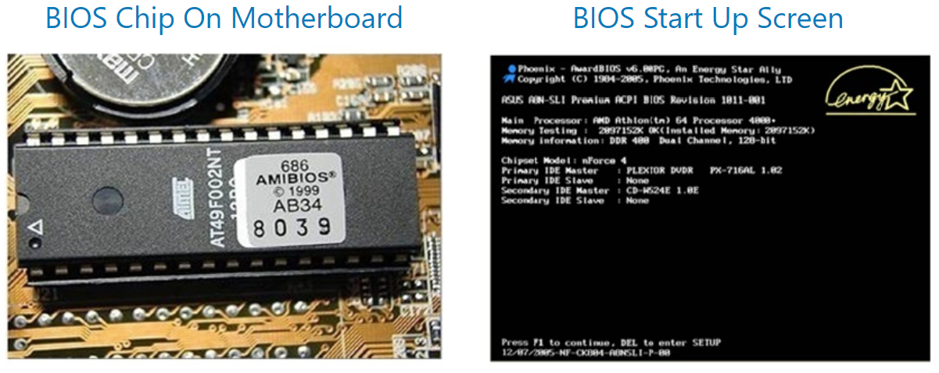
System Booting

Slide 33
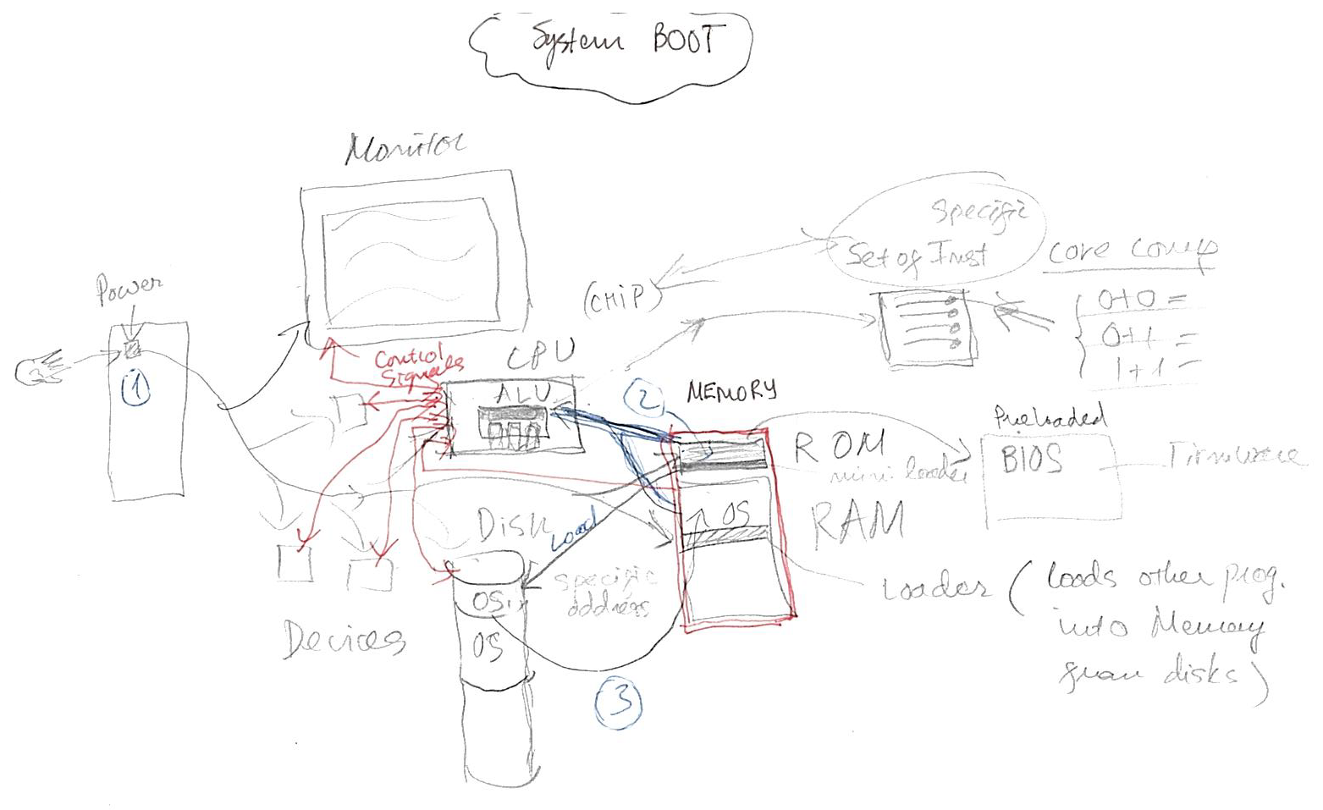
System Booting

Slide 34
Building and Booting an Operating System
Operating systems generally designed to run on a class of systems with variety of perpherals
Commonly, operating system already installed on purchased computer
  But can build and install some other operating systems
  If generating an operating system from scratch
    Write the operating system source code
    Configure the operating system for the system on which it will run
    Compile the operating system
    Install the operating system
    Boot the computer and its new operating system

Slide 35
Building and Booting Linux
Download Linux source code (http://www.kernel.org)
Configure kernel via “make menuconfig”
Compile the kernel using “make”
  Produces vmlinuz, the kernel image
  Compile kernel modules via “make modules”
  Install kernel modules into vmlinuz via “make modules_install”
  Install new kernel on the system via “make install”

Slide 36
System Boot
When power initialized on system, execution starts at a fixed memory location
Operating system must be made available to hardware so hardware can start it
  Small piece of code – bootstrap loader, BIOS, stored in ROM or EEPROM locates the kernel, loads it into memory, and starts it
  Sometimes two-step process where boot block at fixed location loaded by ROM code, which loads bootstrap loader from disk
  Modern systems replace BIOS with Unified Extensible Firmware Interface (UEFI)
Common bootstrap loader, GRUB, allows selection of kernel from multiple disks, versions, kernel options
Kernel loads and system is then running
Boot loaders frequently allow various boot states, such as single user mode

Slide 37
Outline
1. OS Design & Implementation
  • Design: user goal, system goal
  • Mechanism & Policy
  • Implementation
2. OS Structures
  • Simple
  • Limited
  • Layered
  • Microkernels
  • Modules
3. Computer Booting (+ Debugging, Tuning, Tracing)

Slide 38
Operating-System Debugging
Debugging is finding and fixing errors, or bugs
Also performance tuning
OS generate log files containing error information
Failure of an application can generate core dump file capturing memory of the process
Operating system failure can generate crash dump file containing kernel memory
Beyond crashes, performance tuning can optimize system performance
  Sometimes using trace listings of activities, recorded for analysis
  Profiling is periodic sampling of instruction pointer to look for statistical trends
Kernighan’s Law: “Debugging is twice as hard as writing the code in the first place. Therefore, if you write the code as cleverly as possible, you are, by definition, not smart enough to debug it.”

Slide 39
Performance Tuning
Improve performance by removing bottlenecks
OS must provide means of computing and displaying measures of system behavior
For example, “top” program or Windows Task Manager

Slide 40
Tracing
Collects data for a specific event, such as steps involved in a system call invocation
Tools include
  strace – trace system calls invoked by a process
  gdb – source-level debugger
  perf – collection of Linux performance tools
  tcpdump – collects network packets

Slide 41
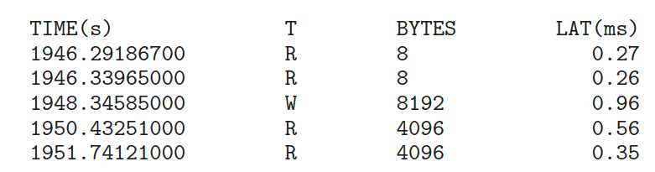
BCC
Debugging interactions between user-level and kernel code nearly impossible without toolset that understands both and an instrument their actions
BCC (BPF Compiler Collection) is a rich toolkit providing tracing features for Linux
  See also the original DTrace
For example, disksnoop.py traces disk I/O activity
Many other tools (next slide)

Slide 42
Linux bcc/BPF Tracing Tools

Slide 43
References
1) this textbook
2) http://faculty.salina.k-state.edu/tim/ossg/Introduction/struct.html
3) https://www.learncomputerscienceonline.com/operating-system/

