Slide 1
Lecture 05 : Virtualization

Slide 2
Outline
1. Introduction to Virtualization
  • Definition
  • Principles & Models
  • History
  • Features, Advantages, Disadvantages
2. Types of Virtualization
  • 2.1 OS Virtual Machines
  • 2.2 Others

Slide 3
Outline
MAIN KEYWORDS: Virtualization, Virtual Machine, Vmware, Java VM
HOMEWORK:
1) Reading : Chapter 18 especially the summary.
2) Make sure to understand and be able to explain every keyword from the list here and the ones which are printed bold in the text book.
3) Important Questions:
• Draw diagrams to compare virtual machine systems and non-virtual machine systems (2.15)
• What is the advantages and disadvantages of using Virtual machine concept in OS ?
• Draw the VMware architecture (2.16)
• Draw a diagram to show the Java VM

Slide 4
Outline
1. Introduction to Virtualization
  • Definition
  • Principles & Models
  • History
  • Features, Advantages, Disadvantages
2. Types of Virtualization
  • 2.1 OS Virtual Machines
  • 2.2 Others

Slide 5
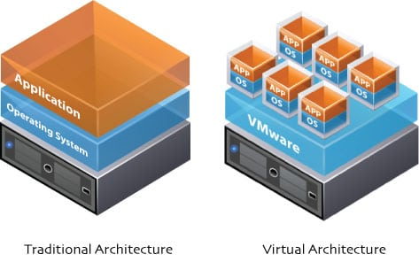
Virtualization Defined
The use of hardware and software to create the perception that one or more entities exist, although the entities, in actuality, are not physically present.

Slide 6
Virtualization Defined
Fundamental idea – abstract hardware of a single computer into several different execution environments
  Similar to layered approach
  But layer creates virtual system (virtual machine, or VM) on which operation systems or applications can run
Using virtualization, we can make:
  one server appear to be many,
  a desktop computer appear to be running multiple operating systems simultaneously,
  a network connection appear to exist, or
  a vast amount of disk space or a vast number of drives to be available.

Slide 7
Outline
1. Introduction to Virtualization
  • Definition
  • Principles & Models
  • History
  • Features, Advantages, Disadvantages
2. Types of Virtualization
  • 2.1 OS Virtual Machines
  • 2.2 Others

Slide 8
Principles
Several components
  Host – underlying hardware system
  Virtual machine manager (VMM) or hypervisor – creates and runs virtual machines by providing interface that is identical to the host
    (Except in the case of paravirtualization)
  Guest – process provided with virtual copy of the host
    Usually an operating system
Single physical machine can run multiple operating systems concurrently, each in its own virtual machine

Slide 9
System Models
Non-virtual machine
Virtual machine

Slide 10
Implementation of VMMs
Vary greatly, with options including:
  Type 0 hypervisors - Hardware-based solutions that provide support for virtual machine creation and management via firmware
    IBM LPARs and Oracle LDOMs are examples
  Type 1 hypervisors - Operating-system-like software built to provide virtualization
    Including VMware ESX, Joyent SmartOS, and Citrix XenServer
  Type 1 hypervisors – Also includes general-purpose operating systems that provide standard functions as well as VMM functions
    Including Microsoft Windows Server with HyperV and RedHat Linux with KVM
  Type 2 hypervisors - Applications that run on standard operating systems but provide VMM features to guest operating systems
    Including VMware Workstation and Fusion, Parallels Desktop, and Oracle VirtualBox

Slide 11
Implementation of VMMs (Cont.)
Other variations include:
  Paravirtualization - Technique in which the guest operating system is modified to work in cooperation with the VMM to optimize performance
  Programming-environment virtualization - VMMs do not virtualize real hardware but instead create an optimized virtual system
    Used by Oracle Java and Microsoft.Net
  Emulators – Allow applications written for one hardware environment to run on a very different hardware environment, such as a different type of CPU

Slide 12
Implementation of VMMs (Cont.)
  Application containment - Not virtualization at all but rather provides virtualization-like features by segregating applications from the operating system, making them more secure, manageable
    Including Oracle Solaris Zones, BSD Jails, and IBM AIX WPARs
Much variation due to breadth, depth and importance of virtualization in modern computing

Slide 13
Outline
1. Introduction to Virtualization
  • Definition
  • Principles & Models
  • History
  • Features, Advantages, Disadvantages
2. Types of Virtualization
  • 2.1 OS Virtual Machines
  • 2.2 Others

Slide 14
History
First appeared in IBM mainframes in 1972
Allowed multiple users to share a batch-oriented system
Formal definition of virtualization helped move it beyond IBM
  A VMM provides an environment for programs that is essentially identical to the original machine
  Programs running within that environment show only minor performance decreases
  The VMM is in complete control of system resources
In late 1990s Intel CPUs fast enough for researchers to try virtualizing on general purpose PCs
  Xen and VMware created technologies, still used today
  Virtualization has expanded to many OSes, CPUs, VMMs

Slide 15
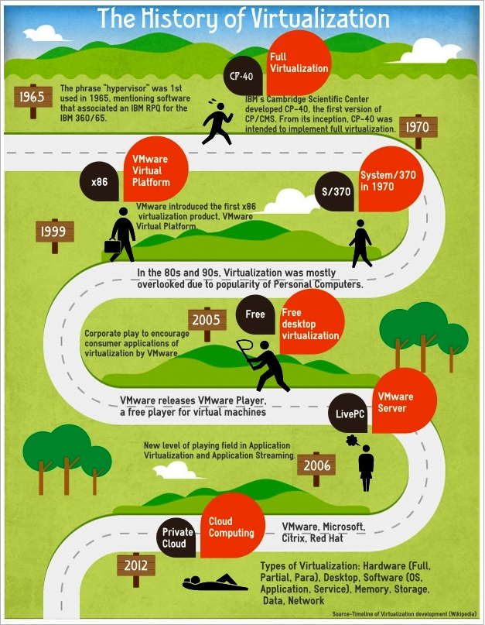
History of Virtualization

Slide 16
Outline
1. Introduction to Virtualization
  • Definition
  • Principles & Models
  • History
  • Features, Advantages, Disadvantages
2. Types of Virtualization
  • 2.1 OS Virtual Machines
  • 2.2 Others

Slide 17
Advantages/Motivations for Virtualization
Increased device utilization (particularly CPU utilization)
Decreased device footprint
Decreased power consumption
Simplified operating system and application administration
Ease of software provisioning and patch releases
Device and storage scalability
Increased user access to key resources
Increased flexibility in supporting multiple operating system environments
Improved use and management of software licenses
Improved utilization reporting, which leads to improved capacity planning
Improved disaster recovery and business continuity

Slide 18
Disadvantages of Virtualization
New staff or staff training may be required to understand the virtualization process.
Not all applications are well suited for virtualization.
The virtualization process adds slight overhead, which will make some applications run more slowly.

Slide 19
Benefits and Features of VM in OS
Host system protected from VMs, VMs protected from each other
  i.e., A virus less likely to spread
  Sharing is provided though via shared file system volume, network communication
Freeze, suspend, running VM
  Then can move or copy somewhere else and resume
  Snapshot of a given state, able to restore back to that state
    Some VMMs allow multiple snapshots per VM
  Clone by creating copy and running both original and copy
Great for OS research, better system development efficiency
Run multiple, different OSes on a single machine
  Consolidation, app dev, …

Slide 20
Benefits and Features of VM in OS
Templating – create an OS + application VM, provide it to customers, use it to create multiple instances of that combination
Live migration – move a running VM from one host to another!
  No interruption of user access
All those features taken together -> cloud computing
  Using APIs, programs tell cloud infrastructure (servers, networking, storage) to create new guests, VMs, virtual desktops

Slide 21
Outline
1. Introduction to Virtualization
  • Definition
  • Principles & Models
  • History
  • Features, Advantages, Disadvantages
2. Types of Virtualization
  • 2.1 OS Virtual Machines
  • 2.2 Others

Slide 22
Types of Virtualization
Virtualization can be done at different levels:
OS kernels: Virtual Machines
OS components:
    Memory Virtualization
    Network Virtualization
    Storage Virtualization
Whole computers:
    Server Virtualization
    Desktop Virtualization
Programming-environment virtualization:
    Java Virtual Machine (JVM)
    Emulators
    App Containers

Slide 23
Outline
1. Introduction to Virtualization
  • Definition
  • Principles & Models
  • History
  • Benefits
2. Types of Virtualization
  • 2.1 OS Virtual Machines
  • 2.2 Others

Slide 24
OS Virtual Machines
Non-virtual machine
Virtual machine

Slide 25
Building Blocks
Generally difficult to provide an exact duplicate of underlying machine
  Especially if only dual-mode operation available on CPU
  But getting easier over time as CPU features and support for VMM improves
  Most VMMs implement virtual CPU (VCPU) to represent state of CPU per guest as guest believes it to be
    When guest context switched onto CPU by VMM, information from VCPU loaded and stored
  Several techniques, as described in next slides

Slide 26
Building Block – Trap and Emulate
Dual mode CPU means guest executes in user mode
  Kernel runs in kernel mode
  Not safe to let guest kernel run in kernel mode too
  So VM needs two modes – virtual user mode and virtual kernel mode
    Both of which run in real user mode
  Actions in guest that usually cause switch to kernel mode must cause switch to virtual kernel mode

Slide 27
Trap-and-Emulate (Cont.)
How does switch from virtual user mode to virtual kernel mode occur?
  Attempting a privileged instruction in user mode causes an error -> trap
  VMM gains control, analyzes error, executes operation as attempted by guest
  Returns control to guest in user mode
  Known as trap-and-emulate
  Most virtualization products use this at least in part
User mode code in guest runs at same speed as if not a guest
But kernel mode privilege mode code runs slower due to trap-and-emulate
  Especially a problem when multiple guests running, each needing trap-and-emulate
CPUs adding hardware support, mode CPU modes to improve virtualization performance

Slide 28
Trap-and-Emulate
Virtualization Implementation

Slide 29
Building Block – Binary Translation
Some CPUs don’t have clean separation between privileged and nonprivileged instructions
  Earlier Intel x86 CPUs are among them
    Earliest Intel CPU designed for a calculator
  Backward compatibility means difficult to improve
  Consider Intel x86 popf instruction
    Loads CPU flags register from contents of the stack
    If CPU in privileged mode -> all flags replaced
    If CPU in user mode -> on some flags replaced
      No trap is generated

Slide 30
Binary Translation (Cont.)
Other similar problem instructions we will call special instructions
  Caused trap-and-emulate method considered impossible until 1998
Binary translation solves the problem
  Basics are simple, but implementation very complex
  If guest VCPU is in user mode, guest can run instructions natively
  If guest VCPU in kernel mode (guest believes it is in kernel mode)
    VMM examines every instruction guest is about to execute by reading a few instructions ahead of program counter
    Non-special-instructions run natively
    Special instructions translated into new set of instructions that perform equivalent task (for example changing the flags in the VCPU)

Slide 31
Binary Translation (Cont.)
Implemented by translation of code within VMM
Code reads native instructions dynamically from guest, on demand, generates native binary code that executes in place of original code
Performance of this method would be poor without optimizations
  Products like VMware use caching
    Translate once, and when guest executes code containing special instruction cached translation used instead of translating again
    Testing showed booting Windows XP as guest caused 950,000 translations, at 3 microseconds each, or 3 second (5 %) slowdown over native

Slide 32
Binary Translation
Virtualization Implementation

Slide 33
Types of Virtual Machines and Implementations
Many variations as well as HW details
  Assume VMMs take advantage of HW features
    HW features can simplify implementation, improve performance
Whatever the type, a VM has a lifecycle
  Created by VMM
  Resources assigned to it (number of cores, amount of memory, networking details, storage details)
  In type 0 hypervisor, resources usually dedicated
  Other types dedicate or share resources, or a mix
  When no longer needed, VM can be deleted, freeing resources
Steps simpler, faster than with a physical machine install
  Can lead to virtual machine sprawl with lots of VMs, history and state difficult to track

Slide 34
Types of VMs – Type 0 Hypervisor
Old idea, under many names by HW manufacturers
  “partitions”, “domains”
  A HW feature implemented by firmware
  OS need to nothing special, VMM is in firmware
  Smaller feature set than other types
  Each guest has dedicated HW
I/O a challenge as difficult to have enough devices, controllers to dedicate to each guest
Sometimes VMM implements a control partition running daemons that other guests communicate with for shared I/O
Can provide virtualization-within-virtualization (guest itself can be a VMM with guests
  Other types have difficulty doing this

Slide 35
Type 0 Hypervisor

Slide 36
Types of VMs – Type 1 Hypervisor
Commonly found in company datacenters
  In a sense becoming “datacenter operating systems”
    Datacenter managers control and manage OSes in new, sophisticated ways by controlling the Type 1 hypervisor
    Consolidation of multiple OSes and apps onto less HW
    Move guests between systems to balance performance
    Snapshots and cloning

Slide 37
Types of VMs – Type 1 Hypervisor (Cont.)
Special purpose operating systems that run natively on HW
  Rather than providing system call interface, create run and manage guest OSes
  Can run on Type 0 hypervisors but not on other Type 1s
  Run in kernel mode
  Guests generally don’t know they are running in a VM
  Implement device drivers for host HW because no other component can
  Also provide other traditional OS services like CPU and memory management

Slide 38
Types of VMs – Type 1 Hypervisor (Cont.)
Another variation is a general purpose OS that also provides VMM functionality
  RedHat Enterprise Linux with KVM, Windows with Hyper-V, Oracle Solaris
  Perform normal duties as well as VMM duties
  Typically less feature rich than dedicated Type 1 hypervisors
In many ways, treat guests OSes as just another process
  Albeit with special handling when guest tries to execute special instructions

Slide 39
Types of VMs – Type 2 Hypervisor
Less interesting from an OS perspective
  Very little OS involvement in virtualization
  VMM is simply another process, run and managed by host
    Even the host doesn’t know they are a VMM running guests
  Tend to have poorer overall performance because can’t take advantage of some HW features
  But also a benefit because require no changes to host OS
    Student could have Type 2 hypervisor on native host, run multiple guests, all on standard host OS such as Windows, Linux, MacOS

Slide 40
2.2 Other Types of Virtualization
Virtualization can be done at different levels:
OS kernels: Virtual Machines
OS components:
    Memory Virtualization
    Network Virtualization
    Storage Virtualization
Whole computers:
    Server Virtualization
    Desktop Virtualization
Programming-environment virtualization:
    Java Virtual Machine (JVM)
    Emulators
    App Containers

Slide 41
Virtualization and
Operating-System Components
Now look at operating system aspects of virtualization
  CPU scheduling, memory management, I/O, storage, and unique VM migration feature
    How do VMMs schedule CPU use when guests believe they have dedicated CPUs?
    How can memory management work when many guests require large amounts of memory?

Slide 42
OS Component – CPU Scheduling
Even single-CPU systems act like multiprocessor ones when virtualized
  One or more virtual CPUs per guest
Generally VMM has one or more physical CPUs and number of threads to run on them
  Guests configured with certain number of VCPUs
    Can be adjusted throughout life of VM
  When enough CPUs for all guests -> VMM can allocate dedicated CPUs, each guest much like native operating system managing its CPUs
  Usually not enough CPUs -> CPU overcommitment
    VMM can use standard scheduling algorithms to put threads on CPUs
    Some add fairness aspect

Slide 43
OS Component –
CPU Scheduling (Cont.)
Cycle stealing by VMM and oversubscription of CPUs means guests don’t get CPU cycles they expect
  Consider timesharing scheduler in a guest trying to schedule 100ms time slices -> each may take 100ms, 1 second, or longer
    Poor response times for users of guest
    Time-of-day clocks incorrect
  Some VMMs provide application to run in each guest to fix time-of-day and provide other integration features

Slide 44
OS Component – Memory Management
Also suffers from oversubscription -> requires extra management efficiency from VMM
For example, VMware ESX guests have a configured amount of physical memory, then ESX uses 3 methods of memory management
  Double-paging, in which the guest page table indicates a page is in a physical frame but the VMM moves some of those pages to backing store
  Install a pseudo-device driver in each guest (it looks like a device driver to the guest kernel but really just adds kernel-mode code to the guest)
    Balloon memory manager communicates with VMM and is told to allocate or de-allocate memory to decrease or increase physical memory use of guest, causing guest OS to free or have more memory available
  De-duplication by VMM determining if same page loaded more than once, memory mapping the same page into multiple guests

Slide 45
OS Component – I/O
Easier for VMMs to integrate with guests because I/O has lots of variation
  Already somewhat segregated / flexible via device drivers
  VMM can provide new devices and device drivers
But overall I/O is complicated for VMMs
  Many short paths for I/O in standard OSes for improved performance
  Less hypervisor needs to do for I/O for guests, the better
  Possibilities include direct device access, DMA pass-through, direct interrupt delivery
    Again, HW support needed for these
Networking also complex as VMM and guests all need network access
  VMM can bridge guest to network (allowing direct access)
  And / or provide network address translation (NAT)
    NAT address local to machine on which guest is running, VMM provides address translation to guest to hide its address

Slide 46
OS Component – Storage Management
Both boot disk and general data access need be provided by VMM
Need to support potentially dozens of guests per VMM (so standard disk partitioning not sufficient)
Type 1 – storage guest root disks and config information within file system provided by VMM as a disk image
Type 2 – store as files in file system provided by host OS
Duplicate file -> create new guest
Move file to another system -> move guest
Physical-to-virtual (P-to-V) convert native disk blocks into VMM format
Virtual-to-physical (V-to-P) convert from virtual format to native or disk format
VMM also needs to provide access to network attached storage (just networking) and other disk images, disk partitions, disks, etc.

Slide 47
OS Component – Live Migration
Taking advantage of VMM features leads to new functionality not found on general operating systems such as live migration
Running guest can be moved between systems, without interrupting user access to the guest or its apps
Very useful for resource management, maintenance downtime windows, etc.
  The source VMM establishes a connection with the target VMM
  The target creates a new guest by creating a new VCPU, etc.
  The source sends all read-only guest memory pages to the target
  The source sends all read-write pages to the target, marking them as clean
  The source repeats step 4, as during that step some pages were probably modified by the guest and are now dirty
  When cycle of steps 4 and 5 becomes very short, source VMM freezes guest, sends VCPU’s final state, sends other state details, sends final dirty pages, and tells target to start running the guest
    Once target acknowledges that guest running, source terminates guest

Slide 48
Live Migration of Guest Between Servers

Slide 49
2.2 Other Types of Virtualization
Virtualization can be done at different levels:
OS kernels: Virtual Machines
OS components:
    Memory Virtualization
    Network Virtualization
    Storage Virtualization
Whole computers:
    Server Virtualization
    Desktop Virtualization
Programming-environment virtualization:
    Java Virtual Machine (JVM)
    Emulators
    App Containers

Slide 50
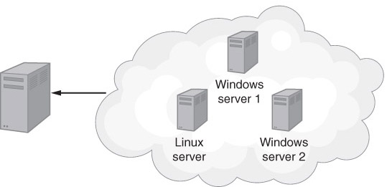
Server Virtualization
Through virtualization, a single physical server can be made to look like multiple separate servers, potentially running different operating systems.

Slide 51
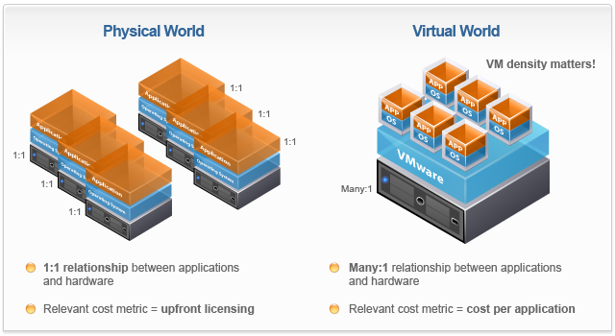
Server Virtualization

Slide 52
Server Virtualization
Making one server appear as many. Each virtual server may run the same or different operating systems.
Server virtualization provides:
  greater CPU utilization,
  a smaller equipment footprint,
  less power consumption, and
  support for multiple operating systems.

Slide 53
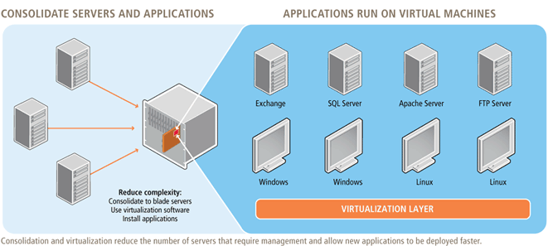
Server Virtualization

Slide 54
EXAMPLE: Microsoft Hyper-V
Microsoft servers now utilize an underlying technology the company refers to as Hyper-V to allow administrators to create virtual servers.

Slide 55
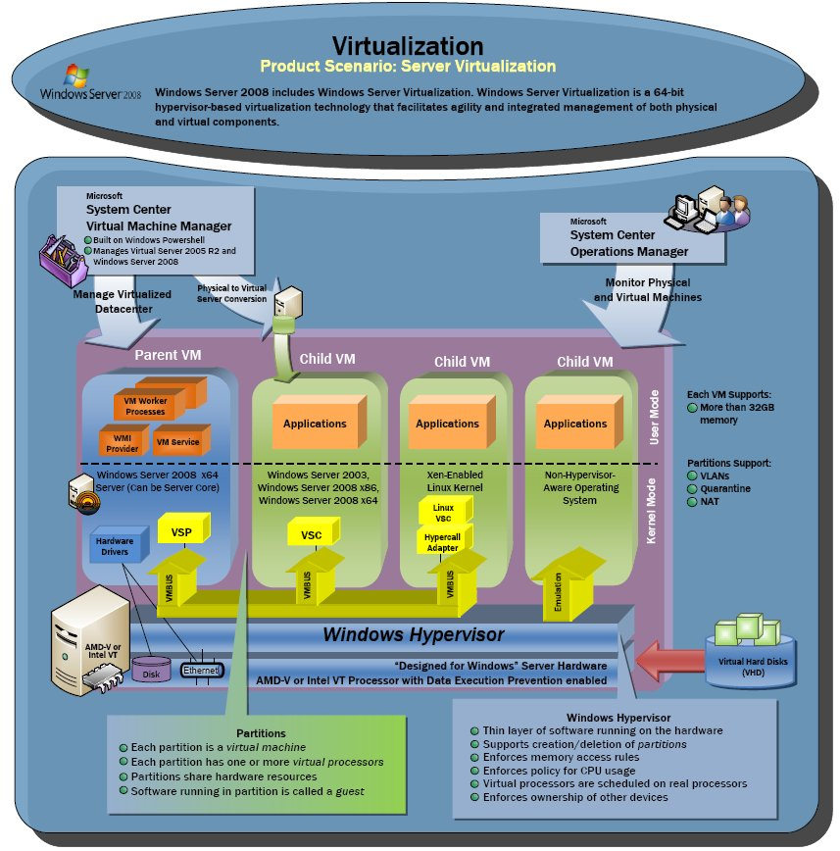
Microsoft Hyper-V

Slide 56
Advantages of Hyper-V
The ability to consolidate servers and increase CPU utilization
Enhanced business continuity and disaster recovery
Ease of deploying testing and support environments
Enhanced support for Windows-based client virtualization
Improved load balancing
Ability to move live virtual machines from one physical server to another on the fly for load balancing and scalability

Slide 57
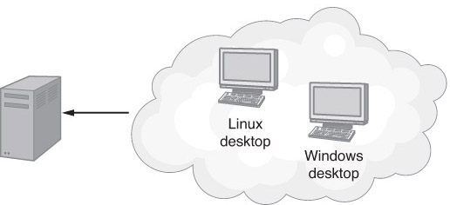
Virtual Desktop
Desktop virtualization allows a desktop computer to run two or more operating systems at the same time and allows a user to quickly switch between the systems.

Slide 58
Advantages of Virtual Desktops
A single desktop computer can simultaneously run multiple operating systems.
There is reduced need for duplicate hardware.
Less power is consumed.

Slide 59
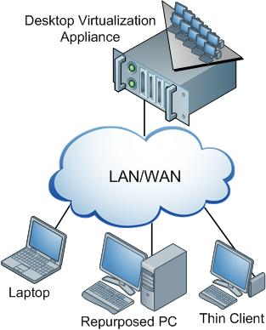
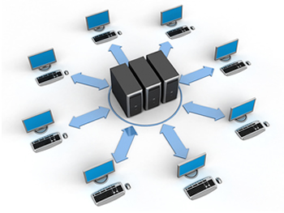
Desktop Virtualization

Slide 60
Desktop Virtualization
Allows a user to switch between multiple operating systems on the same computer. (An operating system that resides within a virtualized environment is known as a guest operating system.)
Some desktop virtualization techniques can provide an operating system environment on demand.
Desktop virtualization provides support for multiple operating systems, which is very convenient for software developers, testers, and help desk support staff.

Slide 61
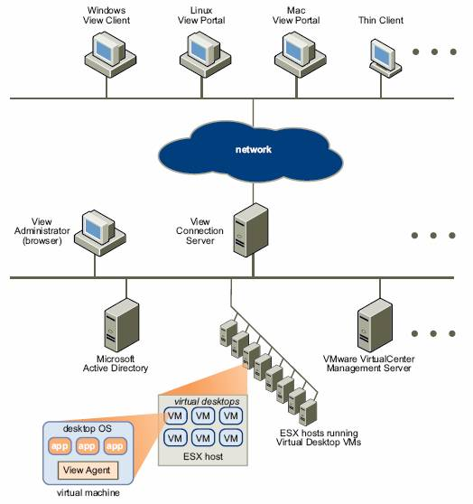
Desktop Virtualization

Slide 62
Microsoft Desktop Virtualization Tools
Microsoft Virtual Desktop Infrastructure (VDI) suite
Microsoft Application Virtualization (App-V)
Microsoft Enterprise Desktop Virtualization (MED-V)
Microsoft Remote Desktop Services (RDS)
Microsoft User State Virtualization (USV)
Windows Thin computer

Slide 63
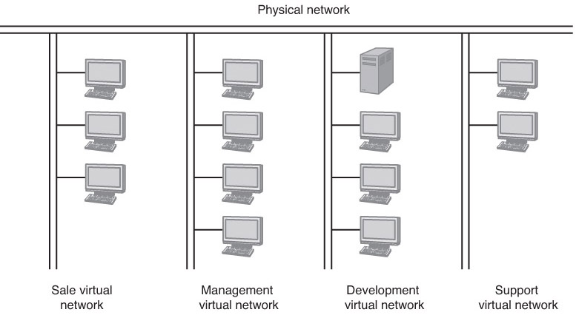
Virtual Network
Virtual local-area network (VLAN), which uses special routers to segment part of the physical network in such a way that the group appears to have its own private network.

Slide 64
Virtual Networks
Create the illusion that a user is connected directly to a company network and resources, although no such physical connection may exist.
Virtual private networks or VPNs: Using a VPN, users can connect to a network and access the network resources from any Internet-connected computer.
Virtual networks let network administrators to segment a network, making different departments such as management, development, and sales appear to have their own separate networks.

Slide 65
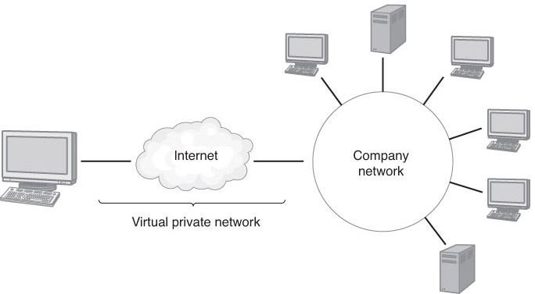
Virtual Private Network (VPN)
VPN software uses a secure Internet connection to give the user the illusion that he or she is physically connected to the remote network from his or her current location.

Slide 66
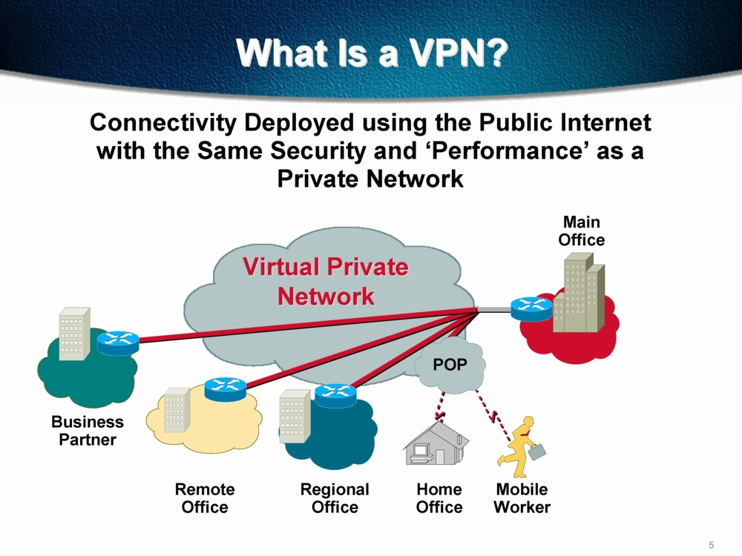
Virtual Networks

Slide 67
Virtual Storage
Provides users (and applications) with access to scalable and redundant physical storage through the use of abstract, or logical, disk drives or file systems, or a database interface.

Slide 68
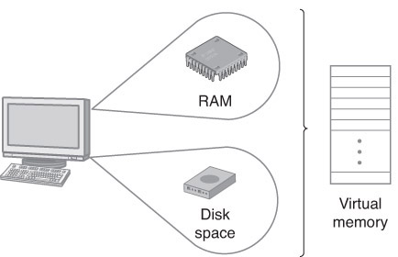
Virtual Memory
Virtual memory combines RAM with a page file on disk to create the illusion, to running programs, of the existence of a vast amount of RAM.

Slide 69
Advantages of Virtual Memory
A running program (process) appears to have unlimited memory.
The operating system can easily manage several different programs, running at the same time, and keep each program’s data and instructions secure.
The operating system can take advantage of disk storage, which is considerably less expensive than RAM.
Disadvantages of Virtual Memory
The disadvantage of virtual memory is that the paging process (the process of moving instructions and data between RAM and disk) adds overhead, mostly because disk drives are much slower than RAM.

Slide 70
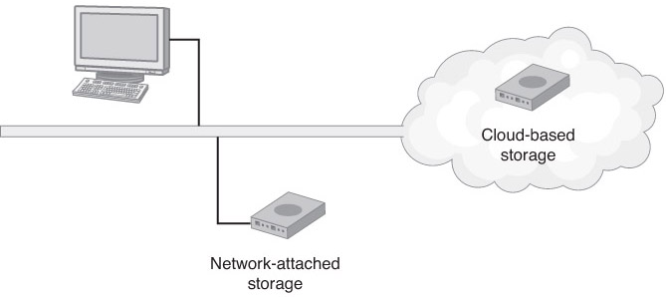
Data Storage Virtualization
Data storage virtualization hides the physical storage device or devices from the logical presentation that users or applications use to access the space.

Slide 71
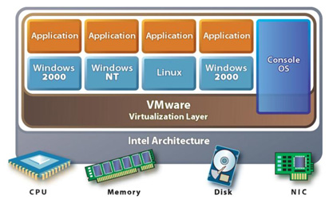
EXAMPLE: VMware ESXi
VMware is one of the best-known providers of virtualization solutions. For companies that need to support multiple operating systems within a virtual-server environment, Vmware ESXi provides the solution.

Slide 72
2.2 Other Types of Virtualization
Virtualization can be done at different levels:
OS kernels: Virtual Machines
OS components:
    Memory Virtualization
    Network Virtualization
    Storage Virtualization
Whole computers:
    Server Virtualization
    Desktop Virtualization
Programming-environment virtualization:
    Java Virtual Machine (JVM)
    Emulators
    App Containers

Slide 73
Programming Environment Virtualization
Also not-really-virtualization but using same techniques, providing similar features
Programming language is designed to run within custom-built virtualized environment
  For example Oracle Java has many features that depend on running in Java Virtual Machine (JVM)
In this case virtualization is defined as providing APIs that define a set of features made available to a language and programs written in that language to provide an improved execution environment
JVM compiled to run on many systems (including some smart phones even)
Programs written in Java run in the JVM no matter the underlying system
Similar to interpreted languages

Slide 74
Java Virtual Machine
Example of programming-environment virtualization
Very popular language / application environment invented by Sun Microsystems in 1995
Write once, run anywhere
Includes language specification (Java), API library, Java virtual machine (JVM)
Java objects specified by class construct, Java program is one or more objects
Each Java object compiled into architecture-neutral bytecode output (.class) which JVM class loader loads
JVM compiled per architecture, reads bytecode and executes
Includes garbage collection to reclaim memory no longer in use
Made faster by just-in-time (JIT) compiler that turns bytecodes into native code and caches them

Slide 75
The Java Virtual Machine

Slide 76
Emulation
Another (older) way for running one operating system on a different operating system
  Virtualization requires underlying CPU to be same as guest was compiled for
  Emulation allows guest to run on different CPU
Necessary to translate all guest instructions from guest CPU to native CPU
  Emulation, not virtualization
Useful when host system has one architecture, guest compiled for other architecture
  Company replacing outdated servers with new servers containing different CPU architecture, but still want to run old applications
Performance challenge – order of magnitude slower than native code
  New machines faster than older machines so can reduce slowdown
Very popular – especially in gaming where old consoles emulated on new

Slide 77
Application Containment
Some goals of virtualization are segregation of apps, performance and resource management, easy start, stop, move, and management of them
Can do those things without full-fledged virtualization
  If applications compiled for the host operating system, don’t need full virtualization to meet these goals
Oracle containers / zones for example create virtual layer between OS and apps
  Only one kernel running – host OS
  OS and devices are virtualized, providing resources within zone with impression that they are only processes on system
  Each zone has its own applications; networking stack, addresses, and ports; user accounts, etc
  CPU and memory resources divided between zones
    Zone can have its own scheduler to use those resources

Slide 78
Solaris 10 with Two Zones

