Slide 1
Lecture 06 :
Process Concept, Scheduling, Operations on Processes

Slide 2
Outline
1. Process Concept
    • Process
    • States
    • PCB
2. Process Scheduling
    • Queues
    • Schedulers
    • Context Switch (F3.4)
3. Operations on Processes
    • Creation
    • Termination

Slide 3
Outline
KEYWORDS: Process, Program counter, Data section, Stack, Process States, PCB, Process Scheduling, Queues, Longterm Schedulers, Short-term Schedulers, I/O-bound process, CPU-bound process, Context Switch, Process Creation, Parent processes, Children processes, Process Termination.
HOMEWORK:
  1) Reading : Chapter 3, especially the summary.
  2) Make sure to understand and be able to explain every keyword from the list here and the ones which are printed bold in the text book.
  3) Important Questions:
    • Draw a diagram showing all process states, queues, schedulers, and their relationships
    • How many device queues are there on a system?
    • True or False ?: The long-term scheduler selects a group of I/O-bound jobs or a group of CPUbound programs for subsequent activity. Explain.
    • What needs to be done in context switch ?
    • Compare short-term , medium-term, and long-term scheduling.
    • Assume that we have 11 processes in the system. What are the possible Min and Max numbers of processes in new state ?, ready state ?, run state?, and waiting state? and of PCB?

Slide 4
Outline
1. Process Concept
    • Process
    • States
    • PCB
2. Process Scheduling
    • Queues
    • Schedulers
    • Context Switch (F3.4)
3. Operations on Processes
    • Creation
    • Termination

Slide 5
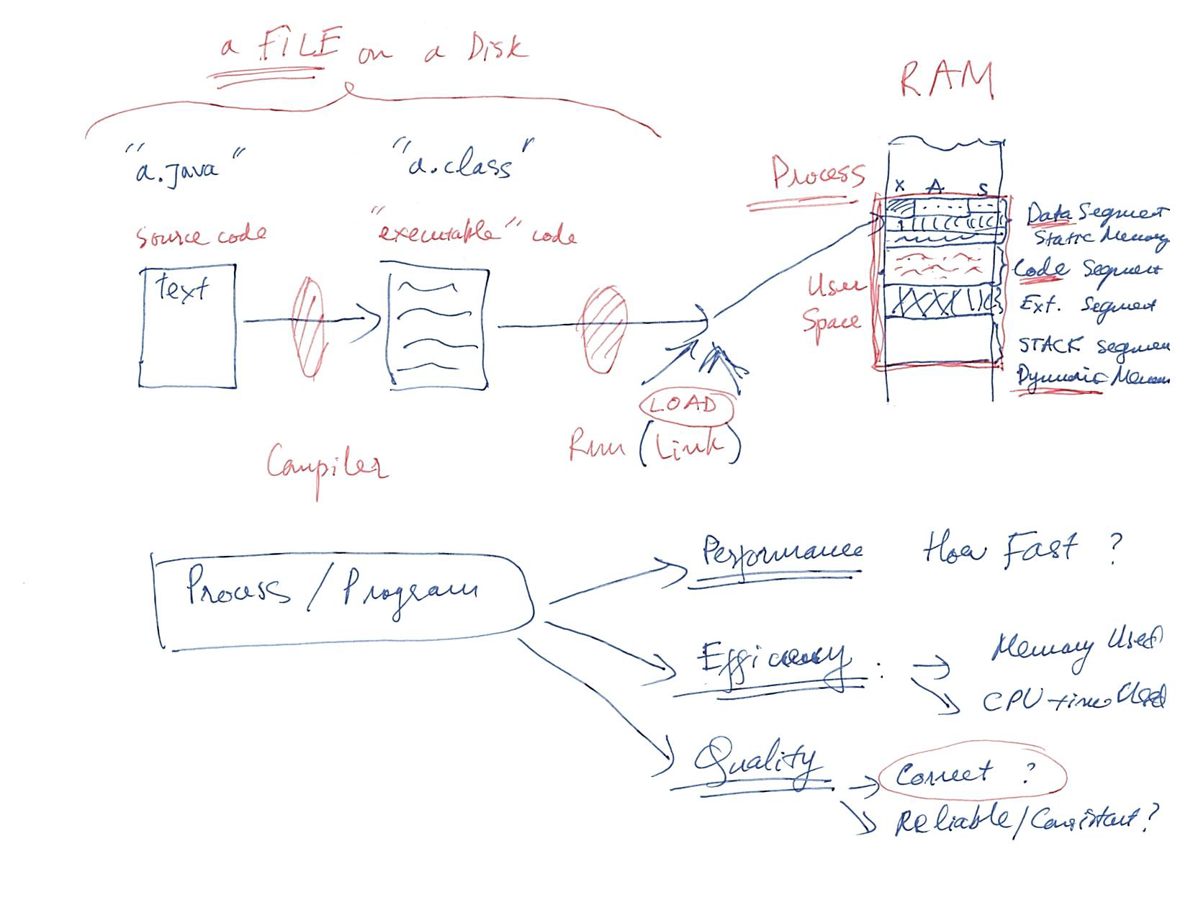
Process Concept

Slide 6
Process Concept
An operating system executes a variety of programs that run as a process.
Process – a program in execution; process execution must progress in sequential fashion. No parallel execution of instructions of a single process
Multiple parts
  The program code, also called text section
  Current activity including program counter, processor registers
  Stack containing temporary data
    Function parameters, return addresses, local variables
  Data section containing global variables
  Heap containing memory dynamically allocated during run time

Slide 7
Process Concept (Cont.)
Program is passive entity stored on disk (executable file); process is active
  Program becomes process when an executable file is loaded into memory
Execution of program started via GUI mouse clicks, command line entry of its name, etc.
One program can be several processes
  Consider multiple users executing the same program

Slide 8
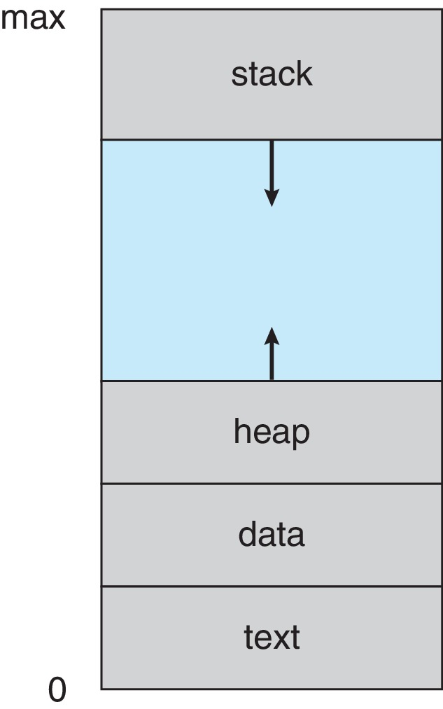
Process in Memory

Slide 9
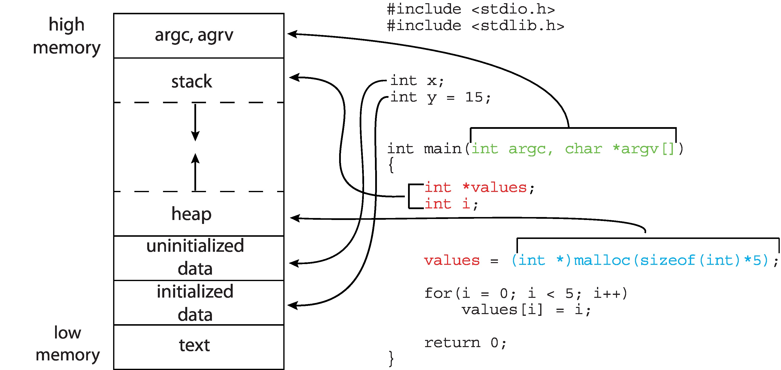
Memory Layout of a C Program

Slide 10
Outline
1. Process Concept
    • Process
    • States
    • PCB
2. Process Scheduling
    • Queues
    • Schedulers
    • Context Switch (F3.4)
3. Operations on Processes
    • Creation
    • Termination

Slide 11
Process State
As a process executes, it changes state
  New: The process is being created
  Running: Instructions are being executed
  Waiting: The process is waiting for some event to occur
  Ready: The process is waiting to be assigned to a processor
  Terminated: The process has finished execution

Slide 12
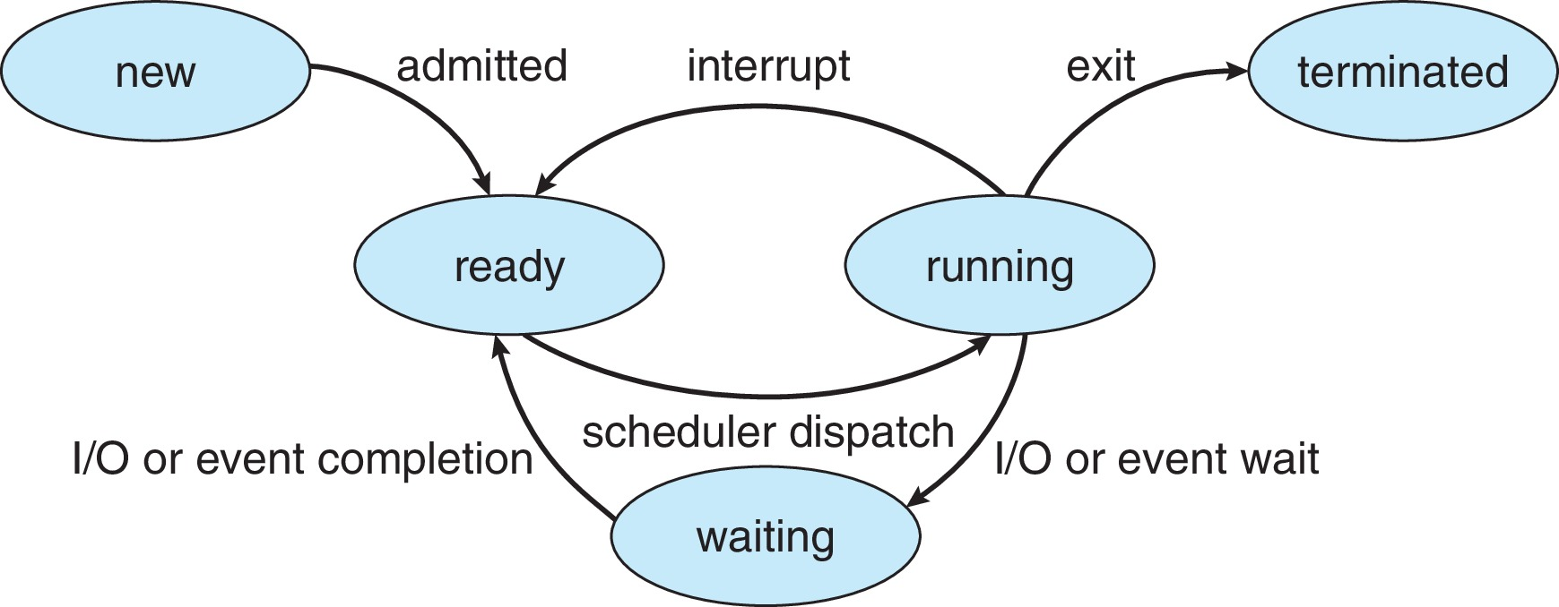
Diagram of Process State

Slide 13
Outline
1. Process Concept
    • Process
    • States
    • PCB
2. Process Scheduling
    • Queues
    • Schedulers
    • Context Switch (F3.4)
3. Operations on Processes
    • Creation
    • Termination

Slide 14
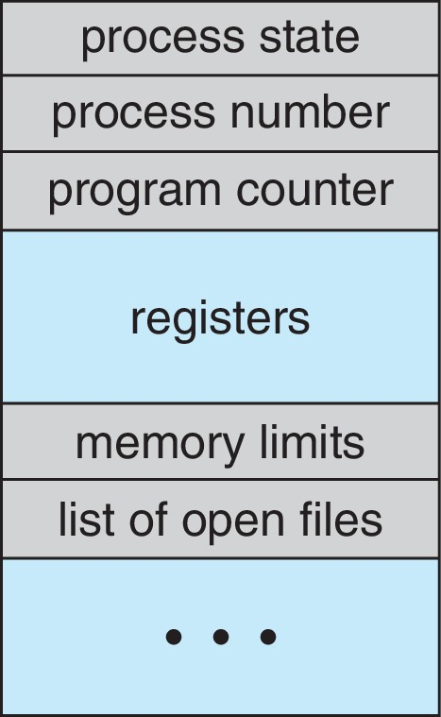
Process Control Block (PCB)
Information associated with each process(also called task control block)
Process state – running, waiting, etc.
Program counter – location of instruction to next execute
CPU registers – contents of all process-centric registers
CPU scheduling information- priorities, scheduling queue pointers
Memory-management information – memory allocated to the process
Accounting information – CPU used, clock time elapsed since start, time limits
I/O status information – I/O devices allocated to process, list of open files

Slide 15
Threads
So far, process has a single thread of execution
Consider having multiple program counters per process
  Multiple locations can execute at once
    Multiple threads of control -> threads
Must then have storage for thread details, multiple program counters in PCB
Explore in detail in Chapter 4

Slide 16
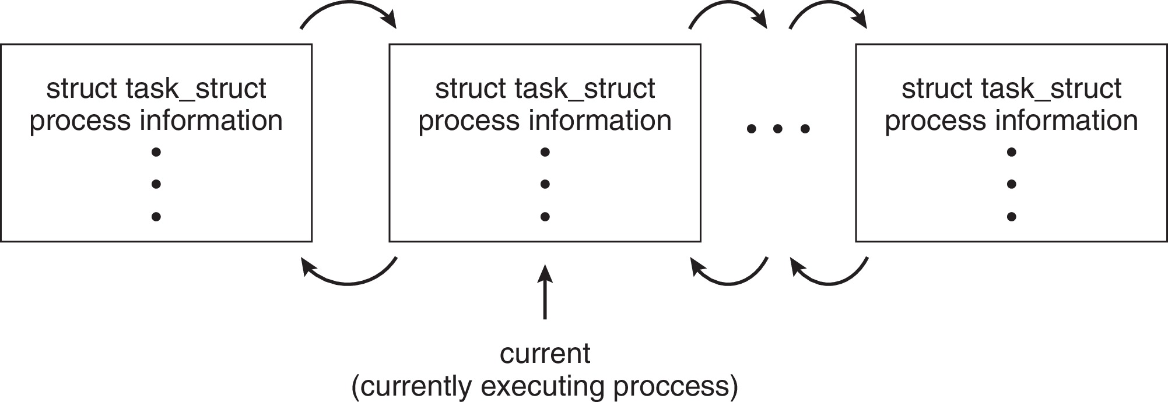
Process Representation in Linux
Represented by the C structure task_struct
pid t_pid; /* process identifier */
long state; /* state of the process */
unsigned int time_slice /* scheduling information */
struct task_struct *parent;/* this process’s parent */
struct list_head children; /* this process’s children */
struct files_struct *files;/* list of open files */
struct mm_struct *mm; /* address space of this process */

Slide 17
Outline
1. Process Concept
    • Process
    • States
    • PCB
2. Process Scheduling
    • Queues
    • Schedulers
    • Context Switch (F3.4)
3. Operations on Processes
    • Creation
    • Termination

Slide 18
Process Scheduling
Process scheduler selects among available processes for next execution on CPU core
Goal -- Maximize CPU use, quickly switch processes onto CPU core
Maintains scheduling queues of processes
  Ready queue – set of all processes residing in main memory, ready and waiting to execute
  Wait queues – set of processes waiting for an event (i.e., I/O)
  Processes migrate among the various queues

Slide 19
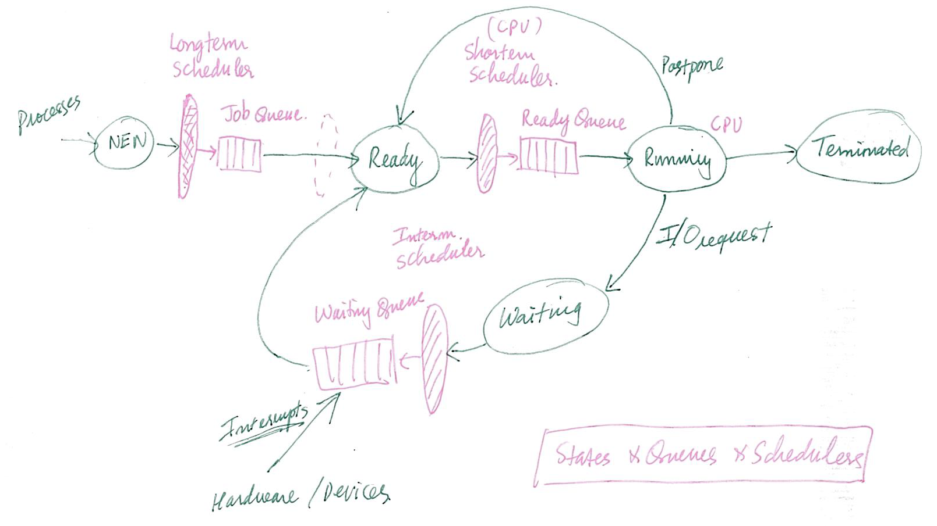
Process Scheduling

Slide 20
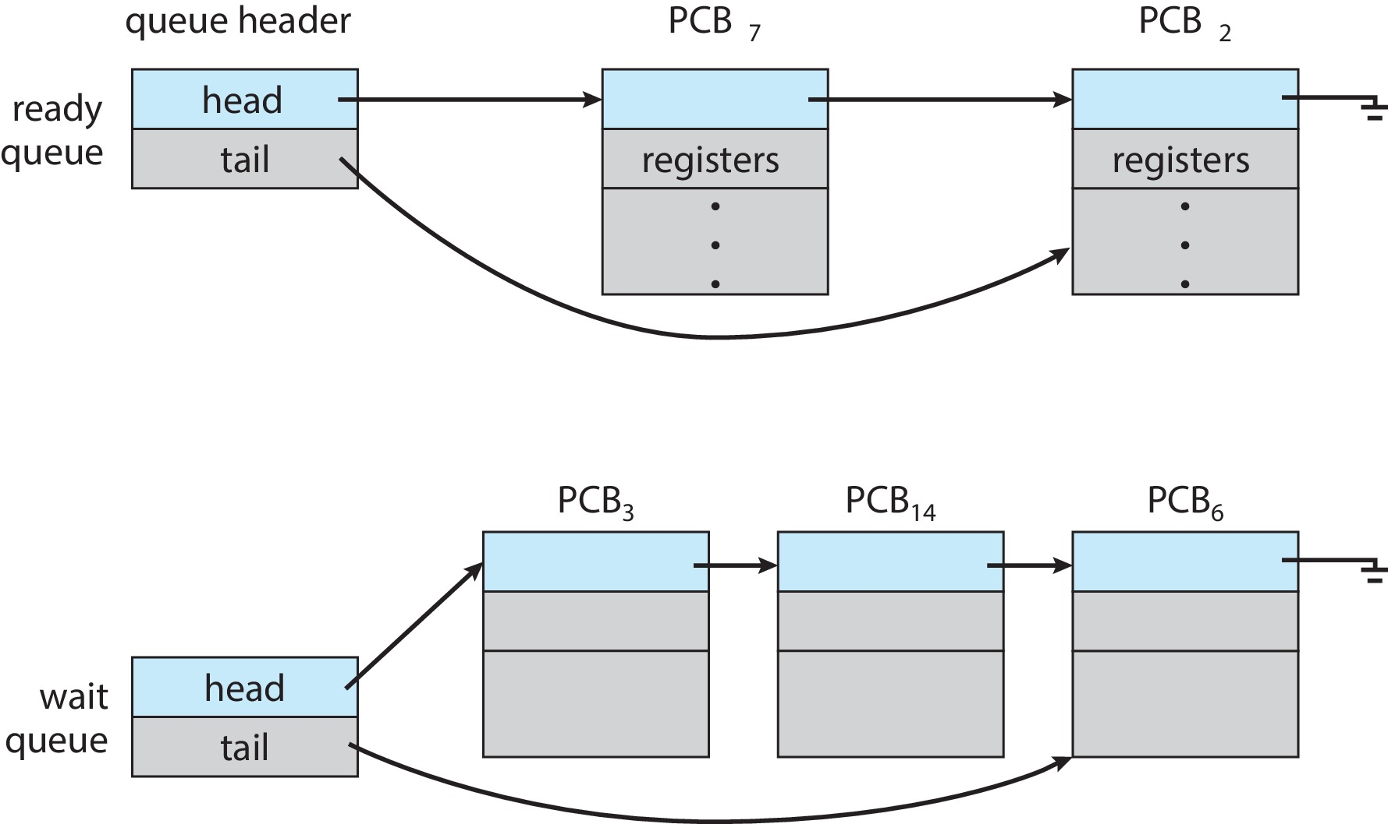
Ready and Wait Queues

Slide 21
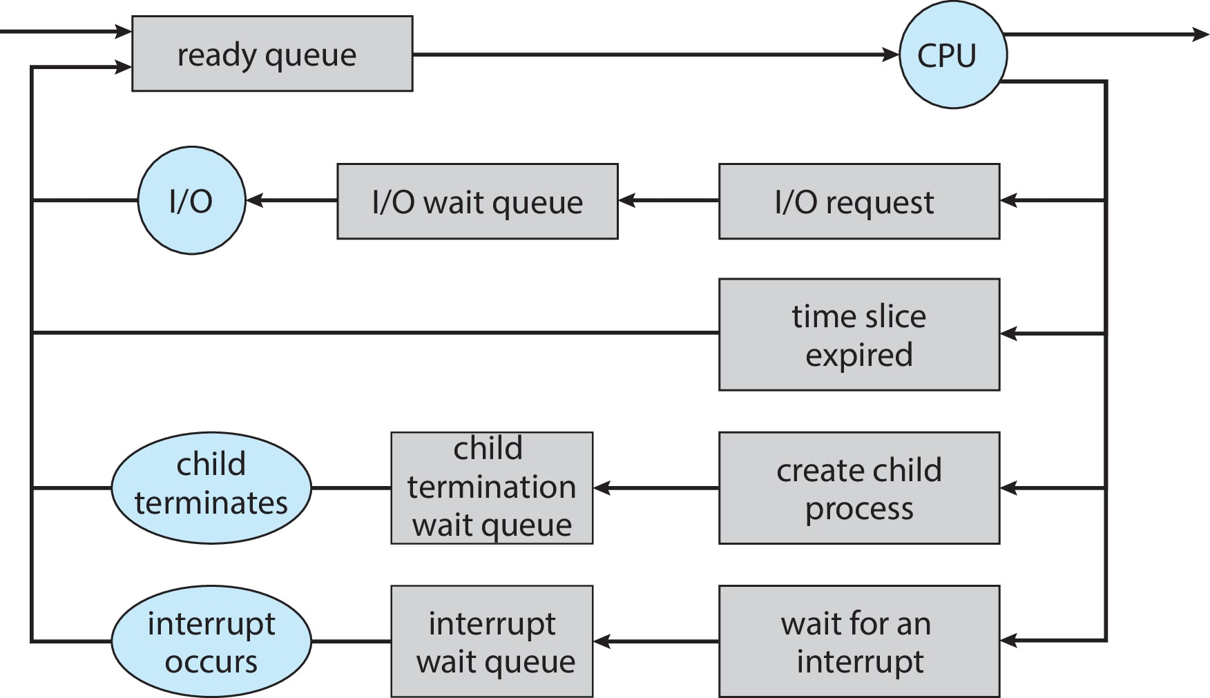
Representation of Process Scheduling

Slide 22
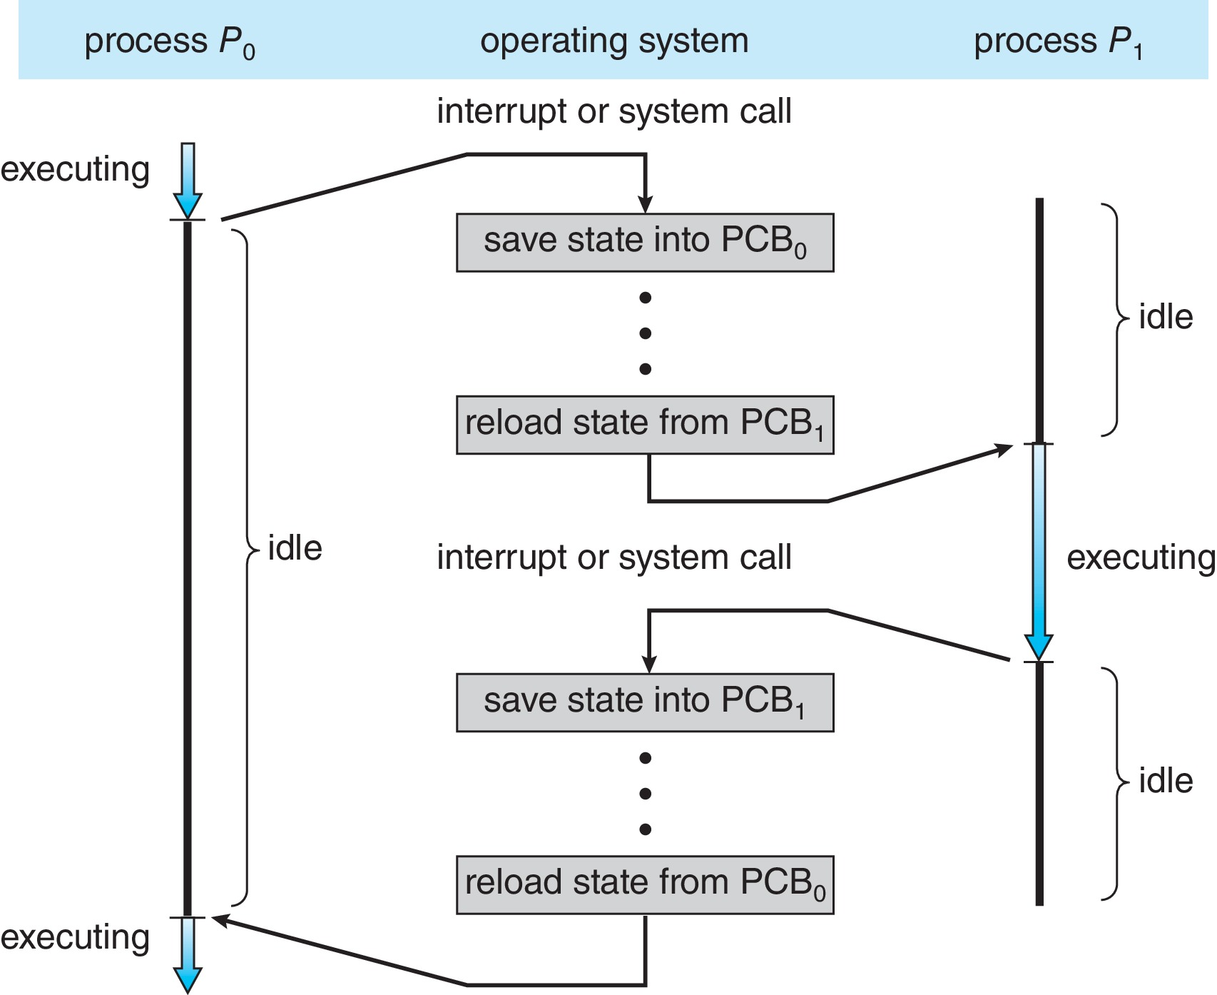
CPU Switch From Process to Process
A context switch occurs when the CPU switches from one process to another.

Slide 23
Context Switch
When CPU switches to another process, the system must save the state of the old process and load the saved state for the new process via a context switch
Context of a process represented in the PCB
Context-switch time is pure overhead; the system does no useful work while switching
  The more complex the OS and the PCB ➔ the longer the context switch
Time dependent on hardware support
  Some hardware provides multiple sets of registers per CPU ➔ multiple contexts loaded at once

Slide 24
Multitasking in Mobile Systems
Some mobile systems (e.g., early version of iOS) allow only one process to run, others suspended
Due to screen real estate, user interface limits iOS provides for a
  Single foreground process- controlled via user interface
  Multiple background processes– in memory, running, but not on the display, and with limits
  Limits include single, short task, receiving notification of events, specific long-running tasks like audio playback
Android runs foreground and background, with fewer limits
  Background process uses a service to perform tasks
  Service can keep running even if background process is suspended
  Service has no user interface, small memory use

Slide 25
Outline
1. Process Concept
    • Process
    • States
    • PCB
2. Process Scheduling
    • Queues
    • Schedulers
    • Context Switch (F3.4)
3. Operations on Processes
    • Creation
    • Termination

Slide 26
Operations on Processes
System must provide mechanisms for:
  Process creation
  Process termination

Slide 27
Process Creation
Parent process create children processes, which, in turn create other processes, forming a tree of processes
Generally, process identified and managed via a process identifier (pid)
Resource sharing options
  Parent and children share all resources
  Children share subset of parent’s resources
  Parent and child share no resources
Execution options
  Parent and children execute concurrently
  Parent waits until children terminate

Slide 28
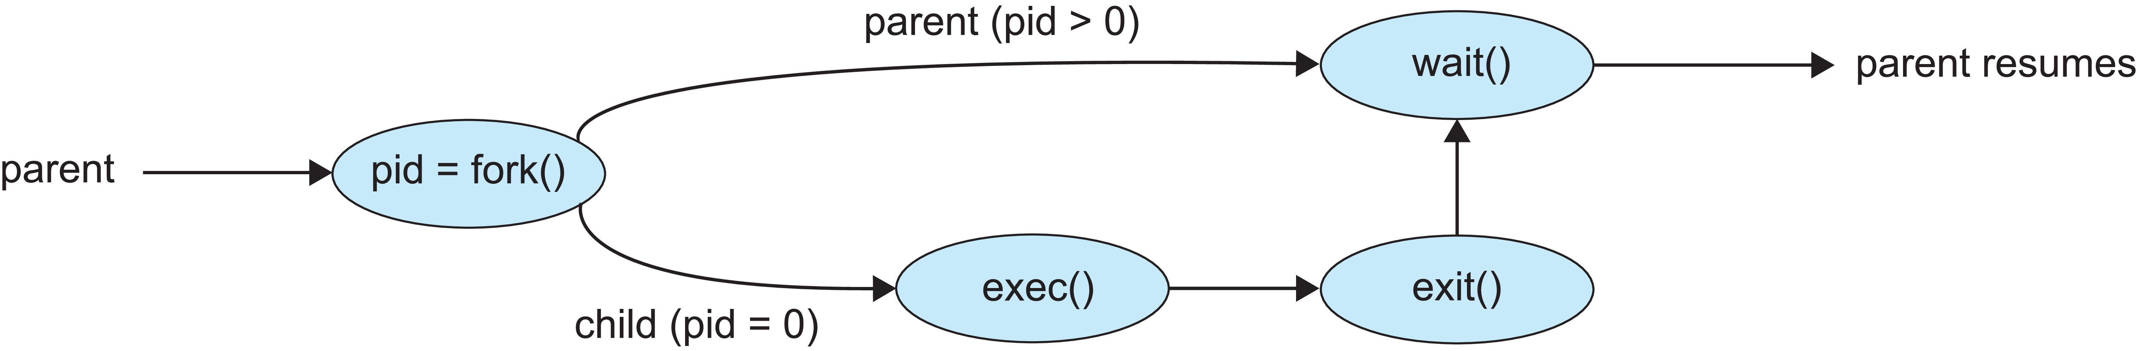
Process Creation (Cont.)
Address space
  Child duplicate of parent
  Child has a program loaded into it
UNIX examples
  fork() system call creates new process
  exec() system call used after a fork() to replace the process’ memory space with a new program
  Parent process calls wait()waiting for the child to terminate

Slide 29
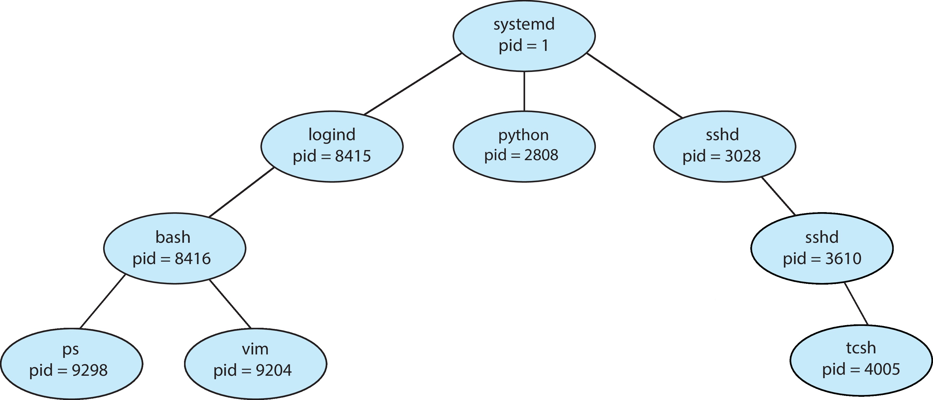
A Tree of Processes in Linux

Slide 30
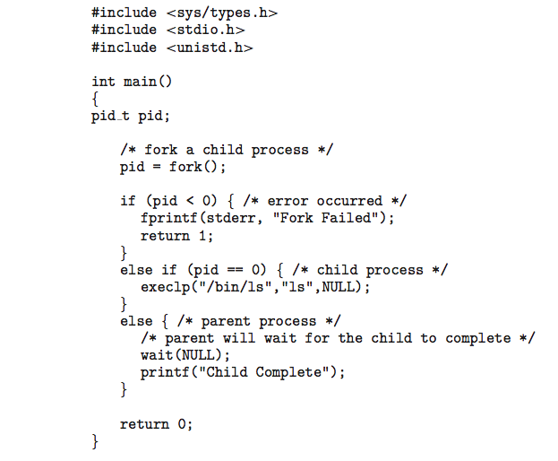
C Program Forking Separate Process

Slide 31
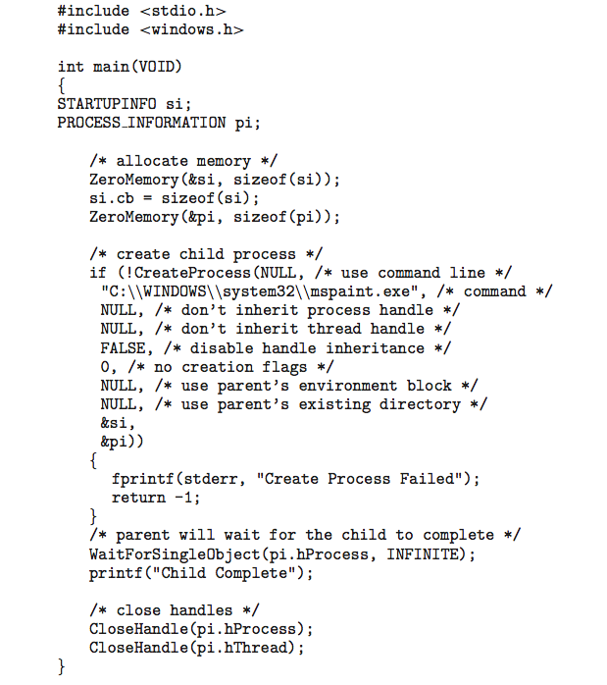
Creating a Separate Process via Windows API

Slide 32
Process Termination
Process executes last statement and then asks the operating system to delete it using the exit() system call.
  Returns status data from child to parent (via wait())
  Process’ resources are deallocated by operating system
Parent may terminate the execution of children processes using the abort() system call. Some reasons for doing so:
  Child has exceeded allocated resources
  Task assigned to child is no longer required
  The parent is exiting, and the operating systems does not allow a child to continue if its parent terminates

Slide 33
Process Termination
Some operating systems do not allow child to exists if its parent has terminated. If a process terminates, then all its children must also be terminated.
  cascading termination. All children, grandchildren, etc., are terminated.
  The termination is initiated by the operating system.
The parent process may wait for termination of a child process by using the wait()system call. The call returns status information and the pid of the terminated process
pid = wait(&status);
If no parent waiting (did not invoke wait()) process is a zombie
If parent terminated without invoking wait(), process is an orphan

Slide 34
Android Process Importance Hierarchy
Mobile operating systems often have to terminate processes to reclaim system resources such as memory. From most to least important:
  Foreground process
  Visible process
  Service process
  Background process
  Empty process
Android will begin terminating processes that are least important.

Slide 35

Multiprocess Architecture – Chrome Browser
Many web browsers ran as single process (some still do)
  If one web site causes trouble, entire browser can hang or crash
Google Chrome Browser is multiprocess with 3 different types of processes:
  Browser process manages user interface, disk and network I/O
  Renderer process renders web pages, deals with HTML, Javascript. A new renderer created for each website opened
    Runs in sandbox restricting disk and network I/O, minimizing effect of security exploits
  Plug-in process for each type of plug-in

Slide 36
Java Process Management
Java utilizes the ProcessBuilder class to create operating system processes. Each ProcessBuilder instance manages a collection of process attributes. The start() method creates a new Process instance with those attributes. The Process class provides methods for input, output, waiting for process completion, checking exit status, and destroying the process.
Example:
import java.io.IOException;
public class ProcessCreation {
public static void main(String[] args) {
try {
ProcessBuilder pb = new ProcessBuilder("ls", "-l"); // Command and arguments
Process process = pb.start(); // Start the process
int exitCode = process.waitFor(); // Wait for the process to complete
System.out.println("Exit Code: " + exitCode);
} catch (IOException | InterruptedException e) {
e.printStackTrace();
}
}
}
In this example, ProcessBuilder is used to create a process that executes the "ls -l" command.
The start() method initiates the process, and waitFor() waits for it to finish, returning the exit code.

