Slide 1
Lecture 07 :
Scheduling Basics & Criteria FIFO Algorithm

Slide 2
Outline
1. Basic Concepts:
    • CPU-I/O burst cycle
    • CPU Scheduler
    • Dispatcher
    • Preemption
2. Scheduling Criteria:
    CPU utilization, Throughput, Waiting time, Turnaround time, Response time
3. Scheduling Algorithms
    • FCFS
    • SJF
    • SRTF

Slide 3
Outline
  KEYWORDS: CPU-I/O burst cycle, CPU Scheduler, Dispatcher, Preemption, CPU utilization, Throughput, Waiting time, Turnaround time, Response time, FIFO/FCFS, Gantt chart, convey effect, starvation, aging.
HOMEWORK:
  1) Reading : Chapter 5, especially the summary.
  2) Make sure to understand and be able to explain every keyword from the list here and the ones which
  are printed bold in the text book.
  3) Important Questions:
  • What is indefinite blocking (starvation) ? How can it occur? How two deal with it ?
  • What is "aging"? its purpose ?
  • An I/O-bound program would typically have what kind of CPU burst?
  • What is a CPU burst? An I/O burst?
  • What is the difference between "preemptive" and “non-preemptive” scheduling ?

Slide 4
Outline
1. Basic Concepts:
    • CPU-I/O burst cycle
    • CPU Scheduler
    • Dispatcher
    • Preemption
2. Scheduling Criteria:
    CPU utilization, Throughput, Waiting time, Turnaround time, Response time
3. Scheduling Algorithms
    • FCFS
    • SJF
    • SRTF

Slide 5
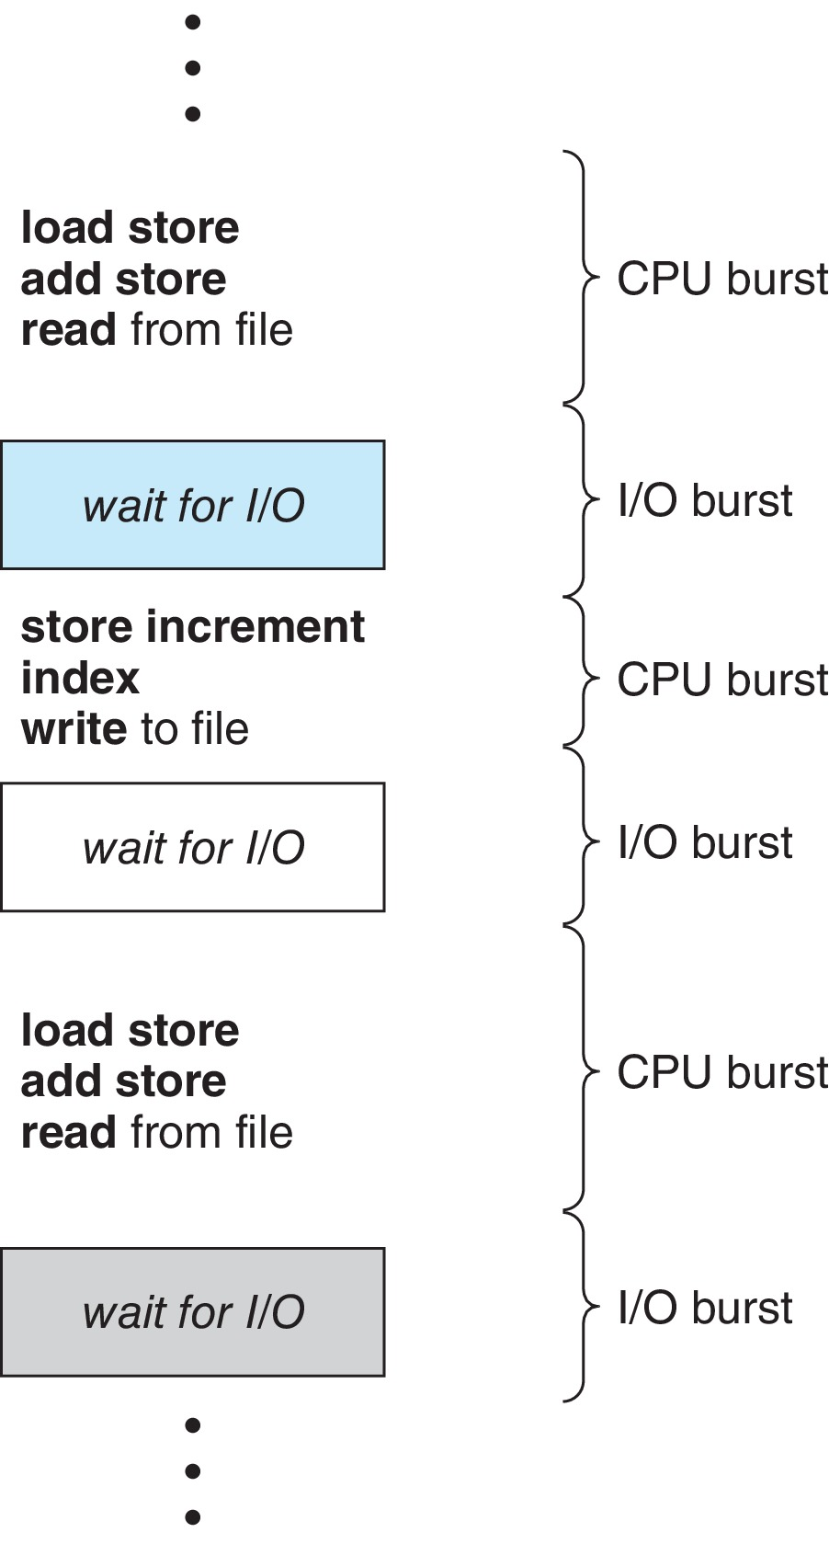
Basic Concepts
Maximum CPU utilization obtained with multiprogramming
CPU–I/O Burst Cycle – Process execution consists of a cycle of CPU execution and I/O wait
CPU burst followed by I/O burst
CPU burst distribution is of main concern

Slide 6
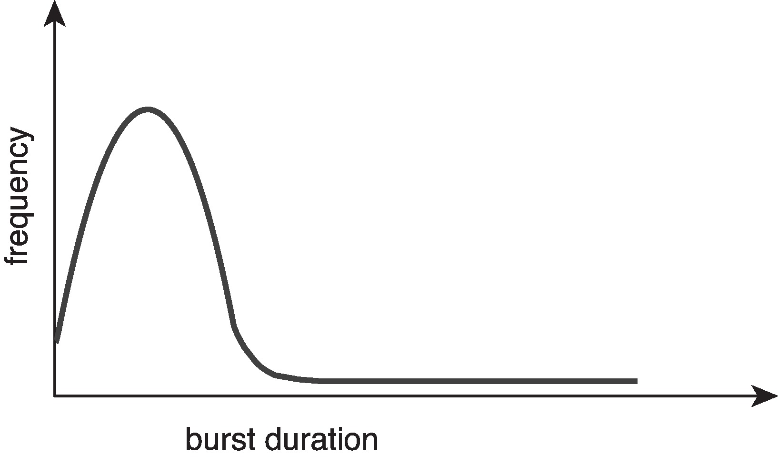
Histogram of CPU-burst Times
Large number of short bursts
Small number of longer bursts

Slide 7
Determining Length of Next CPU Burst
Can only estimate the length – should be similar to the previous one
  Then pick process with shortest predicted next CPU burst
Can be done by using the length of previous CPU bursts, using exponential averaging
Commonly, α set to ½
Preemptive version called shortest-remaining-time-first

Slide 8
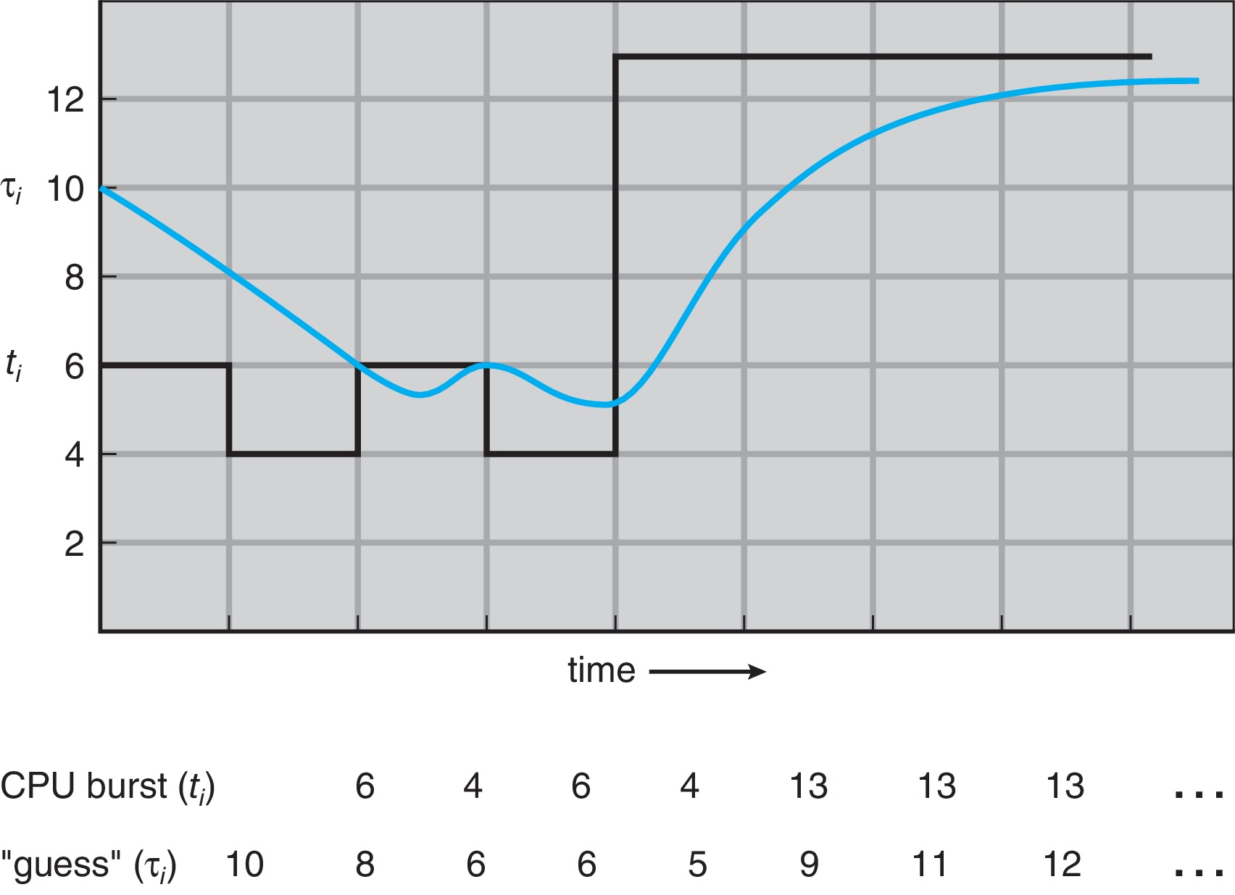
Prediction of the Length of the Next CPU Burst

Slide 9
Examples of Exponential Averaging
α =0
  τ_{n+1} = τ_{n}
  Recent history does not count
α =1
  τ_{n+1} = α t_{n}
  Only the actual last CPU burst counts
If we expand the formula, we get:
    τ_{n+1} = α t_{n}+(1 - α)α t_{n} ₋₁ + …
    +(1 - α )^{j} α t_{n} _{-j} + …
    +(1 - α )^{n +1} τ₀
Since both α and (1 - α) are less than or equal to 1, each successive term has less weight than its predecessor

Slide 10
Outline
1. Basic Concepts:
    • CPU-I/O burst cycle
    • CPU Scheduler
    • Dispatcher
    • Preemption
2. Scheduling Criteria:
    CPU utilization, Throughput, Waiting time, Turnaround time, Response time
3. Scheduling Algorithms
    • FCFS
    • SJF
    • SRTF

Slide 11
CPU Scheduler
The CPU scheduler selects from among the processes in ready queue, and allocates a CPU core to one of them
  Queue may be ordered in various ways
CPU scheduling decisions may take place when a process:
  1. Switches from running to waiting state
  2. Switches from running to ready state
  3. Switches from waiting to ready
  Terminates
For situations 1 and 4, there is no choice in terms of scheduling. A new process (if one exists in the ready queue) must be selected for execution.
For situations 2 and 3, however, there is a choice.

Slide 12
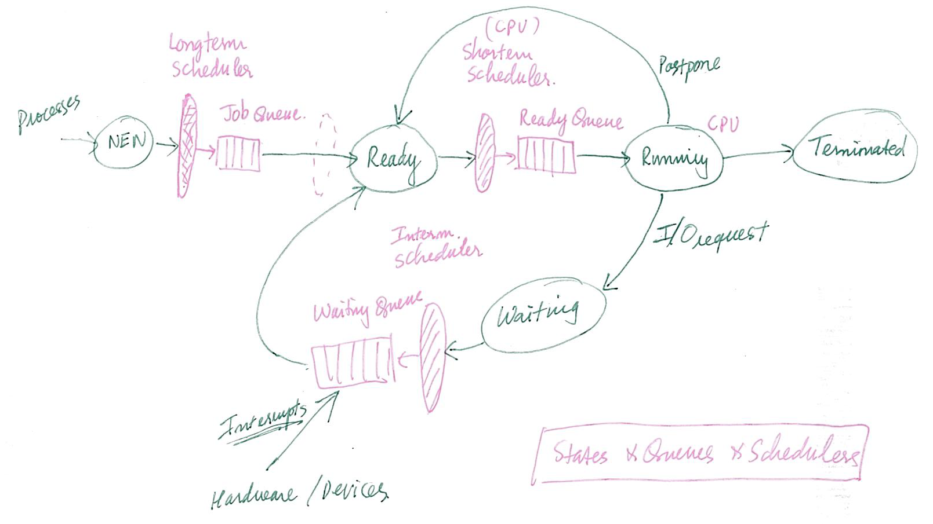
Process Scheduling

Slide 13
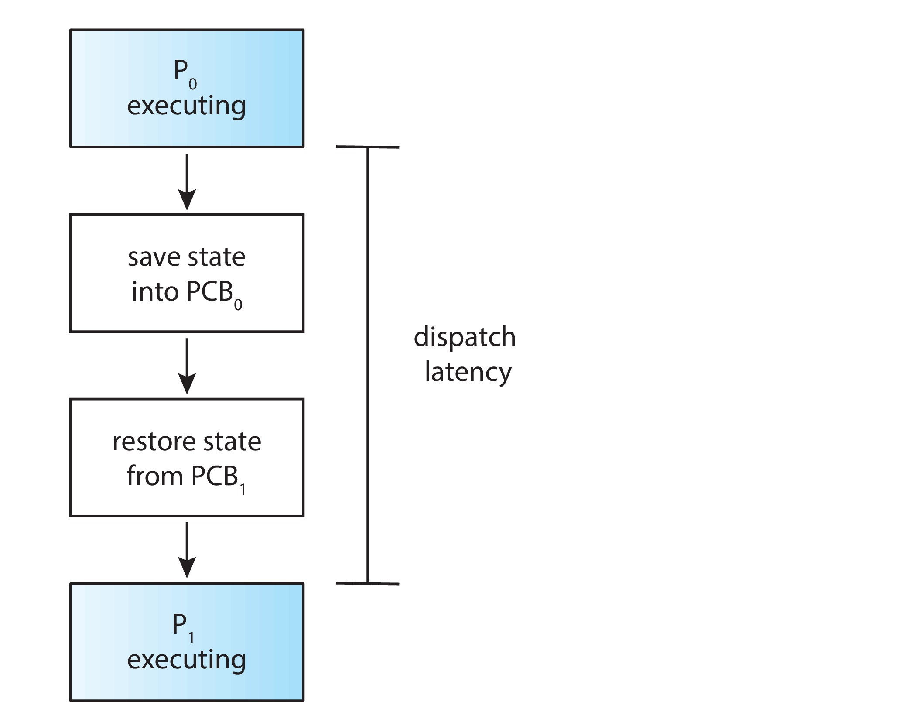
Dispatcher
Dispatcher module gives control of the CPU to the process selected by the CPU scheduler; this involves:
  Switching context
  Switching to user mode
  Jumping to the proper location in the user program to restart that program
Dispatch latency – time it takes for the dispatcher to stop one process and start another running

Slide 14
Preemptive and Nonpreemptive Scheduling
When scheduling takes place only under circumstances 1 and 4, the scheduling scheme is nonpreemptive.
Otherwise, it is preemptive.
Under Nonpreemptive scheduling, once the CPU has been allocated to a process, the process keeps the CPU until it releases it either by terminating or by switching to the waiting state.
Virtually all modern operating systems including Windows, MacOS, Linux, and UNIX use preemptive scheduling algorithms.

Slide 15
Preemptive Scheduling and Race Conditions
Preemptive scheduling can result in race conditions when data are shared among several processes.
Consider the case of two processes that share data. While one process is updating the data, it is preempted so that the second process can run. The second process then tries to read the data, which are in an inconsistent state.
This issue will be explored in detail in Chapter 6.

Slide 16
Outline
1. Basic Concepts:
    • CPU-I/O burst cycle
    • CPU Scheduler
    • Dispatcher
    • Preemption
2. Scheduling Criteria:
    CPU utilization, Throughput, Waiting time, Turnaround time, Response time
3. Scheduling Algorithms
    • FCFS
    • SJF
    • SRTF

Slide 17
Scheduling Criteria
CPU utilization – keep the CPU as busy as possible
Throughput – # of processes that complete their execution per time unit
Turnaround time – amount of time to execute a particular process
Waiting time – amount of time a process has been waiting in the ready queue
Response time – amount of time it takes from when a request was submitted until the first response is produced.

Slide 18
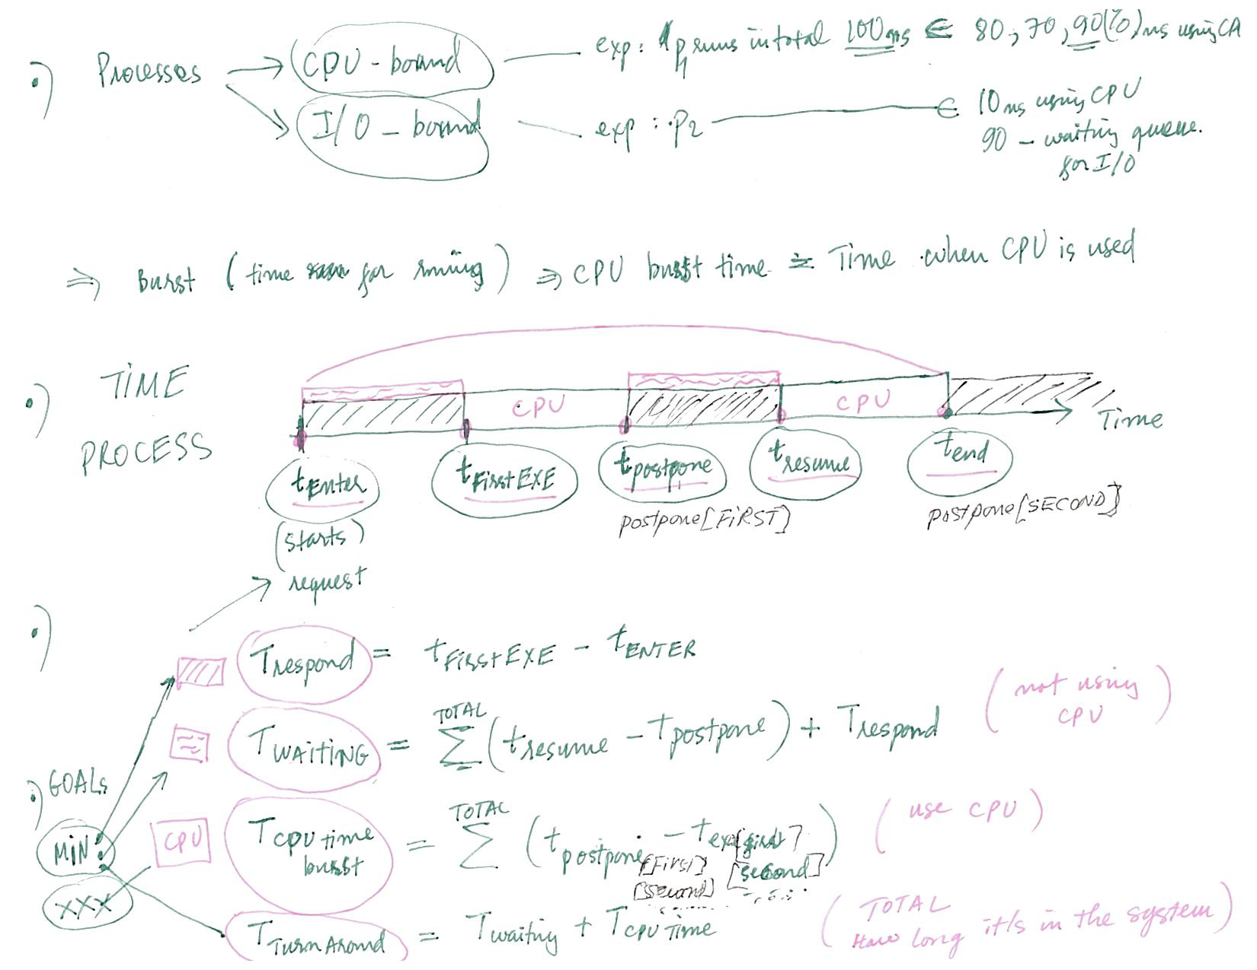
Scheduling Criteria

Slide 19
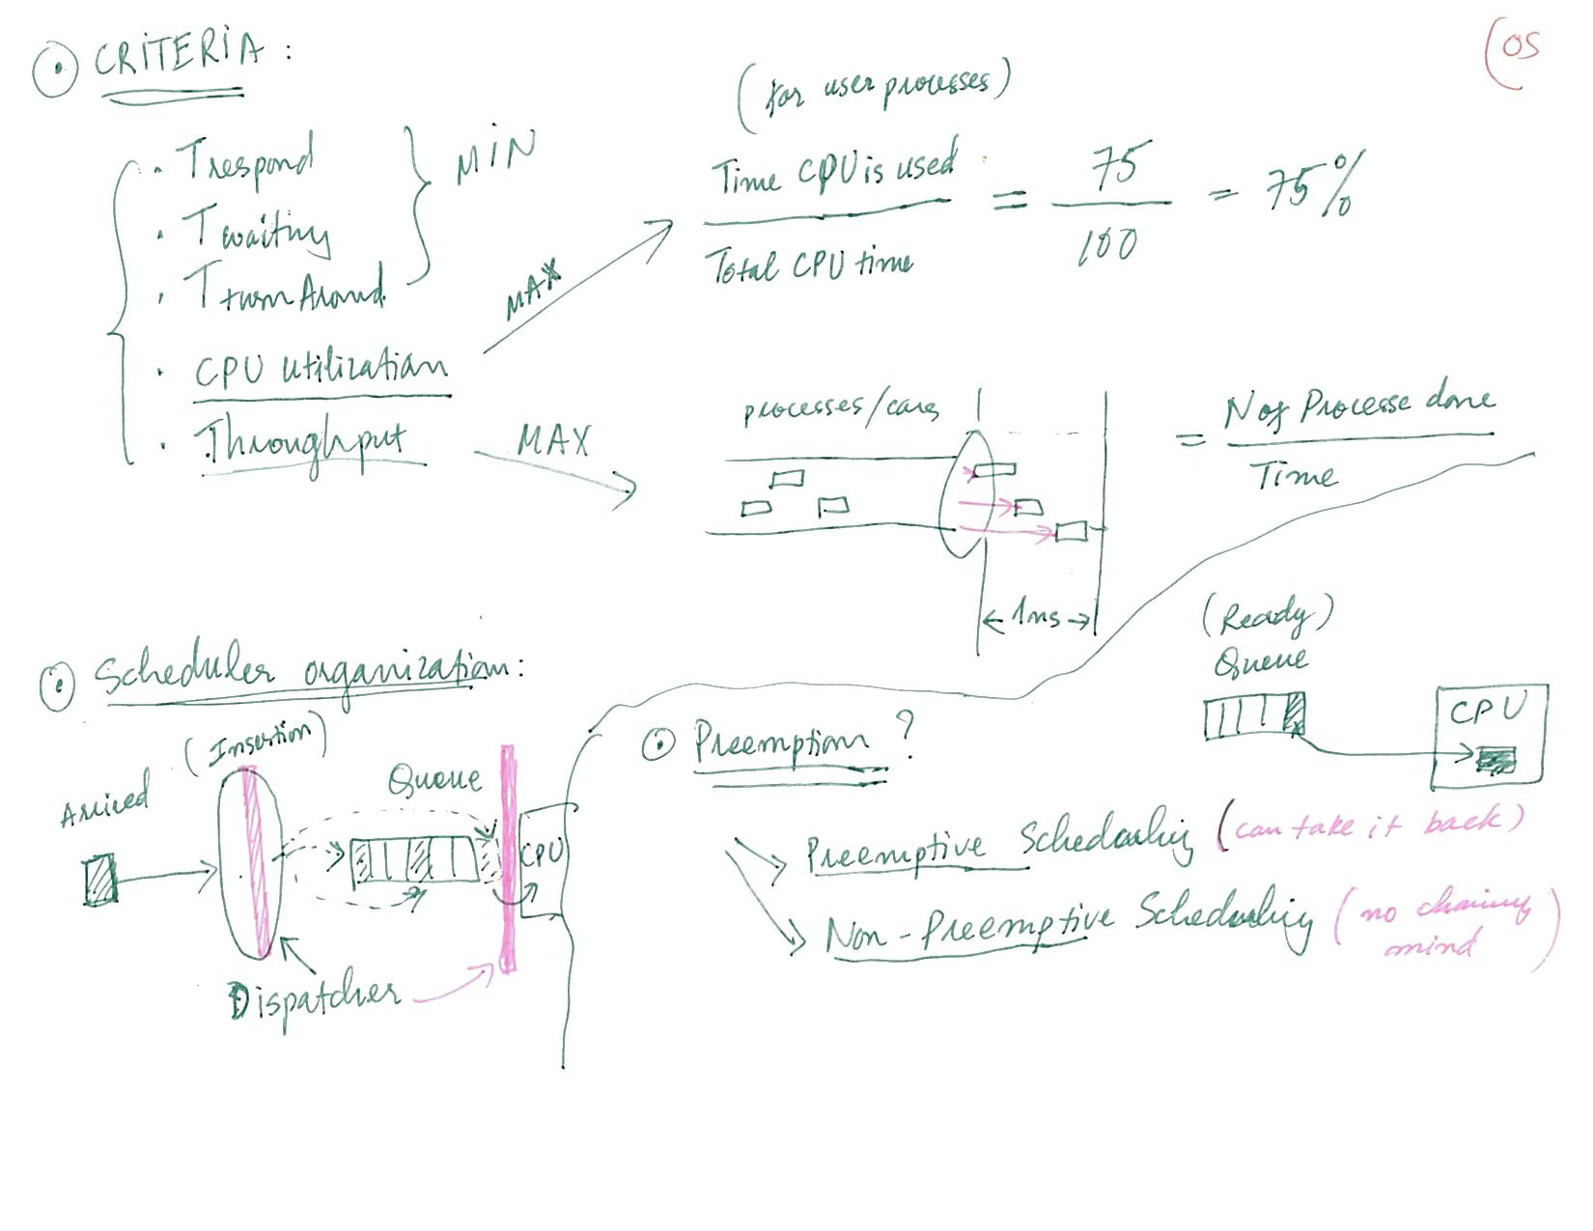
Scheduling Criteria

Slide 20
Scheduling Algorithm Optimization Criteria
Max CPU utilization
Max throughput
Min turnaround time
Min waiting time
Min response time

Slide 21
Outline
1. Basic Concepts:
    • CPU-I/O burst cycle
    • CPU Scheduler
    • Dispatcher
    • Preemption
2. Scheduling Criteria:
    CPU utilization, Throughput, Waiting time, Turnaround time, Response time
3. Scheduling Algorithms
    • FCFS
    • SJF
    • SRTF

Slide 22
First- Come, First-Served (FCFS) Scheduling
Process Burst Time
P₁ 24
P₂ 3
P₃ 3
Suppose that the processes arrive in the order: P₁ , P₂ , P₃
The Gantt Chart for the schedule is:
Waiting time for P₁ = 0; P₂ = 24; P₃ = 27
Average waiting time: (0 + 24 + 27)/3 = 17

Slide 23
FCFS Scheduling (Cont.)
Suppose that the processes arrive in the order:
P₂ , P₃ , P₁
The Gantt chart for the schedule is:
Waiting time for P₁ = 6; P₂ = 0; P₃ = 3
Average waiting time: (6 + 0 + 3)/3 = 3
Much better than previous case
Convoy effect - short process behind long process
  Consider one CPU-bound and many I/O-bound processes

Slide 24
Outline
1. Basic Concepts:
    • CPU-I/O burst cycle
    • CPU Scheduler
    • Dispatcher
    • Preemption
2. Scheduling Criteria:
    CPU utilization, Throughput, Waiting time, Turnaround time, Response time
3. Scheduling Algorithms
    • FCFS
    • SJF
    • SRTF

Slide 25
Shortest-Job-First (SJF) Scheduling
Associate with each process the length of its next CPU burst
  Use these lengths to schedule the process with the shortest time
SJF is optimal – gives minimum average waiting time for a given set of processes
  The difficulty is knowing the length of the next CPU request
  Could ask the user

Slide 26
Example of SJF
ProcessArriva l Time Burst Time
P₁ 0.0 6
P₂ 2.0 8
P₃ 4.0 7
P₄ 5.0 3
SJF scheduling chart
Average waiting time = (3 + 16 + 9 + 0) / 4 = 7

Slide 27
Example of Shortest-Job-first
Now we add the concepts of varying arrival times and preemption to the analysis
ProcessA arri Arrival TimeT Burst Time
P₁ 0 8
P₂ 1 4
P₃ 2 9
P₄ 3 5
Non-Preemptive SJF Gantt Chart
Waiting Time: TWT= P1(0-0)+P2(8-1)+P3(17-2)+P4(12-3)=31
P1 | P2 | P4 | P3
0 | 8 | 12 | 17 | 26

Slide 28
Outline
1. Basic Concepts:
    • CPU-I/O burst cycle
    • CPU Scheduler
    • Dispatcher
    • Preemption
2. Scheduling Criteria:
    CPU utilization, Throughput, Waiting time, Turnaround time, Response time
3. Scheduling Algorithms
    • FCFS
    • SJF
    • SRTF

Slide 29
Shortest-Remaining-Time-First (SRTF)
In SJF: take the process with shortest CPU burst time (needed CPU time for the whole process)
However, if we allow preemption to make it more dynamic, then new coming processes may always have shorter CPU burst time and therefore will always get executed BEFORE the long ones. The long ones can get stuck! That’s starvation! to deal with it we can use a technique called Aging, where we keep track of how long (age) each process has been in the system. Then, if a process is in the system for too long (aged enough) will get executed even when it has longer CPU burst time than the others do.
Shortest-Remaining-Time-First (SRTF) = Preemptive SJF
  take the process with shortest remaining (still needed) CPU burst time (to finish the process)

Slide 30
Example of SRTF (Preemptive SJF)
Now we add the concepts of varying arrival times and preemption to the analysis
ProcessA arri Arrival TimeT Burst Time
P₁ 0 8
P₂ 1 4
P₃ 2 9
P₄ 3 5
t | 0 | 1 | 2 | 3 | 4 | 5 | 6 | 7 | 8
p1 | 8 | 7 | 7 | 7 | 7 | 7 | 7 | 7
p2 | 4 | 4 | 3 | 2 | 1 | 0
p3 | 9 | - | 9 | 9 | 9 | 9 | 9 | 9
p4 | 5 | - | - | 5 | 5 | 5 | 4 | 3 | …

Slide 31
Example of SRTF (cont.)
ProcessA arri Arrival TimeT Burst Time
P₁ 0 8
P₂ 1 4
P₃ 2 9
P₄ 3 5
Preemptive SJF Gantt Chart
TOTAL wait =p1[(0-0)+(10-1)] +p2[1-1] +p3[17-2]+p4[5-3] = 26
Average waiting time = [(10-1)+(10-1)+(1-1)+(17-2)+5-3)]/4 = 26/4 = 6.5

