Slide 1
Lecture 08 :
Scheduling Algorithms: Priority, Round-Robin & Multiple Queues

Slide 2
Outline
  KEYWORDS: Priority Scheduling, Round Robin, Time Quantum, Multilevel Queue, Thread Scheduling, Multiple-Processor Scheduling.
HOMEWORK:
  1) Reading : Chapter 5, especially the summary.
  2) Make sure to understand and be able to explain every keyword from the list here and the ones which are printed bold in the text book.
  3) Important Questions:
    • What are the advantages of SJF? Disadvantages?
    • How are priority and SJF related ?
    • Which algorithms (FIFO,SJF,Priority,RR) to choose if the goal is to minimize CPU utilization ? Throughput ? Waiting time ? Turnaround time ? Response time ?

Slide 3
Outline
1. CPU Scheduling Algorithms
    • Priority Scheduling
    • Round Robin
    • Combined Priority with Round Robin Scheduling
2. Advanced Topics
    • MultiLevel Queues
    • Thread Scheduling
    • Multiple-Processor Scheduling
    • Realtime Scheduling
3. Examples of Scheduling in OS
    • Linux
    • Windows
    • Solaris
4. Evaluation of Scheduling Algorithms

Slide 4
Outline
1. CPU Scheduling Algorithms
    • Priority Scheduling
    • Round Robin
    • Combined Priority with Round Robin Scheduling
2. Advanced Topics
    • MultiLevel Queues
    • Thread Scheduling
    • Multiple-Processor Scheduling
    • Realtime Scheduling
3. Examples of Scheduling in OS
    • Linux
    • Windows
    • Solaris
4. Evaluation of Scheduling Algorithms

Slide 5
Priority Scheduling
A priority number (integer) is associated with each process
The CPU is allocated to the process with the highest priority (smallest integer ≡ highest priority)
  Preemptive
  Nonpreemptive
SJF is priority scheduling where priority is the inverse of predicted next CPU burst time
Problem ≡ Starvation – low priority processes may never execute
Solution ≡ Aging – as time progresses increase the priority of the process

Slide 6
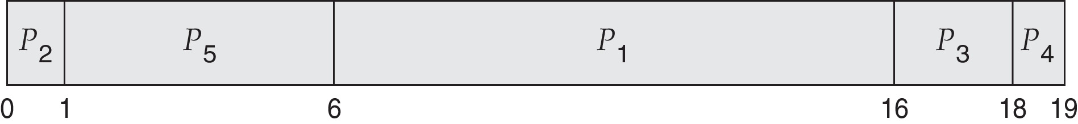
Example of Priority Scheduling
ProcessA arri Burst TimeT Priority
P₁ 10 3
P₂ 1 1
P₃ 2 4
P₄ 1 5
P₅ 5 2
Priority scheduling Gantt Chart
Average waiting time = 8.2

Slide 7
Example of Preemptive Priority Scheduling
ProcessA arri Burst TimeT Priority Arrival
P₁ 10 3 0
P₂ 1 1 2
P₃ 2 4 4
P₄ 1 5 3
P₅ 2 2 5
Priority scheduling Gantt Chart
Average waiting time =
t | 0 | 2 | 3 | 4 | 5 | 6 | 7
p1 | 10 | 8 | 8 | 7 | 6 | 6
p2 |  | 1 | - | - | - | - | - | - | - | - | -
P3 |  |  |  | 2 | 2 | 2
P4 |  |  | 1 | 1 | 1 | 1
p5 |  |  |  |  | 2 | 1 | - | - | - | - | -
CPU | p1 | p2 | p1 | p1 | p5 | p5 | p1

Slide 8
Outline
1. CPU Scheduling Algorithms
    • Priority Scheduling
    • Round Robin
    • Combined Priority with Round Robin Scheduling
2. Advanced Topics
    • MultiLevel Queues
    • Thread Scheduling
    • Multiple-Processor Scheduling
    • Realtime Scheduling
3. Examples of Scheduling in OS
    • Linux
    • Windows
    • Solaris
4. Evaluation of Scheduling Algorithms

Slide 9
Round Robin (RR)
Each process gets a small unit of CPU time (time quantum q), usually 10-100 milliseconds. After this time has elapsed, the process is preempted and added to the end of the ready queue.
If there are n processes in the ready queue and the time quantum is q, then each process gets 1/n of the CPU time in chunks of at most q time units at once. No process waits more than (n-1)q time units.
Timer interrupts every quantum to schedule next process
Performance
  q large ⇒ FIFO
  q small ⇒ q must be large with respect to context switch, otherwise overhead is too high

Slide 10
Example of RR with Time Quantum = 4
Process Burst Time
P₁ 24
P₂ 3
P₃ 3
The Gantt chart is:
Typically, higher average turnaround than SJF, but better response
q should be large compared to context switch time
  q usually 10 milliseconds to 100 milliseconds,
  Context switch < 10 microseconds

Slide 11
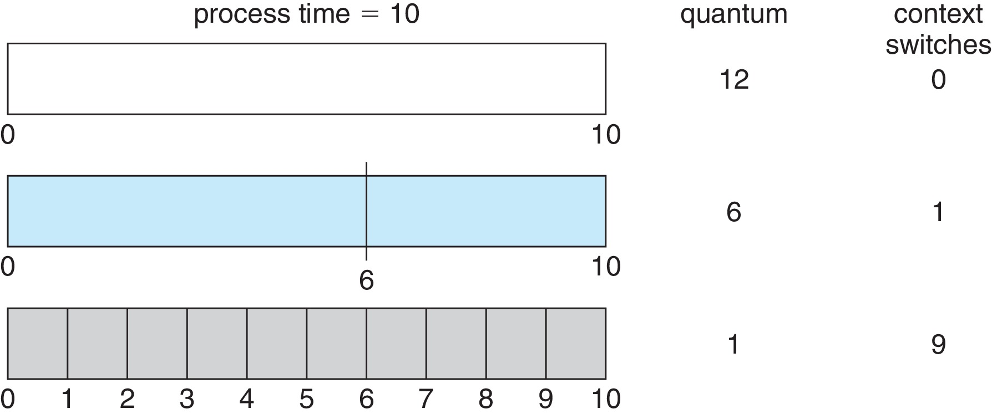
Time Quantum and Context Switch Time

Slide 12
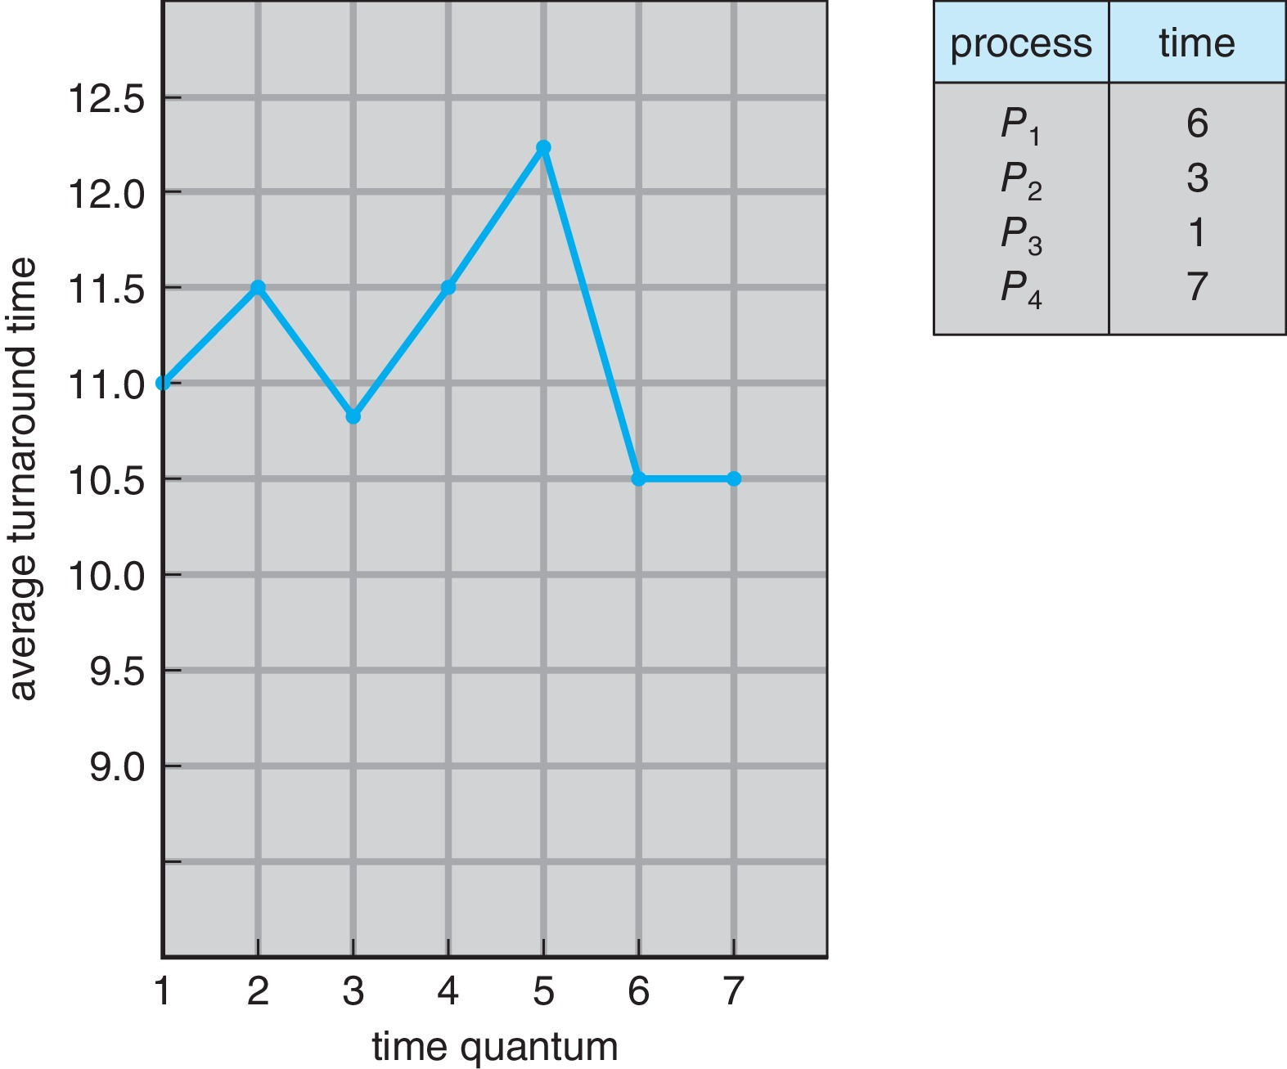
Turnaround Time Varies With The Time Quantum
80% of CPU bursts should be shorter than q

Slide 13
Outline
1. CPU Scheduling Algorithms
    • Priority Scheduling
    • Round Robin
    • Combined Priority with Round Robin Scheduling
2. Advanced Topics
    • MultiLevel Queues
    • Thread Scheduling
    • Multiple-Processor Scheduling
    • Realtime Scheduling
3. Examples of Scheduling in OS
    • Linux
    • Windows
    • Solaris
4. Evaluation of Scheduling Algorithms

Slide 14
Priority Scheduling w/ Round-Robin
ProcessA arri Burst TimeT Priority
P₁ 4 3
P₂ 5 2
P₃ 8 2
P₄ 7 1
P₅ 3 3
Run the process with the highest priority. Processes with the same priority run round-robin
Gantt Chart with time quantum = 2
p4 | p2 | p3 | p1 | p5
0 | 2 | 4 | 6 | 8

Slide 15
Outline
1. CPU Scheduling Algorithms
    • Priority Scheduling
    • Round Robin
    • Combined Priority with Round Robin Scheduling
2. Advanced Topics
    • MultiLevel Queues
    • Thread Scheduling
    • Multiple-Processor Scheduling
    • Realtime Scheduling
3. Examples of Scheduling in OS
    • Linux
    • Windows
    • Solaris
4. Evaluation of Scheduling Algorithms

Slide 16
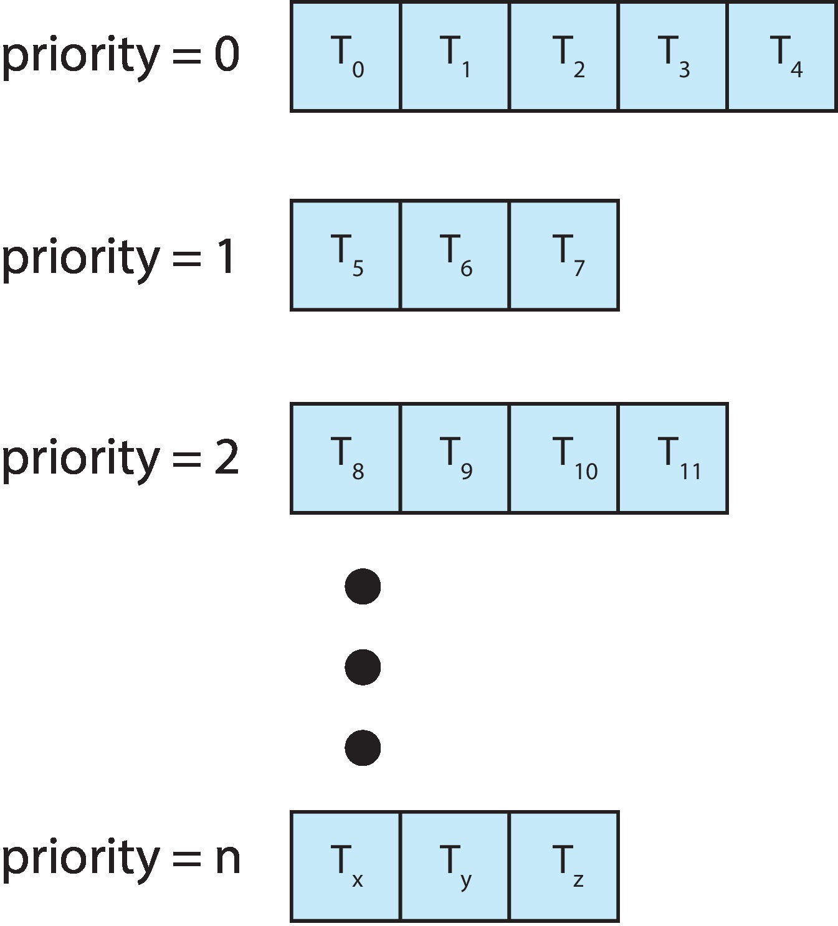
Multilevel Queue
With priority scheduling, have separate queues for each priority.
Schedule the process in the highest-priority queue!

Slide 17
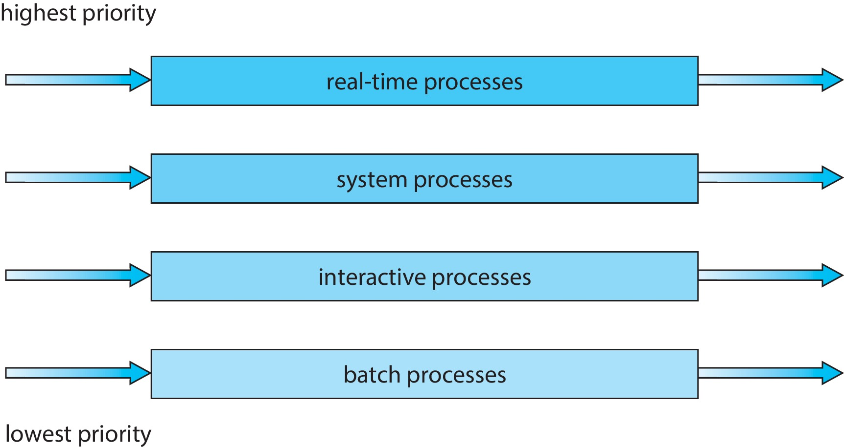
Multilevel Queue
Prioritization based upon process type

Slide 18
Multilevel Feedback Queue
A process can move between the various queues.
Multilevel-feedback-queue scheduler defined by the following parameters:
  Number of queues
  Scheduling algorithms for each queue
  Method used to determine when to upgrade a process
  Method used to determine when to demote a process
  Method used to determine which queue a process will enter when that process needs service
Aging can be implemented using multilevel feedback queue

Slide 19
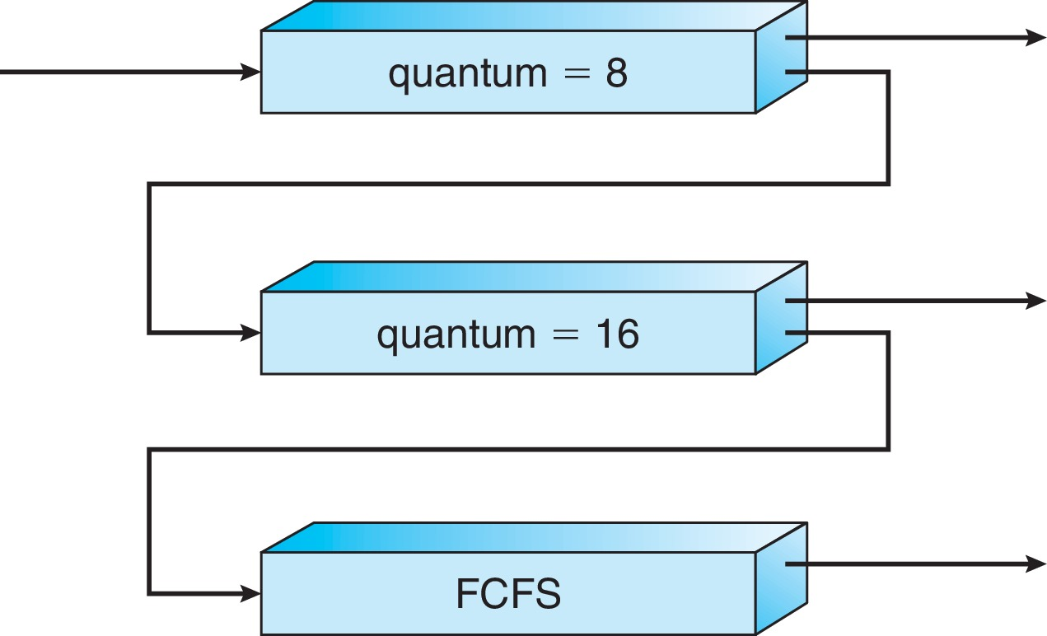
Example of Multilevel Feedback Queue
Three queues:
  Q₀ – RR with time quantum 8 milliseconds
  Q₁ – RR time quantum 16 milliseconds
  Q₂ – FCFS
Scheduling
  A new process enters queue Q₀ which is served in RR
    When it gains CPU, the process receives 8 milliseconds
    If it does not finish in 8 milliseconds, the process is moved to queue Q₁
  At Q₁ job is again served in RR and receives 16 additional milliseconds
    If it still does not complete, it is preempted and moved to queue Q₂

Slide 20
Outline
1. CPU Scheduling Algorithms
    • Priority Scheduling
    • Round Robin
    • Combined Priority with Round Robin Scheduling
2. Advanced Topics
    • MultiLevel Queues
    • Thread Scheduling
    • Multiple-Processor Scheduling
    • Realtime Scheduling
3. Examples of Scheduling in OS
    • Linux
    • Windows
    • Solaris
4. Evaluation of Scheduling Algorithms

Slide 21
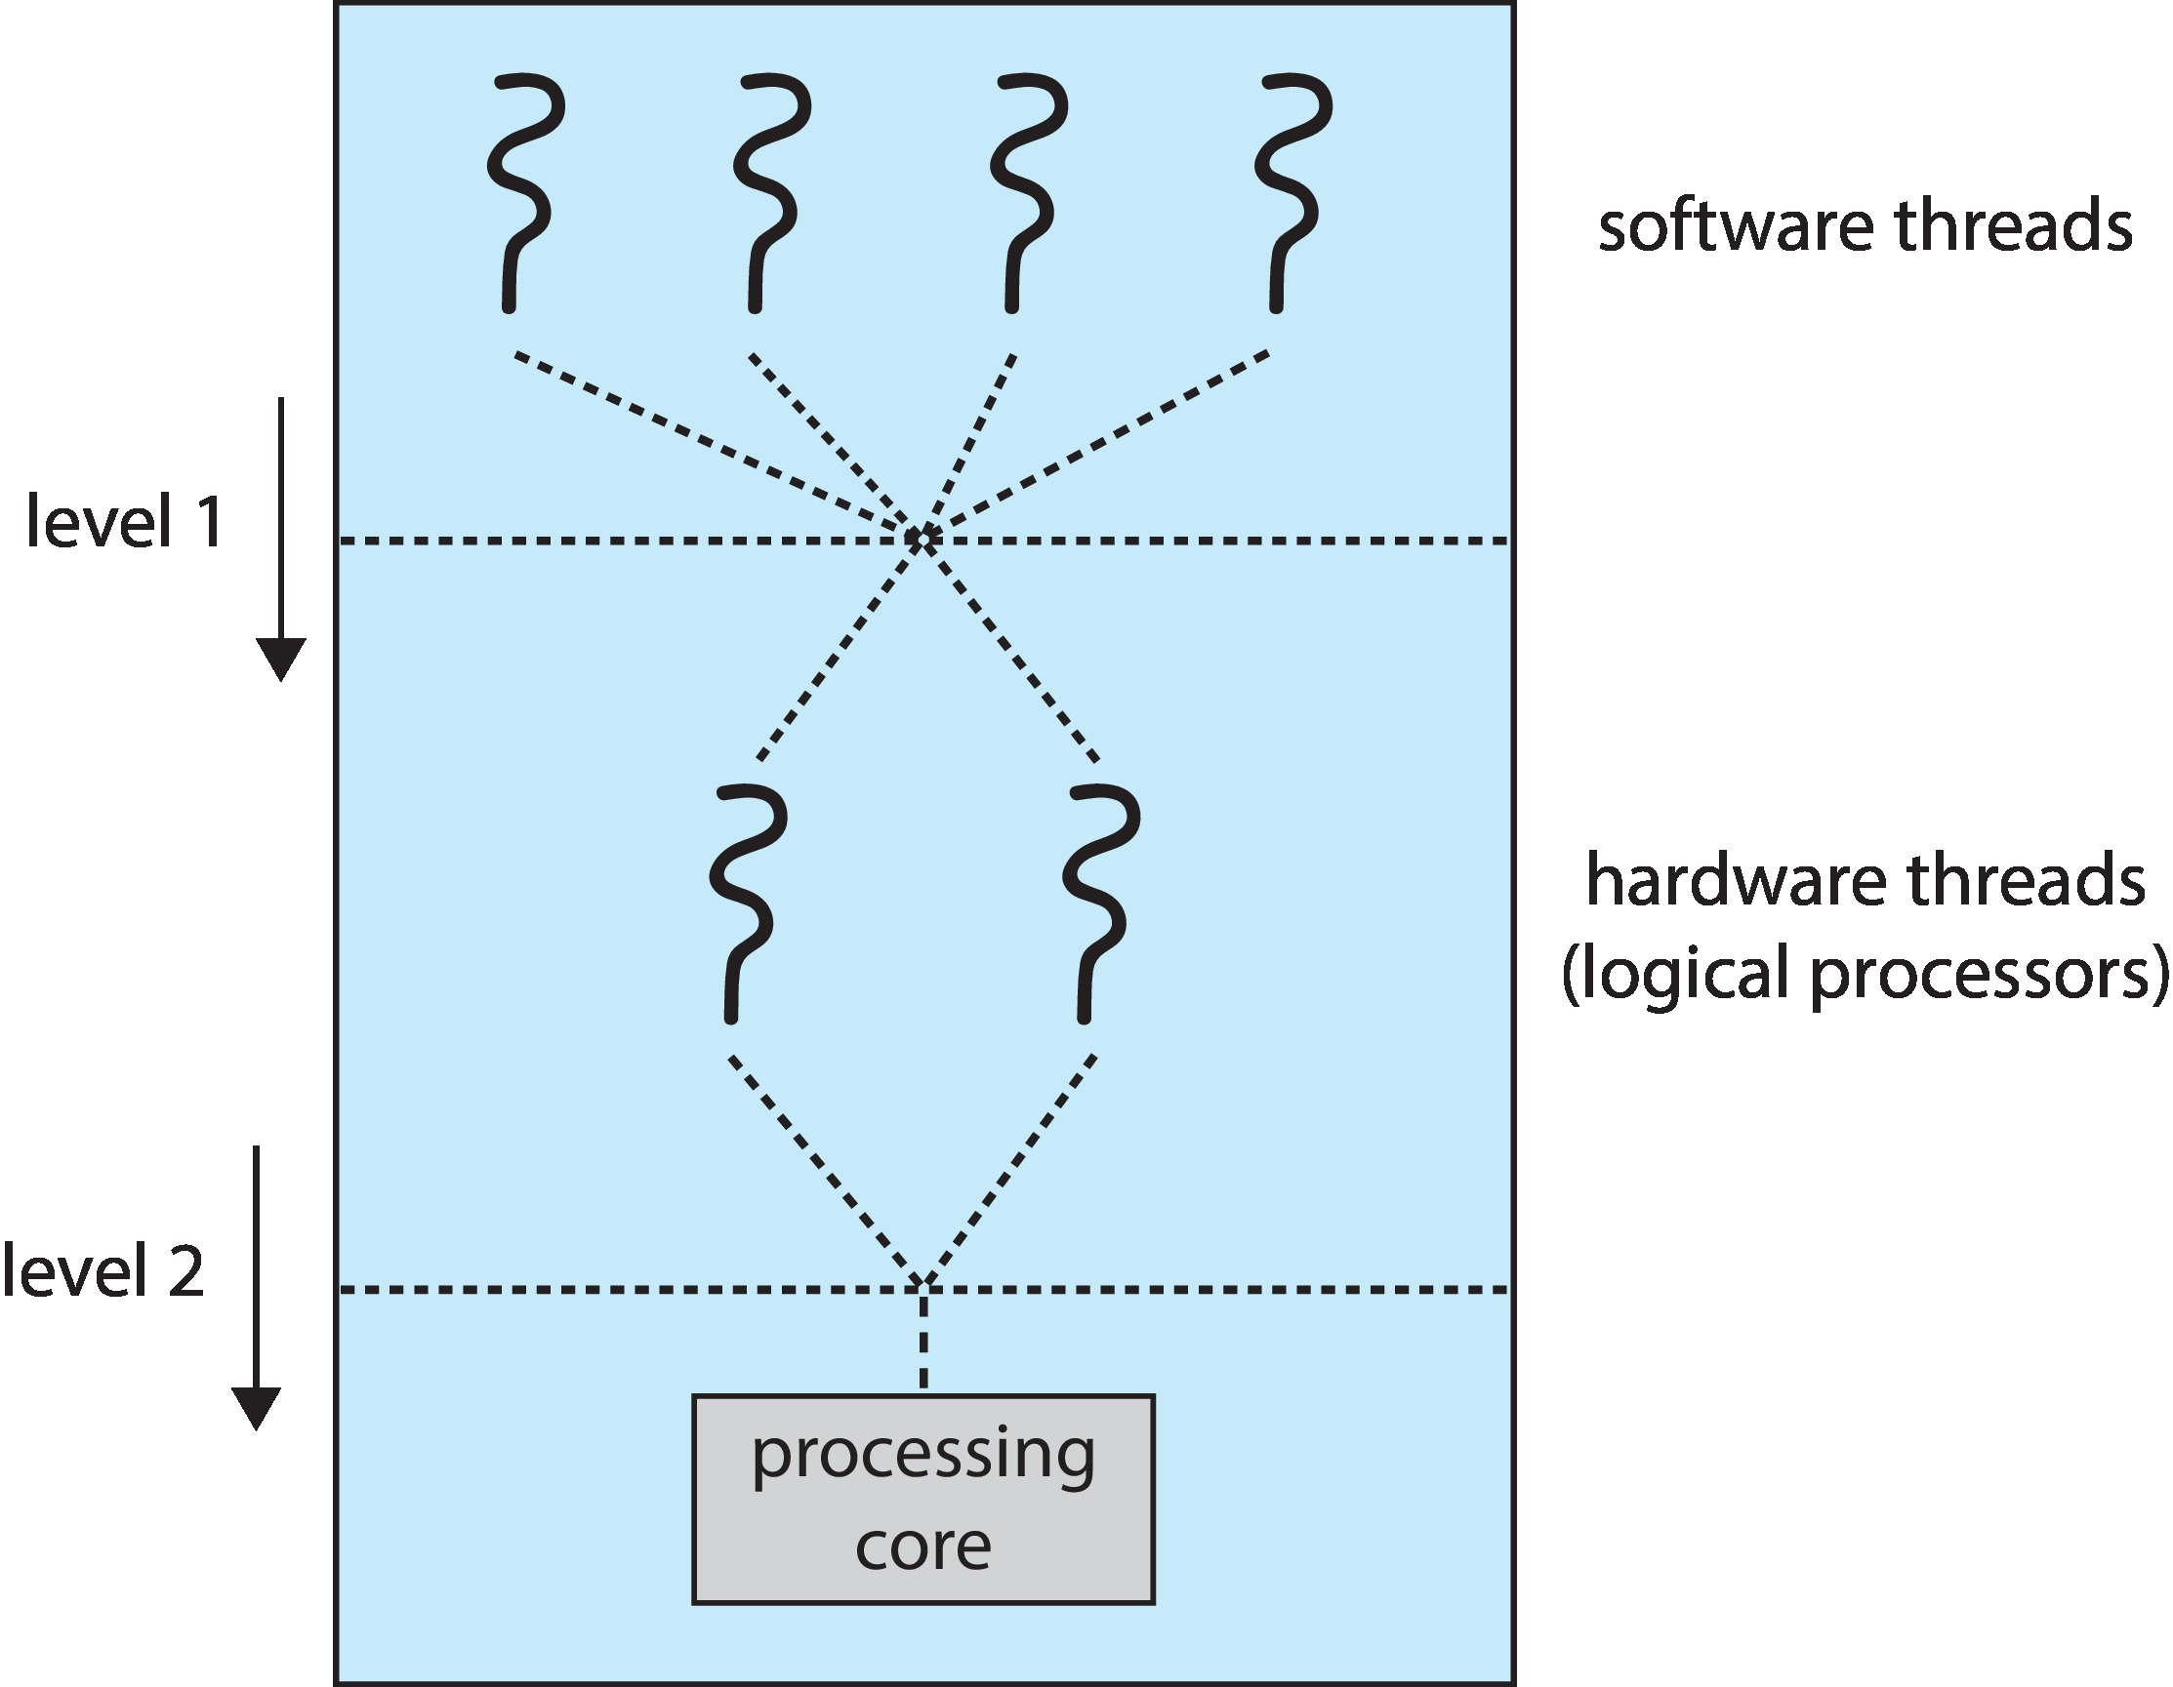
Multithreaded Multicore System
Two levels of scheduling:
  The operating system deciding which software thread to run on a logical CPU
  How each core decides which hardware thread to run on the physical core.

Slide 22
Thread Scheduling
Distinction between user-level and kernel-level threads
When threads supported, threads scheduled, not processes
Many-to-one and many-to-many models, thread library schedules user-level threads to run on LWP
  Known as process-contention scope (PCS) since scheduling competition is within the process
  Typically done via priority set by programmer
Kernel thread scheduled onto available CPU is system-contention scope (SCS) – competition among all threads in system

Slide 23
Outline
1. CPU Scheduling Algorithms
    • Priority Scheduling
    • Round Robin
    • Combined Priority with Round Robin Scheduling
2. Advanced Topics
    • MultiLevel Queues
    • Thread Scheduling
    • Multiple-Processor Scheduling
    • Realtime Scheduling
3. Examples of Scheduling in OS
    • Linux
    • Windows
    • Solaris
4. Evaluation of Scheduling Algorithms

Slide 24
Multiple-Processor Scheduling
CPU scheduling more complex when multiple CPUs are available
Multiprocess may be any one of the following architectures:
  Multicore CPUs
  Multithreaded cores
  NUMA systems
  Heterogeneous multiprocessing

Slide 25
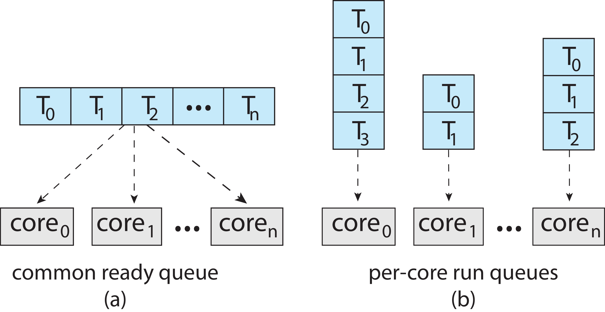
Multiple-Processor Scheduling
Symmetric multiprocessing (SMP) is where each processor is self scheduling.
All threads may be in a common ready queue (a)
Each processor may have its own private queue of threads (b)

Slide 26
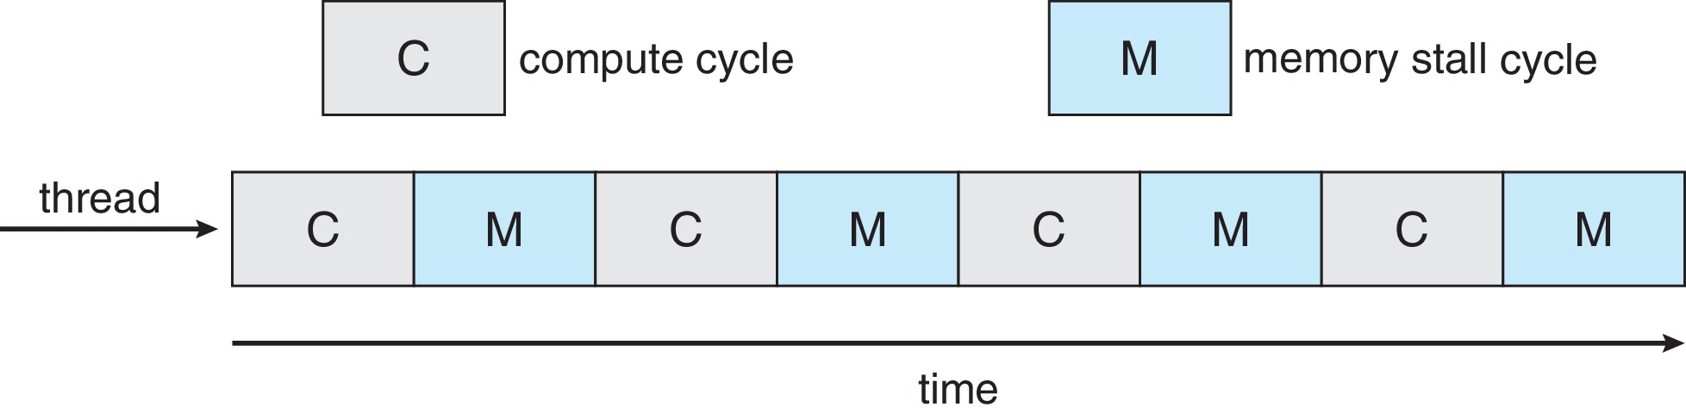
Multicore Processors
Recent trend to place multiple processor cores on same physical chip
Faster and consumes less power
Multiple threads per core also growing
  Takes advantage of memory stall to make progress on another thread while memory retrieve happens
Figure

Slide 27
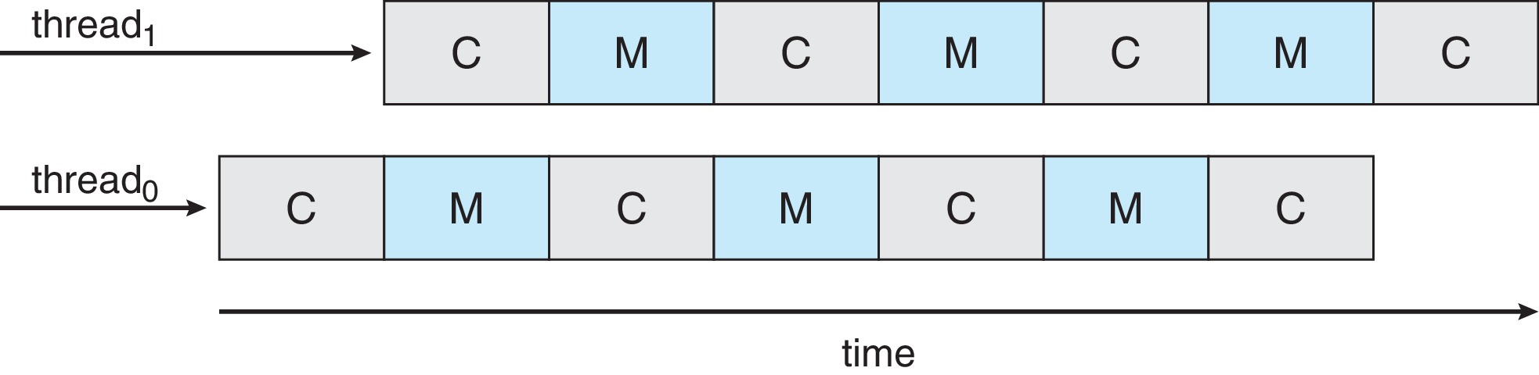
Multithreaded Multicore System
Each core has > 1 hardware threads.
If one thread has a memory stall, switch to another thread!
Figure

Slide 28
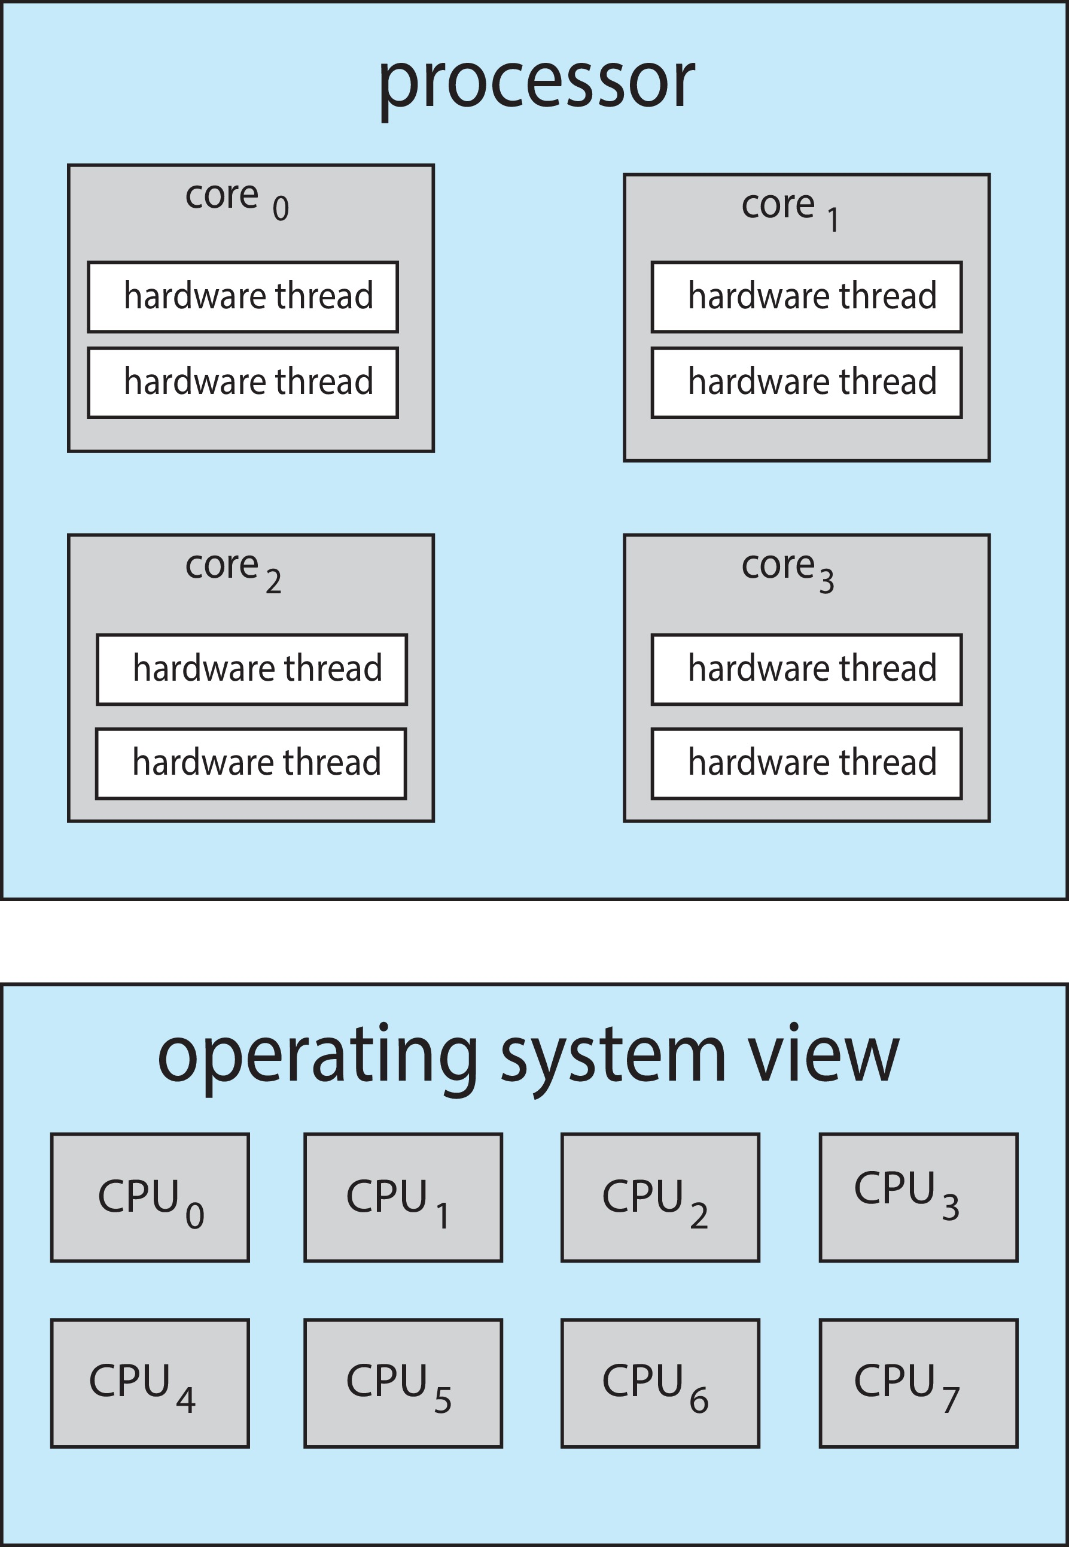
Multithreaded Multicore System
Chip-multithreading (CMT) assigns each core multiple hardware threads. (Intel refers to this as hyperthreading.)
On a quad-core system with 2 hardware threads per core, the operating system sees 8 logical processors.

Slide 29
Multithreaded Multicore System
Two levels of scheduling:
  The operating system deciding which software thread to run on a logical CPU
  How each core decides which hardware thread to run on the physical core.

Slide 30
Multiple-Processor Scheduling – Load Balancing
If SMP, need to keep all CPUs loaded for efficiency
Load balancing attempts to keep workload evenly distributed
Push migration – periodic task checks load on each processor, and if found pushes task from overloaded CPU to other CPUs
Pull migration – idle processors pulls waiting task from busy processor

Slide 31
Multiple-Processor Scheduling – Processor Affinity
When a thread has been running on one processor, the cache contents of that processor stores the memory accesses by that thread.
We refer to this as a thread having affinity for a processor (i.e., “processor affinity”)
Load balancing may affect processor affinity as a thread may be moved from one processor to another to balance loads, yet that thread loses the contents of what it had in the cache of the processor it was moved off of.
Soft affinity – the operating system attempts to keep a thread running on the same processor, but no guarantees.
Hard affinity – allows a process to specify a set of processors it may run on.

Slide 32
NUMA and CPU Scheduling
If the operating system is NUMA-aware, it will assign memory closes to the CPU the thread is running on.

Slide 33
Outline
1. CPU Scheduling Algorithms
    • Priority Scheduling
    • Round Robin
    • Combined Priority with Round Robin Scheduling
2. Advanced Topics
    • MultiLevel Queues
    • Thread Scheduling
    • Multiple-Processor Scheduling
    • Realtime Scheduling
3. Examples of Scheduling in OS
    • Linux
    • Windows
    • Solaris
4. Evaluation of Scheduling Algorithms

Slide 34
Real-Time CPU Scheduling
Can present obvious challenges
Soft real-time systems – Critical real-time tasks have the highest priority, but no guarantee as to when tasks will be scheduled
Hard real-time systems – task must be serviced by its deadline

Slide 35
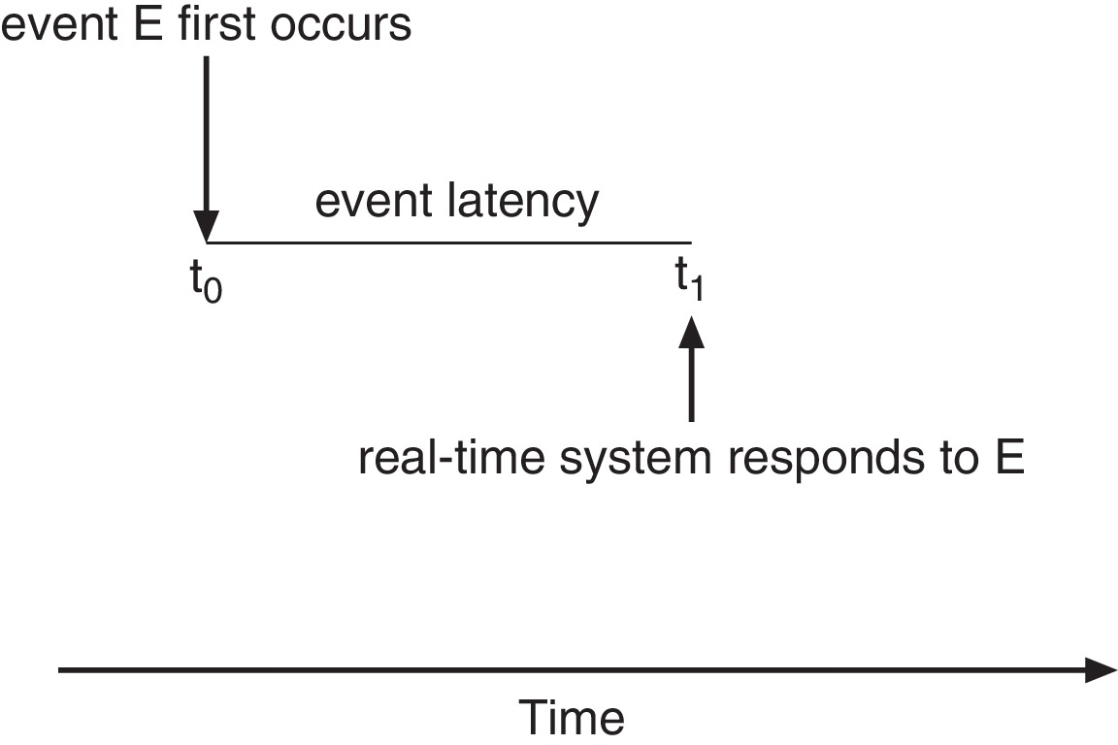
Real-Time CPU Scheduling
Event latency – the amount of time that elapses from when an event occurs to when it is serviced.
Two types of latencies affect performance
  Interrupt latency – time from arrival of interrupt to start of routine that services interrupt
  Dispatch latency – time for schedule to take current process off CPU and switch to another

Slide 36
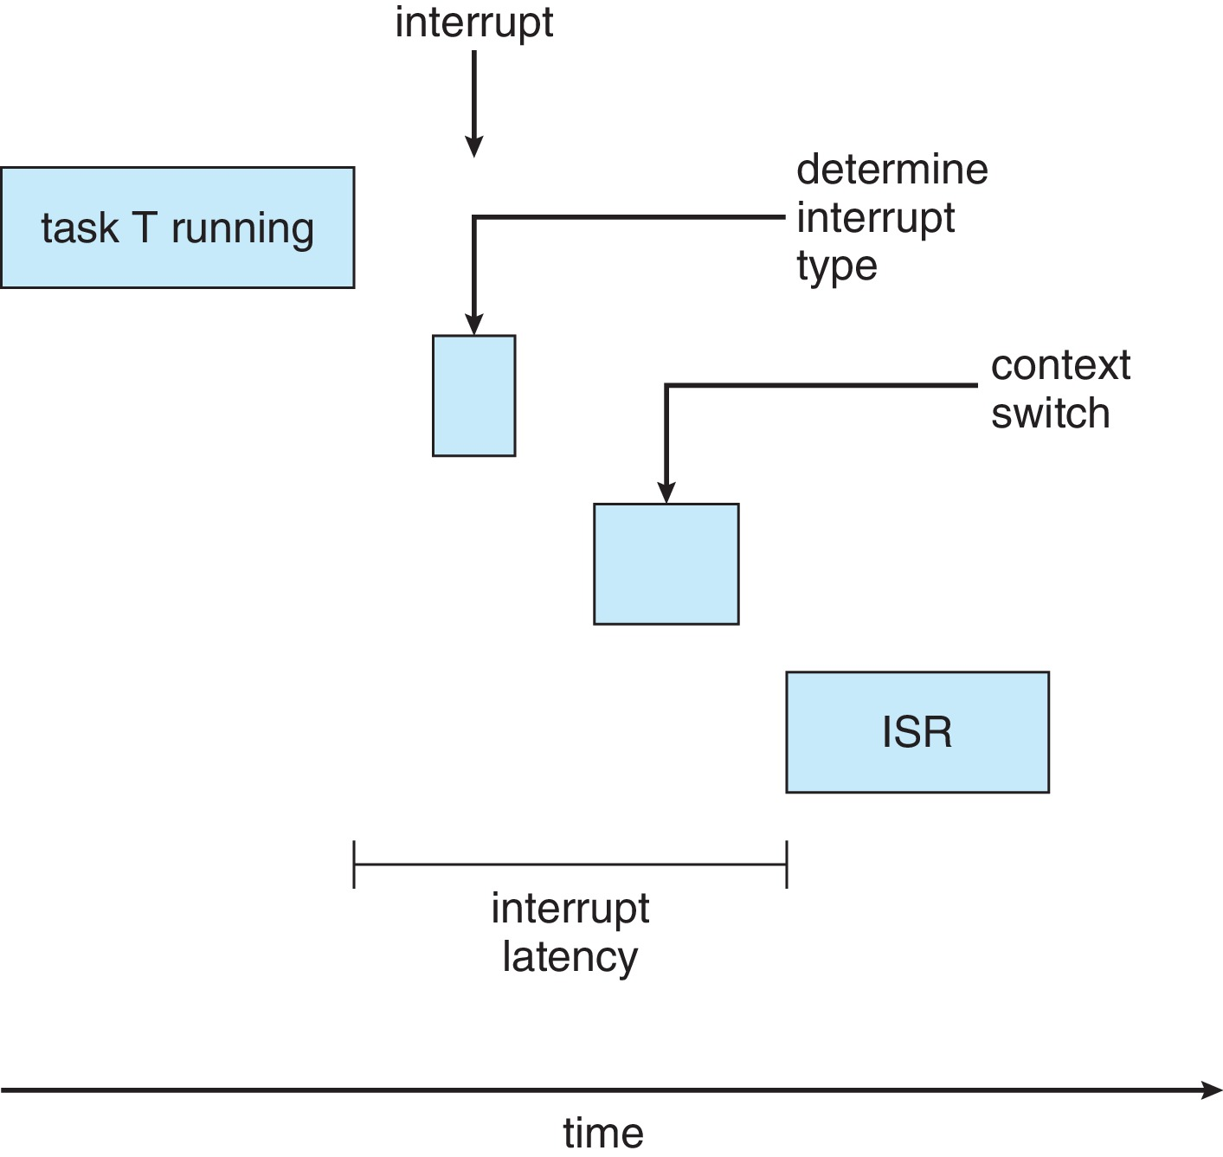
Interrupt Latency

Slide 37
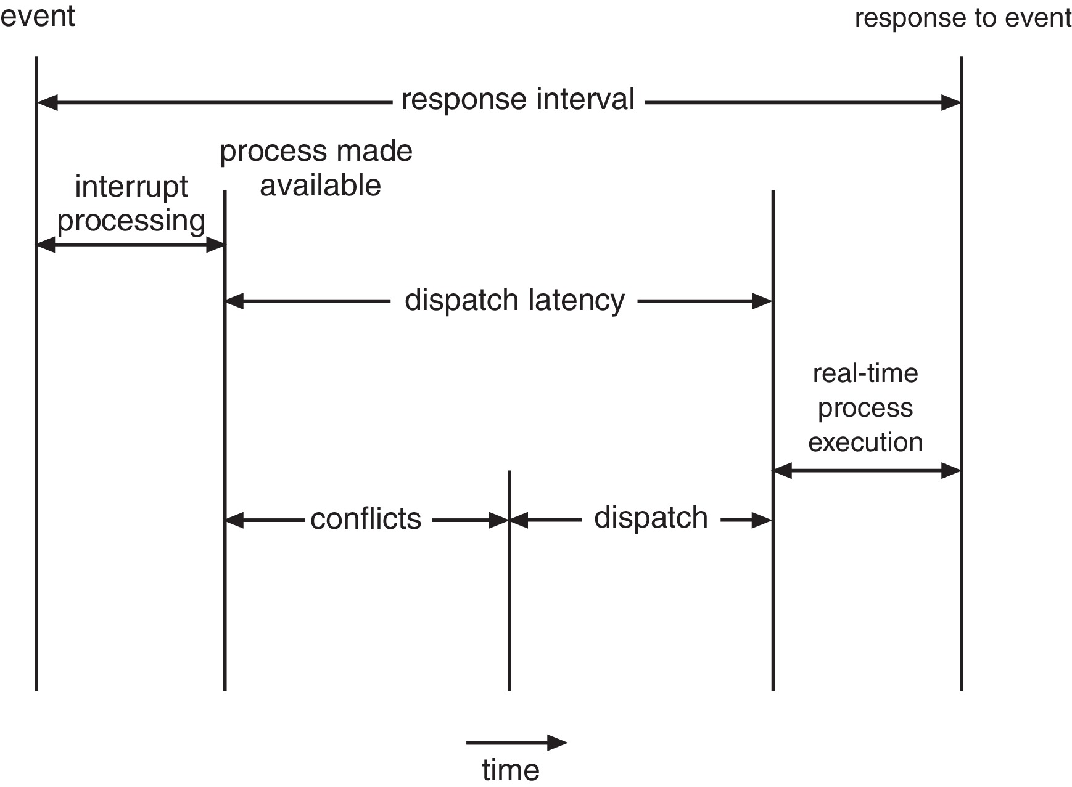
Dispatch Latency
Conflict phase of dispatch latency:
  Preemption of any process running in kernel mode
  Release by low-priority process of resources needed by high-priority processes

Slide 38
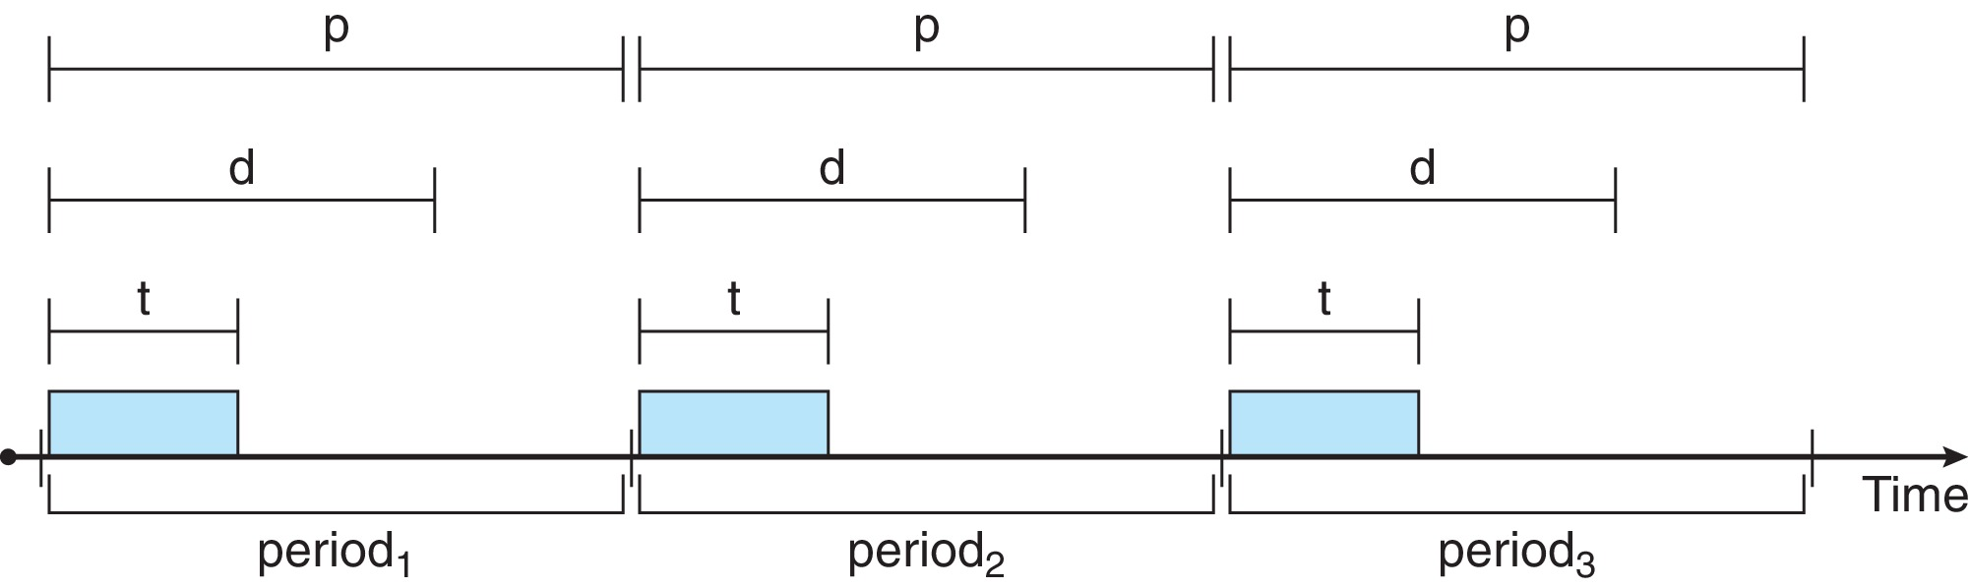
Priority-based Scheduling
For real-time scheduling, scheduler must support preemptive, priority-based scheduling
  But only guarantees soft real-time
For hard real-time must also provide ability to meet deadlines
Processes have new characteristics: periodic ones require CPU at constant intervals
  Has processing time t, deadline d, period p
  0 ≤ t ≤ d ≤ p
  Rate of periodic task is 1/p

Slide 39
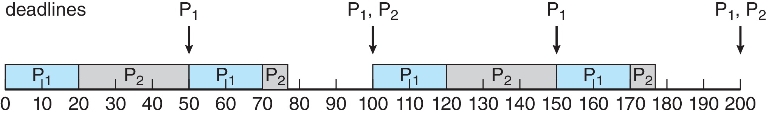
Rate Monotonic Scheduling
A priority is assigned based on the inverse of its period
Shorter periods = higher priority;
Longer periods = lower priority
P₁ is assigned a higher priority than P₂.

Slide 40
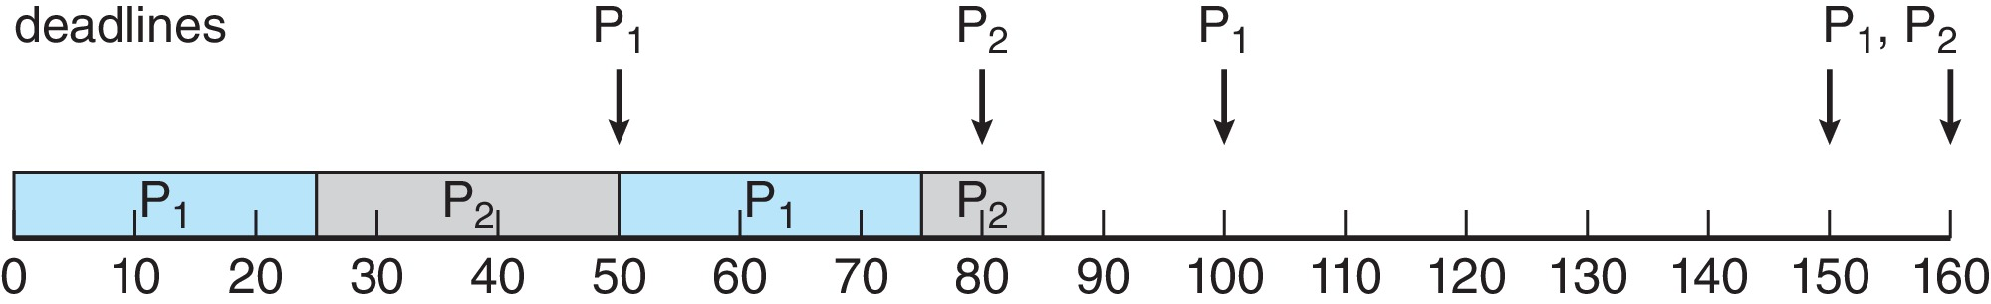
Missed Deadlines with Rate Monotonic Scheduling
Process P₂ misses finishing its deadline at time 80
Figure

Slide 41
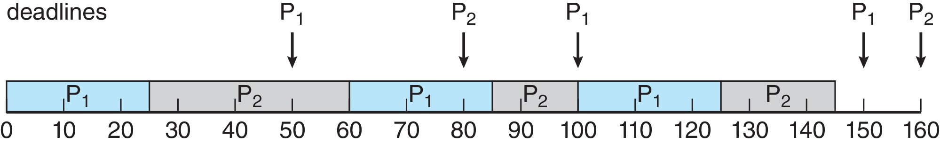
Earliest Deadline First Scheduling (EDF)
Priorities are assigned according to deadlines:
  The earlier the deadline, the higher the priority
  The later the deadline, the lower the priority
Figure

Slide 42
Proportional Share Scheduling
T shares are allocated among all processes in the system
An application receives N shares where N < T
This ensures each application will receive N / T of the total processor time

Slide 43
Outline
1. CPU Scheduling Algorithms
    • Priority Scheduling
    • Round Robin
    • Combined Priority with Round Robin Scheduling
2. Advanced Topics
    • MultiLevel Queues
    • Thread Scheduling
    • Multiple-Processor Scheduling
    • Realtime Scheduling
3. Examples of Scheduling in OS
    • Linux
    • Windows
    • Solaris
4. Evaluation of Scheduling Algorithms

Slide 44
Operating System Examples
Linux scheduling
Windows scheduling
Solaris scheduling

Slide 45
Linux Scheduling Through Version 2.5
Prior to kernel version 2.5, ran variation of standard UNIX scheduling algorithm
Version 2.5 moved to constant order O(1) scheduling time
  Preemptive, priority based
  Two priority ranges: time-sharing and real-time
  Real-time range from 0 to 99 and nice value from 100 to 140
  Map into global priority with numerically lower values indicating higher priority
  Higher priority gets larger q
  Task run-able as long as time left in time slice (active)
  If no time left (expired), not run-able until all other tasks use their slices
  All run-able tasks tracked in per-CPU runqueue data structure
    Two priority arrays (active, expired)
    Tasks indexed by priority
    When no more active, arrays are exchanged
  Worked well, but poor response times for interactive processes

Slide 46
Linux Scheduling in Version 2.6.23 +
Completely Fair Scheduler (CFS)
Scheduling classes
  Each has specific priority
  Scheduler picks highest priority task in highest scheduling class
  Rather than quantum based on fixed time allotments, based on proportion of CPU time
  Two scheduling classes included, others can be added
    default
    real-time

Slide 47
Linux Scheduling in Version 2.6.23 + (Cont.)
Quantum calculated based on nice value from -20 to +19
  Lower value is higher priority
  Calculates target latency – interval of time during which task should run at least once
  Target latency can increase if say number of active tasks increases
CFS scheduler maintains per task virtual run time in variable vruntime
  Associated with decay factor based on priority of task – lower priority is higher decay rate
  Normal default priority yields virtual run time = actual run time
To decide next task to run, scheduler picks task with lowest virtual run time

Slide 48
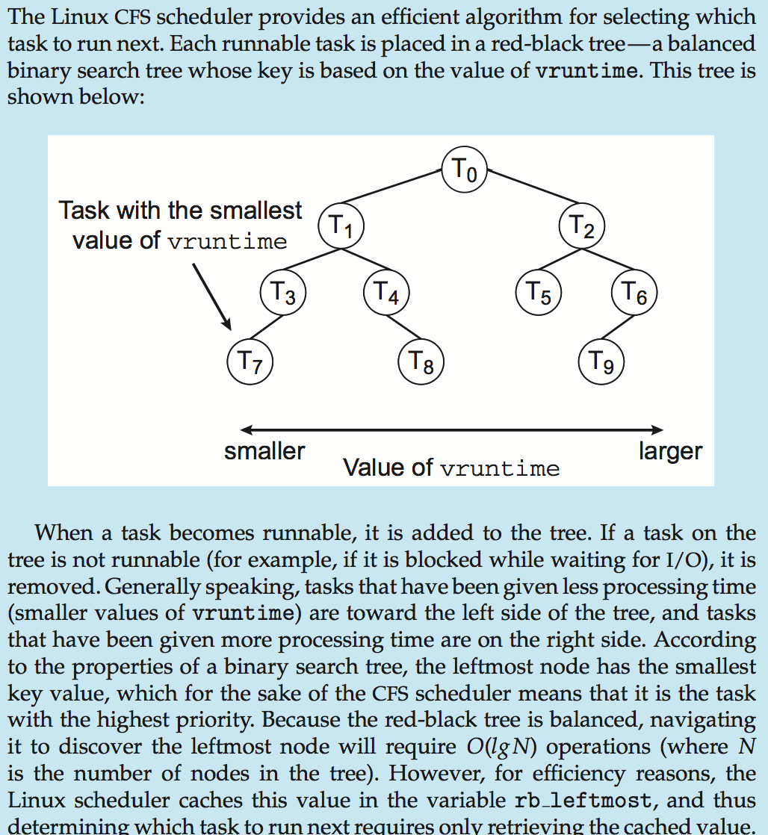
CFS Performance

Slide 49
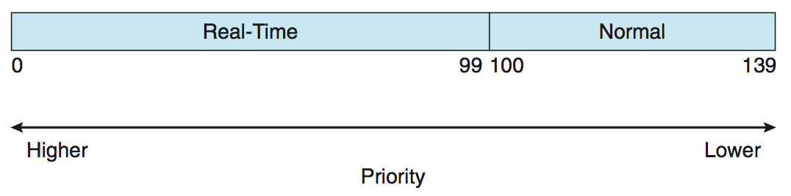
Linux Scheduling (Cont.)
Real-time scheduling according to POSIX.1b
  Real-time tasks have static priorities
Real-time plus normal map into global priority scheme
Nice value of -20 maps to global priority 100
Nice value of +19 maps to priority 139

Slide 50
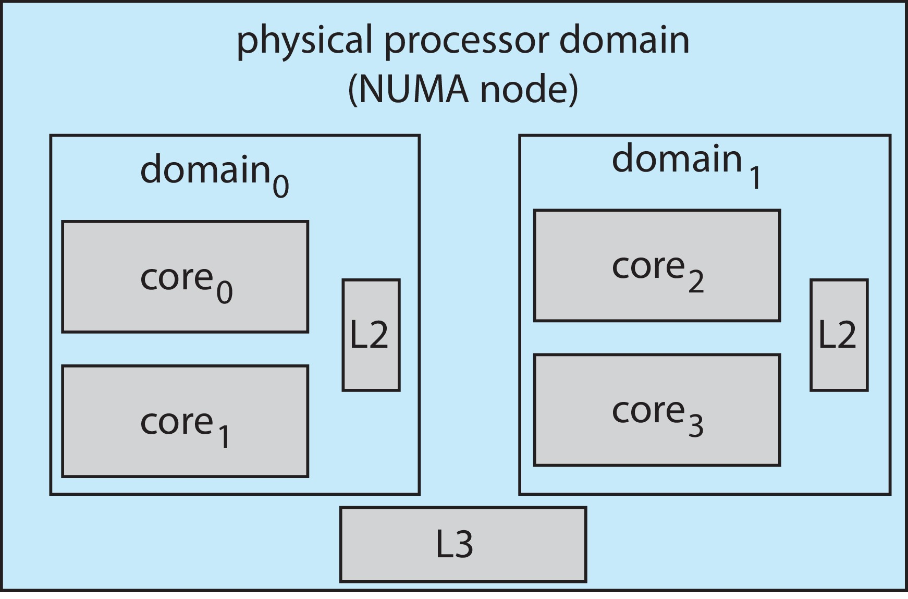
Linux Scheduling (Cont.)
Linux supports load balancing, but is also NUMA-aware.
Scheduling domain is a set of CPU cores that can be balanced against one another.
Domains are organized by what they share (i.e., cache memory.) Goal is to keep threads from migrating between domains.

Slide 51
Outline
1. CPU Scheduling Algorithms
    • Priority Scheduling
    • Round Robin
    • Combined Priority with Round Robin Scheduling
2. Advanced Topics
    • MultiLevel Queues
    • Thread Scheduling
    • Multiple-Processor Scheduling
    • Realtime Scheduling
3. Examples of Scheduling in OS
    • Linux
    • Windows
    • Solaris
4. Evaluation of Scheduling Algorithms

Slide 52
Windows Scheduling
Windows uses priority-based preemptive scheduling
Highest-priority thread runs next
Dispatcher is scheduler
Thread runs until (1) blocks, (2) uses time slice, (3) preempted by higher-priority thread
Real-time threads can preempt non-real-time
32-level priority scheme
Variable class is 1-15, real-time class is 16-31
Priority 0 is memory-management thread
Queue for each priority
If no run-able thread, runs idle thread

Slide 53
Windows Priority Classes
Win32 API identifies several priority classes to which a process can belong
  REALTIME_PRIORITY_CLASS, HIGH_PRIORITY_CLASS, ABOVE_NORMAL_PRIORITY_CLASS,NORMAL_PRIORITY_CLASS, BELOW_NORMAL_PRIORITY_CLASS, IDLE_PRIORITY_CLASS
  All are variable except REALTIME
A thread within a given priority class has a relative priority
  TIME_CRITICAL, HIGHEST, ABOVE_NORMAL, NORMAL, BELOW_NORMAL, LOWEST, IDLE
Priority class and relative priority combine to give numeric priority
Base priority is NORMAL within the class
If quantum expires, priority lowered, but never below base

Slide 54
Windows Priority Classes (Cont.)
If wait occurs, priority boosted depending on what was waited for
Foreground window given 3x priority boost
Windows 7 added user-mode scheduling (UMS)
  Applications create and manage threads independent of kernel
  For large number of threads, much more efficient
  UMS schedulers come from programming language libraries like C++ Concurrent Runtime (ConcRT) framework

Slide 55
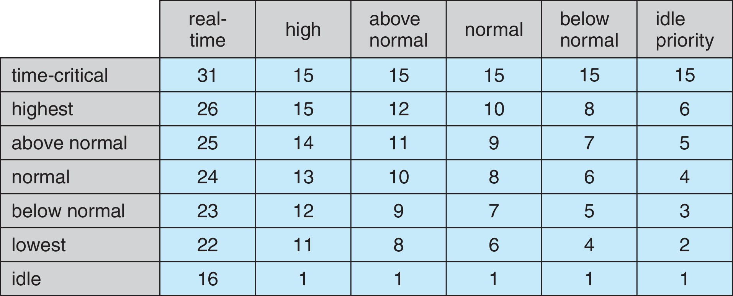
Windows Priorities

Slide 56
Outline
1. CPU Scheduling Algorithms
    • Priority Scheduling
    • Round Robin
    • Combined Priority with Round Robin Scheduling
2. Advanced Topics
    • MultiLevel Queues
    • Thread Scheduling
    • Multiple-Processor Scheduling
    • Realtime Scheduling
3. Examples of Scheduling in OS
    • Linux
    • Windows
    • Solaris
4. Evaluation of Scheduling Algorithms

Slide 57
Solaris
Priority-based scheduling
Six classes available
  Time sharing (default) (TS)
  Interactive (IA)
  Real time (RT)
  System (SYS)
  Fair Share (FSS)
  Fixed priority (FP)
Given thread can be in one class at a time
Each class has its own scheduling algorithm
Time sharing is multi-level feedback queue
  Loadable table configurable by sysadmin

Slide 58
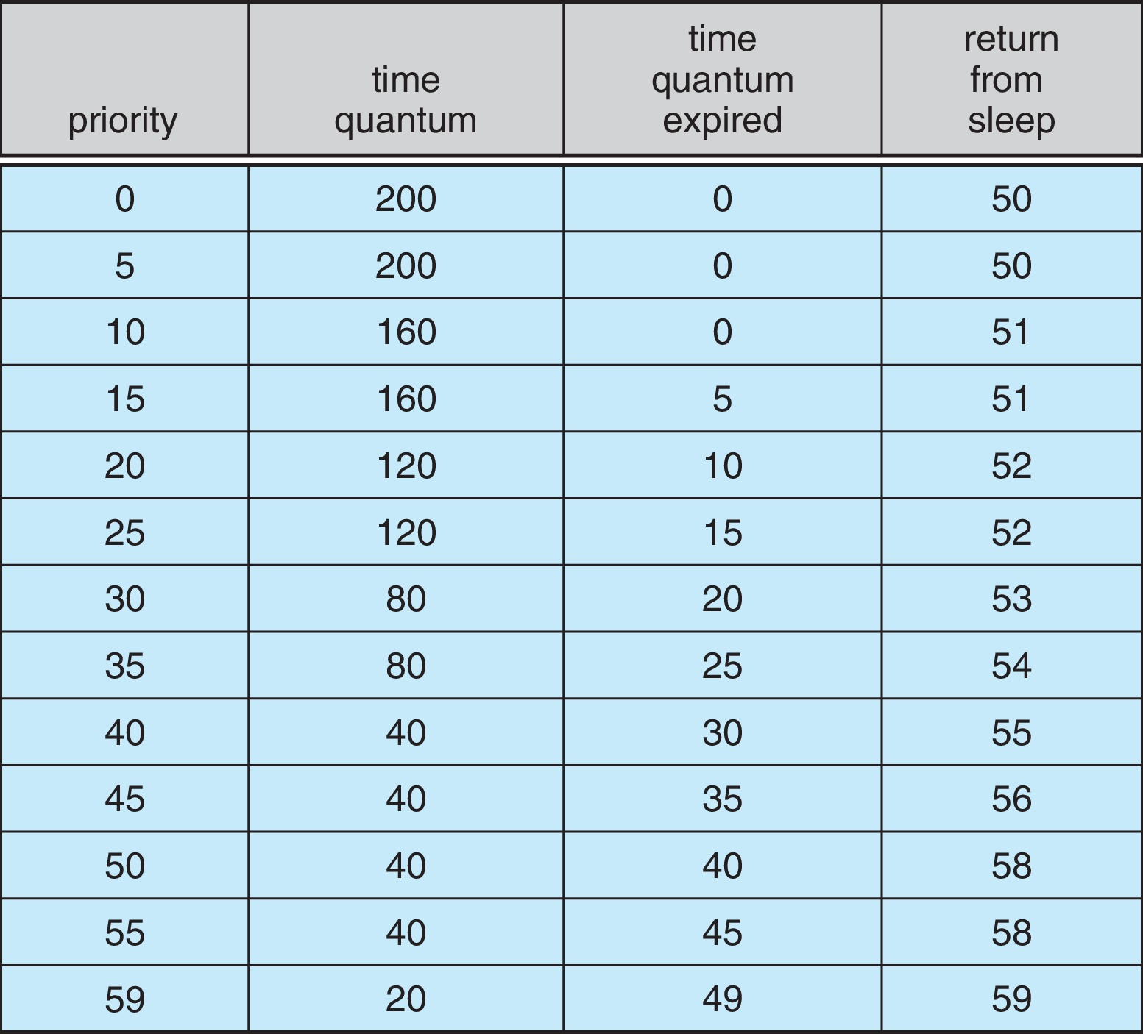
Solaris Dispatch Table

Slide 59
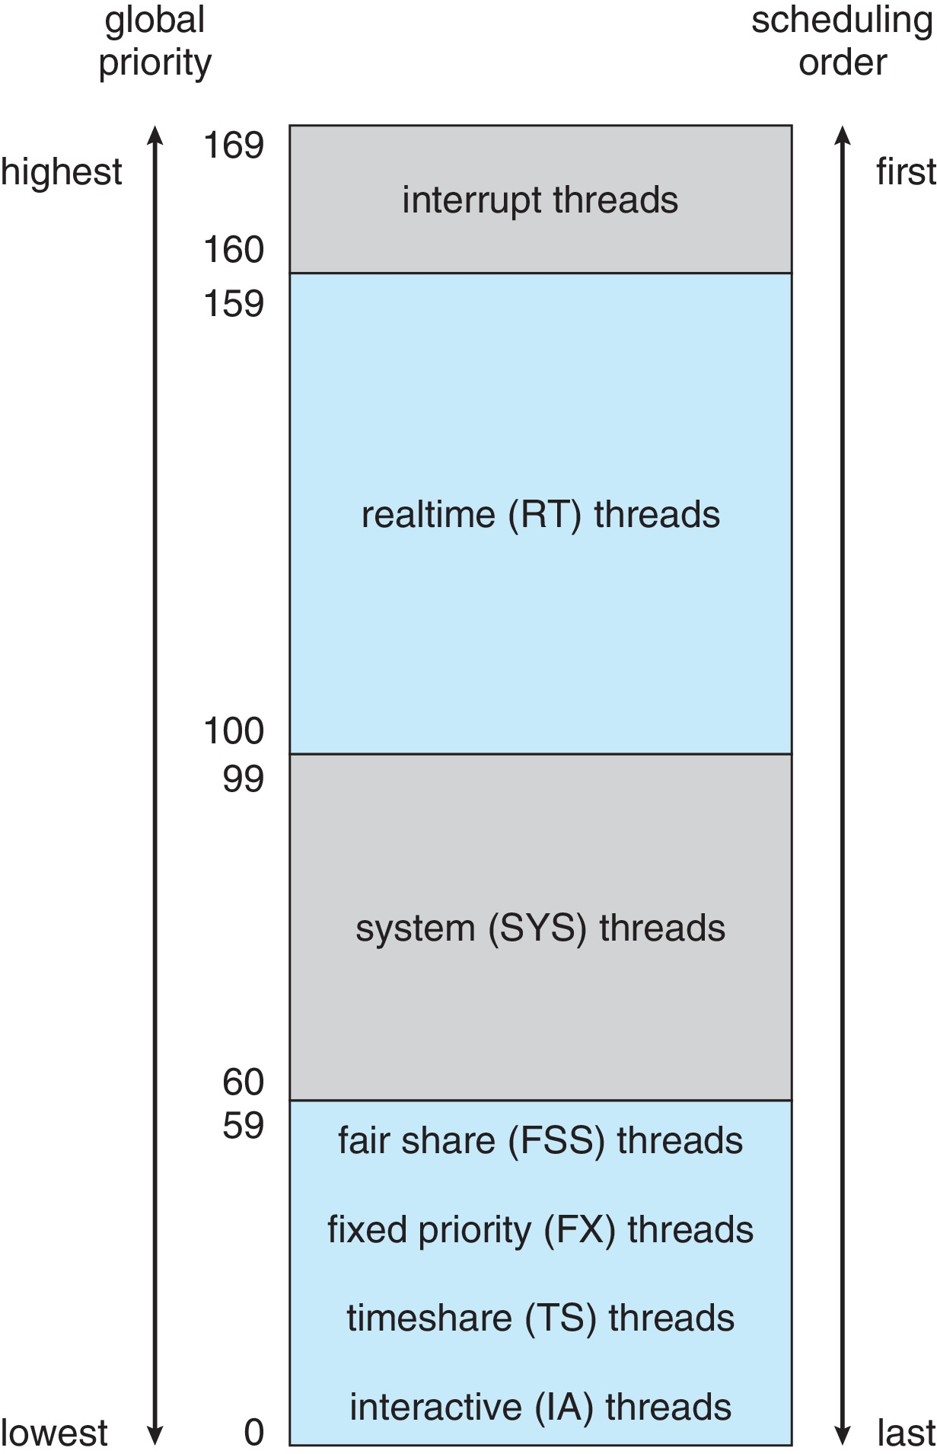
Solaris Scheduling

Slide 60
Solaris Scheduling (Cont.)
Scheduler converts class-specific priorities into a per-thread global priority
  Thread with highest priority runs next
  Runs until (1) blocks, (2) uses time slice, (3) preempted by higher-priority thread
  Multiple threads at same priority selected via RR

Slide 61
Outline
1. CPU Scheduling Algorithms
    • Priority Scheduling
    • Round Robin
    • Combined Priority with Round Robin Scheduling
2. Advanced Topics
    • MultiLevel Queues
    • Thread Scheduling
    • Multiple-Processor Scheduling
    • Realtime Scheduling
3. Examples of Scheduling in OS
    • Linux
    • Windows
    • Solaris
4. Evaluation of Scheduling Algorithms

Slide 62
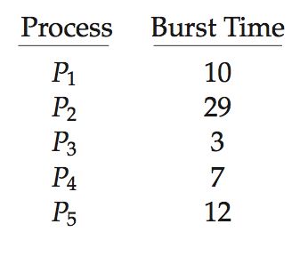
Algorithm Evaluation
How to select CPU-scheduling algorithm for an OS?
Determine criteria, then evaluate algorithms
Deterministic modeling
  Type of analytic evaluation
  Takes a particular predetermined workload and defines the performance of each algorithm for that workload
Consider 5 processes arriving at time 0:

Slide 63
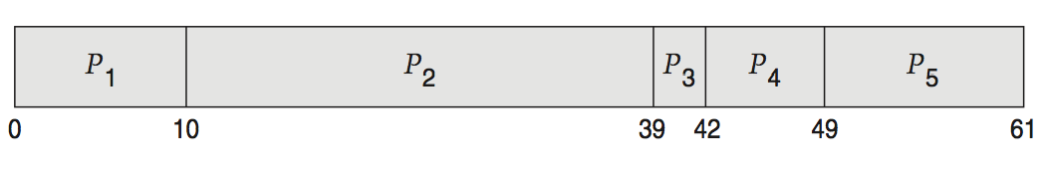
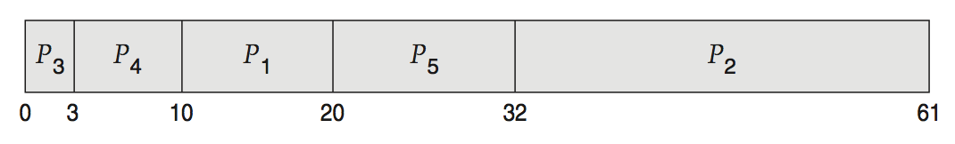
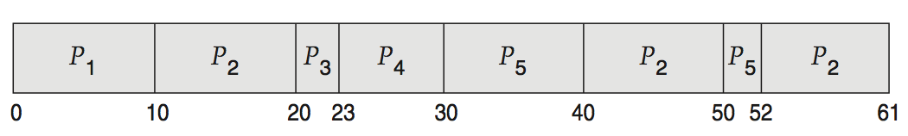
Deterministic Evaluation
For each algorithm, calculate minimum average waiting time
Simple and fast, but requires exact numbers for input, applies only to those inputs
  FCS is 28ms:
  Non-preemptive SFJ is 13ms:
  RR is 23ms:

Slide 64
Queueing Models
Describes the arrival of processes, and CPU and I/O bursts probabilistically
  Commonly exponential, and described by mean
  Computes average throughput, utilization, waiting time, etc.
Computer system described as network of servers, each with queue of waiting processes
  Knowing arrival rates and service rates
  Computes utilization, average queue length, average wait time, etc.

Slide 65
Simulations
Queueing models limited
Simulations more accurate
  Programmed model of computer system
  Clock is a variable
  Gather statistics indicating algorithm performance
  Data to drive simulation gathered via
    Random number generator according to probabilities
    Distributions defined mathematically or empirically
    Trace tapes record sequences of real events in real systems

Slide 66
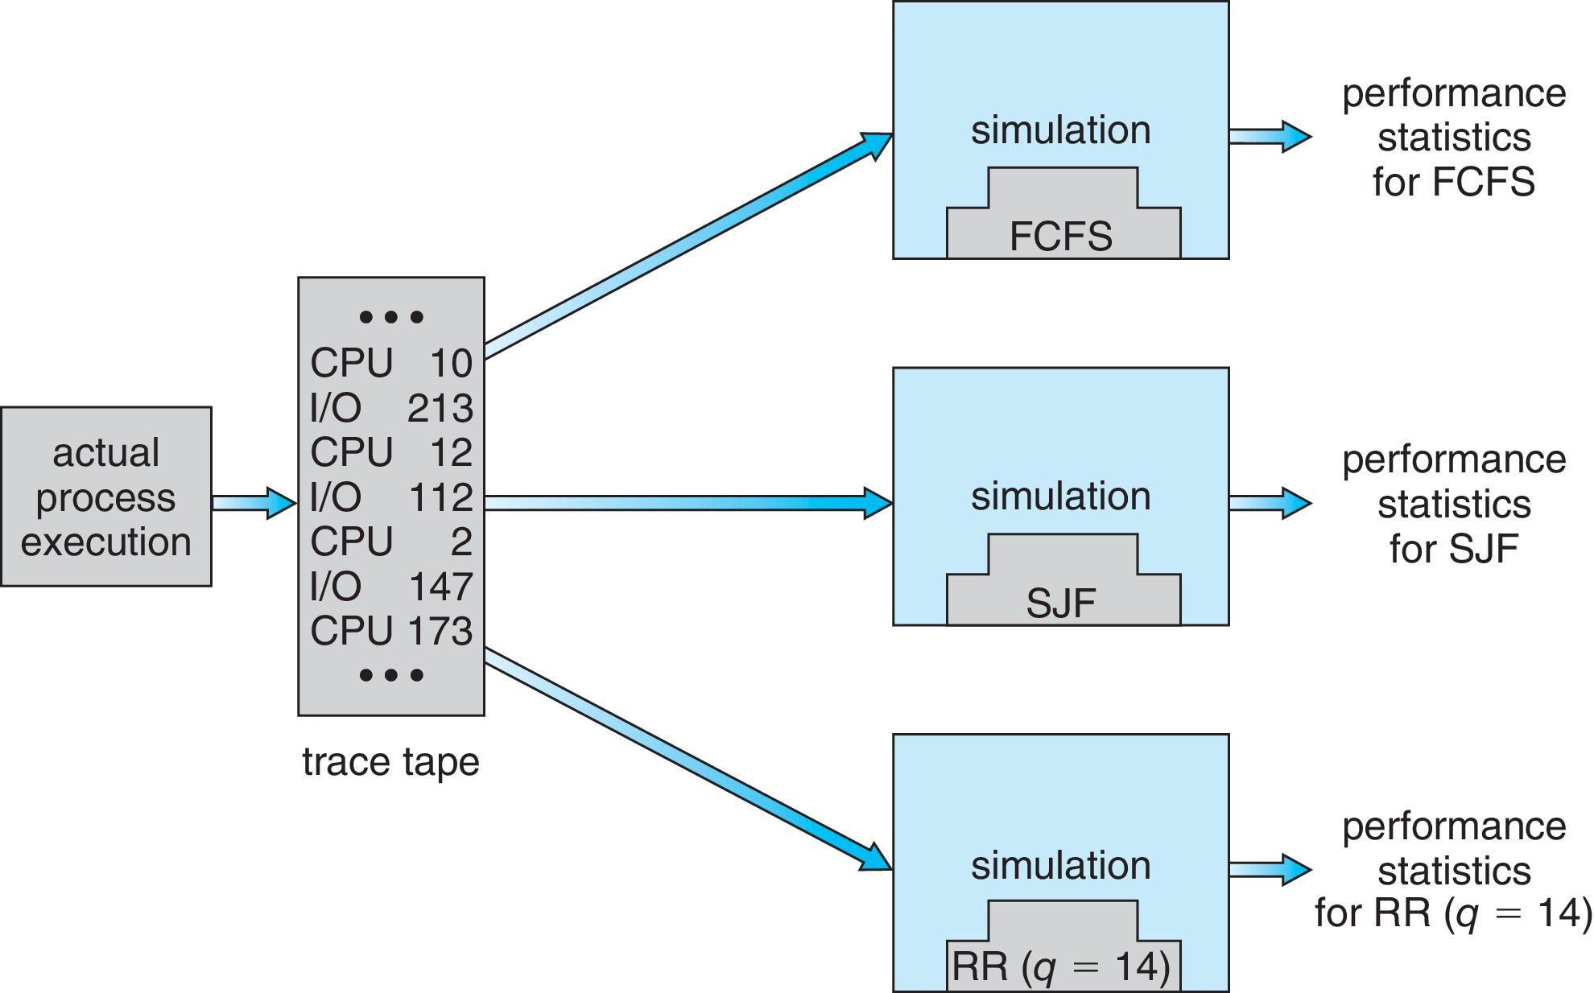
Evaluation of CPU Schedulers by Simulation

Slide 67
Implementation
Even simulations have limited accuracy
Just implement new scheduler and test in real systems
  High cost, high risk
  Environments vary
Most flexible schedulers can be modified per-site or per-system
Or APIs to modify priorities
But again environments vary

Slide 68
End of Chapter 5

