Slide 1
Lecture 10 : Cooperating Processes & Process Communication

Slide 2
Outline
1. Cooperating Processes
2. Interprocess Communication (IPC)
  Shared-memory:
    Procedure-Consumer Problem
    Bounded-buffer
    Unbounded-buffer
  Message-passing
    Communication link:
      Direct & Indirect Communication
      Synchronous or Asynchronous Communication
      Automatic or Explicit buffering
    Naming
    Synchronization
    Buffering: Zero, bounded, unbounded
3. Communication in Client-Server Systems
  Sockets
  RPC
  RMI

Slide 3
Outline
  KEYWORDS: Buffering, Bounded-buffer, Unbounded-buffer, Direct Communication , Indirect Communication, Independent process, Cooperating process, Producer process, Consumer process, Communication link.
HOMEWORK:
  1) Reading : Chapter 3, especially the summary.
  2) Make sure to understand and be able to explain every keyword from the list here and the ones which are printed bold in the text book.
  3) Important Questions:
    Describe the producer/consumer problem.
    Compare Direct & Indirect Communication
    Compare Synchronous or Asynchronous Communication
    When do we have a rendezvous of two processes ?
    When should we have Zero-capacity buffer ? bounded-capacity buffer ? unbounded-capacity buffer ?

Slide 4
Outline
1. Cooperating Processes
2. Interprocess Communication (IPC)
  Shared-memory:
    Procedure-Consumer Problem
    Bounded-buffer
    Unbounded-buffer
  Message-passing
    Communication link:
      Direct & Indirect Communication
      Synchronous or Asynchronous Communication
      Automatic or Explicit buffering
    Naming
    Synchronization
    Buffering: Zero, bounded, unbounded
3. Communication in Client-Server Systems
  Sockets
  RPC
  RMI

Slide 5
Cooperating Processes
Processes within a system may be independent or cooperating
Independent process cannot affect or be affected by the execution of another process
Cooperating process can affect or be affected by the execution of another process. They may
  call each other procedures/functions/methods or
  pass each other data/results or
  share the same resources(including data)

Slide 6
Cooperating Processes
Reasons for having cooperating processes (advantages)
  Information sharing
  Computation speedup
  Modularity
  Convenience

Slide 7
Cooperating Processes
Cooperating processes may
  execute concurrently
  may be interrupted at any time, partially completing execution
Concurrent access to shared data may result in data inconsistency
Maintaining data consistency requires mechanisms to ensure the orderly execution of cooperating processes
Cooperating processes need interprocess communication (IPC)

Slide 8
Outline
1. Cooperating Processes
2. Interprocess Communication (IPC)
  Shared-memory:
    Procedure-Consumer Problem
    Bounded-buffer
    Unbounded-buffer
  Message-passing
    Communication link:
      Direct & Indirect Communication
      Synchronous or Asynchronous Communication
      Automatic or Explicit buffering
    Naming
    Synchronization
    Buffering: Zero, bounded, unbounded
3. Communication in Client-Server Systems
  Sockets
  RPC
  RMI

Slide 9
Interprocess Communication (IPC)
Cooperating processes need interprocess communication (IPC)
Two models of IPC
  Shared memory
  Message passing

Slide 10
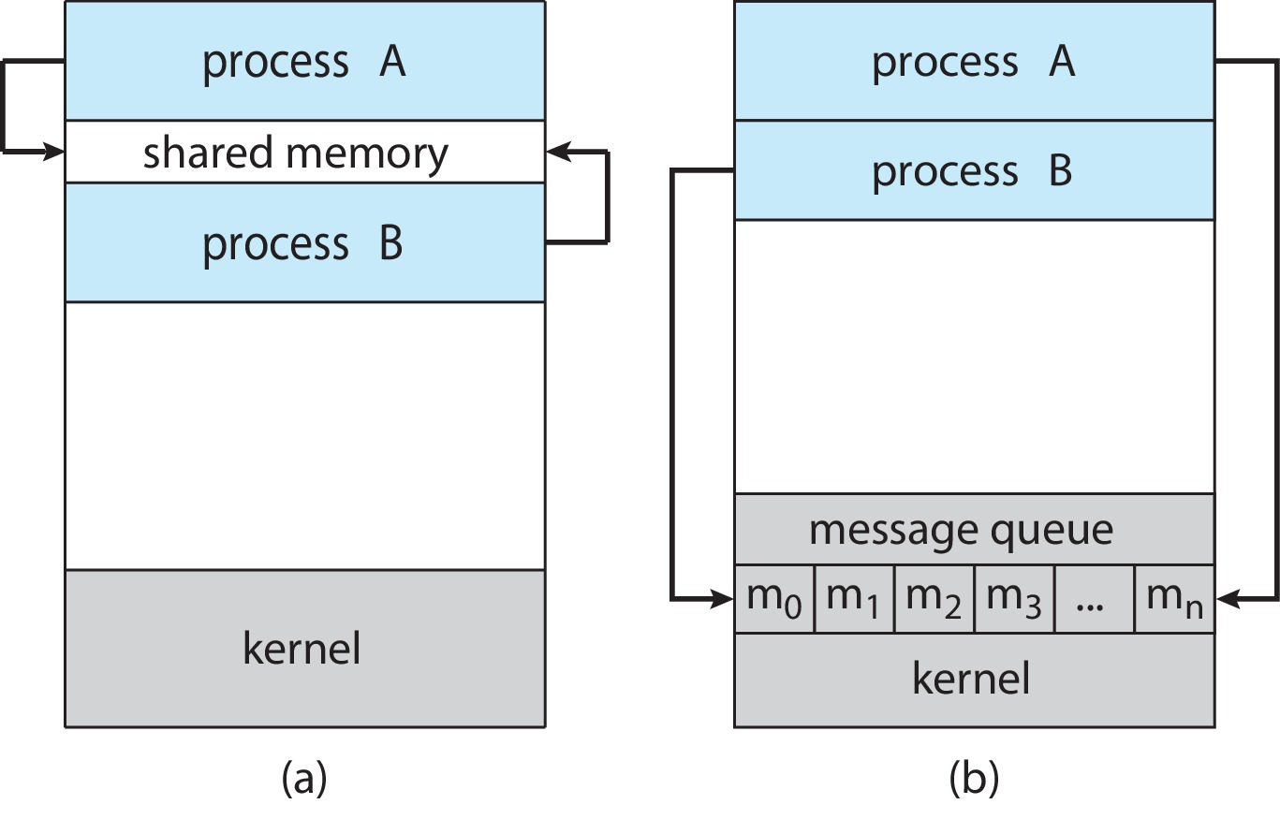
Communications Models
(a) Shared memory. (b) Message passing.

Slide 11
IPC – Shared Memory
An area of memory shared among the processes that wish to communicate
The communication is under the control of the users processes not the operating system.
Major issues is to provide mechanism that will allow the user processes to synchronize their actions when they access shared memory.
Synchronization is discussed in great details in Chapters 6 & 7.

Slide 12
Producer-Consumer Problem
Paradigm for cooperating processes:
  producer process produces information that is consumed by a consumer process
Two variations:
  unbounded-buffer places no practical limit on the size of the buffer:
    Producer never waits
    Consumer waits if there is no buffer to consume
  bounded-buffer assumes that there is a fixed buffer size
    Producer must wait if all buffers are full
    Consumer waits if there is no buffer to consume

Slide 13
Interprocess Communication (IPC)

Slide 14
Interprocess Communication (IPC)

Slide 15
Bounded-Buffer – Shared-Memory Solution
Shared data
      #define BUFFER_SIZE 10
      typedef struct {
      . . .
      } item;
      item buffer[BUFFER_SIZE];
      int in = 0;
      int out = 0;
Solution is correct, but can only use BUFFER_SIZE-1 elements

Slide 16
Producer Process – Shared Memory
item next_produced;
while (true) {
/* produce an item in next produced */
while (((in + 1) % BUFFER_SIZE) == out)
; /* do nothing */
buffer[in] = next_produced;
in = (in + 1) % BUFFER_SIZE;
}

Slide 17
Consumer Process – Shared Memory
item next_consumed;
while (true) {
while (in == out)
; /* do nothing */
next_consumed = buffer[out];
out = (out + 1) % BUFFER_SIZE;
/* consume the item in next consumed */
}

Slide 18
What about Filling all the Buffers?
Suppose that we wanted to provide a solution to the consumer-producer problem that fills all the buffers.
We can do so by having an integer counter that keeps track of the number of full buffers.
Initially, counter is set to 0.
The integer counter is incremented by the producer after it produces a new buffer.
The integer counter is and is decremented by the consumer after it consumes a buffer.

Slide 19
Producer
while (true) {
/* produce an item in next produced */
while (counter == BUFFER_SIZE)
; /* do nothing */
buffer[in] = next_produced;
in = (in + 1) % BUFFER_SIZE;
counter++;
}

Slide 20
Consumer
while (true) {
while (counter == 0)
; /* do nothing */
next_consumed = buffer[out];
out = (out + 1) % BUFFER_SIZE;
counter--;
/* consume the item in next consumed */
}

Slide 21
Race Condition
counter++ could be implemented as
register1 = counter
register1 = register1 + 1
counter = register1
counter-- could be implemented as
register2 = counter
register2 = register2 - 1
counter = register2
Consider this execution interleaving with “counter = 5” initially:
  S0: producer execute register1 = counter {register1 = 5}
  S1: producer execute register1 = register1 + 1 {register1 = 6}
  S2: consumer execute register2 = counter {register2 = 5}
  S3: consumer execute register2 = register2 – 1 {register2 = 4}
  S4: producer execute counter = register1 {counter = 6 }
  S5: consumer execute counter = register2 {counter = 4}

Slide 22
Race Condition (Cont.)
Question – why was there no race condition in the first solution (where at most N – 1) buffers can be filled?
More in Chapter 6.

Slide 23
Outline
1. Cooperating Processes
2. Interprocess Communication (IPC)
  Shared-memory:
    Procedure-Consumer Problem
    Bounded-buffer
    Unbounded-buffer
  Message-passing
    Communication link:
      Direct & Indirect Communication
      Synchronous or Asynchronous Communication
      Automatic or Explicit buffering
    Naming
    Synchronization
    Buffering: Zero, bounded, unbounded
3. Communication in Client-Server Systems
  Sockets
  RPC
  RMI

Slide 24
IPC – Message Passing
Processes communicate with each other without resorting to shared variables
IPC facility provides two operations:
  send(message)
  receive(message)
The message size is either fixed or variable

Slide 25
Message Passing (Cont.)
If processes P and Q wish to communicate, they need to:
  Establish a communication link between them
  Exchange messages via send/receive
Implementation issues:
  How are links established?
  Can a link be associated with more than two processes?
  How many links can there be between every pair of communicating processes?
  What is the capacity of a link?
  Is the size of a message that the link can accommodate fixed or variable?
  Is a link unidirectional or bi-directional?

Slide 26
Implementation of Communication Link
Physical:
  Shared memory
  Hardware bus
  Network
Logical:
  Direct or indirect
  Synchronous or asynchronous
  Automatic or explicit buffering

Slide 27
Direct Communication
Processes must name each other explicitly:
  send (P, message) – send a message to process P
  receive(Q, message) – receive a message from process Q
Properties of communication link
  Links are established automatically
  A link is associated with exactly one pair of communicating processes
  Between each pair there exists exactly one link
  The link may be unidirectional, but is usually bi-directional

Slide 28
Indirect Communication
Messages are directed and received from mailboxes (also referred to as ports)
  Each mailbox has a unique id
  Processes can communicate only if they share a mailbox
Properties of communication link
  Link established only if processes share a common mailbox
  A link may be associated with many processes
  Each pair of processes may share several communication links
  Link may be unidirectional or bi-directional

Slide 29
Indirect Communication (Cont.)
Operations
  Create a new mailbox (port)
  Send and receive messages through mailbox
  Delete a mailbox
Primitives are defined as:
  send(A, message) – send a message to mailbox A
  receive(A, message) – receive a message from mailbox A

Slide 30
Indirect Communication (Cont.)
Mailbox sharing
  P₁, P₂, and P₃ share mailbox A
  P₁, sends; P₂ and P₃ receive
  Who gets the message?
Solutions
  Allow a link to be associated with at most two processes
  Allow only one process at a time to execute a receive operation
  Allow the system to select arbitrarily the receiver. Sender is notified who the receiver was.

Slide 31
Synchronization
Message passing may be either blocking or non-blocking
Blocking is considered synchronous
  Blocking send -- the sender is blocked until the message is received
  Blocking receive -- the receiver is blocked until a message is available
Non-blocking is considered asynchronous
  Non-blocking send -- the sender sends the message and continue
  Non-blocking receive -- the receiver receives:
    A valid message, or
    Null message
Different combinations possible
  If both send and receive are blocking, we have a rendezvous

Slide 32
Interprocess Communication (IPC)

Slide 33
Producer-Consumer: Message Passing
Producer
message next_produced;
while (true) {
/* produce an item in next_produced */
send(next_produced);
}
Consumer
message next_consumed;
while (true) {
receive(next_consumed)
/* consume the item in next_consumed */
}

Slide 34
Buffering
Queue of messages attached to the link.
Implemented in one of three ways
  1. Zero capacity – no messages are queued on a link.
  Sender must wait for receiver (rendezvous)
  2. Bounded capacity – finite length of n messages
  Sender must wait if link full
  3. Unbounded capacity – infinite length
  Sender never waits

Slide 35
Examples of IPC Systems - POSIX
POSIX Shared Memory
  Process first creates shared memory segment
  shm_fd = shm_open(name, O CREAT | O RDWR, 0666);
  Also used to open an existing segment
  Set the size of the object
ftruncate(shm_fd, 4096);
  Use mmap() to memory-map a file pointer to the shared memory object
  Reading and writing to shared memory is done by using the pointer returned by mmap().

Slide 36
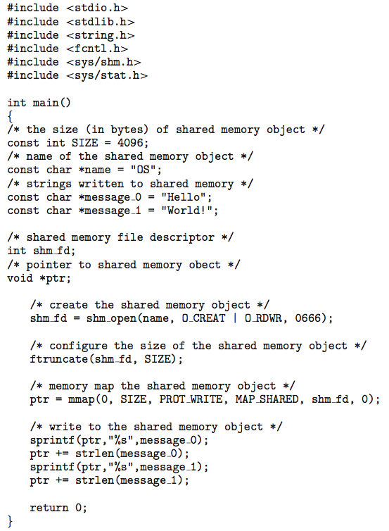
IPC POSIX Producer

Slide 37
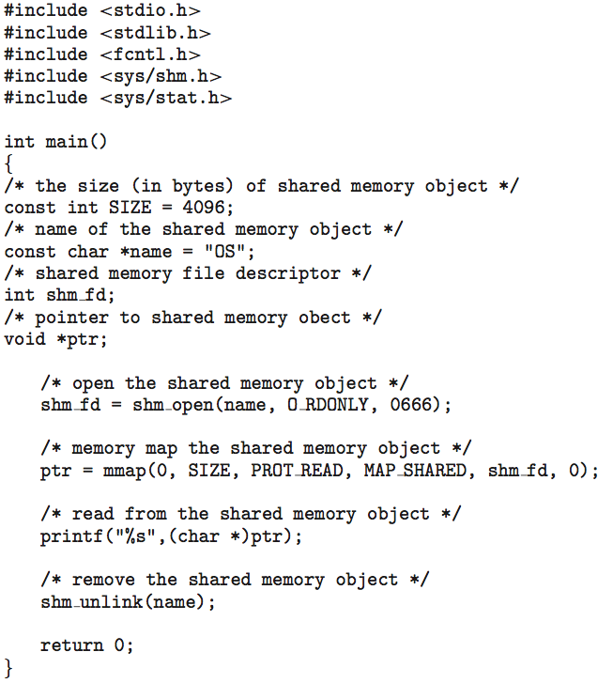
IPC POSIX Consumer

Slide 38
Examples of IPC Systems - Mach
Mach communication is message based
  Even system calls are messages
  Each task gets two ports at creation - Kernel and Notify
  Messages are sent and received using the mach_msg() function
  Ports needed for communication, created via
  mach_port_allocate()
  Send and receive are flexible; for example four options if mailbox full:
    Wait indefinitely
    Wait at most n milliseconds
    Return immediately
    Temporarily cache a message

Slide 39
Mach Messages
#include<mach/mach.h>
struct message {
mach_msg_header_t header;
int data;
};
mach port t client;
mach port t server;

Slide 40
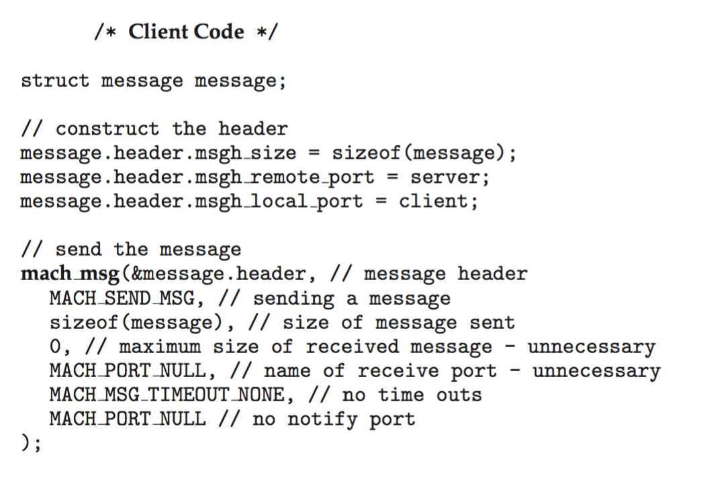
Mach Message Passing - Client

Slide 41
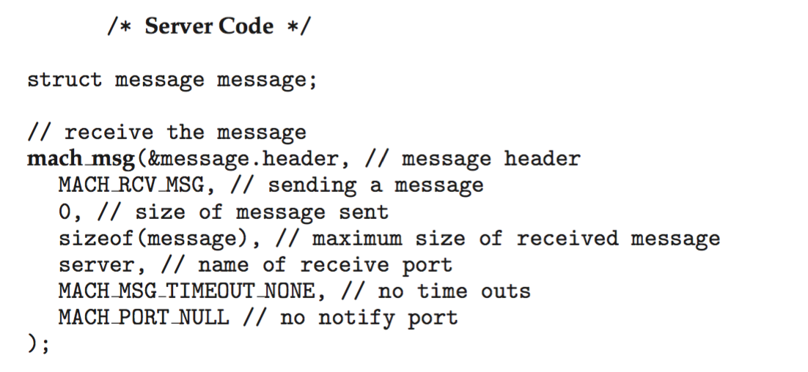
Mach Message Passing - Server

Slide 42
Examples of IPC Systems – Windows
Message-passing centric via advanced local procedure call (LPC) facility
  Only works between processes on the same system
  Uses ports (like mailboxes) to establish and maintain communication channels
  Communication works as follows:
    The client opens a handle to the subsystem’s connection port object.
    The client sends a connection request.
    The server creates two private communication ports and returns the handle to one of them to the client.
    The client and server use the corresponding port handle to send messages or callbacks and to listen for replies.

Slide 43
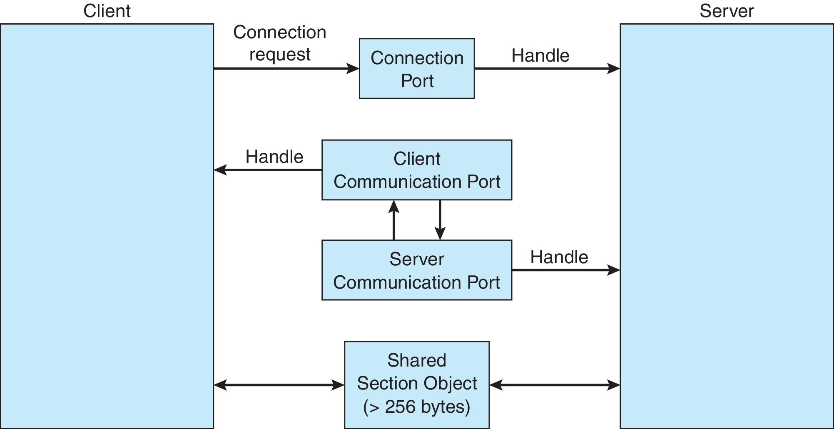
Local Procedure Calls in Windows

Slide 44
Pipes
Acts as a conduit allowing two processes to communicate
Issues:
  Is communication unidirectional or bidirectional?
  In the case of two-way communication, is it half or full-duplex?
  Must there exist a relationship (i.e., parent-child) between the communicating processes?
  Can the pipes be used over a network?
Ordinary pipes – cannot be accessed from outside the process that created it. Typically, a parent process creates a pipe and uses it to communicate with a child process that it created.
Named pipes – can be accessed without a parent-child relationship.

Slide 45
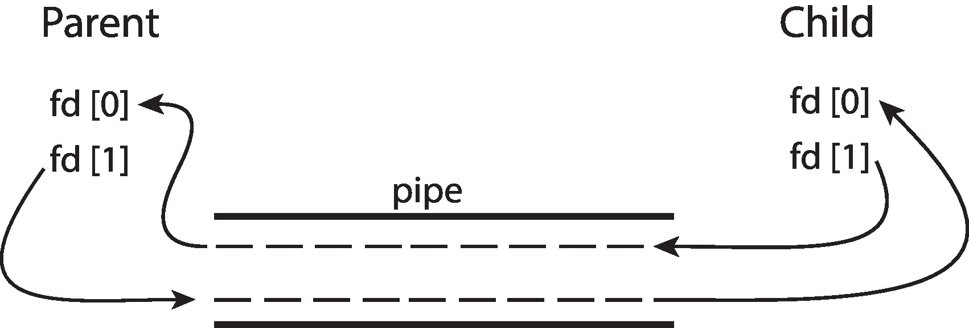
Ordinary Pipes
Ordinary Pipes allow communication in standard producer-consumer style
Producer writes to one end (the write-end of the pipe)
Consumer reads from the other end (the read-end of the pipe)
Ordinary pipes are therefore unidirectional
Require parent-child relationship between communicating processes
Windows calls these anonymous pipes

Slide 46
Named Pipes
Named Pipes are more powerful than ordinary pipes
Communication is bidirectional
No parent-child relationship is necessary between the communicating processes
Several processes can use the named pipe for communication
Provided on both UNIX and Windows systems

Slide 47
Outline
1. Cooperating Processes
2. Interprocess Communication (IPC)
  Shared-memory:
    Procedure-Consumer Problem
    Bounded-buffer
    Unbounded-buffer
  Message-passing
    Communication link:
      Direct & Indirect Communication
      Synchronous or Asynchronous Communication
      Automatic or Explicit buffering
    Naming
    Synchronization
    Buffering: Zero, bounded, unbounded
3. Communication in Client-Server Systems
  Sockets
  RPC
  RMI

Slide 48
Communications in Client-Server Systems
Sockets
Remote Procedure Calls
RMI

Slide 49
Outline
1. Cooperating Processes
2. Interprocess Communication (IPC)
  Shared-memory:
    Procedure-Consumer Problem
    Bounded-buffer
    Unbounded-buffer
  Message-passing
    Communication link:
      Direct & Indirect Communication
      Synchronous or Asynchronous Communication
      Automatic or Explicit buffering
    Naming
    Synchronization
    Buffering: Zero, bounded, unbounded
3. Communication in Client-Server Systems
  Sockets
  RPC
  RMI

Slide 50
Sockets
A socket is defined as an endpoint for communication
Concatenation of IP address and port – a number included at start of message packet to differentiate network services on a host
The socket 161.25.19.8:1625 refers to port 1625 on host 161.25.19.8
Communication consists between a pair of sockets
All ports below 1024 are well known, used for standard services
Special IP address 127.0.0.1 (loopback) to refer to system on which process is running

Slide 51
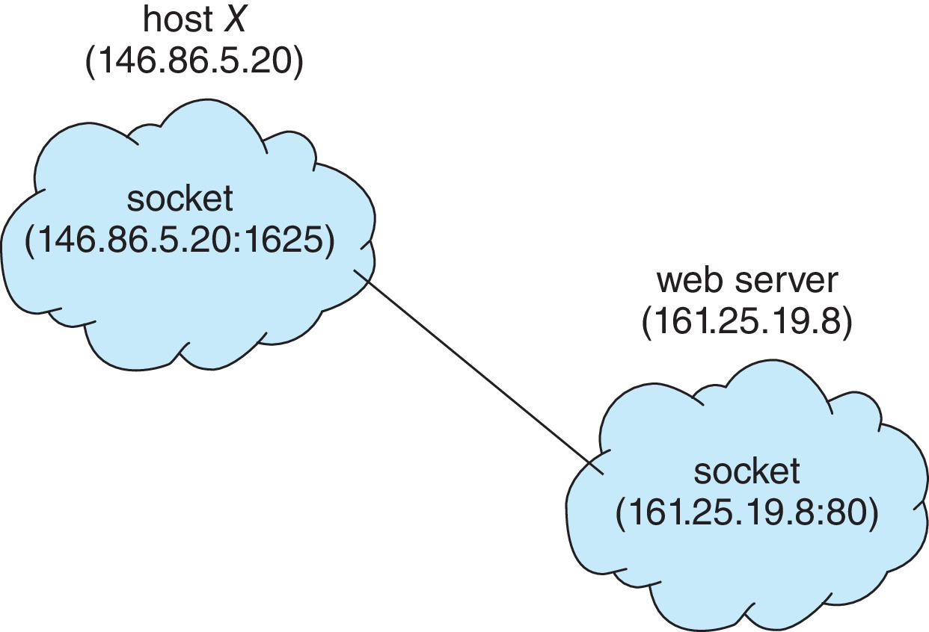
Socket Communication

Slide 52
Socket Communication

Slide 53
Socket Communication

Slide 54
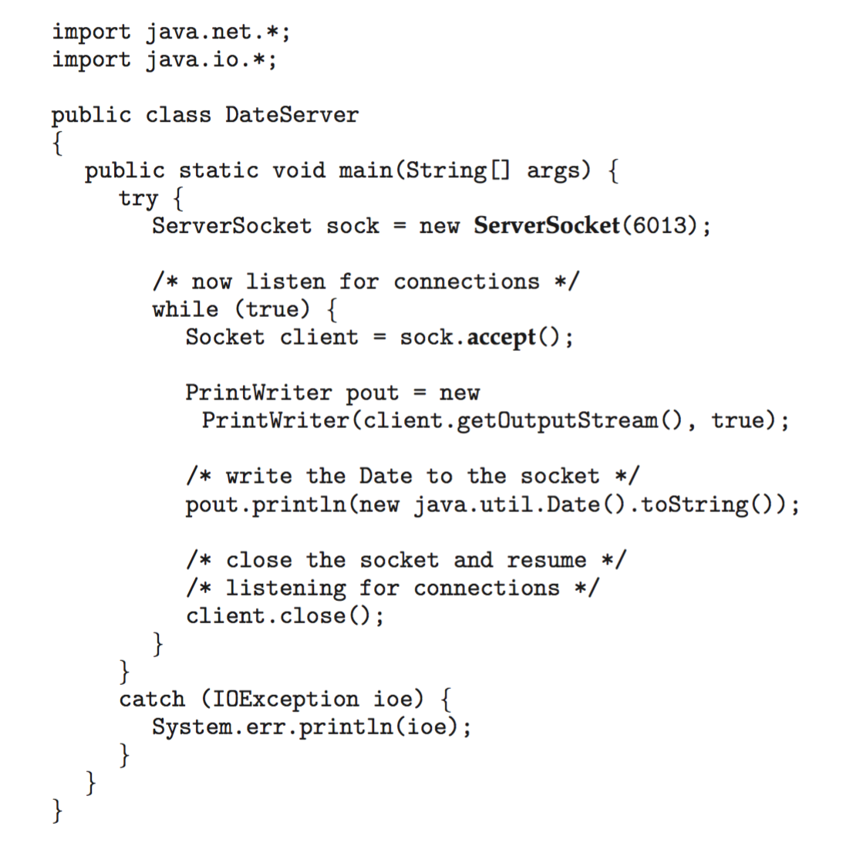
Sockets in Java
Three types of sockets
  Connection-oriented (TCP)
  Connectionless (UDP)
  MulticastSocket class– data can be sent to multiple recipients
Consider this “Date” server in Java:

Slide 55
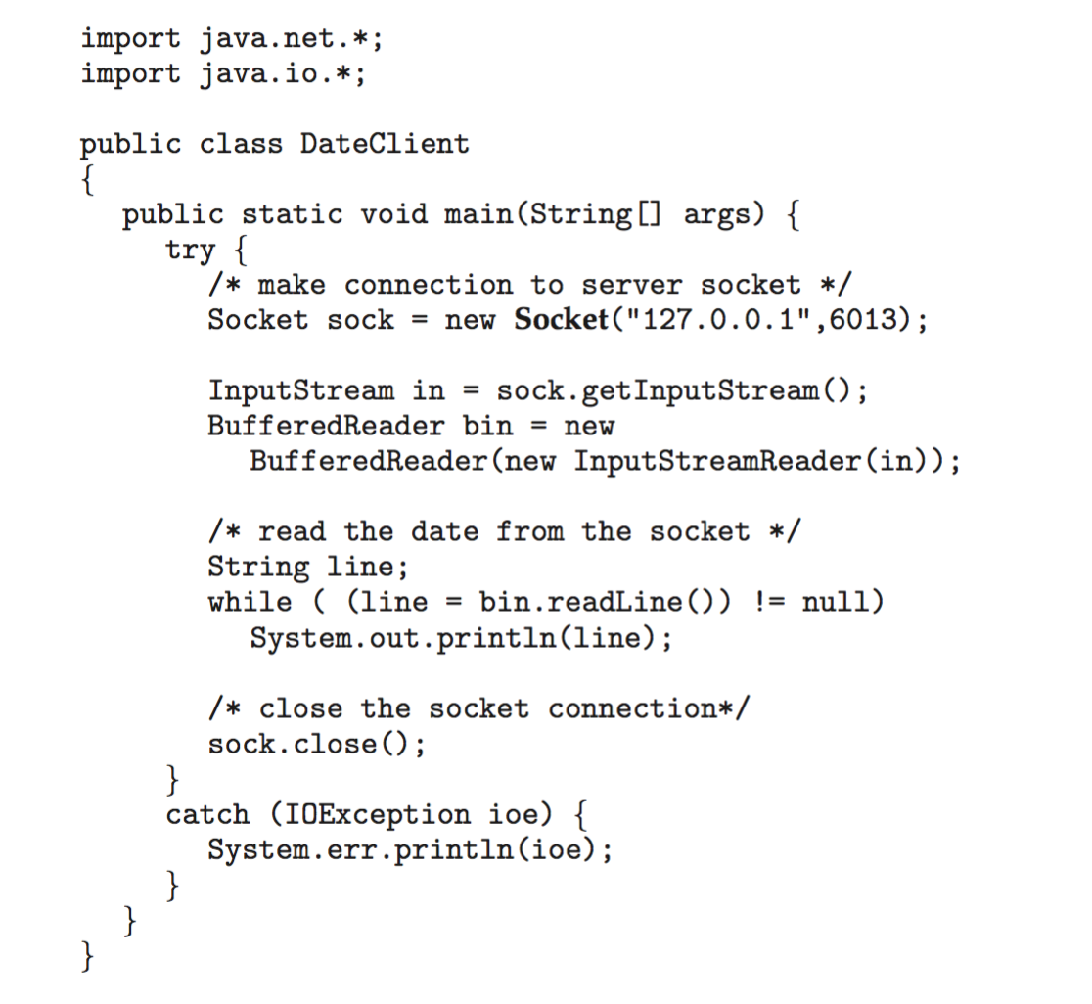
Sockets in Java
The equivalent Date client

Slide 56
Outline
1. Cooperating Processes
2. Interprocess Communication (IPC)
  Shared-memory:
    Procedure-Consumer Problem
    Bounded-buffer
    Unbounded-buffer
  Message-passing
    Communication link:
      Direct & Indirect Communication
      Synchronous or Asynchronous Communication
      Automatic or Explicit buffering
    Naming
    Synchronization
    Buffering: Zero, bounded, unbounded
3. Communication in Client-Server Systems
  Sockets
  RPC
  RMI

Slide 57
Remote Procedure Calls
Remote procedure call (RPC) abstracts procedure calls between processes on networked systems
  Again uses ports for service differentiation
Stubs – client-side proxy for the actual procedure on the server
The client-side stub locates the server and marshalls the parameters
The server-side stub receives this message, unpacks the marshalled parameters, and performs the procedure on the server
On Windows, stub code compile from specification written in Microsoft Interface Definition Language (MIDL)

Slide 58
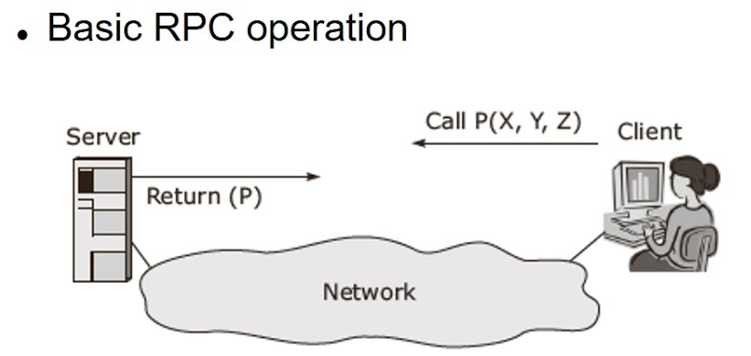
Remote Procedure Calls

Slide 59
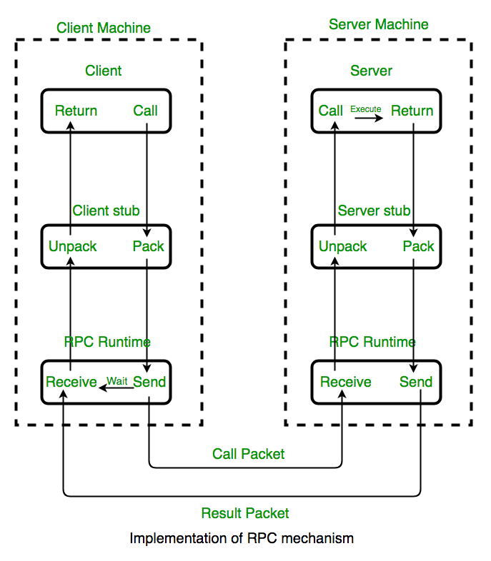
Remote Procedure Calls

Slide 60
Remote Procedure Calls (Cont.)
Data representation handled via External Data Representation (XDL) format to account for different architectures
  Big-endian and little-endian
Remote communication has more failure scenarios than local
  Messages can be delivered exactly once rather than at most once
OS typically provides a rendezvous (or matchmaker) service to connect client and server

Slide 61
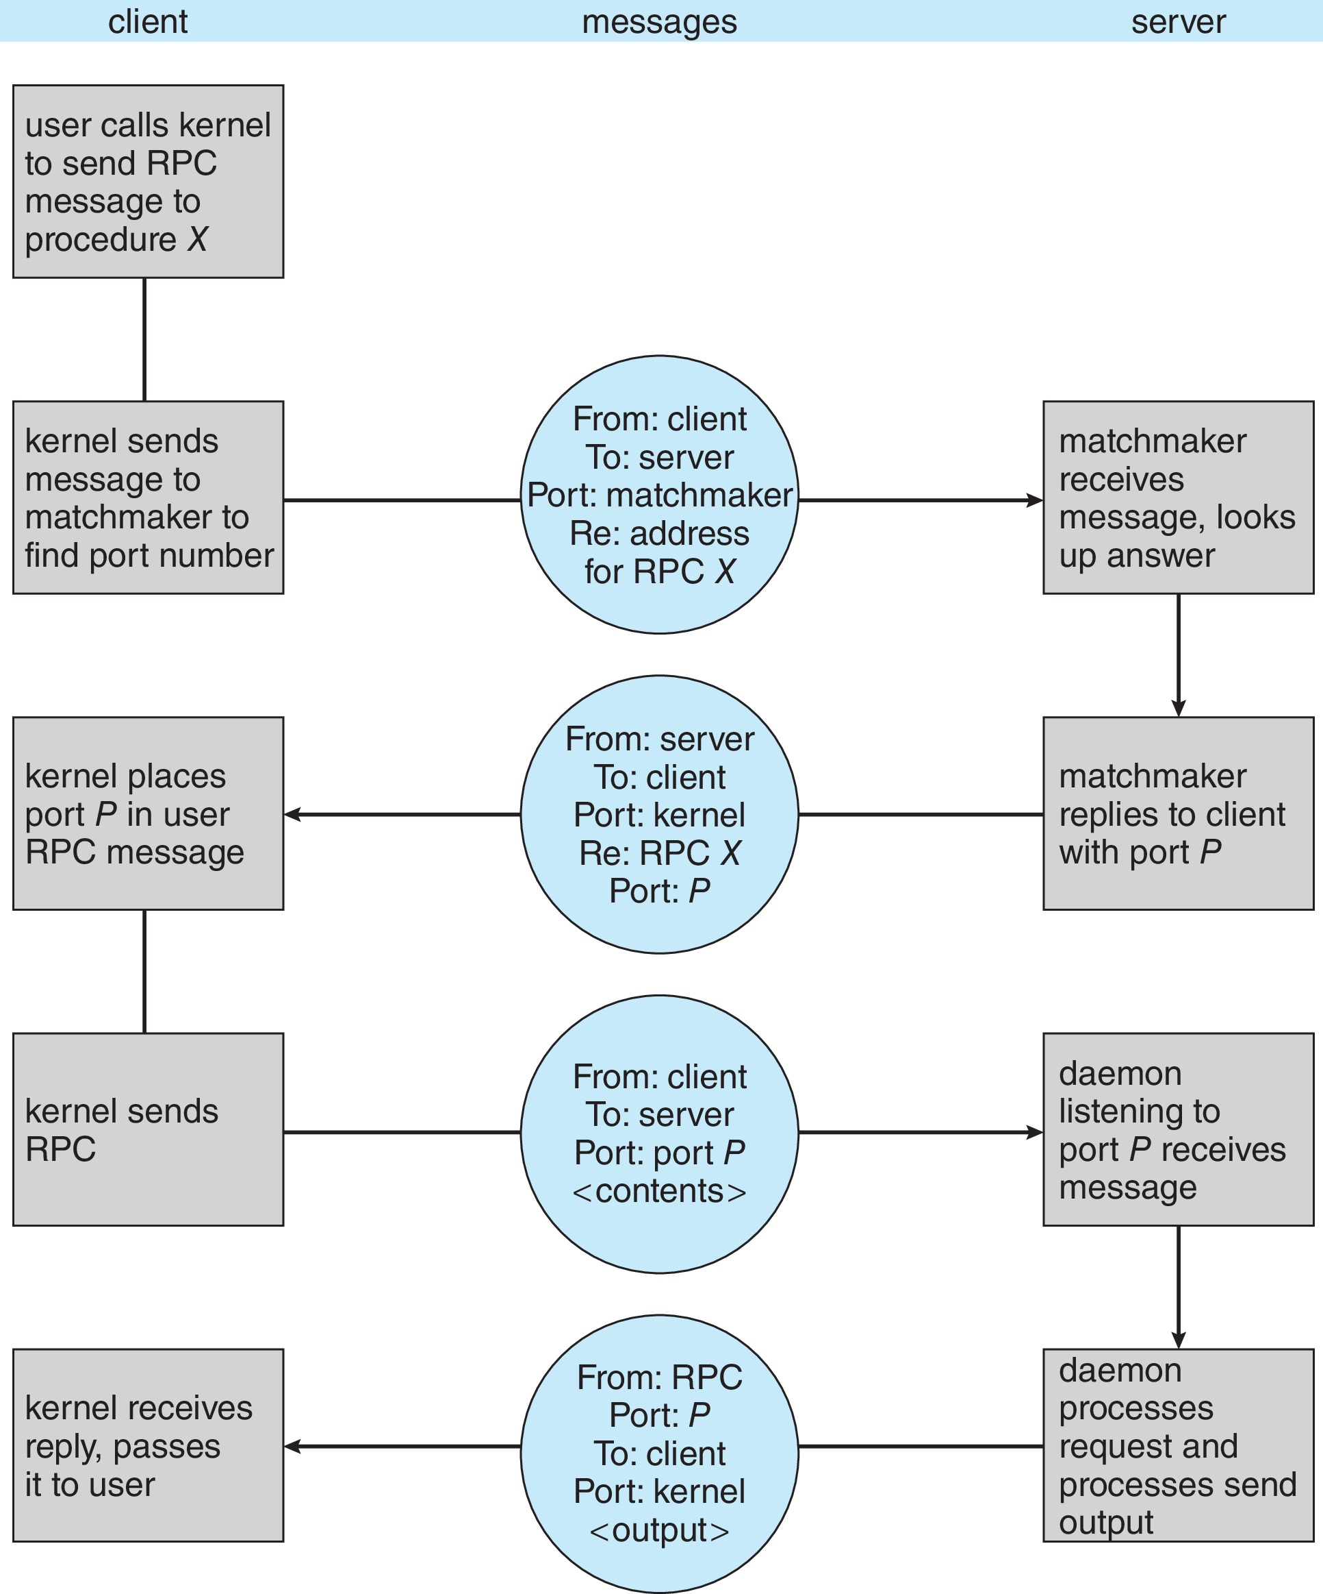
Execution of RPC

Slide 62
Outline
1. Cooperating Processes
2. Interprocess Communication (IPC)
  Shared-memory:
    Procedure-Consumer Problem
    Bounded-buffer
    Unbounded-buffer
  Message-passing
    Communication link:
      Direct & Indirect Communication
      Synchronous or Asynchronous Communication
      Automatic or Explicit buffering
    Naming
    Synchronization
    Buffering: Zero, bounded, unbounded
3. Communication in Client-Server Systems
  Sockets
  RPC
  RMI

Slide 63
Remote Method Invocation (RMI)
RMI = Java version of RPC
https://www.tutorialspoint.com/java_rmi/java_rmi_application.htm

Slide 64
Remote Method Invocation (RMI)

Slide 65
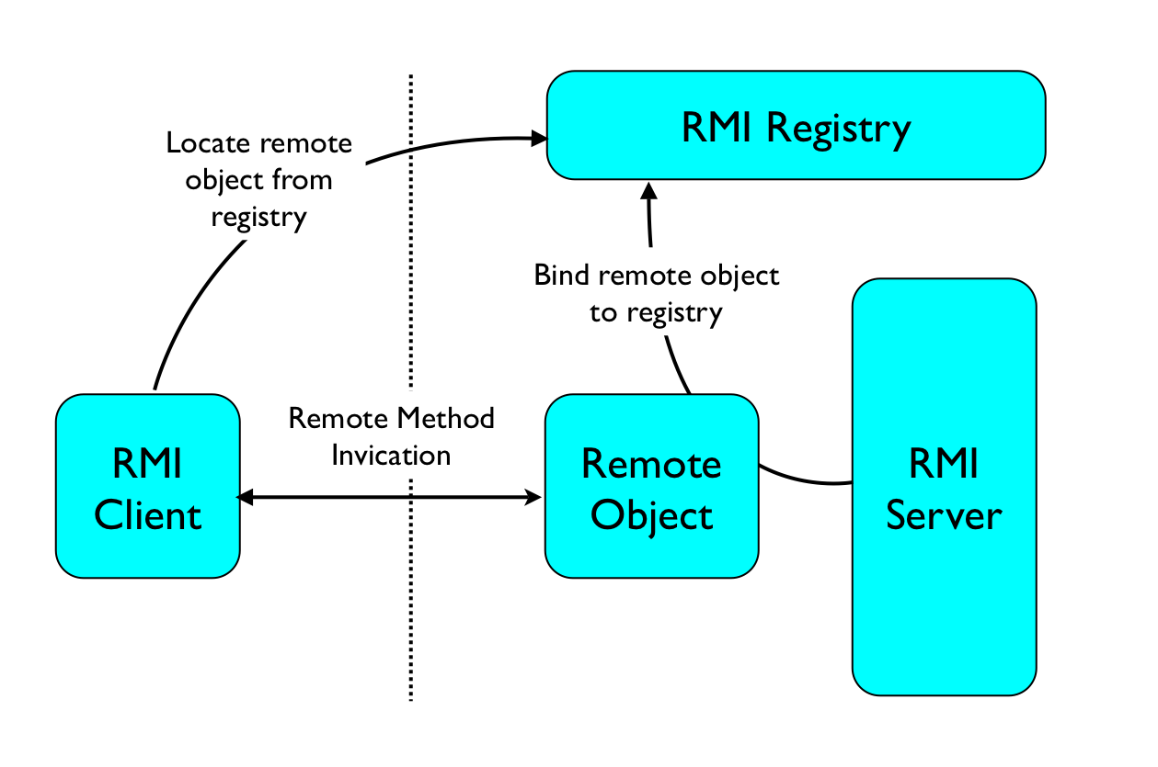
Remote Method Invocation (RMI)

Slide 66
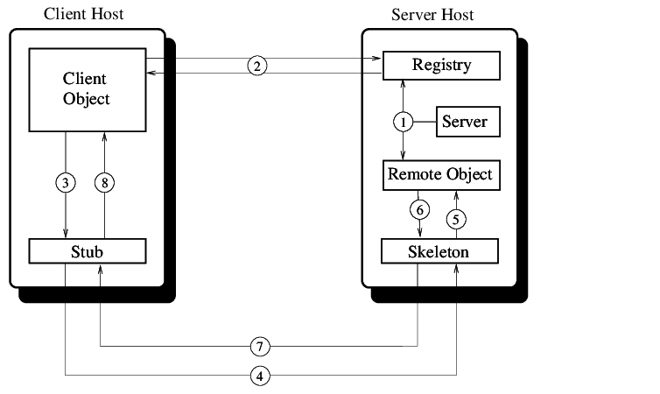
Remote Method Invocation (RMI)

Slide 67
End of Chapter 3

