Slide 1
Lecture 15
Logical & Physical Memory, Memory Allocations

Slide 2
Outline
1. Background
  Basics of Memory Organization
  Address Binding
  Logical & Physical Memory
  Dynamic loading and linking
2. Memory Allocation
  Contiguous Allocation
  Allocation methods:
      o First-Fit (FF)
      o Best-Fit (BF)
      o Worst-Fit (WF)
  Fragmentations

Slide 3
Outline
  KEYWORDS: Base register, Limit register, physical address, logical address, Binding, Compile time, Load time, Execution time, MMU, Swapping, Backing store, FF,BF,WF, Internal & External Fragmentation.
HOMEWORK:
  1) Reading : Chapter 9, especially the summary.
  2) Make sure to understand and be able to explain every keyword from the list here and the ones which are printed bold in the text book.
  3) Important Questions:
    What is the advantage of dynamic loading?
    Explain the difference between logical and physical addresses.
    Explain the difference between internal and external fragmentation.
    List the common allocation methods. Which is the poorest? What was the rationale for even considering it?
    Given memory partitions of 100K, 500K, 200K, 300K, and 600K (in that order), how would each of the First-fit, Best-fit, and Worst-fit algorithms place the processes of 212K, 417K, 112K, and 426K (in that order) ? Which algorithm makes the most efficient use of memory?

Slide 4
Outline
1. Background
  Basics of Memory Organization
  Address binding
  Logical & Physical Memory
  Dynamic loading and linking
2. Memory Allocation
  Contiguous Allocation
  Allocation methods:
      o First-Fit (FF)
      o Best-Fit (BF)
      o Worst-Fit (WF)
  Fragmentations

Slide 5
Background
Program must be brought (from disk) into memory and placed within a process for it to be run
Main memory and registers are only storage CPU can access directly
Memory unit only sees a stream of:
  addresses + read requests, or
  address + data and write requests
Register access is done in one CPU clock (or less)
Main memory can take many cycles, causing a stall
Cache sits between main memory and CPU registers
Protection of memory required to ensure correct operation

Slide 6
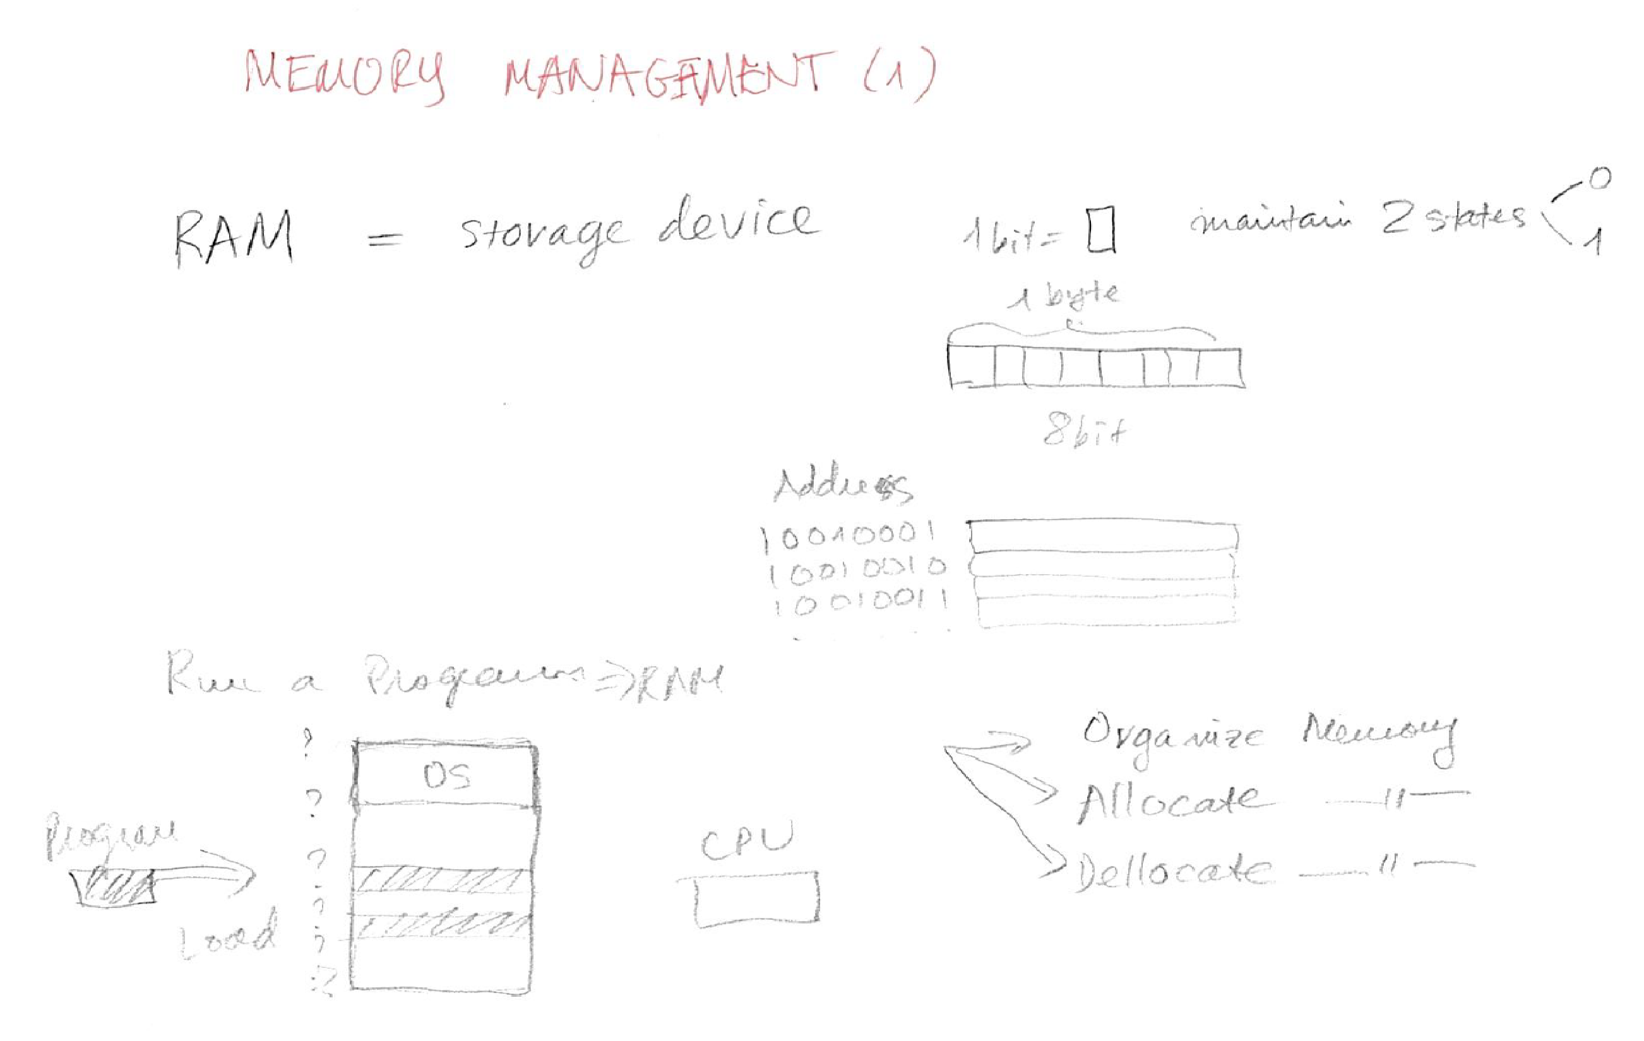
Background

Slide 7
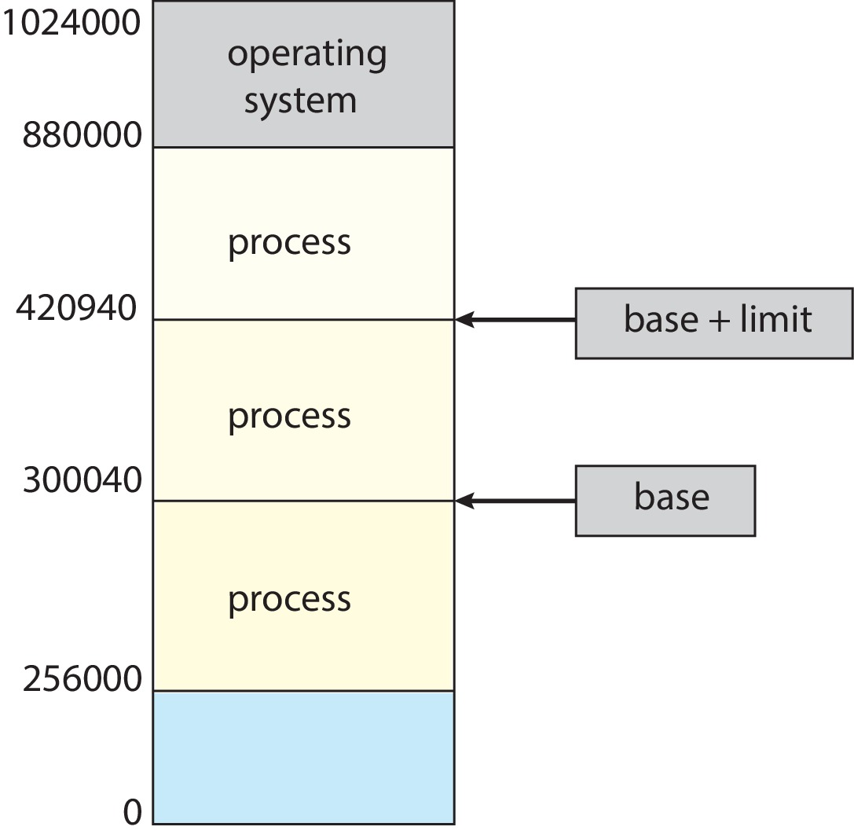
Protection
Need to censure that a process can access only access those addresses in it address space.
We can provide this protection by using a pair of base and limit registers define the logical address space of a process

Slide 8
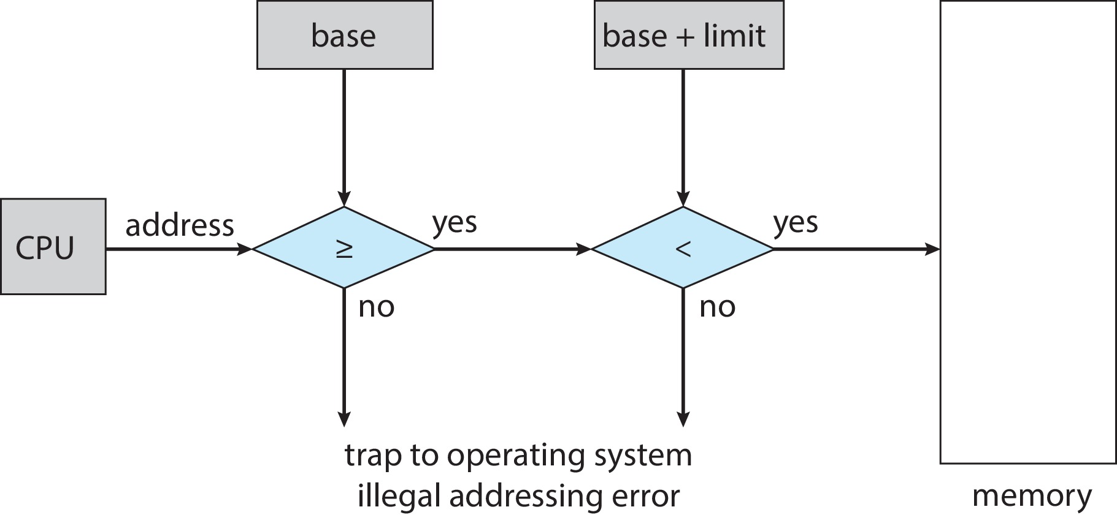
Hardware Address Protection
CPU must check every memory access generated in user mode to be sure it is between base and limit for that user
the instructions to loading the base and limit registers are privileged

Slide 9
Outline
1. Background
  Basics of Memory Organization
  Address Binding
  Logical & Physical Memory
  Dynamic loading and linking
2. Memory Allocation
  Contiguous Allocation
  Allocation methods:
      o First-Fit (FF)
      o Best-Fit (BF)
      o Worst-Fit (WF)
  Fragmentations

Slide 10
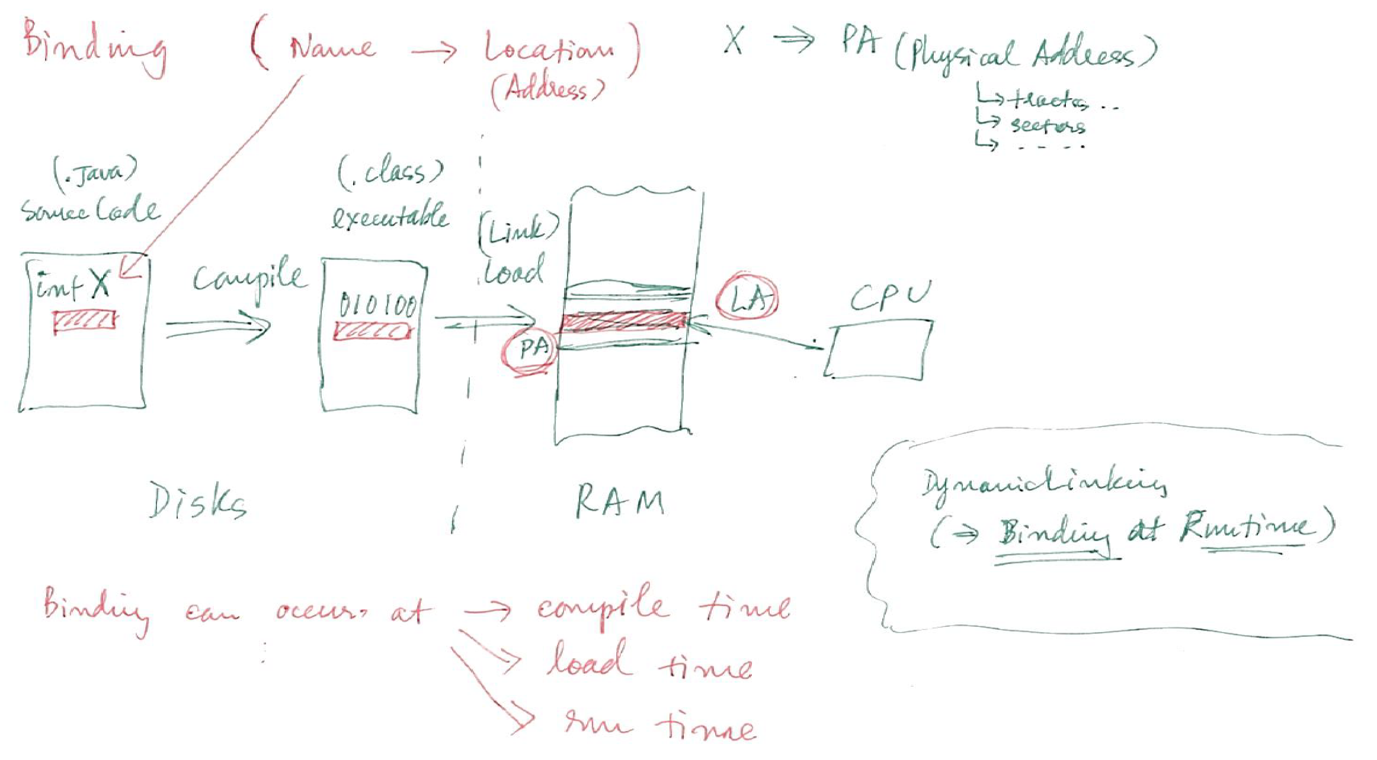
Address Binding

Slide 11
Address Binding
Programs on disk, ready to be brought into memory to execute form an input queue
  Without support, must be loaded into address 0000
Inconvenient to have first user process physical address always at 0000
  How can it not be?
Addresses represented in different ways at different stages of a program’s life
  Source code addresses usually symbolic
  Compiled code addresses bind to relocatable addresses
    i.e., “14 bytes from beginning of this module”
  Linker or loader will bind relocatable addresses to absolute addresses
    i.e., 74014
  Each binding maps one address space to another

Slide 12
Binding of Instructions and Data to Memory
Address binding of instructions and data to memory addresses can happen at three different stages
  Compile time: If memory location known a priori, absolute code can be generated; must recompile code if starting location changes
  Load time: Must generate relocatable code if memory location is not known at compile time
  Execution time: Binding delayed until run time if the process can be moved during its execution from one memory segment to another
    Need hardware support for address maps (e.g., base and limit registers)

Slide 13
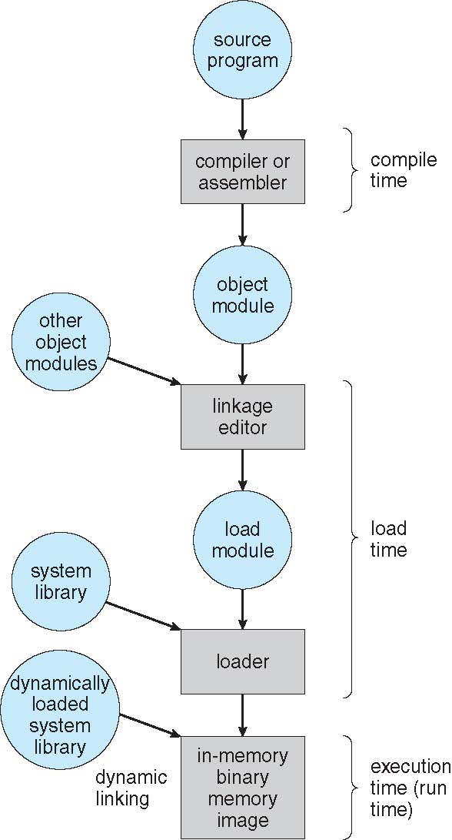
Multistep Processing of a User Program

Slide 14
Address Binding

Slide 15
Outline
1. Background
  Basics of Memory Organization
  Address binding
  Logical & Physical Memory
  Dynamic loading and linking
2. Memory Allocation
  Contiguous Allocation
  Allocation methods:
      o First-Fit (FF)
      o Best-Fit (BF)
      o Worst-Fit (WF)
  Fragmentations

Slide 16
Logical vs. Physical Address Space
The concept of a logical address space that is bound to a separate physical address space is central to proper memory management
  Logical address – generated by the CPU; also referred to as virtual address
  Physical address – address seen by the memory unit
Logical and physical addresses are the same in compile-time and load-time address-binding schemes; logical (virtual) and physical addresses differ in execution-time address-binding scheme
Logical address space is the set of all logical addresses generated by a program
Physical address space is the set of all physical addresses generated by a program

Slide 17
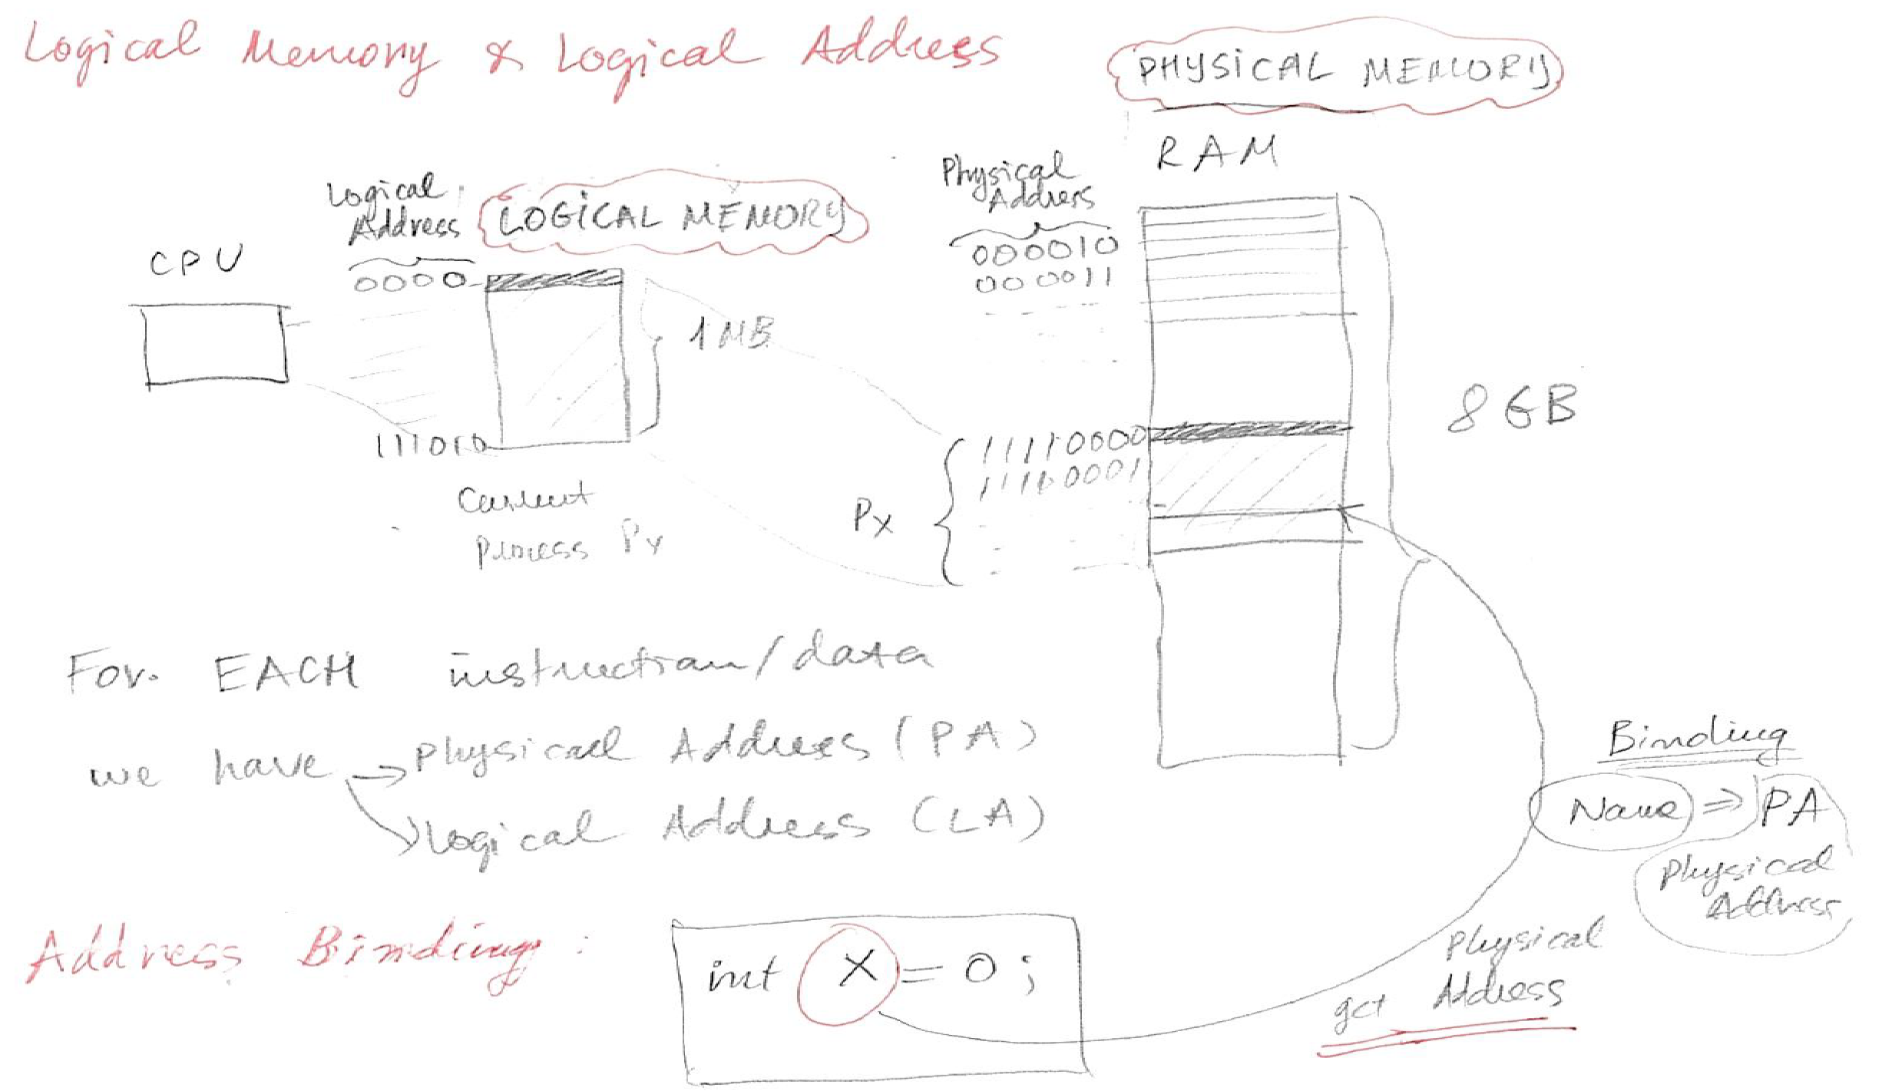
Background

Slide 18
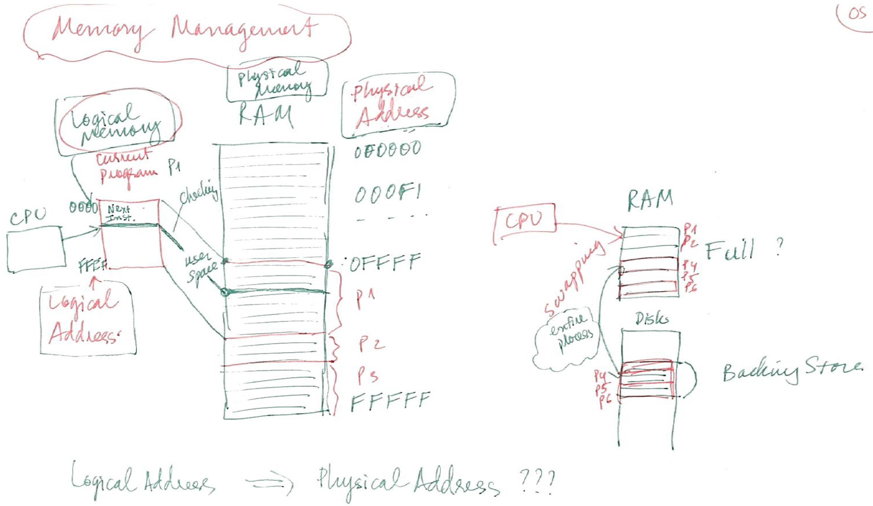
Background

Slide 19
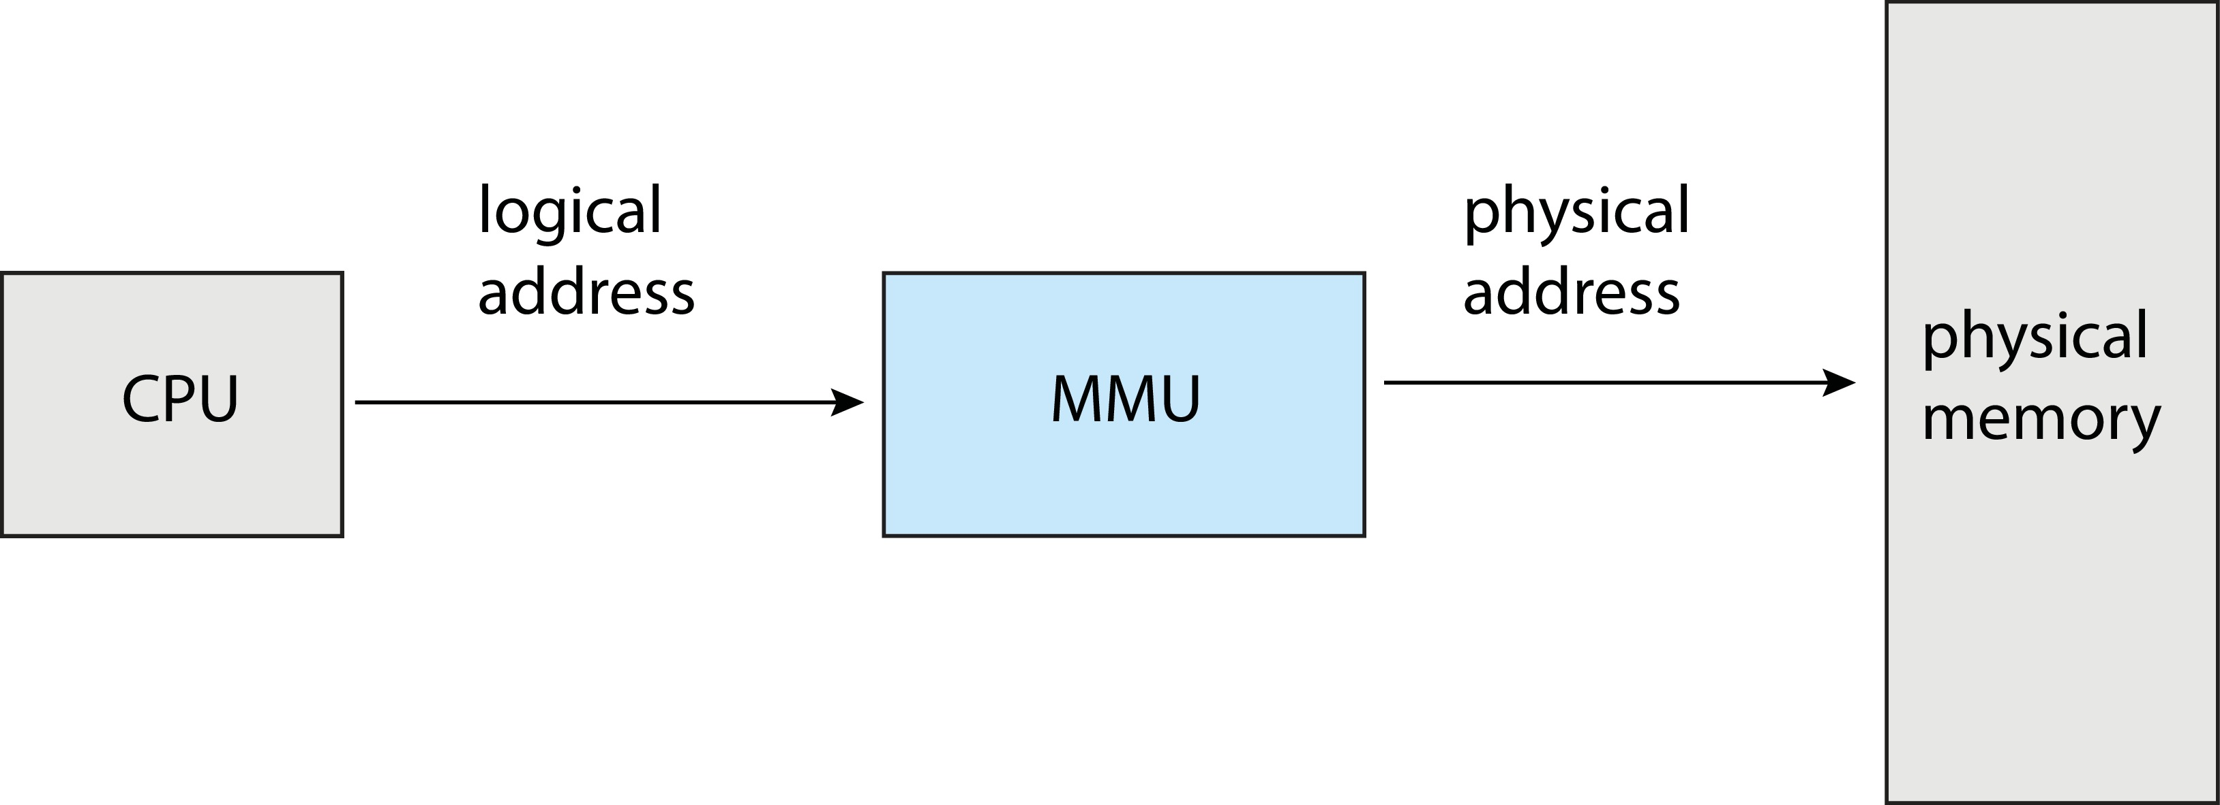
Memory-Management Unit (MMU)
Hardware device that at run time maps virtual to physical address
Many methods possible, covered in the rest of this chapter

Slide 20
Memory-Management Unit (Cont.)
Consider simple scheme. which is a generalization of the base-register scheme.
  The base register now called relocation register
The value in the relocation register is added to every address generated by a user process at the time it is sent to memory
The user program deals with logical addresses; it never sees the real physical addresses
  Execution-time binding occurs when reference is made to location in memory
  Logical address bound to physical addresses

Slide 21
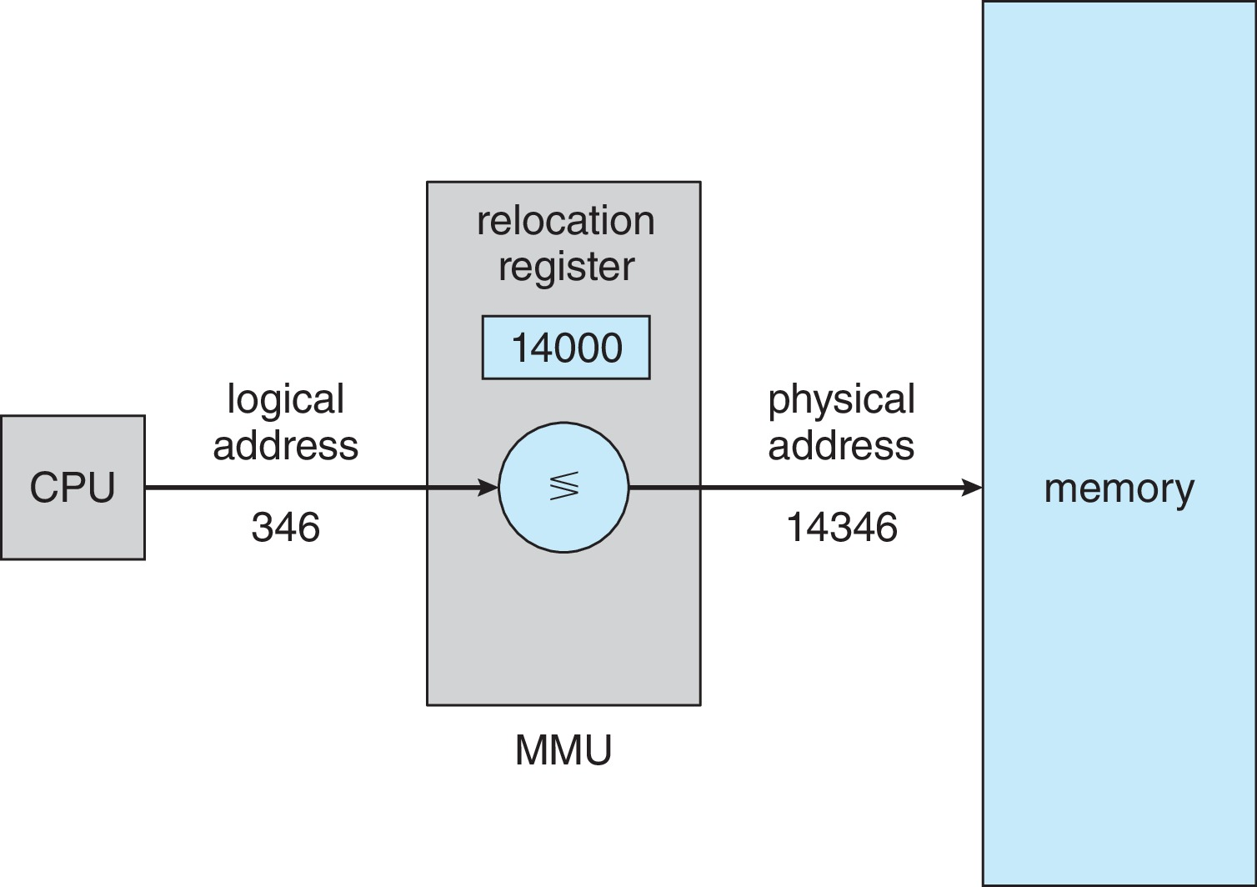
Memory-Management Unit (Cont.)
Consider simple scheme. which is a generalization of the base-register scheme.
  The base register now called relocation register
The value in the relocation register is added to every address generated by a user process at the time it is sent to memory

Slide 22
Outline
1. Background
  Basics of Memory Organization
  Address Binding
  Logical & Physical Memory
  Dynamic Loading and Linking
2. Memory Allocation
  Contiguous Allocation
  Allocation methods:
      o First-Fit (FF)
      o Best-Fit (BF)
      o Worst-Fit (WF)
  Fragmentations

Slide 23
Dynamic Loading
The entire program does need to be in memory to execute
Routine is not loaded until it is called
Better memory-space utilization; unused routine is never loaded
All routines kept on disk in relocatable load format
Useful when large amounts of code are needed to handle infrequently occurring cases
No special support from the operating system is required
  Implemented through program design
  OS can help by providing libraries to implement dynamic loading

Slide 24
Dynamic Linking
Static linking – system libraries and program code combined by the loader into the binary program image
Dynamic linking –linking postponed until execution time
Small piece of code, stub, used to locate the appropriate memory-resident library routine
Stub replaces itself with the address of the routine, and executes the routine
Operating system checks if routine is in processes’ memory address
  If not in address space, add to address space
Dynamic linking is particularly useful for libraries
System also known as shared libraries
Consider applicability to patching system libraries
  Versioning may be needed

Slide 25
Outline
1. Background
  Basics of Memory Organization
  Address binding
  Logical & Physical addresses
  Dynamic loading and linking
2. Memory Allocation
  Contiguous Allocation
  Allocation methods:
      o First-Fit (FF)
      o Best-Fit (BF)
      o Worst-Fit (WF)
  Fragmentations

Slide 26
Contiguous Allocation
Main memory must support both OS and user processes
Limited resource, must allocate efficiently
Contiguous allocation is one early method
Main memory usually into two partitions:
  Resident operating system, usually held in low memory with interrupt vector
  User processes then held in high memory
  Each process contained in single contiguous section of memory

Slide 27
Contiguous Allocation (Cont.)
Relocation registers used to protect user processes from each other, and from changing operating-system code and data
  Base register contains value of smallest physical address
  Limit register contains range of logical addresses – each logical address must be less than the limit register
  MMU maps logical address dynamically
  Can then allow actions such as kernel code being transient and kernel changing size

Slide 28
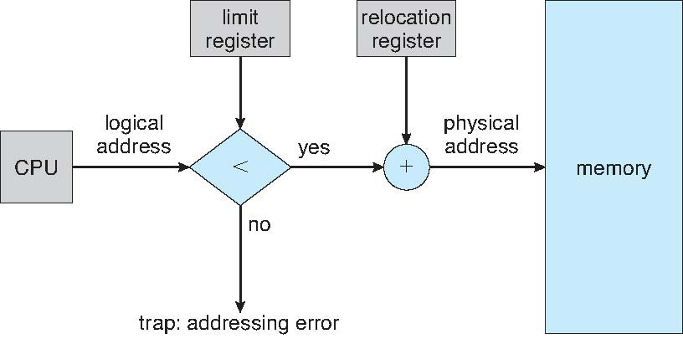
Hardware Support for Relocation and Limit Registers

Slide 29
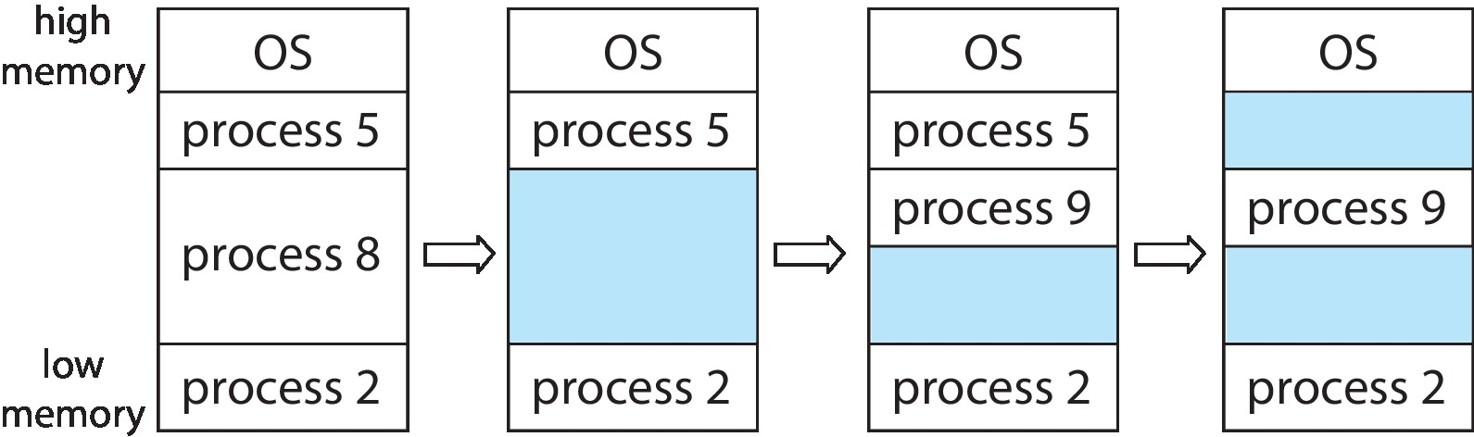
Variable Partition
Multiple-partition allocation
  Degree of multiprogramming limited by number of partitions
  Variable-partition sizes for efficiency (sized to a given process’ needs)
  Hole – block of available memory; holes of various size are scattered throughout memory
  When a process arrives, it is allocated memory from a hole large enough to accommodate it
  Process exiting frees its partition, adjacent free partitions combined
  Operating system maintains information about:
  a) allocated partitions b) free partitions (hole)

Slide 30
Outline
1. Background
  Basics of Memory Organization
  Address binding
  Logical & Physical addresses
  Dynamic loading and linking
2. Memory Allocation
  Contiguous Allocation
  Allocation methods:
      o First-Fit (FF)
      o Best-Fit (BF)
      o Worst-Fit (WF)
  Fragmentations

Slide 31
Dynamic Storage-Allocation Problem
How to satisfy a request of size n from a list of free holes?
First-fit: Allocate the first hole that is big enough
Best-fit: Allocate the smallest hole that is big enough; must search entire list, unless ordered by size
  Produces the smallest leftover hole
Worst-fit: Allocate the largest hole; must also search entire list
  Produces the largest leftover hole
First-fit and best-fit better than worst-fit in terms of speed and storage utilization

Slide 32
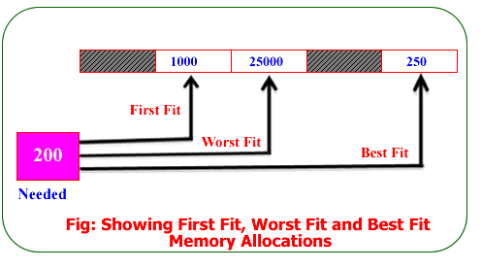
Memory Allocation Methods

Slide 33
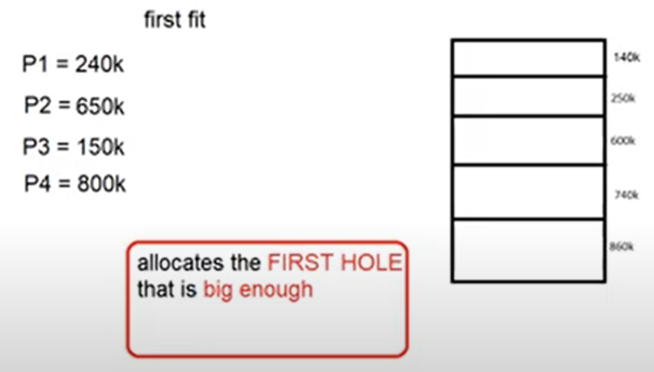
First-Fit Memory Allocation Method

Slide 34
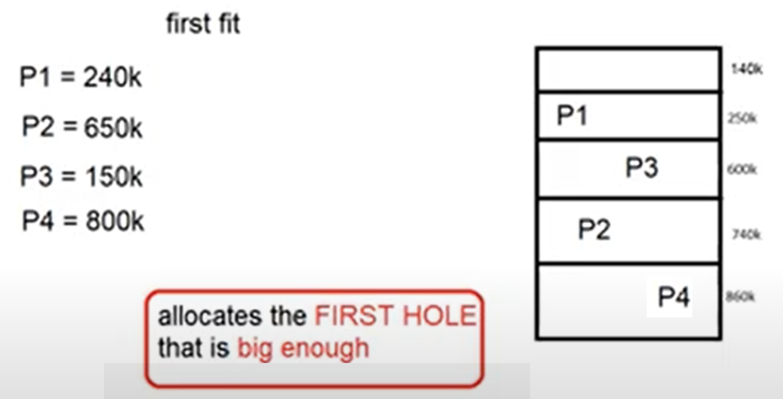
First-Fit Memory Allocation Method

Slide 35
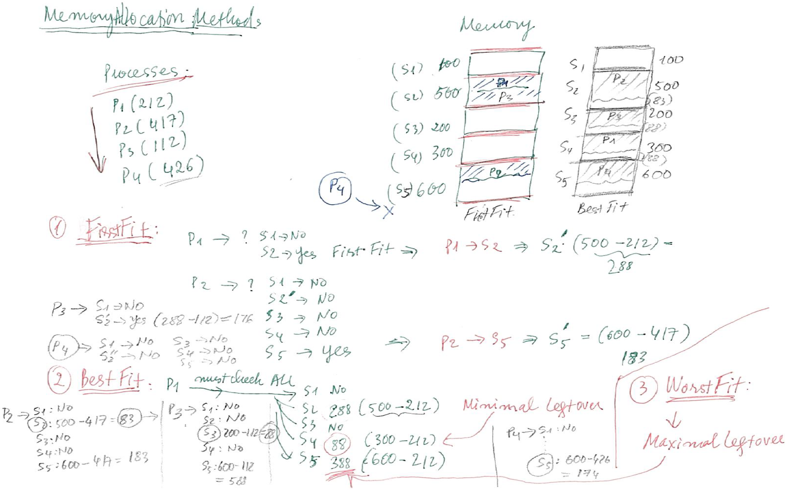
Memory Allocation Methods

Slide 36
Outline
1. Background
  Basics of Memory Organization
  Address Binding
  Logical & Physical Memory
  Dynamic loading and linking
2. Memory Allocation
  Contiguous Allocation
  Allocation methods:
      o First-Fit (FF)
      o Best-Fit (BF)
      o Worst-Fit (WF)
  Fragmentations

Slide 37
Fragmentation
External Fragmentation – total memory space exists to satisfy a request, but it is not contiguous
Internal Fragmentation – allocated memory may be slightly larger than requested memory; this size difference is memory internal to a partition, but not being used
First fit analysis reveals that given N blocks allocated, 0.5 N blocks lost to fragmentation
  1/3 may be unusable -> 50-percent rule

Slide 38
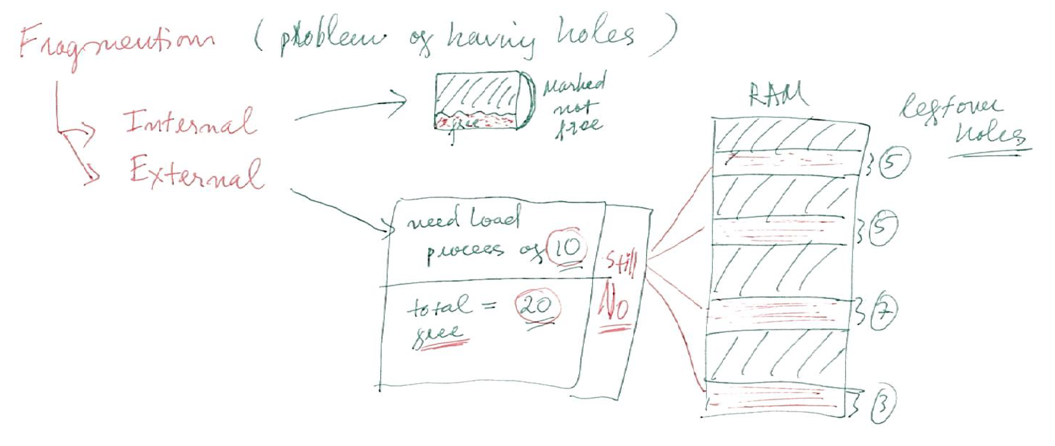
Fragmentation

Slide 39
Fragmentation (Cont.)
Reduce external fragmentation by compaction
  Shuffle memory contents to place all free memory together in one large block
  Compaction is possible only if relocation is dynamic, and is done at execution time
  I/O problem
    Latch job in memory while it is involved in I/O
    Do I/O only into OS buffers
Now consider that backing store has same fragmentation problems

