Slide 1
Lecture 16
Paging and Segmentation

Slide 2
Outline
1. Paging
  The Scheme, Address Translation
  Hardware support
  Shared Pages
  Advanced Topics
2. Swapping
3. Segmentation
  The Scheme, Address Translation
  Segmentation with Paging in Intel Pentium

Slide 3
Outline
  KEYWORDS: Paging, Frames, Pages, Page Table, Shared Pages, Segmentation, Segmentation table, Offset, swapping.
HOMEWORK:
  1) Reading : Chapter 9, especially the summary.
  2) Make sure to understand and be able to explain every keyword from the list here and the ones which are printed bold in the text book.
  3) Important Questions:
  Describe the page-to-frame translation. List advantages of paging.
  How does fragmentation for segmentation differ from that in paging?
  Consider a logical address space of eight pages of 1024 words each, mapped onto a physical memory of 32 frames.
    a. How many bits are there in the logical address?
    b. How many bits are there in the physical address?

Slide 4
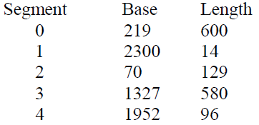
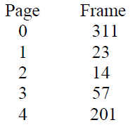
Outline
  3) Important Questions:
  Consider the following segment table:
  What are the physical addresses for the following logical addresses?
      a. 0,430
      b. 2,500
      c. 4,112
  Consider the following page table:
  Each page has 1000 byte. Each address covers one byte. What is the physical address for the following logical address?
  Logical Address LA = 3,251
  Physical Address PA = ?

Slide 5
Outline
1. Paging
  The Scheme, Address Translation
  Hardware support
  Shared Pages
  Advanced Topics
2. Swapping
3. Segmentation
  The Scheme, Address Translation
  Segmentation with Paging in Intel Pentium

Slide 6
Memory Organization
Paging & Segmentation are methods to organize RAM
Divide both physical and logical memory into blocks
In PAGING: blocks of same size
  Blocks in logical memory are called pages
  Blocks in physical memory are called frames
In SEGMENTATION: blocks of various sizes called segments

Slide 7
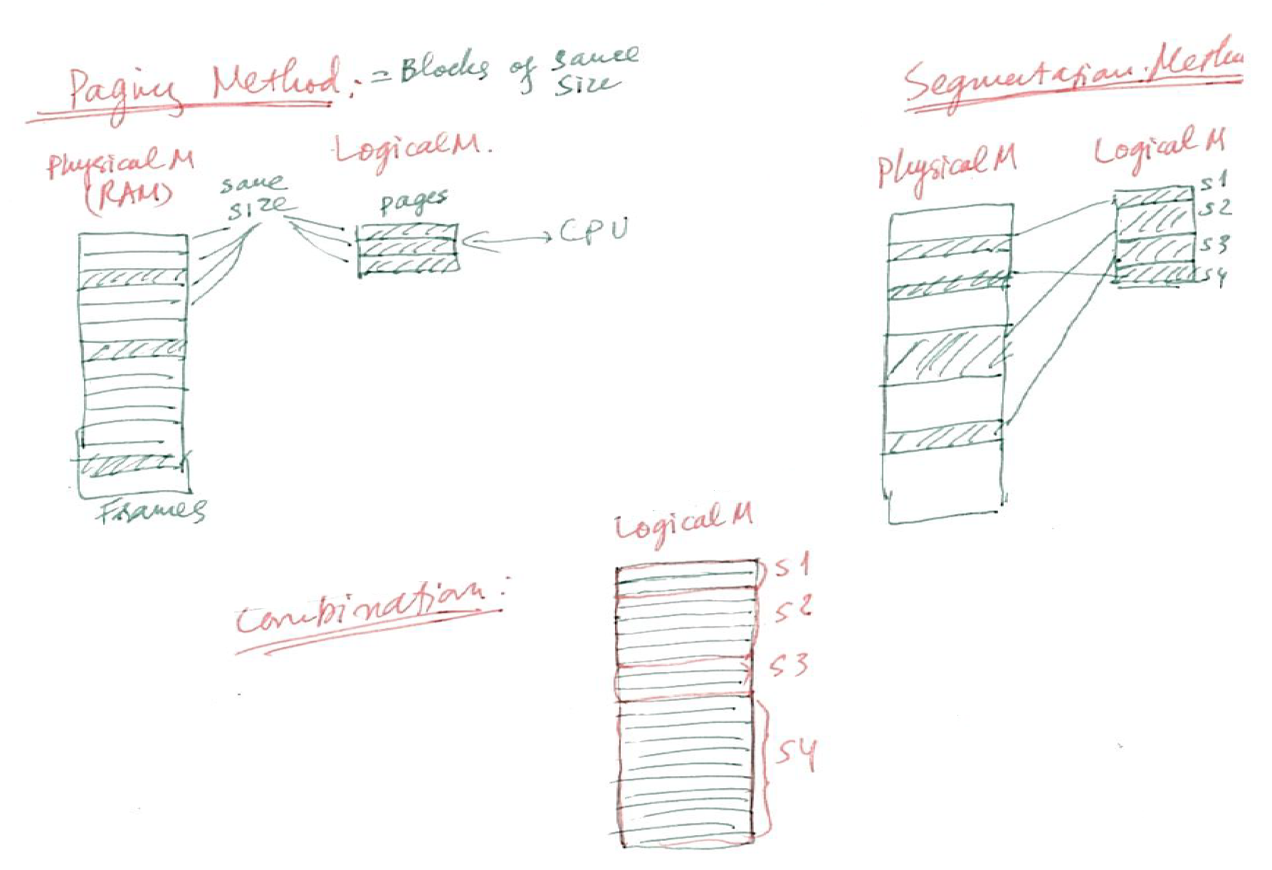
Overview of Paging & Segmentation

Slide 8
Outline
1. Paging
  The Scheme, Address Translation
  Hardware support
  Shared Pages
  Advanced Topics
2. Swapping
3. Segmentation
  The Scheme, Address Translation
  Segmentation with Paging in Intel Pentium

Slide 9
Paging
Physical address space of a process can be noncontiguous; process is allocated physical memory whenever the latter is available
  Avoids external fragmentation
  Avoids problem of varying sized memory chunks
Divide physical memory into fixed-sized blocks called frames
  Size is power of 2, between 512 bytes and 16 Mbytes
Divide logical memory into blocks of same size called pages
Keep track of all free frames
To run a program of size N pages, need to find N free frames and load program
Set up a page table to translate logical to physical addresses
Backing store likewise split into pages
Still have Internal fragmentation

Slide 10
Address Translation Scheme
Address generated by CPU is divided into:
  Page number (p) – used as an index into a page table which contains base address of each page in physical memory
  Page offset (d) – combined with base address to define the physical memory address that is sent to the memory unit
  For given logical address space 2^{m} and page size 2^{n}

Slide 11
Outline
1. Paging
  The Scheme, Address Translation
  Hardware support
  Shared Pages
  Advanced Topics
2. Swapping
3. Segmentation
  The Scheme, Address Translation
  Segmentation with Paging in Intel Pentium

Slide 12
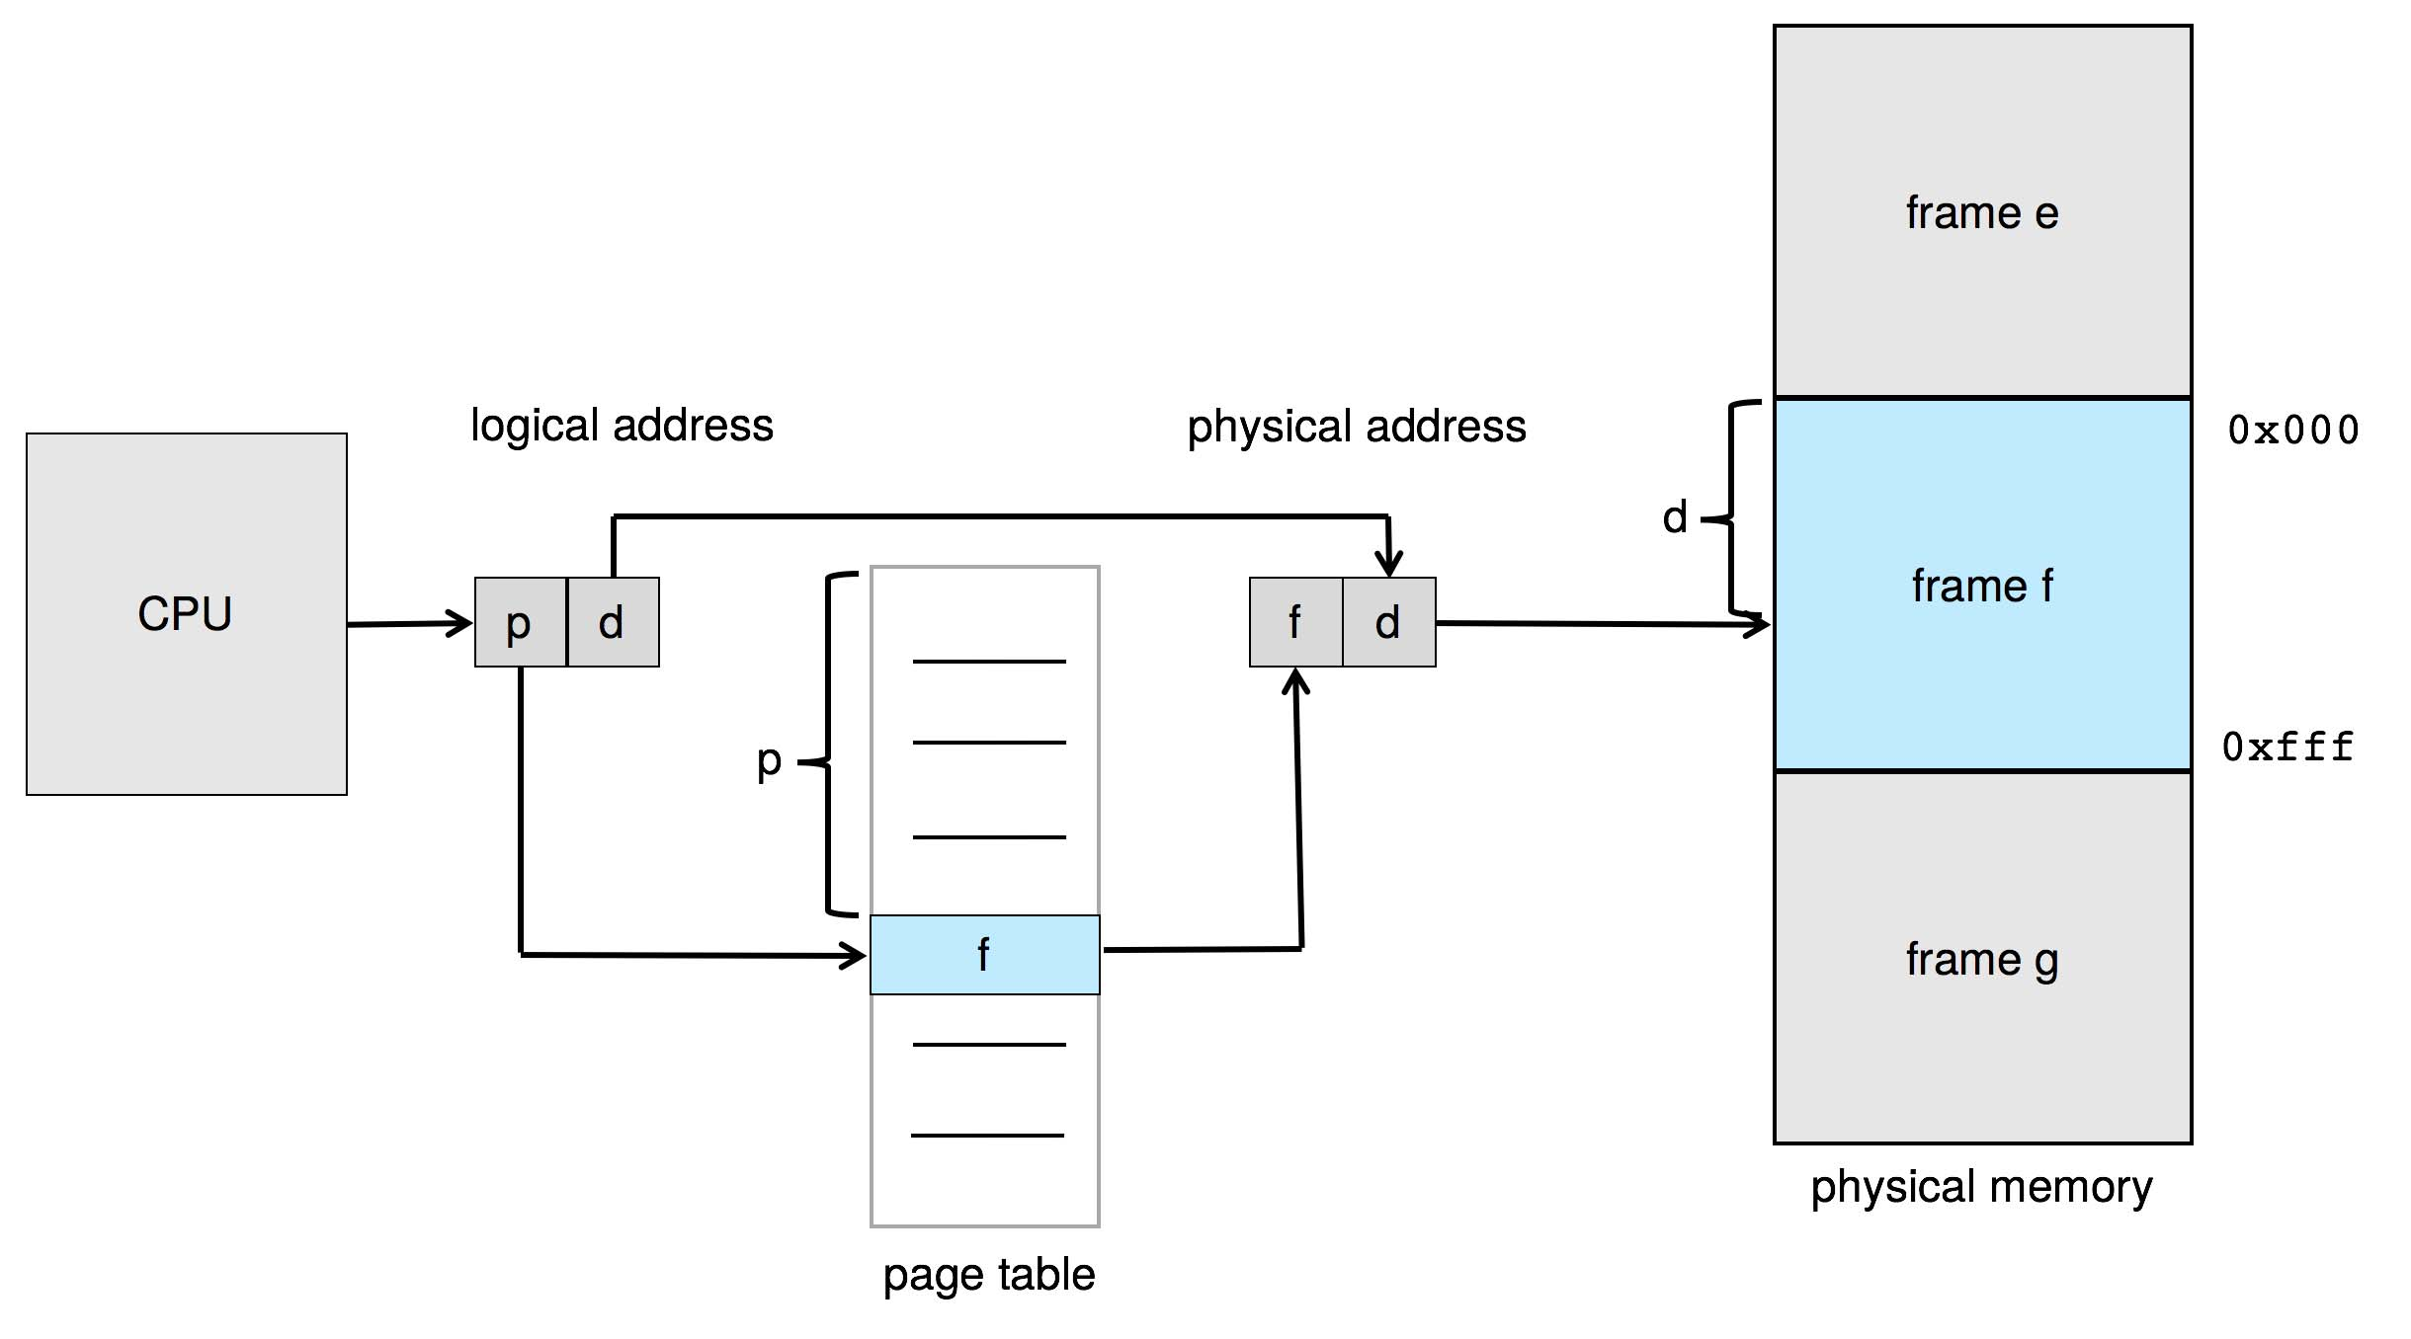
Paging Hardware

Slide 13
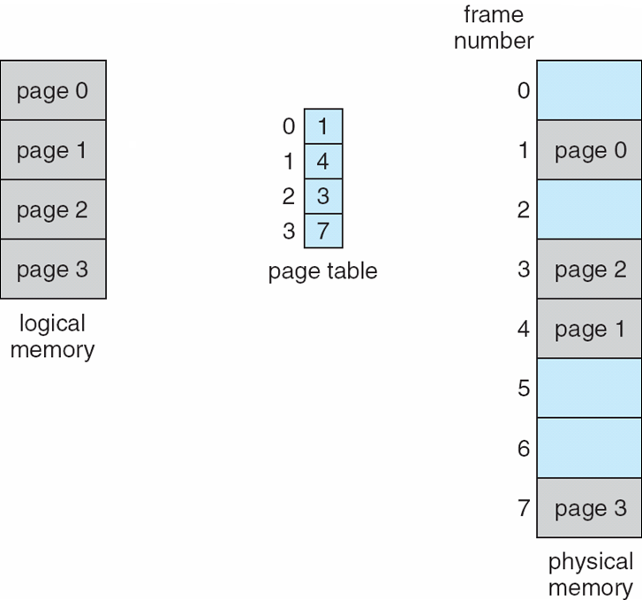
Paging Model of Logical and Physical Memory

Slide 14
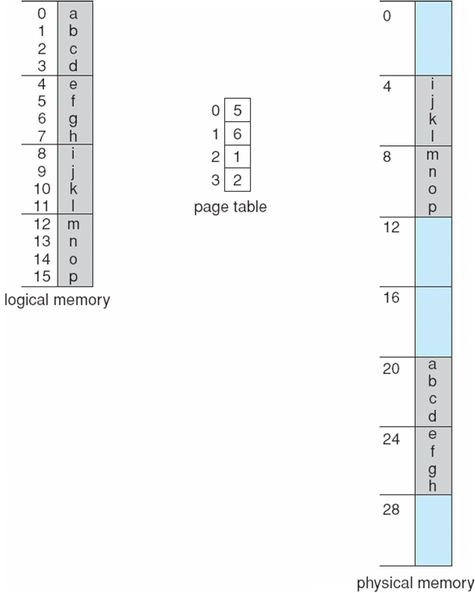
Paging Example 1
Logical address: LA = [ 2,3 ] (for “l”) it means that page # = 2 and d/offset = 4
THEN Physical address PA = [ 1, 3 ] because in the Page Table: page # 2 links to frame # 1
Using a page size of 4 bytes and a physical memory of 32 bytes (8 pages)
Page #
0
1
2
3
Frame #
0
1
2
3
4
5
…
LA
PA

Slide 15
Paging Example 2
Logical address: LA = [ 1,2 ] (for “g”) it means that page # = 1 and d/offset = 3
THEN Physical address PA = [ 6,2 ] because in the Page Table: page # 1 links to frame # 6
Using a page size of 4 bytes and a physical memory of 32 bytes (8 pages)
Page #
0
1
2
3
Frame #
0
1
2
3
4
5
…
LA
PA

Slide 16
Paging -- Calculating internal fragmentation
Page size = 2,048 bytes
Process size = 72,766 bytes
35 pages + 1,086 bytes
Internal fragmentation of 2,048 - 1,086 = 962 bytes
Worst case fragmentation = 1 frame – 1 byte
On average fragmentation = 1 / 2 frame size
So small frame sizes desirable?
But each page table entry takes memory to track
Page sizes growing over time
  Solaris supports two page sizes – 8 KB and 4 MB

Slide 17
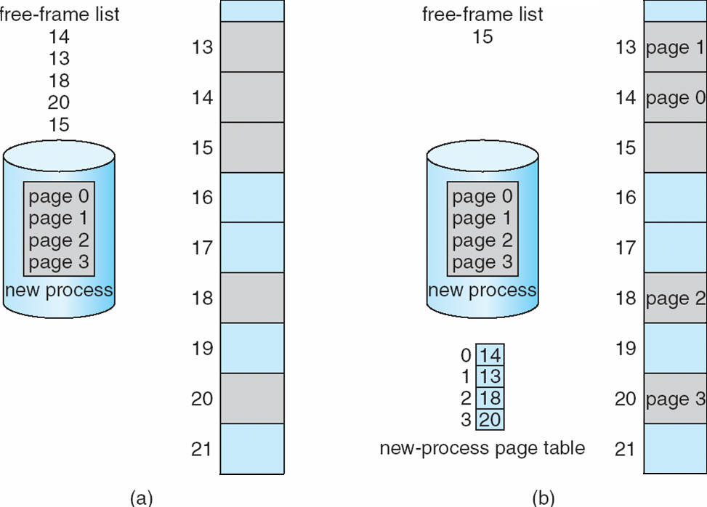
Free Frames
Before allocation
After allocation

Slide 18
Implementation of Page Table
Page table is kept in main memory
  Page-table base register (PTBR) points to the page table
  Page-table length register (PTLR) indicates size of the page table
In this scheme every data/instruction access requires two memory accesses
  One for the page table and one for the data / instruction
The two-memory access problem can be solved by the use of a special fast-lookup hardware cache called translation look-aside buffers (TLBs) (also called associative memory).

Slide 19
Translation Look-Aside Buffer
Some TLBs store address-space identifiers (ASIDs) in each TLB entry – uniquely identifies each process to provide address-space protection for that process
  Otherwise need to flush at every context switch
TLBs typically small (64 to 1,024 entries)
On a TLB miss, value is loaded into the TLB for faster access next time
  Replacement policies must be considered
  Some entries can be wired down for permanent fast access

Slide 20
Hardware
Associative memory – parallel search
Address translation (p, d)
  If p is in associative register, get frame # out
  Otherwise get frame # from page table in memory

Slide 21
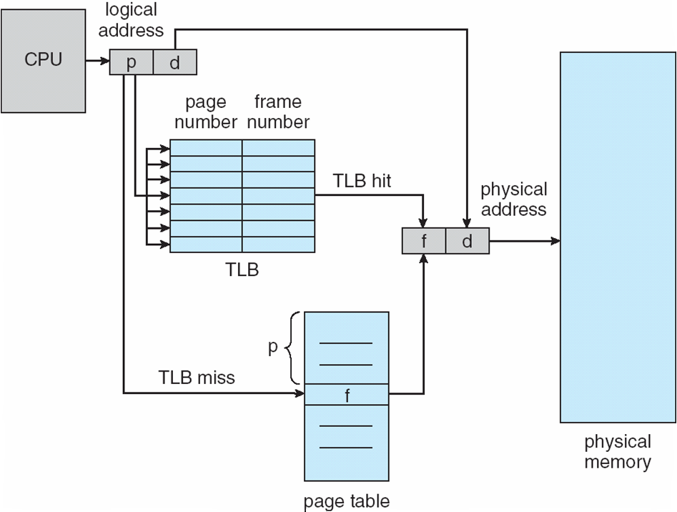
Paging Hardware With TLB

Slide 22
Translation of LA to PA with Page Table
Consider the following page table:
Page # Frame #
0 7311
1 323
2 814
3 257
4 9201
Each page has 1000 bytes. Each address covers one byte. What is the physical address for the following Logical Address LA = [ 2 , 257 ] ? Explain how you find it.
ANSWER:
Logical Address LA = [ 2 , 257 ] = [Page #, Offset]
means page number = 2 and the Offset = 257.
Use page = 2 in LA, look up at the Page Table,
we’ll have Frame = 814, the Offset = 257
Therefore, the physical address (PA) is [ Frame #, Offset ] or [ 814, 257 ]

Slide 23
Effective Access Time
  Hit ratio – percentage of times that a page number is found in the TLB
An 80% hit ratio means that we find the desired page number in the TLB 80% of the time.
Suppose that 10 nanoseconds to access memory.
  If we find the desired page in TLB then a mapped-memory access take 10 ns
  Otherwise we need two memory access so it is 20 ns
Effective Access Time (EAT)
EAT = 0.80 x 10 + 0.20 x 20 = 12 nanoseconds
implying 20% slowdown in access time
Consider amore realistic hit ratio of 99%,
  EAT = 0.99 x 10 + 0.01 x 20 = 10.1ns
implying only 1% slowdown in access time.

Slide 24
Memory Protection
Memory protection implemented by associating protection bit with each frame to indicate if read-only or read-write access is allowed
  Can also add more bits to indicate page execute-only, and so on
Valid-invalid bit attached to each entry in the page table:
  “valid” indicates that the associated page is in the process’ logical address space, and is thus a legal page
  “invalid” indicates that the page is not in the process’ logical address space
  Or use page-table length register (PTLR)
Any violations result in a trap to the kernel

Slide 25
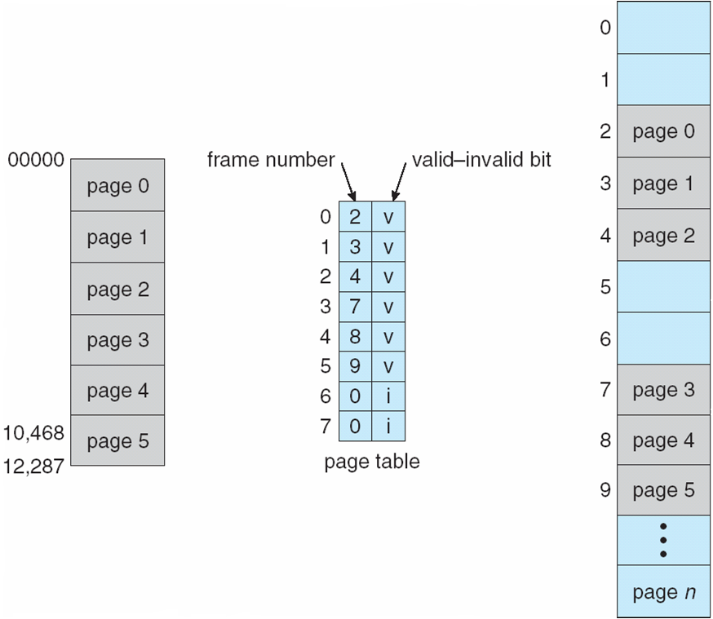
Valid (v) or Invalid (i) Bit In A Page Table

Slide 26
Outline
1. Paging
  The Scheme, Address Translation
  Hardware support
  Shared Pages
  Advanced Topics
2. Swapping
3. Segmentation
  The Scheme, Address Translation
  Segmentation with Paging in Intel Pentium

Slide 27
Shared Pages
Shared code
  One copy of read-only (reentrant) code shared among processes (i.e., text editors, compilers, window systems)
  Similar to multiple threads sharing the same process space
  Also useful for interprocess communication if sharing of read-write pages is allowed
Private code and data
  Each process keeps a separate copy of the code and data
  The pages for the private code and data can appear anywhere in the logical address space

Slide 28
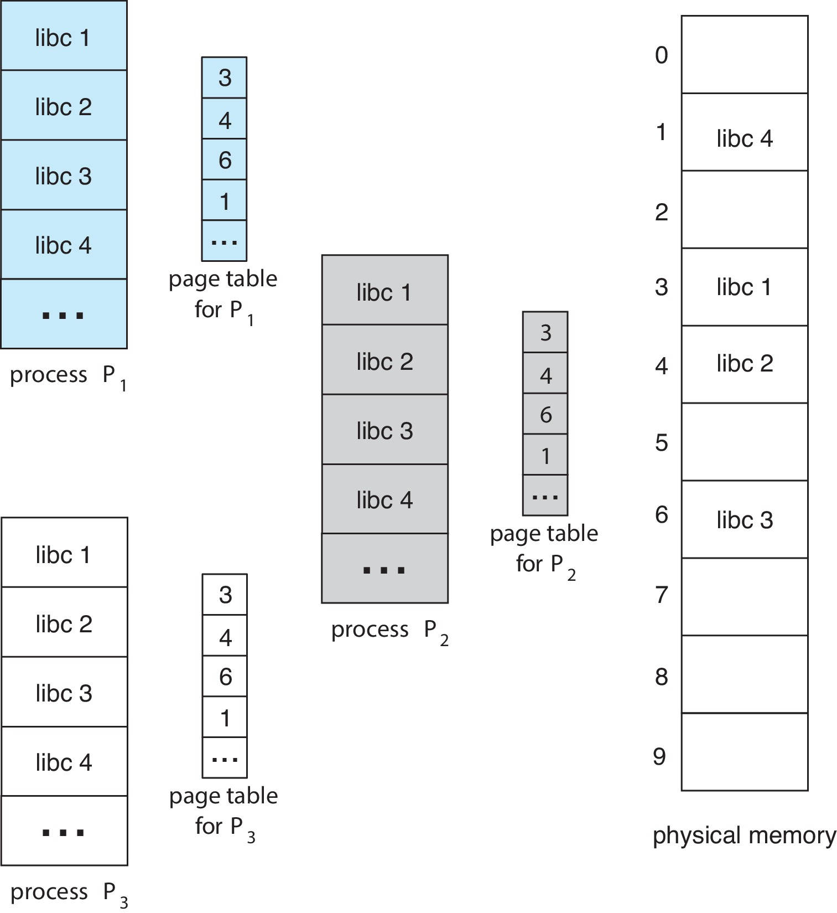
Shared Pages Example

Slide 29
Outline
1. Paging
  The Scheme, Address Translation
  Hardware support
  Shared Pages
  Advanced Topics
2. Swapping
3. Segmentation
  The Scheme, Address Translation
  Segmentation with Paging in Intel Pentium

Slide 30
Structure of the Page Table
Memory structures for paging can get huge using straight-forward methods
  Consider a 32-bit logical address space as on modern computers
  Page size of 4 KB (2¹²)
  Page table would have 1 million entries (2³² / 2¹²)
  If each entry is 4 bytes ➔ each process 4 MB of physical address space for the page table alone
    Don’t want to allocate that contiguously in main memory
  One simple solution is to divide the page table into smaller units
    Hierarchical Paging
    Hashed Page Tables
    Inverted Page Tables

Slide 31
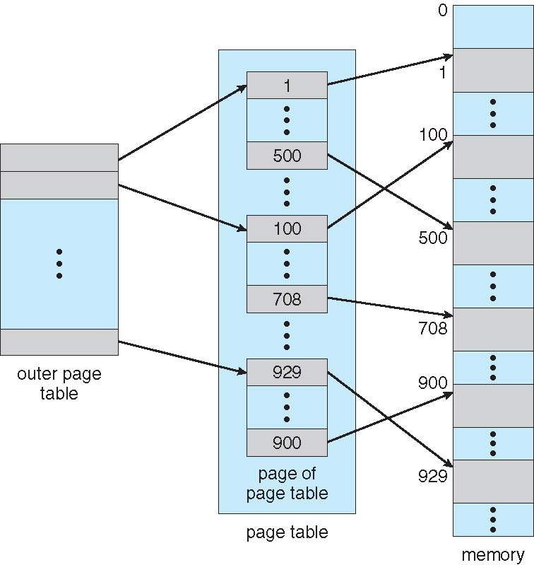
Hierarchical Page Tables
Break up the logical address space into multiple page tables
A simple technique is a two-level page table
We then page the page table

Slide 32
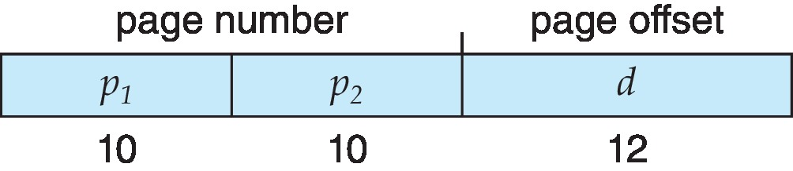
Two-Level Paging Example
A logical address (on 32-bit machine with 1K page size) is divided into:
  a page number consisting of 22 bits
  a page offset consisting of 10 bits
Since the page table is paged, the page number is further divided into:
  a 10-bit page number
  a 12-bit page offset
Thus, a logical address is as follows:
where p₁ is an index into the outer page table, and p₂ is the displacement within the page of the inner page table
Known as forward-mapped page table

Slide 33
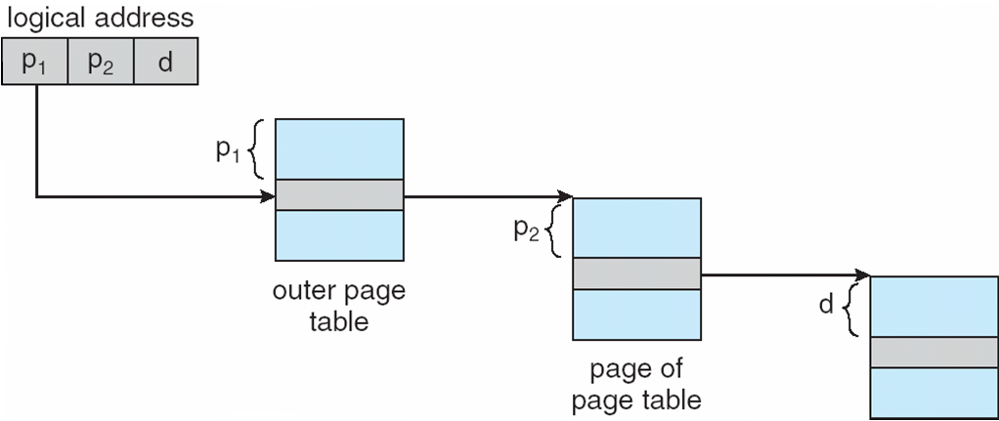
Address-Translation Scheme

Slide 34
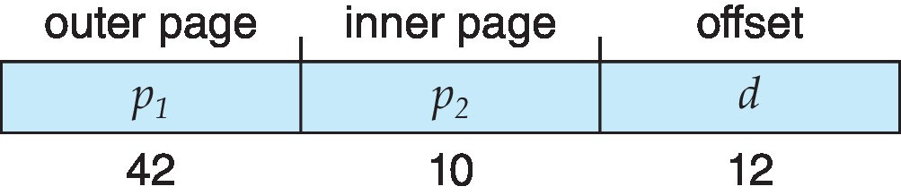
64-bit Logical Address Space
Even two-level paging scheme not sufficient
If page size is 4 KB (2¹²)
  Then page table has 2⁵² entries
  If two level scheme, inner page tables could be 2¹⁰ 4-byte entries
  Address would look like
  Outer page table has 2⁴² entries or 2⁴⁴ bytes
  One solution is to add a 2nd outer page table
  But in the following example the 2nd outer page table is still 2³⁴ bytes in size
    And possibly 4 memory access to get to one physical memory location

Slide 35
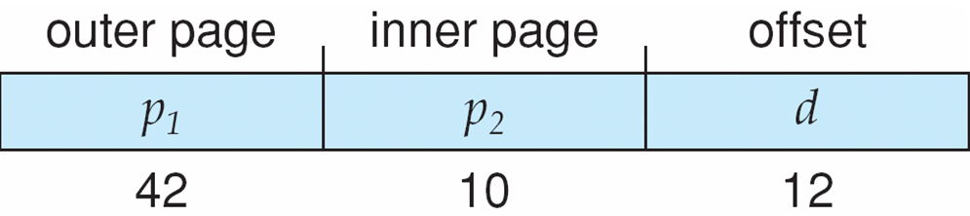
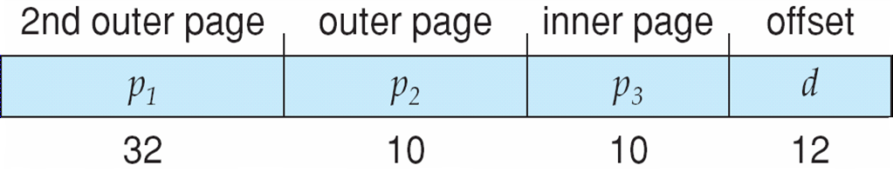
Three-level Paging Scheme

Slide 36
Hashed Page Tables
Common in address spaces > 32 bits
The virtual page number is hashed into a page table
  This page table contains a chain of elements hashing to the same location
Each element contains (1) the virtual page number (2) the value of the mapped page frame (3) a pointer to the next element
Virtual page numbers are compared in this chain searching for a match
  If a match is found, the corresponding physical frame is extracted
Variation for 64-bit addresses is clustered page tables
  Similar to hashed but each entry refers to several pages (such as 16) rather than 1
  Especially useful for sparse address spaces (where memory references are non-contiguous and scattered)

Slide 37
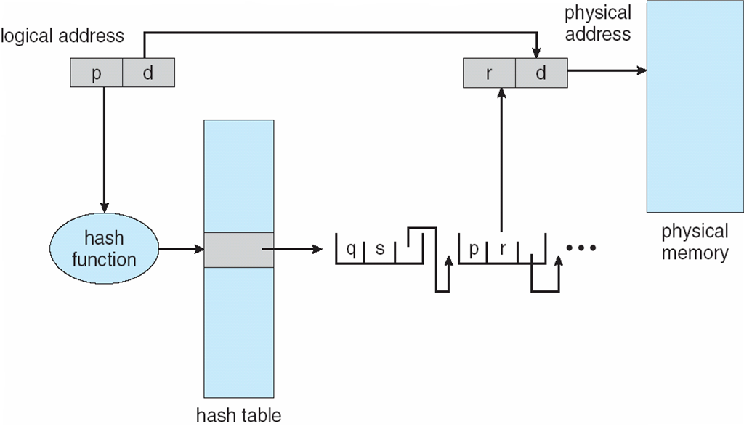
Hashed Page Table

Slide 38
Inverted Page Table
Rather than each process having a page table and keeping track of all possible logical pages, track all physical pages
One entry for each real page of memory
Entry consists of the virtual address of the page stored in that real memory location, with information about the process that owns that page
Decreases memory needed to store each page table, but increases time needed to search the table when a page reference occurs
Use hash table to limit the search to one — or at most a few — page-table entries
  TLB can accelerate access
But how to implement shared memory?
  One mapping of a virtual address to the shared physical address

Slide 39
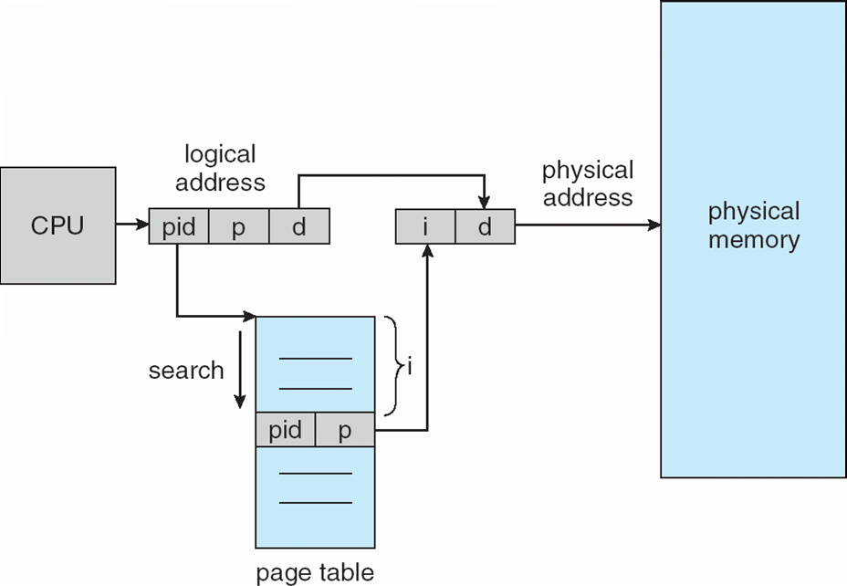
Inverted Page Table Architecture

Slide 40
Outline
1. Paging
  The Scheme, Address Translation
  Hardware support
  Shared Pages
  Advanced Topics
2. Swapping
3. Segmentation
  The Scheme, Address Translation
  Segmentation with Paging in Intel Pentium

Slide 41
Swapping
A process can be swapped temporarily out of memory to a backing store, and then brought back into memory for continued execution
  Total physical memory space of processes can exceed physical memory
Backing store – fast disk large enough to accommodate copies of all memory images for all users; must provide direct access to these memory images
Roll out, roll in – swapping variant used for priority-based scheduling algorithms; lower-priority process is swapped out so higher-priority process can be loaded and executed
Major part of swap time is transfer time; total transfer time is directly proportional to the amount of memory swapped
System maintains a ready queue of ready-to-run processes which have memory images on disk

Slide 42
Swapping (Cont.)
Does the swapped out process need to swap back in to same physical addresses?
Depends on address binding method
  Plus consider pending I/O to / from process memory space
Modified versions of swapping are found on many systems (i.e., UNIX, Linux, and Windows)
  Swapping normally disabled
  Started if more than threshold amount of memory allocated
  Disabled again once memory demand reduced below threshold

Slide 43
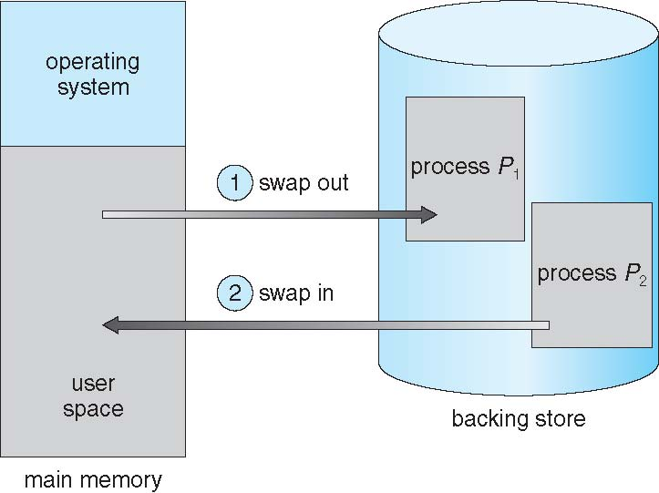
Schematic View of Swapping

Slide 44
Context Switch Time including Swapping
If next processes to be put on CPU is not in memory, need to swap out a process and swap in target process
Context switch time can then be very high
100MB process swapping to hard disk with transfer rate of 50MB/sec
  Swap out time of 2000 ms
  Plus swap in of same sized process
  Total context switch swapping component time of 4000ms (4 seconds)
Can reduce if reduce size of memory swapped – by knowing how much memory really being used
  System calls to inform OS of memory use via request_memory() and release_memory()

Slide 45
Context Switch Time and Swapping (Cont.)
Other constraints as well on swapping
  Pending I/O – can’t swap out as I/O would occur to wrong process
  Or always transfer I/O to kernel space, then to I/O device
    Known as double buffering, adds overhead
Standard swapping not used in modern operating systems
  But modified version common
    Swap only when free memory extremely low

Slide 46
Swapping on Mobile Systems
Not typically supported
  Flash memory based
    Small amount of space
    Limited number of write cycles
    Poor throughput between flash memory and CPU on mobile platform
Instead use other methods to free memory if low
  iOS asks apps to voluntarily relinquish allocated memory
    Read-only data thrown out and reloaded from flash if needed
    Failure to free can result in termination
  Android terminates apps if low free memory, but first writes application state to flash for fast restart
  Both OSes support paging as discussed below

Slide 47
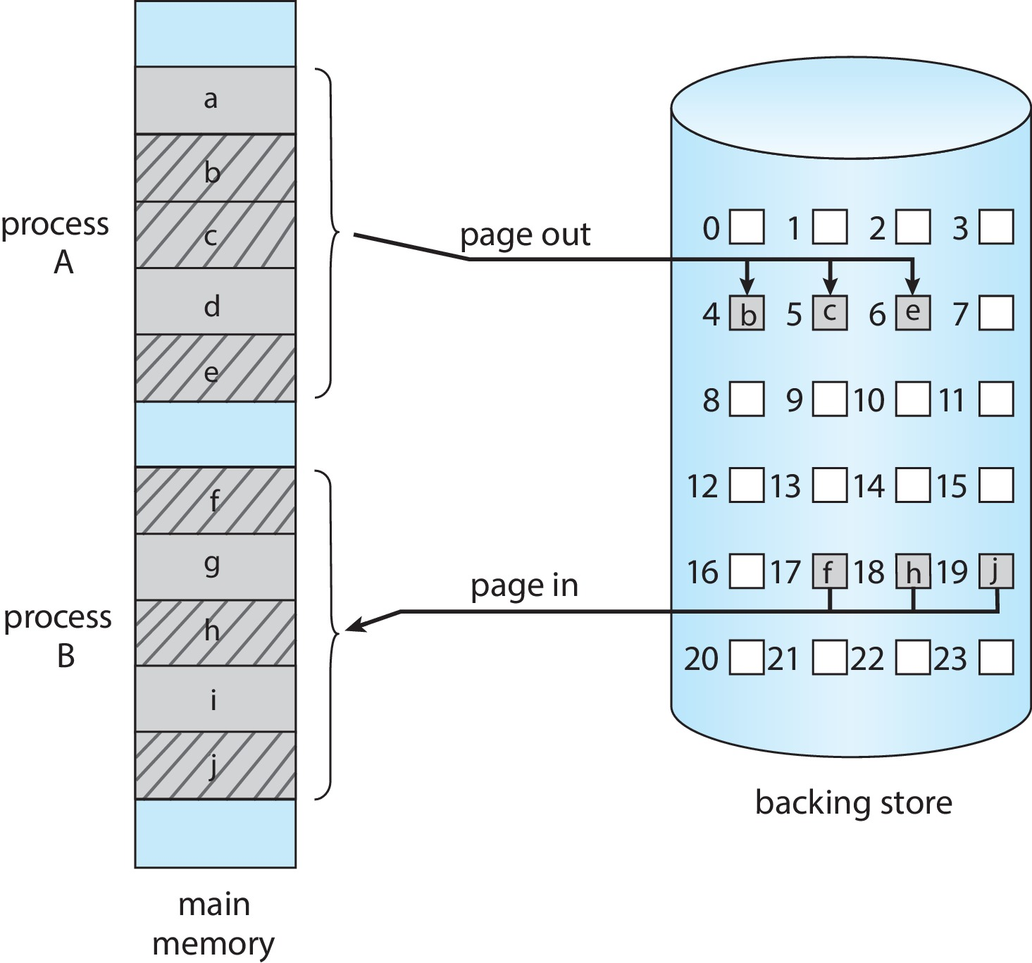
Swapping with Paging

Slide 48
Outline
1. Paging
  The Scheme, Address Translation
  Hardware support
  Shared Pages
  Advanced Topics
2. Swapping
3. Segmentation
  The Scheme, Address Translation
  Segmentation with Paging in Intel Pentium

Slide 49
Segmentation
Memory-management scheme that supports user view of memory
A program is a collection of segments
  A segment is a logical unit such as:
main program
procedure
function
method
object
local variables, global variables
common block
stack
symbol table
arrays

Slide 50
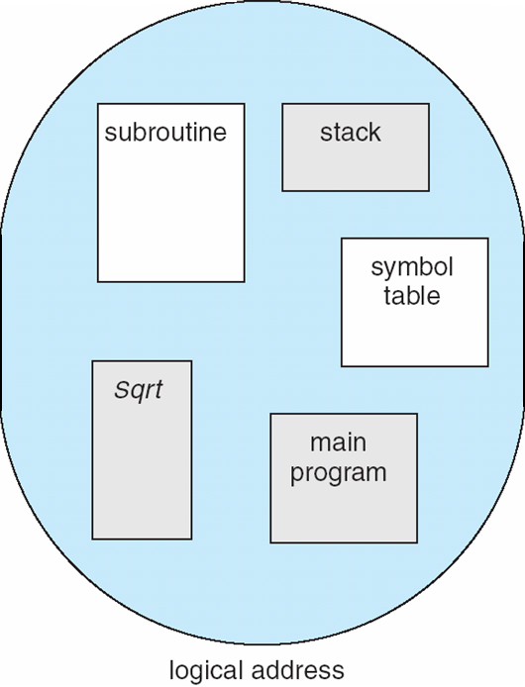
User’s View of a Program

Slide 51
Logical View of Segmentation
1
1
4
2
3
4
2
3
user space
physical memory space

Slide 52
Segmentation Architecture
Logical address consists of a two tuple:
<segment-number, offset>,
Segment table – maps two-dimensional physical addresses; each table entry has:
  base – contains the starting physical address where the segments reside in memory
  limit – specifies the length of the segment
Segment-table base register (STBR) points to the segment table’s location in memory
Segment-table length register (STLR) indicates number of segments used by a program;
segment number s is legal if s < STLR

Slide 53
Segmentation Architecture (Cont.)
Protection
  With each entry in segment table associate:
    validation bit = 0 ⇒ illegal segment
    read/write/execute privileges
Protection bits associated with segments; code sharing occurs at segment level
Since segments vary in length, memory allocation is a dynamic storage-allocation problem
A segmentation example is shown in the following diagram

Slide 54
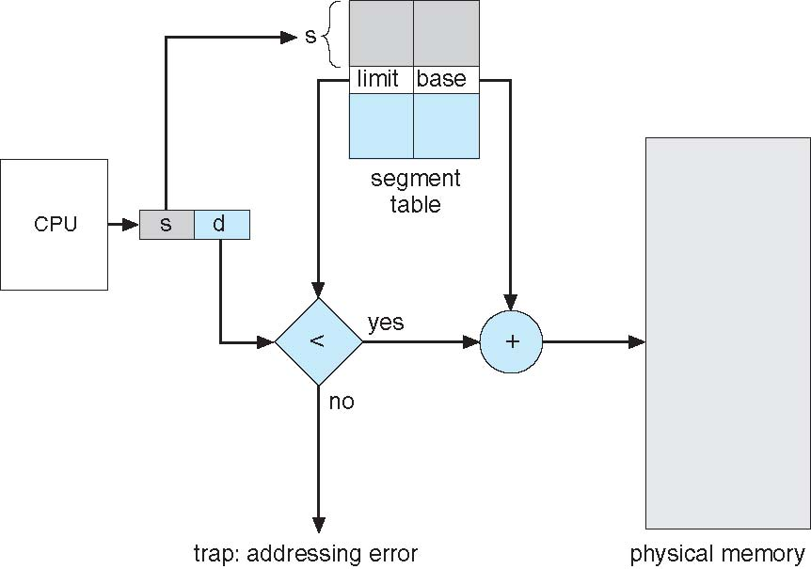
Segmentation Hardware

Slide 55
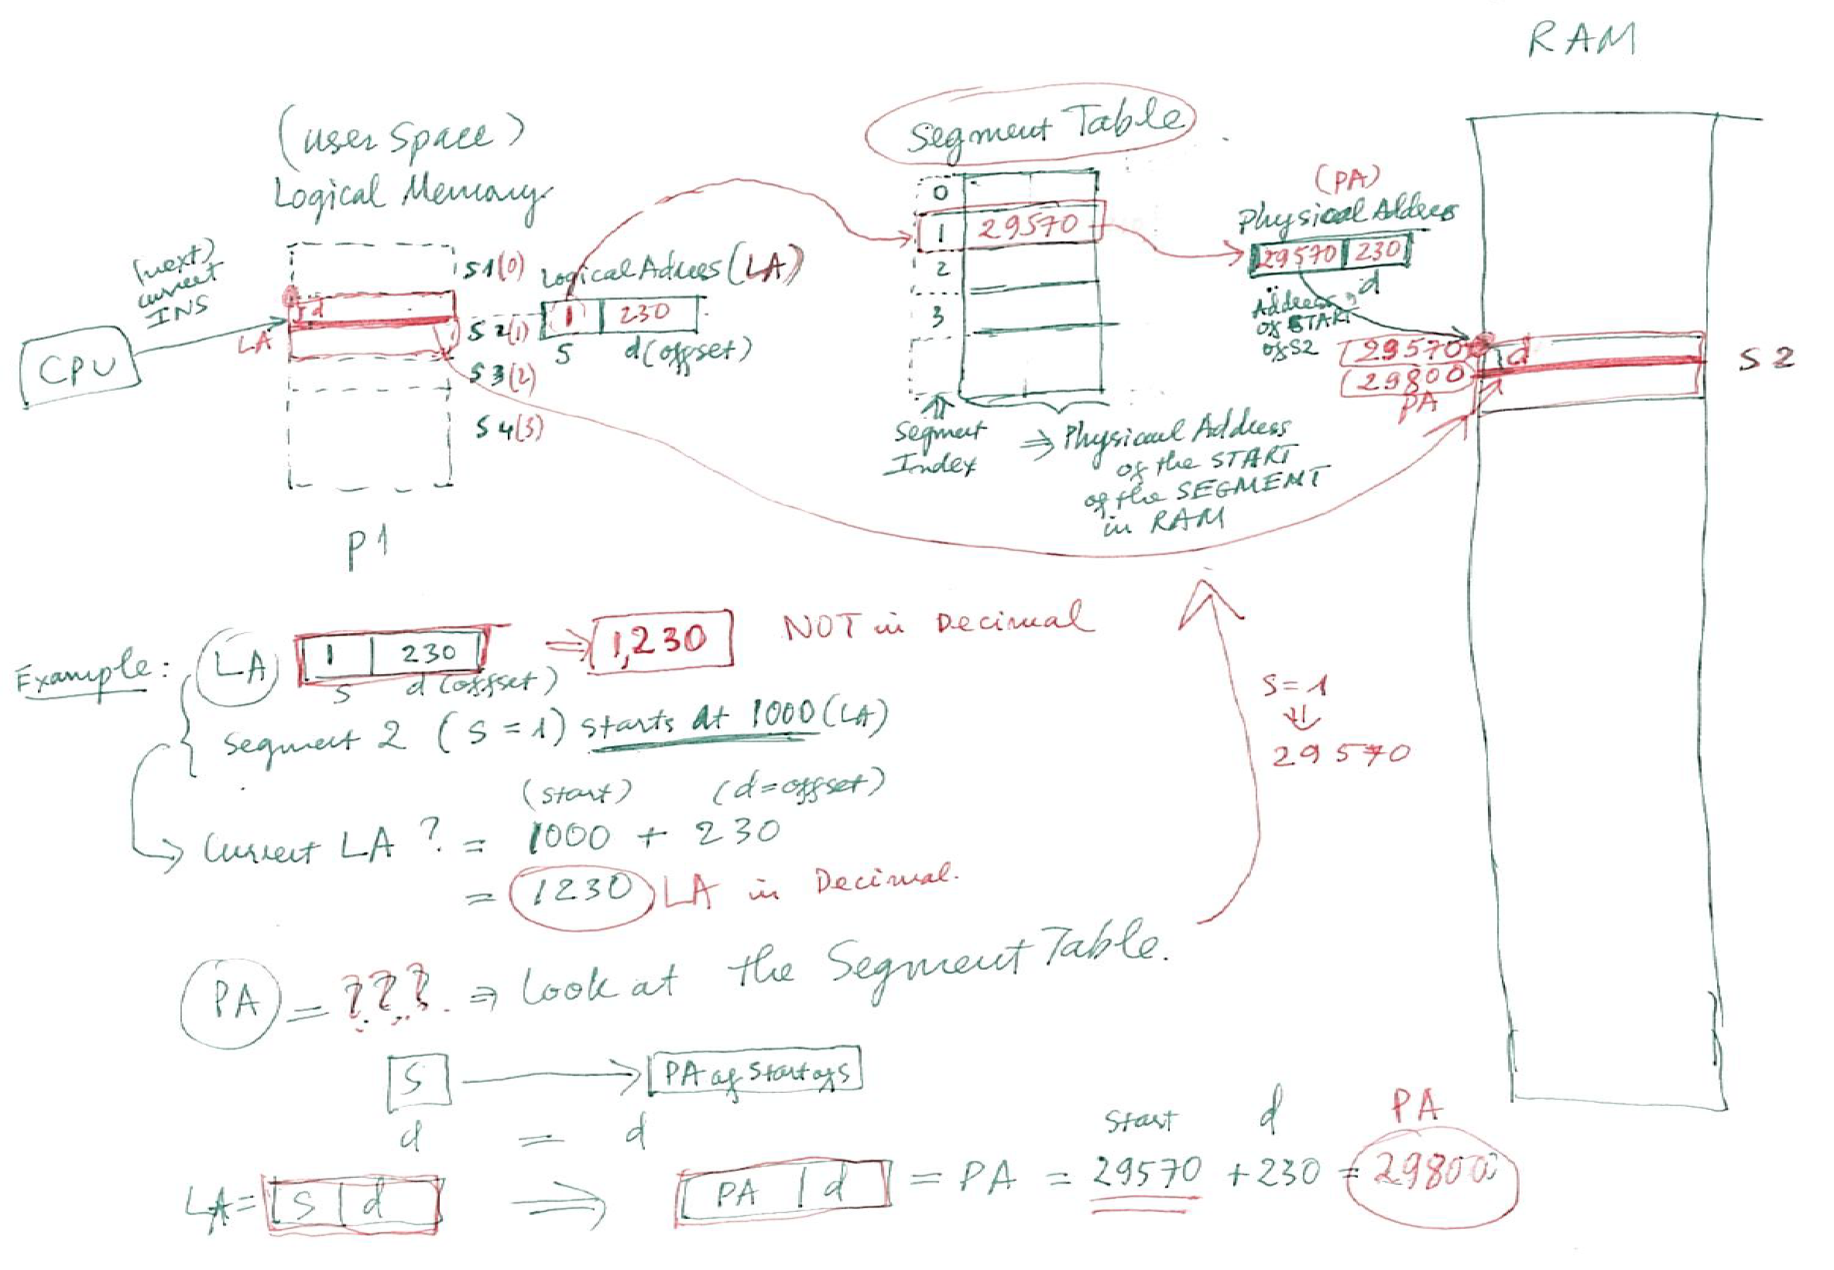
Example of Logical & Physical Addresses with SEGMENTATION

Slide 56
Translation of LA to PA with Segmentation Table
Consider the following segment table:
Segment # Base Length
0 321 600
1 5230 214
2 170 112
3 2086 580
4 952 396
What is the physical address for the following Logical Addresses. Explain how you find it.
a) LA = [ 3 , 500 ]
b) LA = [ 1 , 321 ]
ANSWER:
a) Logical Address LA = [Segment #, Offset] = [ 3 , 500 ] means the segment# = 3 and the Offset = 500.
Use the fact that the segment = 3 in LA, look up at the Segment Table,
we’ll have Base = 2086, and the Offset = 500
As the length = 580, which is more than the Offset. Therefore, it’s OK.
The physical address = BASE, Offset or = [ 2086, 500 ]
b) Logical Address LA = [ 1 , 321 ] means the segment number = 1 and the Offset = 321.
Use the fact that the segment = 1 in LA, look up at the Segment Table,
we’ll have Base = 5230, the Offset = 312
BUT the length = 214, which is less than the Offset. Therefore, it’s an INVALID ADDRESS.
It will generate a TRAP.

Slide 57
Outline
1. Paging
  The Scheme, Address Translation
  Hardware support
  Shared Pages
  Advanced Topics
2. Swapping
3. Segmentation
  The Scheme, Address Translation
  Segmentation with Paging in Intel Pentium

Slide 58
Example: The Intel 32 and 64-bit Architectures
Dominant industry chips
Pentium CPUs are 32-bit and called IA-32 architecture
Current Intel CPUs are 64-bit and called IA-64 architecture
Many variations in the chips, cover the main ideas here

Slide 59
Example: The Intel IA-32 Architecture
Supports both segmentation and segmentation with paging
  Each segment can be 4 GB
  Up to 16 K segments per process
  Divided into two partitions
    First partition of up to 8 K segments are private to process (kept in local descriptor table (LDT))
    Second partition of up to 8K segments shared among all processes (kept in global descriptor table (GDT))

Slide 60

Example: The Intel IA-32 Architecture (Cont.)
CPU generates logical address
  Selector given to segmentation unit
    Which produces linear addresses
  Linear address given to paging unit
    Which generates physical address in main memory
    Paging units form equivalent of MMU
    Pages sizes can be 4 KB or 4 MB

Slide 61
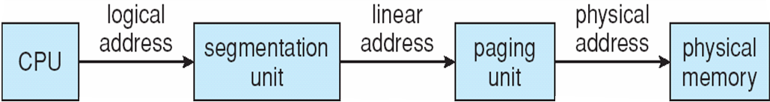
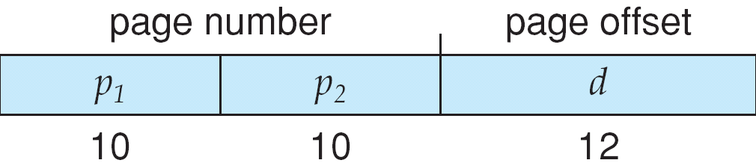
Logical to Physical Address Translation in IA-32

Slide 62
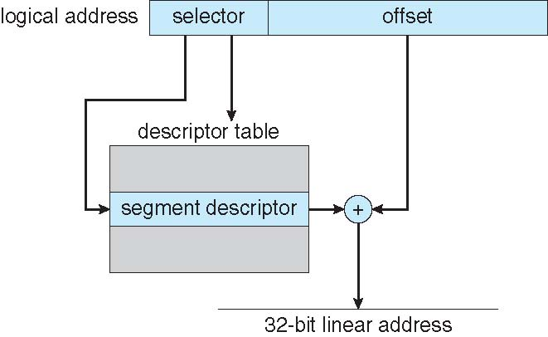
Intel IA-32 Segmentation

Slide 63
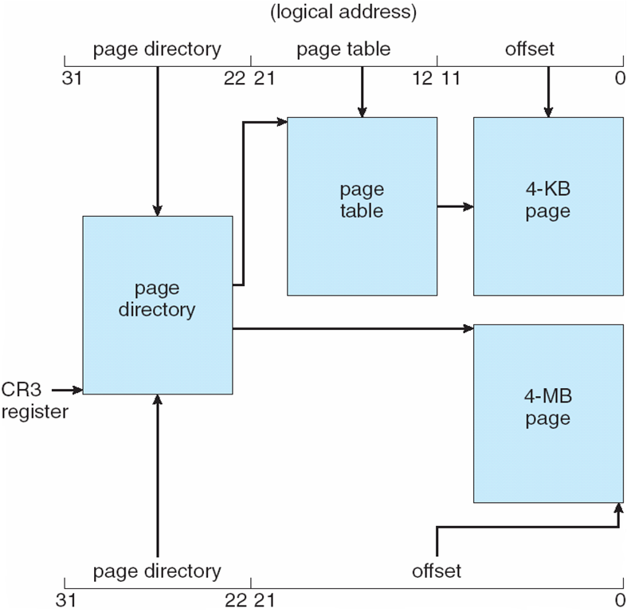
Intel IA-32 Paging Architecture

Slide 64
Intel IA-32 Page Address Extensions
32-bit address limits led Intel to create page address extension (PAE), allowing 32-bit apps access to more than 4GB of memory space
  Paging went to a 3-level scheme
  Top two bits refer to a page directory pointer table
  Page-directory and page-table entries moved to 64-bits in size
  Net effect is increasing address space to 36 bits – 64GB of physical memory

Slide 65
Intel x86-64
Current generation Intel x86 architecture
64 bits is ginormous (> 16 exabytes)
In practice only implement 48 bit addressing
  Page sizes of 4 KB, 2 MB, 1 GB
  Four levels of paging hierarchy
Can also use PAE so virtual addresses are 48 bits and physical addresses are 52 bits

Slide 66
Example: ARM Architecture
Dominant mobile platform chip (Apple iOS and Google Android devices for example)
Modern, energy efficient, 32-bit CPU
4 KB and 16 KB pages
1 MB and 16 MB pages (termed sections)
One-level paging for sections, two-level for smaller pages
Two levels of TLBs
  Outer level has two micro TLBs (one data, one instruction)
  Inner is single main TLB
  First inner is checked, on miss outers are checked, and on miss page table walk performed by CPU

