Slide 1
Lecture 17
Virtual Memory, Demand Paging

Slide 2
Outline
1. Virtual Memory Concept
2. Demand Paging
3. Page Replacement
  Basics

Slide 3
Outline
  KEYWORDS: Virtual Memory, Demand Paging, Valid-Invalid Bits, Page Fault, Page Replacement
  HOMEWORK:
  1) Reading : Chapter 9, especially the summary.
  2) Make sure to understand and be able to explain every keyword from the list here and the ones which are printed bold in the text book.
  3) Important Questions:
  Draw a diagram to describe the Virtual Memory concept
  Why do we need Page Replacement ?
  What is demand paging ?
  When do page faults occur?

Slide 4
Outline
1. Virtual Memory Concept
2. Demand Paging
3. Page Replacement
  Basics

Slide 5
Background
Code needs to be in memory to execute, but entire program rarely used
  Error code, unusual routines, large data structures
Entire program code not needed at same time
Consider ability to execute partially-loaded program
  Program no longer constrained by limits of physical memory
  Each program takes less memory while running -> more programs run at the same time
    Increased CPU utilization and throughput with no increase in response time or turnaround time
  Less I/O needed to load or swap programs into memory -> each user program runs faster

Slide 6
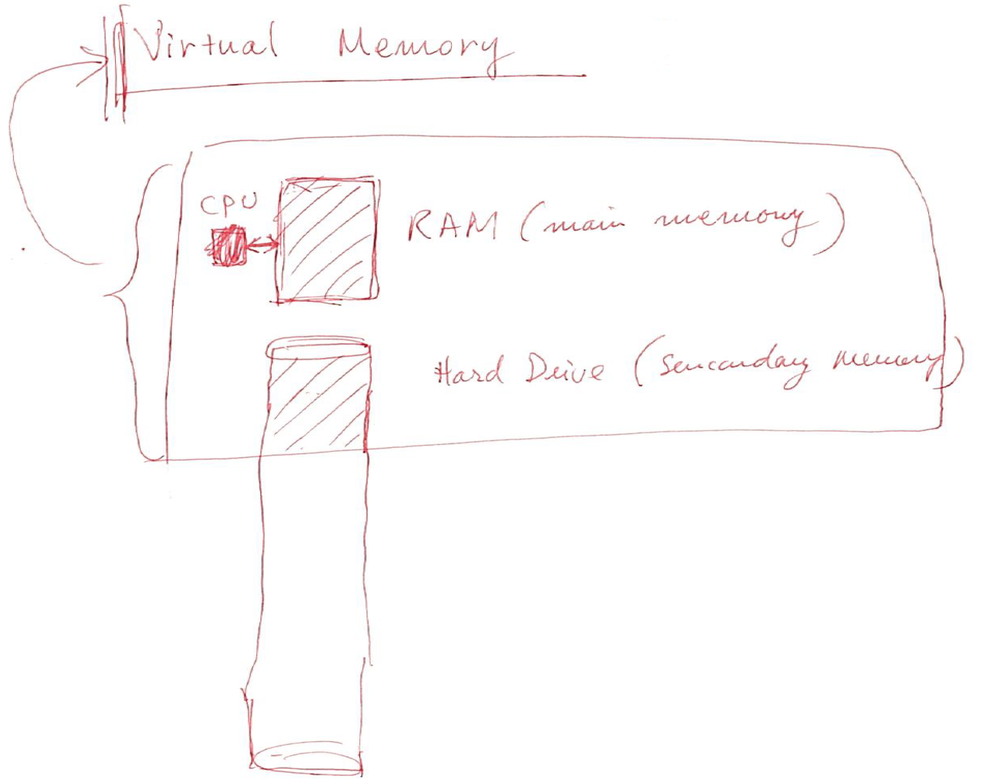
Virtual memory

Slide 7
Virtual memory
Virtual memory = extends real and physical memory (RAM) by using/adding a part of a hard disk
  Only a part of the program (which is currently running) needs to be in memory
  Logical address space can therefore be much larger than physical address space
  Allows address spaces to be shared by several processes
  Allows for more efficient process creation
  More programs running concurrently
  Less I/O needed to load or swap processes

Slide 8
Virtual memory (Cont.)
Virtual address space – logical view of how process is stored in memory
  Usually start at address 0, contiguous addresses until end of space
  Meanwhile, physical memory organized in page frames
  MMU must map logical to physical
Virtual memory can be implemented via:
  Demand paging
  Demand segmentation

Slide 9
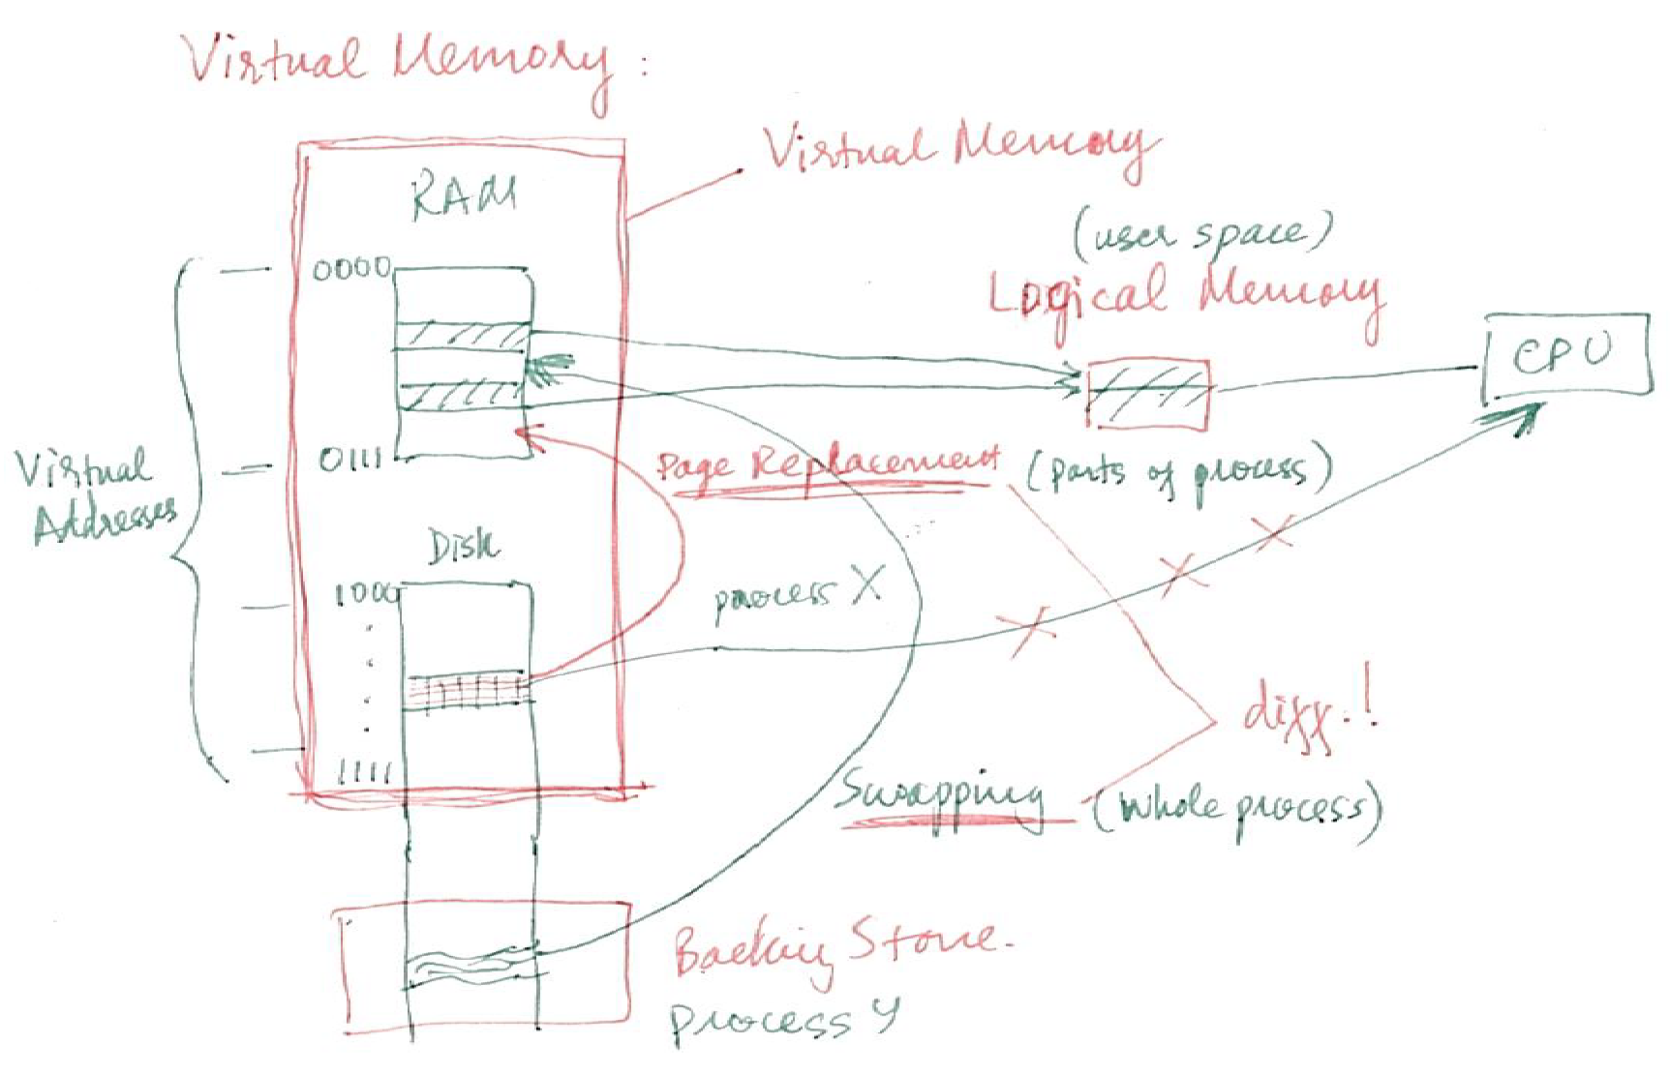
Virtual vs. Logical vs. Physical Memory

Slide 10
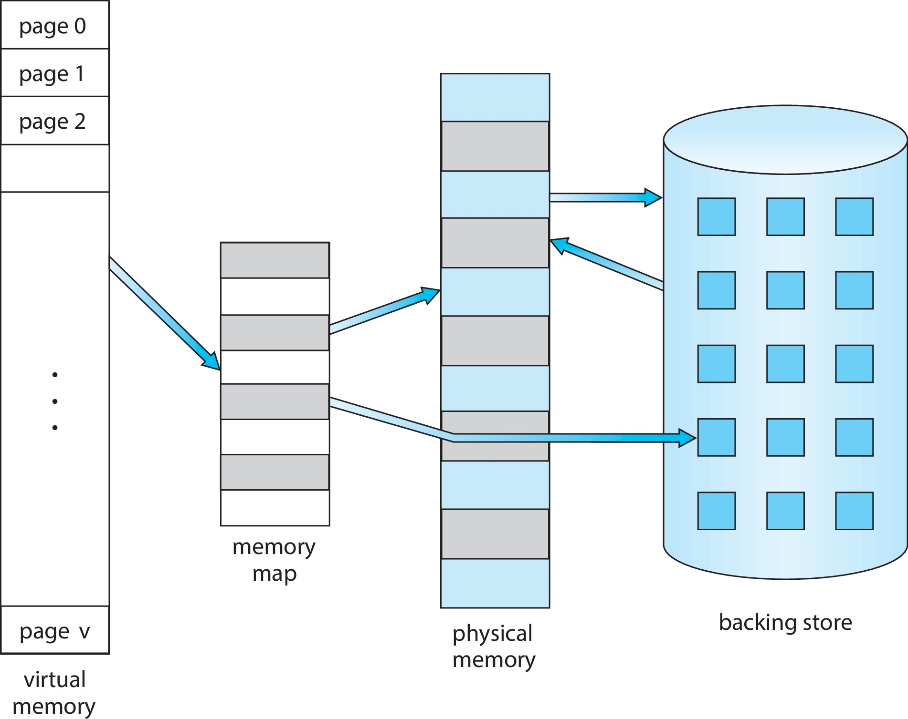
Virtual Memory That is Larger Than Physical Memory

Slide 11
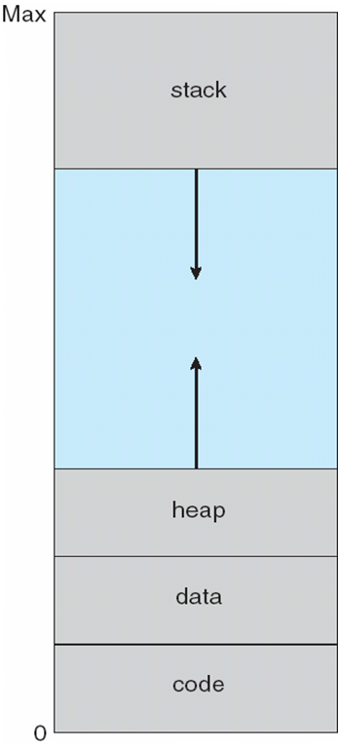
Virtual-address Space
Usually design logical address space for stack to start at Max logical address and grow “down” while heap grows “up”
  Maximizes address space use
  Unused address space between the two is hole
    No physical memory needed until heap or stack grows to a given new page
Enables sparse address spaces with holes left for growth, dynamically linked libraries, etc.
System libraries shared via mapping into virtual address space
Shared memory by mapping pages read-write into virtual address space
Pages can be shared during fork(), speeding process creation

Slide 12
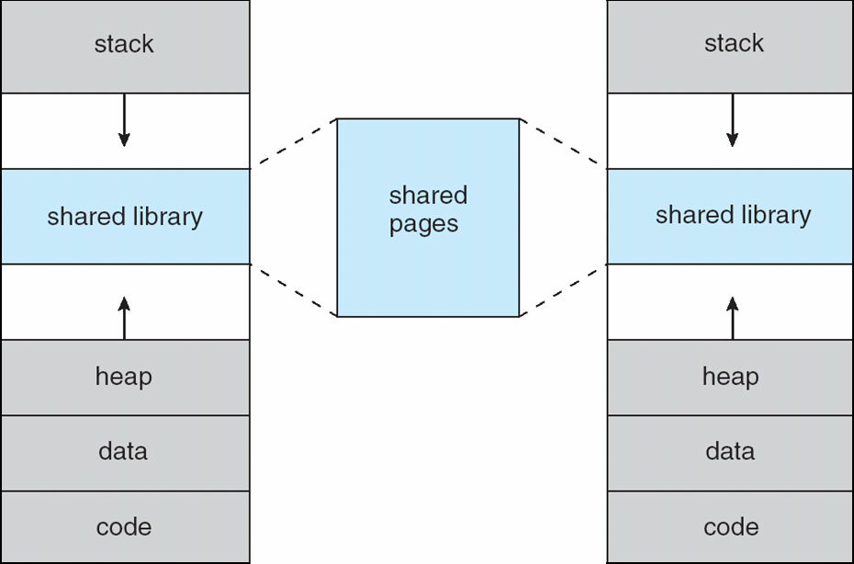
Shared Library Using Virtual Memory

Slide 13
Outline
1. Virtual Memory Concept
2. Demand Paging
3. Page Replacement
  Basics

Slide 14
Demand Paging
Could bring entire process into memory at load time
Or bring a page into memory only when it is needed
  Less I/O needed, no unnecessary I/O
  Less memory needed
  Faster response
  More users
Similar to paging system with swapping (diagram on right)
Page is needed ⇒ reference to it
  invalid reference ⇒ abort
  not-in-memory ⇒ bring to memory
Lazy swapper – never swaps a page into memory unless page will be needed
  Swapper that deals with pages is a pager

Slide 15
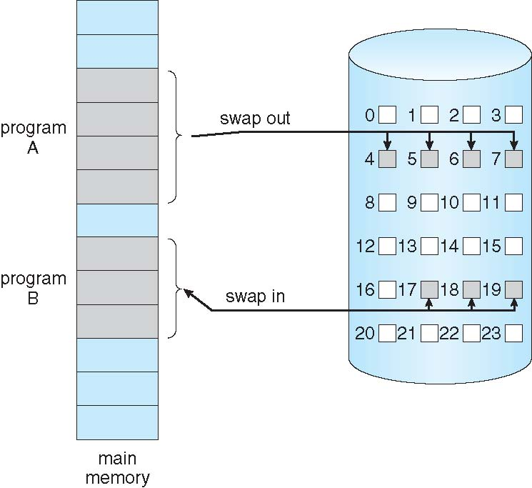
Demand Paging
Could bring entire process into memory at load time
Or bring a page into memory only when it is needed
  Less I/O needed, no unnecessary I/O
  Less memory needed
  Faster response
  More users
Similar to paging system with swapping (diagram on right)

Slide 16
Basic Concepts
With swapping, pager guesses which pages will be used before swapping out again
Instead, pager brings in only those pages into memory
How to determine that set of pages?
  Need new MMU functionality to implement demand paging
If pages needed are already memory resident
  No difference from non demand-paging
If page needed and not memory resident
  Need to detect and load the page into memory from storage
    Without changing program behavior
    Without programmer needing to change code

Slide 17
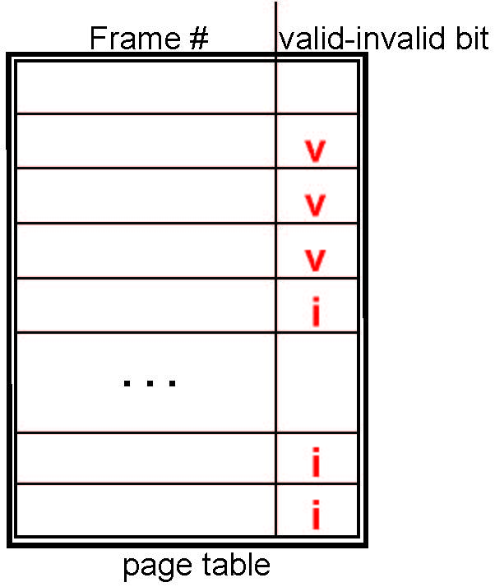
Valid-Invalid Bit
With each page table entry a valid–invalid bit is associated
(v ⇒ in-memory – memory resident, i ⇒ not-in-memory)
Initially valid–invalid bit is set to i on all entries
Example of a page table snapshot:
During MMU address translation, if valid–invalid bit in page table entry is i ⇒ page fault

Slide 18
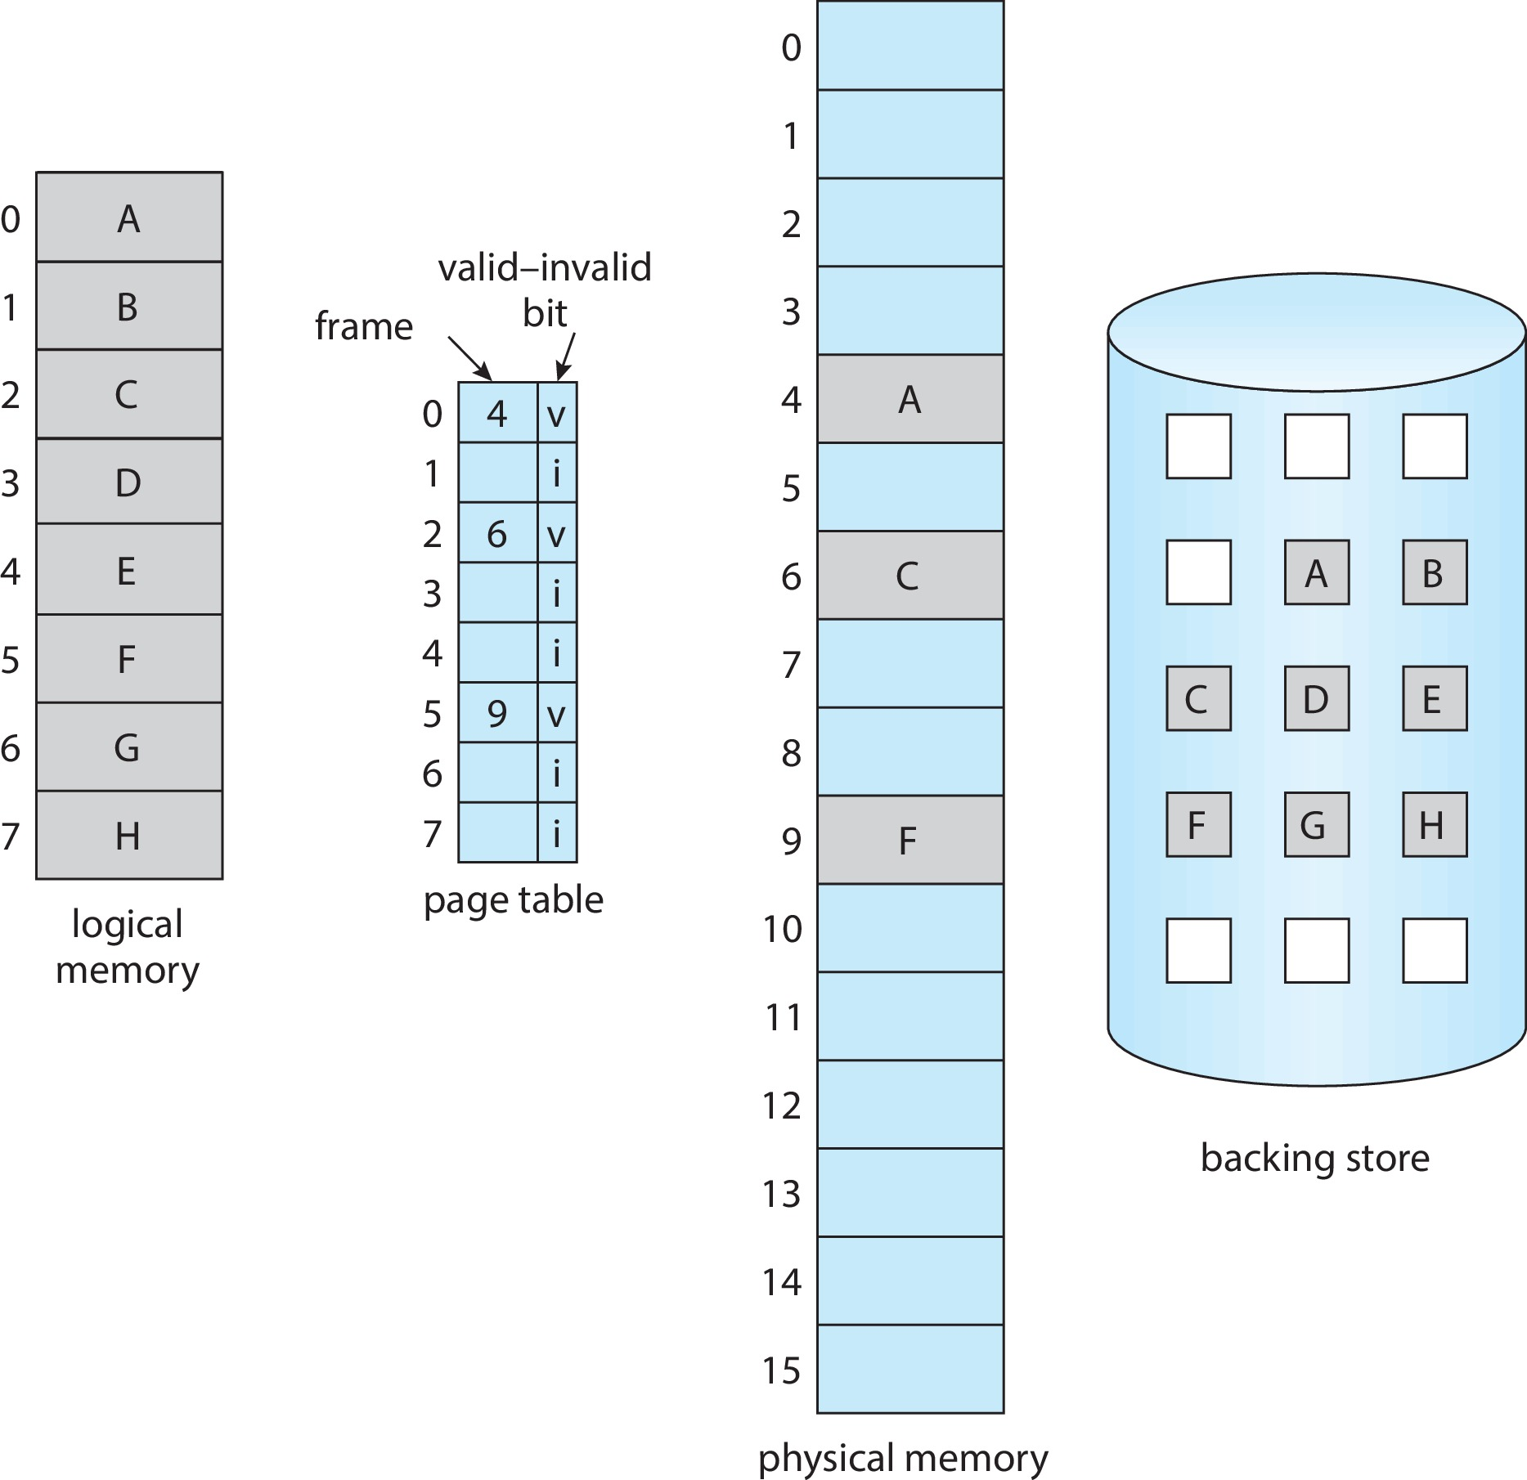
Page Table When Some Pages Are Not in Main Memory

Slide 19
Steps in Handling Page Fault
If there is a reference to a page, first reference to that page will trap to operating system
  Page fault
Operating system looks at another table to decide:
  Invalid reference ⇒ abort
  Just not in memory
Find free frame
Swap page into frame via scheduled disk operation
Reset tables to indicate page now in memory
Set validation bit = v
Restart the instruction that caused the page fault

Slide 20
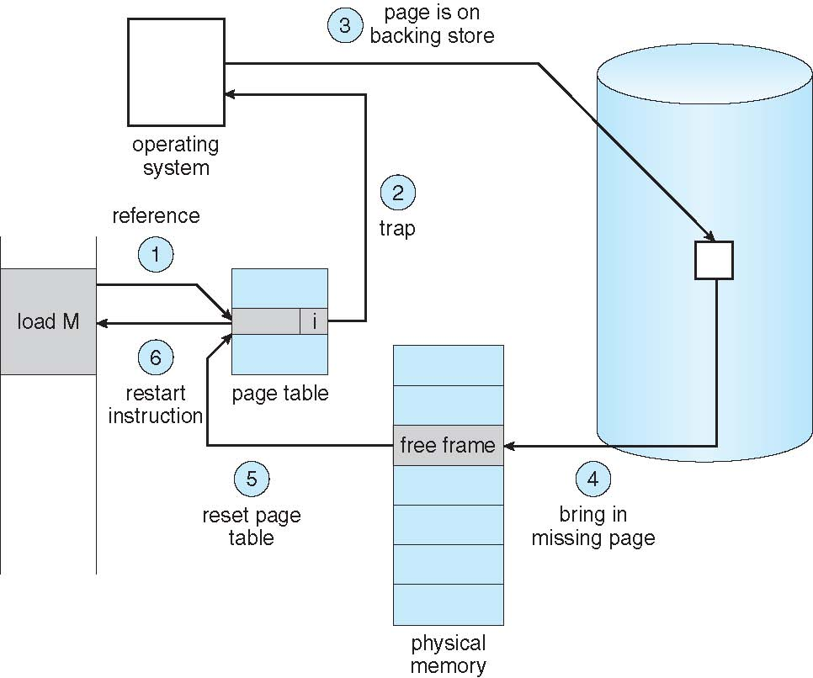
Steps in Handling a Page Fault (Cont.)

Slide 21
Aspects of Demand Paging
Extreme case – start process with no pages in memory
  OS sets instruction pointer to first instruction of process, non-memory-resident -> page fault
  And for every other process pages on first access
  Pure demand paging
Actually, a given instruction could access multiple pages -> multiple page faults
  Consider fetch and decode of instruction which adds 2 numbers from memory and stores result back to memory
  Pain decreased because of locality of reference
Hardware support needed for demand paging
  Page table with valid / invalid bit
  Secondary memory (swap device with swap space)
  Instruction restart

Slide 22
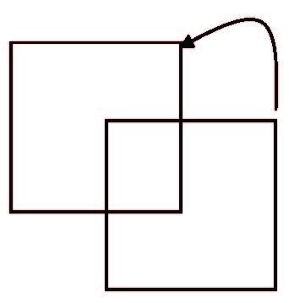
Instruction Restart
Consider an instruction that could access several different locations
  Block move
  Auto increment/decrement location
  Restart the whole operation?
    What if source and destination overlap?

Slide 23
Free-Frame List
When a page fault occurs, the operating system must bring the desired page from secondary storage into main memory.
Most operating systems maintain a free-frame list -- a pool of free frames for satisfying such requests.
Operating system typically allocate free frames using a technique known as zero-fill-on-demand -- the content of the frames zeroed-out before being allocated.
When a system starts up, all available memory is placed on the free-frame list.

Slide 24
Stages in Demand Paging – Worse Case
Trap to the operating system
Save the user registers and process state
Determine that the interrupt was a page fault
Check that the page reference was legal and determine the location of the page on the disk
Issue a read from the disk to a free frame:
  Wait in a queue for this device until the read request is serviced
  Wait for the device seek and/or latency time
  Begin the transfer of the page to a free frame

Slide 25
Stages in Demand Paging (Cont.)
While waiting, allocate the CPU to some other user
Receive an interrupt from the disk I/O subsystem (I/O completed)
Save the registers and process state for the other user
Determine that the interrupt was from the disk
Correct the page table and other tables to show page is now in memory
Wait for the CPU to be allocated to this process again
Restore the user registers, process state, and new page table, and then
resume the interrupted instruction

Slide 26
Performance of Demand Paging
Three major activities
  Service the interrupt – careful coding means just several hundred instructions needed
  Read the page – lots of time
  Restart the process – again just a small amount of time
Page Fault Rate 0 ≤ p ≤ 1
  if p = 0 no page faults
  if p = 1, every reference is a fault
Effective Access Time (EAT)
EAT = (1 – p) x memory access
+ p (page fault overhead
+ swap page out
+ swap page in )

Slide 27
Demand Paging Example
Memory access time = 200 nanoseconds
Average page-fault service time = 8 milliseconds
EAT = (1 – p) x 200 + p (8 milliseconds)
= (1 – p x 200 + p x 8,000,000
= 200 + p x 7,999,800
If one access out of 1,000 causes a page fault, then
EAT = 8.2 microseconds.
This is a slowdown by a factor of 40!!
If want performance degradation < 10 percent
  220 > 200 + 7,999,800 x p
  20 > 7,999,800 x p
  p < .0000025
  < one page fault in every 400,000 memory accesses

Slide 28
Demand Paging Optimizations
Swap space I/O faster than file system I/O even if on the same device
  Swap allocated in larger chunks, less management needed than file system
Copy entire process image to swap space at process load time
  Then page in and out of swap space
  Used in older BSD Unix
Demand page in from program binary on disk, but discard rather than paging out when freeing frame
  Used in Solaris and current BSD
  Still need to write to swap space
    Pages not associated with a file (like stack and heap) – anonymous memory
    Pages modified in memory but not yet written back to the file system
Mobile systems
  Typically don’t support swapping
  Instead, demand page from file system and reclaim read-only pages (such as code)

Slide 29
Copy-on-Write
Copy-on-Write (COW) allows both parent and child processes to initially share the same pages in memory
  If either process modifies a shared page, only then is the page copied
COW allows more efficient process creation as only modified pages are copied
In general, free pages are allocated from a pool of zero-fill-on-demand pages
  Pool should always have free frames for fast demand page execution
    Don’t want to have to free a frame as well as other processing on page fault
  Why zero-out a page before allocating it?
vfork() variation on fork() system call has parent suspend and child using copy-on-write address space of parent
  Designed to have child call exec()
  Very efficient

Slide 30
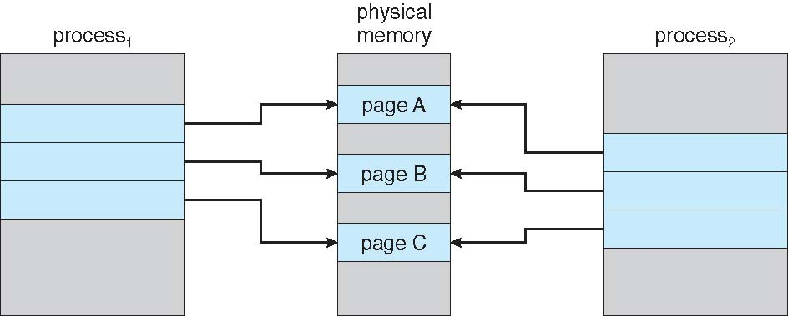
Before Process 1 Modifies Page C

Slide 31
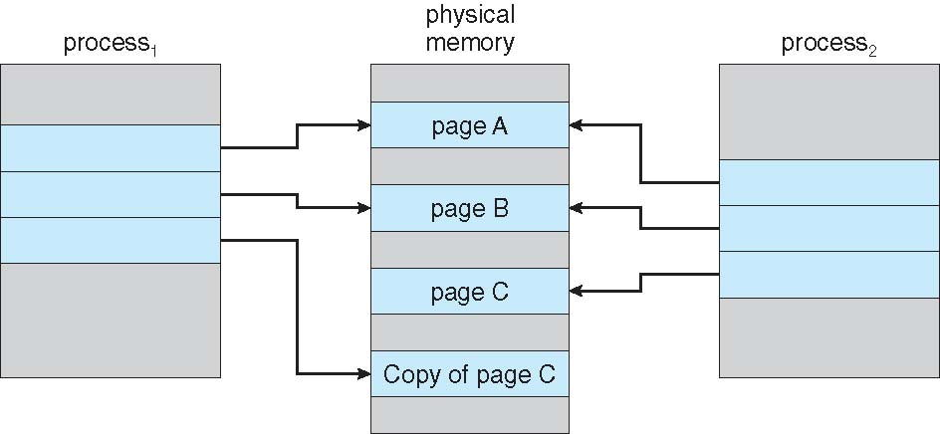
After Process 1 Modifies Page C

Slide 32
What Happens if There is no Free Frame?
Used up by process pages
Also in demand from the kernel, I/O buffers, etc
How much to allocate to each?
Page replacement – find some page in memory, but not really in use, page it out
  Algorithm – terminate? swap out? replace the page?
  Performance – want an algorithm which will result in minimum number of page faults
Same page may be brought into memory several times

Slide 33
Outline
1. Virtual Memory Concept
2. Demand Paging
3. Page Replacement
  Basics

Slide 34
Page Replacement in Virtual memory

Slide 35
Page Replacement
Prevent over-allocation of memory by modifying page-fault service routine to include page replacement
Use modify (dirty) bit to reduce overhead of page transfers – only modified pages are written to disk
Page replacement completes separation between logical memory and physical memory – large virtual memory can be provided on a smaller physical memory

Slide 36
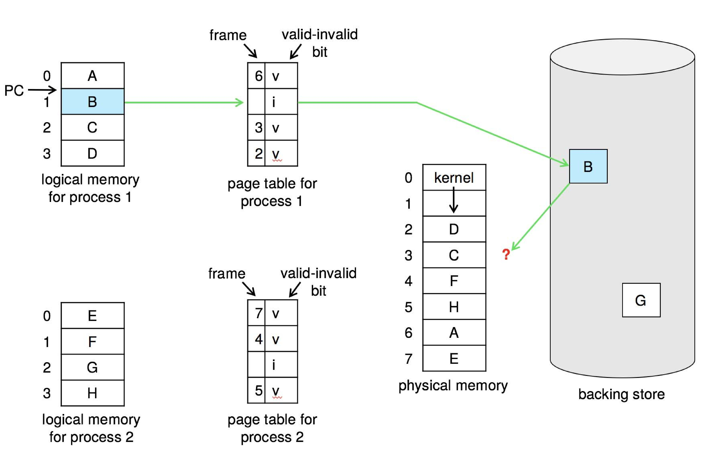
Need For Page Replacement

Slide 37
Basic Page Replacement
Find the location of the desired page on disk
Find a free frame:
- If there is a free frame, use it
- If there is no free frame, use a page replacement algorithm to select a victim frame
- Write victim frame to disk if dirty
Bring the desired page into the (newly) free frame; update the page and frame tables
Continue the process by restarting the instruction that caused the trap
Note now potentially 2 page transfers for page fault – increasing EAT

Slide 38
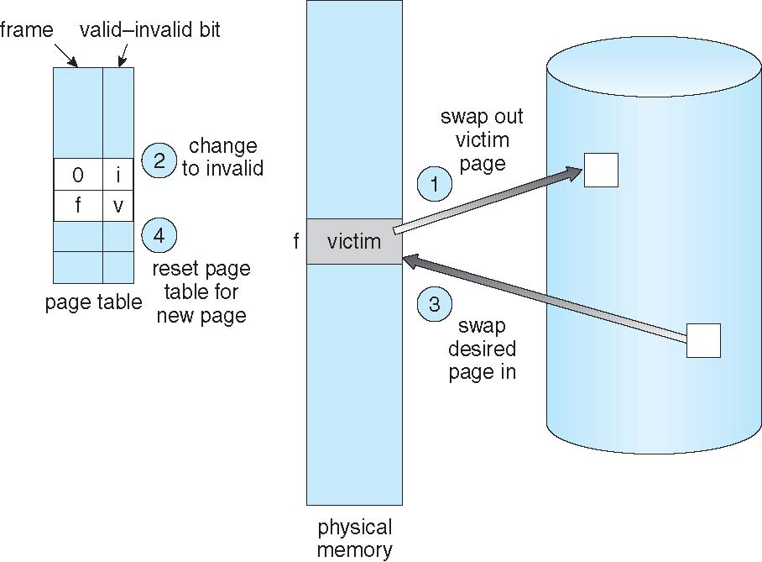
Page Replacement

Slide 39
Page and Frame Replacement Algorithms
Frame-allocation algorithm determines
  How many frames to give each process
  Which frames to replace
Page-replacement algorithm
  Want lowest page-fault rate on both first access and re-access
Evaluate algorithm by running it on a particular string of memory references (reference string) and computing the number of page faults on that string
  String is just page numbers, not full addresses
  Repeated access to the same page does not cause a page fault
  Results depend on number of frames available
In all our examples, the reference string of referenced page numbers is
7,0,1,2,0,3,0,4,2,3,0,3,0,3,2,1,2,0,1,7,0,1

Slide 40
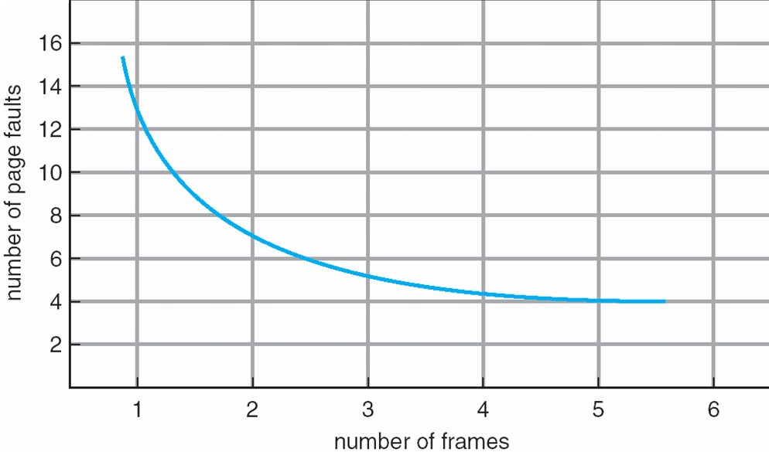
Graph of Page Faults Versus the Number of Frames

