Slide 1
Lecture 18
Page Replacement Methods

Slide 2
Outline
Page Replacement Algorithms:
      o FIFO
      o Optimal (future-based)
      o LRU (past-last-time-used-based)
      o LFU/MFU (past-frequency-based)

Slide 3
Outline
  KEYWORDS: Page Replacement, FIFO, LRU, LFU, MFU.
HOMEWORK:
  1) Reading : Chapter 10, especially the summary.
  2) Make sure to understand and be able to explain every keyword from the list here and the ones which are printed bold in the text book.
  3) Important Questions:
  Consider the following page reference string:
  1, 2, 3, 4, 2, 1, 5, 6, 2, 1, 2, 3, 7, 6, 3, 2, 1, 2, 3, 6.
  How many page faults would occur for the following replacement algorithms, assuming one, two, three, four, five, six, or seven frames? Remember all frames are initially empty, so your first unique pages will all cost one fault each.
    FIFO replacement
    Optimal replacement
    LRU replacement
    LFU replacement
    MFU replacement

Slide 4
Outline
Page Replacement Algorithms:
      o FIFO
      o Optimal (future-based)
      o LRU (past-last-time-used-based)
      o LFU/MFU (past-frequency-based)

Slide 5
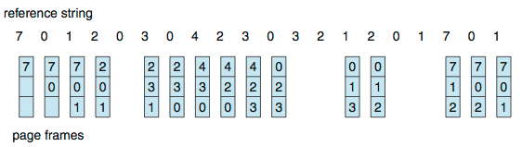
First-In-First-Out (FIFO) Algorithm
Reference string: 7,0,1,2,0,3,0,4,2,3,0,3,0,3,2,1,2,0,1,7,0,1
3 frames (3 pages can be in memory at a time per process)
Can vary by reference string: consider 1,2,3,4,1,2,5,1,2,3,4,5
  Adding more frames can cause more page faults!
    Belady’s Anomaly
How to track ages of pages?
  Just use a FIFO queue
1 | 1 | 1 | 1 | - | 1 | 1 | 1 | 1 | 1 | 1 |  |  | 1 | 1 |  |  | 1 | 1 | 1
15 page faults

Slide 6
First-In-First-Out (FIFO) Algorithm
Reference string: 7,0,1,2,0,3,0,4,2,3,0,3,0,3,2,1,2,0,1,7,0,1
3 frames (3 pages can be in memory at a time per process)
Can vary by reference string: consider 1,2,3,4,1,2,5,1,2,3,4,5
  Adding more frames can cause more page faults!
    Belady’s Anomaly
How to track ages of pages?
  Just use a FIFO queue
15 page faults

Slide 7
FIFO Illustrating Belady’s Anomaly

Slide 8
Outline
Page Replacement Algorithms:
      o FIFO
      o Optimal (future-based)
      o LRU (past-last-time-used-based)
      o LFU/MFU (past-frequency-based)

Slide 9
Algorithms Based on Timestamps
+ Optimal Method (future: when it’ll be needed)
+ LRU (past: when it was LAST used)

Slide 10
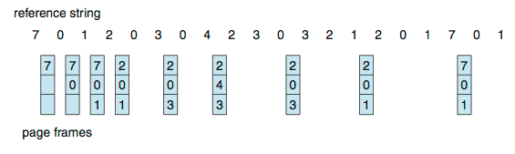
Optimal Algorithm
Replace page that will not be used for longest period of time
  9 is optimal for the example
How do you know this?
  Can’t read the future
Used for measuring how well your algorithm performs
1 | 1 | 1 | 1 | - | 1 | -
Fr | P# | #S | For (3)
1 | 2 | 4 | 2
2 | 0 | 2 | 0
3 | 1 | 9 | 3
Fr | P# | #S | For (2)
1 | 7 | 15 | 2
2 | 0 | 2 | 0
3 | 1 | 11 | 1

Slide 11
Optimal Algorithm
Replace page that will not be used for longest period of time
  9 is optimal for the example
How do you know this?
  Can’t read the future
Used for measuring how well your algorithm performs

Slide 12
Outline
Page Replacement Algorithms:
      o FIFO
      o Optimal (future-based)
      o LRU/MRU (past-last-time-used-based)
      o LFU/MFU (past-frequency-based)

Slide 13
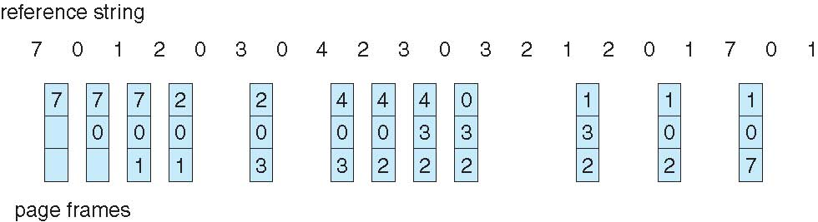
Least Recently Used (LRU) Algorithm
Use past knowledge rather than future
Replace page that has not been used in the most amount of time
Associate time of last use with each page
12 faults – better than FIFO but worse than OPT
Generally good algorithm and frequently used
But how to implement?
1 | 1 |  |  | 4 |  |  |  | 8
2 |  | 2 |  |  | 5 |  | 7
3 |  |  | 3 |  |  | 6

Slide 14
Least Recently Used (LRU) Algorithm
Use past knowledge rather than future
Replace page that has not been used in the most amount of time
Associate time of last use with each page
12 faults – better than FIFO but worse than OPT
Generally good algorithm and frequently used
But how to implement?

Slide 15
LRU Algorithm (Cont.)
Counter implementation
  Every page entry has a counter; every time page is referenced through this entry, copy the clock into the counter
  When a page needs to be changed, look at the counters to find smallest value
    Search through table needed
Stack implementation
  Keep a stack of page numbers in a double link form:
  Page referenced:
    move it to the top
    requires 6 pointers to be changed
  But each update more expensive
  No search for replacement

Slide 16
LRU Algorithm (Cont.)
LRU and OPT are cases of stack algorithms that don’t have Belady’s Anomaly
Use Of A Stack to Record Most Recent Page References

Slide 17
LRU Approximation Algorithms
LRU needs special hardware and still slow
Reference bit
  With each page associate a bit, initially = 0
  When page is referenced bit set to 1
  Replace any with reference bit = 0 (if one exists)
    We do not know the order, however

Slide 18
LRU Approximation Algorithms (cont.)
Second-chance algorithm
  Generally FIFO, plus hardware-provided reference bit
  Clock replacement
  If page to be replaced has
    Reference bit = 0 -> replace it
    reference bit = 1 then:
      set reference bit 0, leave page in memory
      replace next page, subject to same rules

Slide 19
Second-chance Algorithm

Slide 20
Enhanced Second-Chance Algorithm
Improve algorithm by using reference bit and modify bit (if available) in concert
Take ordered pair (reference, modify):
  (0, 0) neither recently used not modified – best page to replace
  (0, 1) not recently used but modified – not quite as good, must write out before replacement
  (1, 0) recently used but clean – probably will be used again soon
  (1, 1) recently used and modified – probably will be used again soon and need to write out before replacement
When page replacement called for, use the clock scheme but use the four classes replace page in lowest non-empty class
  Might need to search circular queue several times

Slide 21
Most Recently Used (MRU) Algorithm
Use past knowledge rather than future
Replace page that has been used in the least amount of time
Associate time of last use with each page
Reference string: 7,0,1,2,0,3,0,4,2,3,0,3,0,3,2,1,2,0,1,7,0,1
3 frames (3 pages can be in memory at a time per process)
1 | 7 |  |  |  |  |  |  |  |  |  |  |  |  |  |  |  |  |  | - | 0
2 |  | 0 |  |  | - | 3 | 0 | 4
3 |  |  | 1 | 2 |  |  |  |  | - | 3 | 0 | 3 | 0 | 2 | 1 | 2 | 0 | 1 |  |  | -
1 | 1 |  |  |  |  |  |  |  |  |  |  |  |  |  |  |  |  |  | 19 | 20
2 |  | 2 |  |  | 5 | 6 | 7 | 8
3 |  |  | 3 | 4 |  |  |  |  | 9 | 10 | 11 | 12 | 13 | 14 | 15 | 16 | 17 | 18 |  |  | 21

Slide 22
Outline
Page Replacement Algorithms:
      o FIFO
      o Optimal (future-based)
      o LRU (past-last-time-used-based)
      o LFU/MFU (past-frequency-based)

Slide 23
Counting Algorithms (LFU/MFU)
Keep a counter of the number of references that have been made to each page
  Not common
Least Frequently Used (LFU) Algorithm:
  Replaces page with smallest count
  Based on the argument that the page with the smallest count was probably just brought in and has yet to be used
Most Frequently Used (MFU) Algorithm:
  Replaces page with highest count
  Based on the argument that the page with the highest count was probably just brought in and has yet to be used

Slide 24
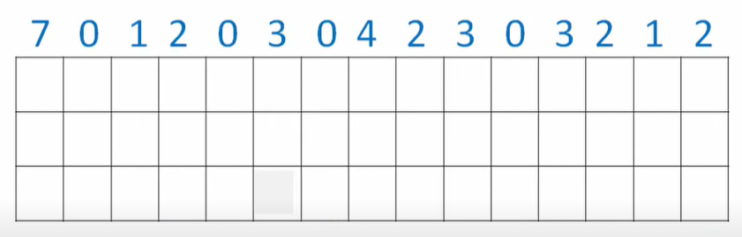
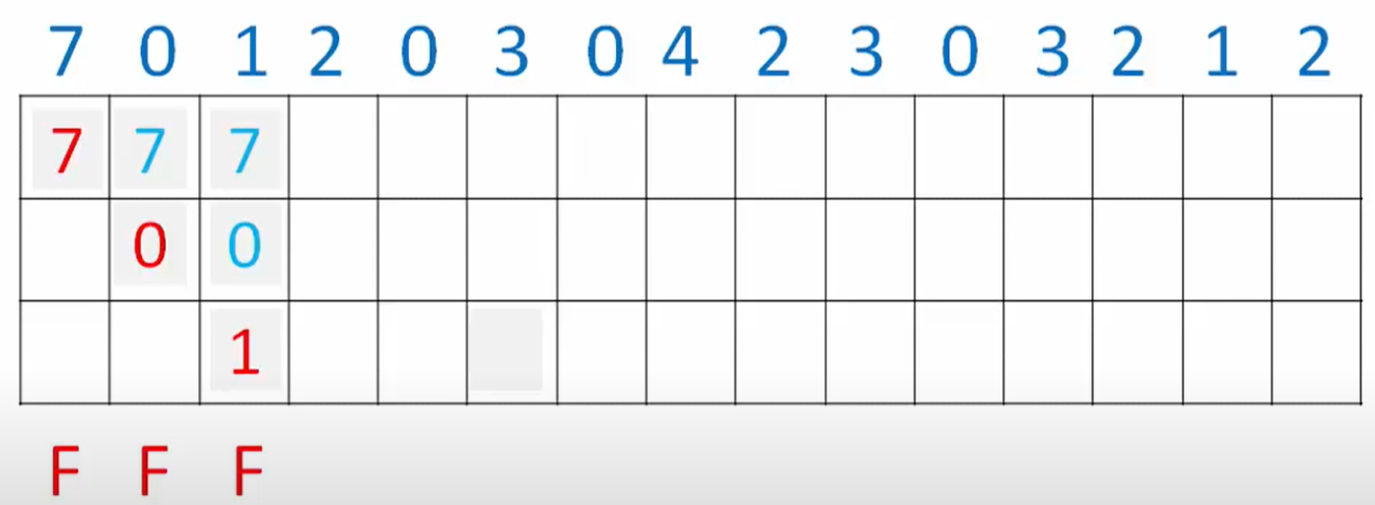
Least Frequently Used (LFU) Algorithm
f(7)=1 ; f(0)=1 ; f(1)=1 ; all the same => use FIFO
Number of Frames =3, https://www.youtube.com/watch?v=uL0xP57negc

Slide 25
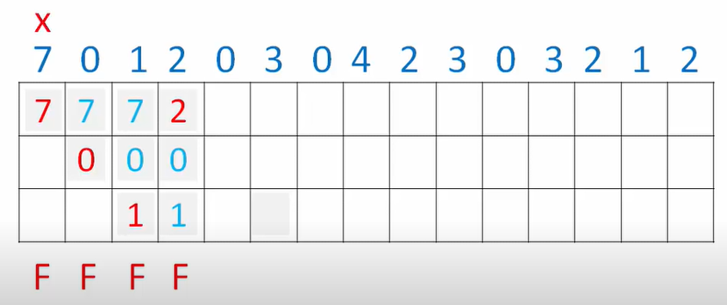
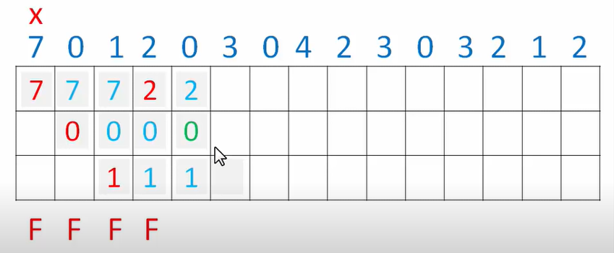
Least Frequently Used (LFU) Algorithm
f(7)=0 ; f(0)=1 ; f(1)=1 ; f(2)=1;
f(7)=0 ; f(0)=2 ; f(1)=1 ; f(2)=1;

Slide 26
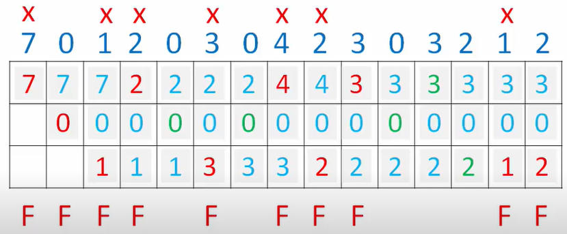
Least Frequently Used (LFU) Algorithm
f(7)=1 ; f(0)=4 ; f(1)=0 ; f(2)=1 ; f(3)=2 ; f(4)=0 ;
TOTAL number of page faults = 10

Slide 27
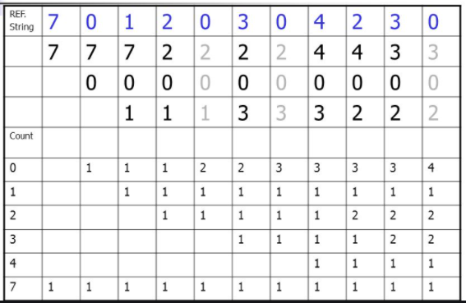
Least Frequently Used (LFU) Algorithm
Another Example: TOTAL number of page faults = 7

Slide 28
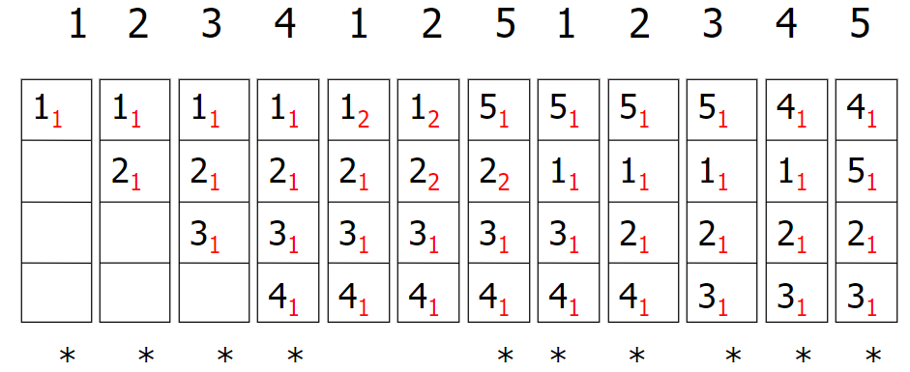
Most Frequently Used (MFU) Algorithm
Victim (the page we’ll replace) is the page that has been used MOST
TOTAL number of page faults = 9

Slide 29
Page-Buffering Algorithms
Keep a pool of free frames, always
  Then frame available when needed, not found at fault time
  Read page into free frame and select victim to evict and add to free pool
  When convenient, evict victim
Possibly, keep list of modified pages
  When backing store otherwise idle, write pages there and set to non-dirty
Possibly, keep free frame contents intact and note what is in them
  If referenced again before reused, no need to load contents again from disk
  Generally useful to reduce penalty if wrong victim frame selected

Slide 30
Applications and Page Replacement
All of these algorithms have OS guessing about future page access
Some applications have better knowledge – i.e. databases
Memory intensive applications can cause double buffering
  OS keeps copy of page in memory as I/O buffer
  Application keeps page in memory for its own work
Operating system can given direct access to the disk, getting out of the way of the applications
  Raw disk mode
Bypasses buffering, locking, etc.

