Slide 1
Lecture 19
Allocation of Frames, Thrashing

Slide 2
Outline
1. Allocation of Frames
  Background
  Fixed & Variable allocations
  Equal & Proportional allocations
  Local & Global allocations
2. Thrashing
  Cause & Detection
  Solutions
  Working-Set Model
3. Allocating Kernel Memory
4. Other Issues

Slide 3
Outline
KEYWORDS: fixed allocation, priority allocation, local allocation, global allocation, equal allocation, proportional allocation, thrashing, working set.
HOMEWORK:
  1) Reading : Chapter 10, especially the summary.
  2) Make sure to understand and be able to explain every keyword from the list here and the ones which are printed bold in the text book.
  3) Important Questions:
  What is the cause of thrashing?
  How does the system detect thrashing ? How does the system deal with it ?
  Compare fixed & priority allocations
  Compare equal & proportional allocations
  Compare local & global allocations
  What is working set ? its purpose ?

Slide 4
Outline
1. Allocation of Frames
  Background
  Fixed & Variable allocations
  Equal & Proportional allocations
  Local & Global allocations
2. Thrashing
  Cause & Detection
  Working-Set Model
3. Allocating Kernel Memory
4. Other Issues

Slide 5
Allocation of Frames
Each process needs MINIMUM number of frames (for performance)
Example: IBM 370 – 6 pages to handle SS MOVE instruction:
  instruction is 6 bytes, might span 2 pages
  2 pages to handle from
  2 pages to handle to
MAXIMUM number of frames we can give to a process of course is total frames in the system => can be a big waste
REALITY: not enough frames for all processes

Slide 6
Allocation of Frames
Allocating frames:
    Given: m frames and n processes
    Question: how many frames should we give to each process?
Memory Allocation Schemes = mechanisms for memory allocation where we assign processes (which need run and therefore to be loaded to RAM) to available blocks of memory.
We can divide RAM into partitions which can be:
Contiguous partition: Single partitions or Multiple(fixed and variable) partitions.
Non-contiguous partition: Paging, Segmentation, and Combined segmented paging scheme.

Slide 7
Outline
1. Allocation of Frames
  Background
  Fixed & Variable allocations
  Equal & Proportional allocations
  Local & Global allocations
2. Thrashing
  Cause & Detection
  Solutions
  Working-Set Model
3. Allocating Kernel Memory
4. Other Issues

Slide 8
Allocation of Frames
Within contiguous partition:
Single partitions: RAM is divided into two parts for OS and for a user program that is running. Only one user with one process is present in the system. It is simple but inefficient and program size is fixed.
Multiple partitions: RAM is divided into more than one partitions which allows to accommodate many processes at a time.
  Fixed/Static allocation: each process has equal or unequal size of partitions and a partition is allocated to an active process, it supports only a fixed number of active processes.
  Variable/Dynamic allocation: In contrast with fixed allocation, partitions are not made before the execution. The size of a partition/block fits the size of each process.

Slide 9
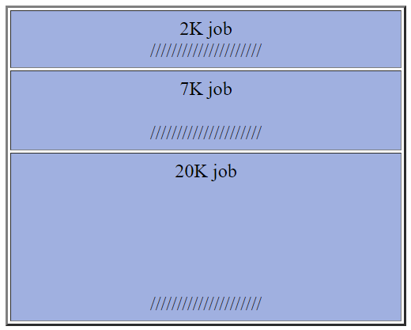
Fixed Allocation
RAM is divided into several regions of fixed size. Generally, a process runs in a partition that is the best fit to its memory needs, though some internal fragmentation is almost always involved.
An example is IBM MFT (Multiprogramming with a Fixed number of Tasks) which was part of OS/360. The fixed partitions were set up by the operator in the morning and remained the same for the rest of the day.
Example: Three jobs of size 2K, 7K, 20K running on a system with fixed partitions of 4K, 8K, and 24K:
Here "/////////////////////" represents fragmentation: space that is allocated but not used (here 7K out of a total of 36K)
Lack of flexibility: The basic problem with this scheme is its lack of flexibility. For example, in the above situation, a job of size 4K might be in the queue. This could fit in the space not needed by the 20K job; but this would not be possible since partitions are fixed.
Maximum job size determined by size of largest partition: A related problem: the size of the largest partition determines the size of the largest runnable job. This either means that no unusually large jobs can ever run, or else one very large partition has to be created, most of whose space is unused at most times.

Slide 10
Outline
1. Allocation of Frames
  Background
  Fixed & Variable allocations
  Equal & Proportional allocations
  Local & Global allocations
2. Thrashing
  Cause & Detection
  Solutions
  Working-Set Model
3. Allocating Kernel Memory
4. Other Issues

Slide 11
Fixed Allocation: EQUAL allocation
EQUAL method allocates an equal number of frames per job
Example
100 frames
5 processes
Each process gets 20 frames
Issues
But jobs use memory unequally
High priority jobs have same number of page
frames and low priority jobs
Degree of multiprogramming might vary

Slide 12
Fixed Allocation: PROPORTIONAL allocation
Size-based Proportional allocation – Allocate according to the size of process. How do you determine job size ?
  Run command parameters ?
  Dynamically? as degree of multiprogramming, process sizes change
Priority (Proportional) allocation – Use a proportional allocation scheme using priorities rather than size.
If process P_{i} generates a page fault,
  select for replacement one of its frames
  select for replacement a frame from a process with lower priority number

Slide 13
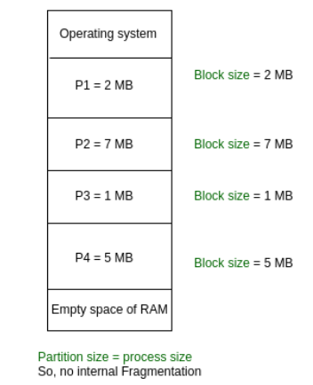
Variable Allocation
Variable/Dynamic allocation: In contrast with fixed allocation, partitions are not made before the execution. The size of a partition/block fits the size of each process.
Features:
  Initially RAM is empty and partitions are made during the run-time according to process’s need instead of partitioning during system configure.
  The size of partition will be equal to incoming process.
  The partition size varies according to the need of the process so that the internal fragmentation can be avoided to ensure efficient utilization of RAM.
  Number of partitions in RAM is not fixed and depends on the number of incoming process and Main Memory’s size.

Slide 14
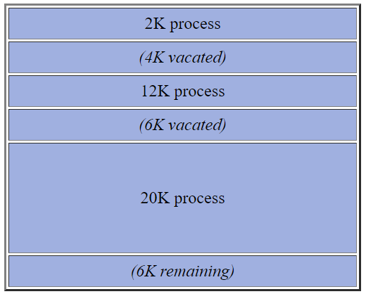
Variable Allocation
each process is given just the memory allocation it needs (or sometimes slightly more). Partitions change location, size, and often even quantity as processes come and go. (Ex: IBM MVT) As processes leave the system, this results in external fragmentation.
Example: The following processes arrive on a 56K system: 8K, 4K, 12K, 6K, 20K. The 4K and 6K processes terminate, leaving three holes (including the unallocated memory at the end) of size 4K, 6K, 4K:
Now, suppose a process arrives needing 8K of memory. Observe that it cannot be fit in, even though the total available storage is enough for two such processes.
Basic problem is that over time memory will become fragmented into many small unusable units
Problem can be overcome by compaction

Slide 15
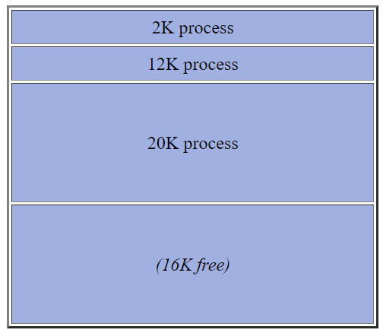
Compaction for Variable Allocation
Partial compaction
As a block of storage becomes free, a check is made to see if either or both of its neighbors are free. If so, then the freed block is conjoined to its neighbor(s) to make one large blocks. This can be done fairly simply - especially in a situation like this, where the total number of blocks is relatively small.
Ex: In the above, if the 12K process terminates, we would combine its allocation with its 4K and 6K neighbors, to make one block of 22K instead of three blocks of 4, 6, and 12K.
Full compaction
All existing allocations are moved so as to leave all free space in a single large block, typically at one end of memory.
Ex: In the above, we could move storage in use down toward the start of memory to produce:

Slide 16
Compaction for Variable Allocation
But this is a non-trivial task, due to:
Processor time involved in doing the movement.
On many machines, memory would have to be moved word by word, using a loop with as many as four instructions: move the word, increment pointer, test for completion, branch to loop. Some machines have block move instructions that make this faster.
Relocation
More serious is the problem of relocation, to be discussed as a separate issue below. Without some form of hardware relocation, this problem makes compaction a virtual impossibility.
Source: http://www.cs.gordon.edu/courses/cs322/lectures/memory.html

Slide 17
Outline
1. Allocation of Frames
  Background
  Fixed & Variable allocations
  Equal & Proportional allocations
  Local & Global allocations
2. Thrashing
  Cause & Detection
  Solutions
  Working-Set Model
3. Allocating Kernel Memory
4. Other Issues

Slide 18
Global vs. Local Allocation
Possible replacement scopes:
Global replacement – process selects a replacement frame from the set of all frames; one process can take a frame from another
  But then process execution time can vary greatly
  But greater throughput so more common
Local replacement – each process selects from only its own set of allocated frames
  More consistent per-process performance
  But possibly underutilized memory

Slide 19
Reclaiming Pages
A strategy to implement global page-replacement policy
All memory requests are satisfied from the free-frame list, rather than waiting for the list to drop to zero before we begin selecting pages for replacement,
Page replacement is triggered when the list falls below a certain threshold.
This strategy attempts to ensure there is always sufficient free memory to satisfy new requests.

Slide 20
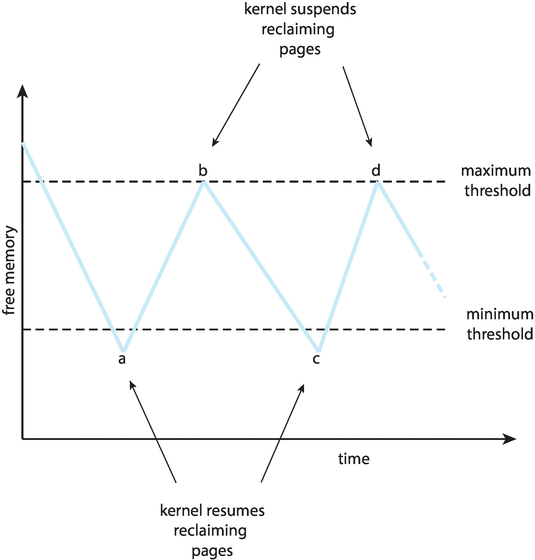
Reclaiming Pages Example

Slide 21
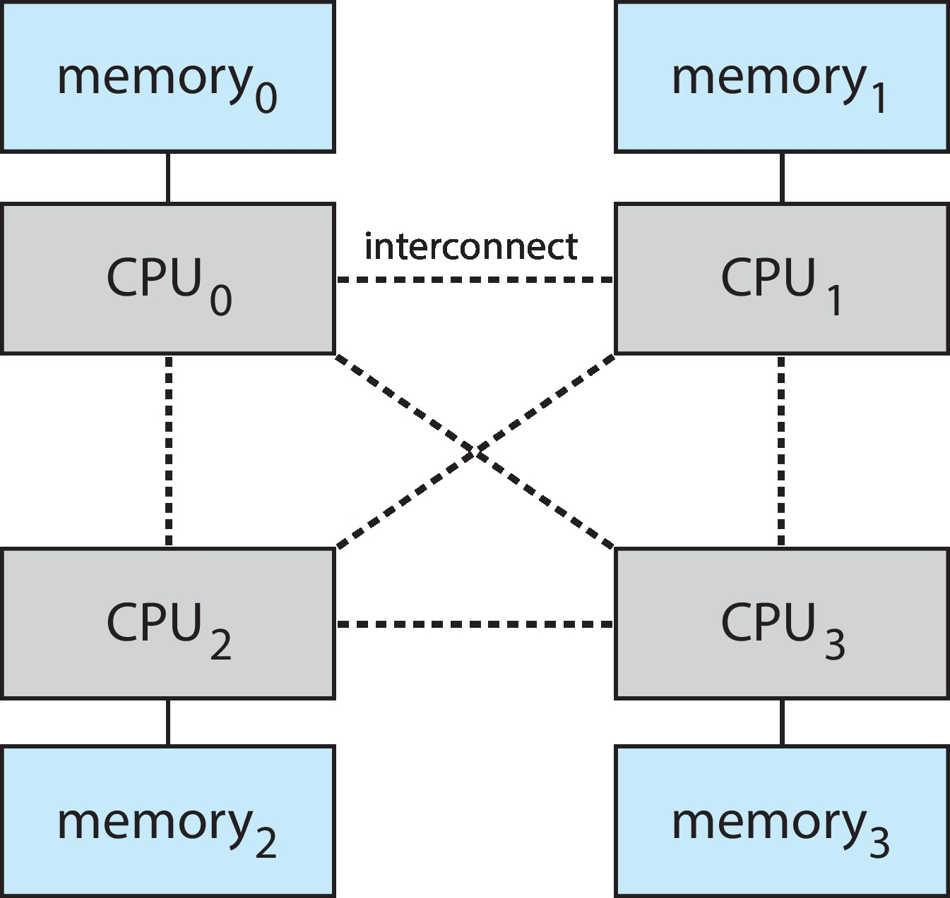
Non-Uniform Memory Access
So far, we assumed that all memory accessed equally
Many systems are NUMA – speed of access to memory varies
  Consider system boards containing CPUs and memory, interconnected over a system bus
NUMA multiprocessing architecture

Slide 22
Non-Uniform Memory Access (Cont.)
Optimal performance comes from allocating memory “close to” the CPU on which the thread is scheduled
  And modifying the scheduler to schedule the thread on the same system board when possible
  Solved by Solaris by creating lgroups
    Structure to track CPU / Memory low latency groups
    Used my schedule and pager
    When possible schedule all threads of a process and allocate all memory for that process within the lgroup

Slide 23
Outline
1. Allocation of Frames
  Background
  Fixed & Variable allocations
  Equal & Proportional allocations
  Local & Global allocations
2. Thrashing
  Cause & Detection
  Solutions
  Working-Set Model
3. Allocating Kernel Memory
4. Other Issues

Slide 24
Thrashing
Thrashing = A process is busy swapping pages in and out. In other words, a process is spending more time swapping paging than executing.
If a process does not have “enough” pages, the page-fault rate is very high
  Page fault to get page
  Replace existing frame
  But quickly need replaced frame back
  This leads to:
    Low CPU utilization
    Operating system thinking that it needs to increase the degree of multiprogramming
    Another process added to the system

Slide 25
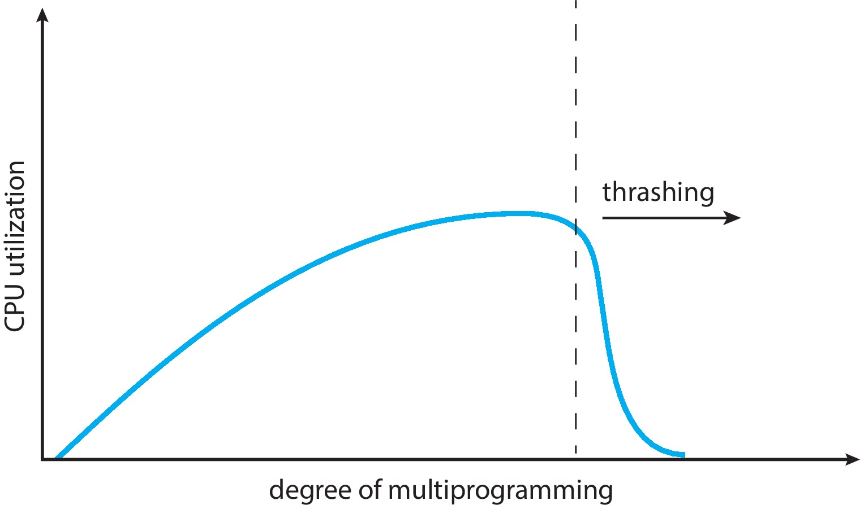
Thrashing (Cont.)
Thrashing. A process is busy swapping pages in and out

Slide 26
Outline
1. Allocation of Frames
  Background
  Fixed & Variable allocations
  Equal & Proportional allocations
  Local & Global allocations
2. Thrashing
  Cause & Detection
  Solutions
  Working-Set Model
3. Allocating Kernel Memory
4. Other Issues

Slide 27
Prepaging
To reduce the large number of page faults that occurs at process startup
Prepage all or some of the pages a process will need, before they are referenced
But if prepaged pages are unused, I/O and memory was wasted
Assume s pages are prepaged and α of the pages is used
  Is cost of s * α save pages faults > or < than the cost of prepaging
  s * (1- α) unnecessary pages?
  α near zero ⇒ prepaging loses

Slide 28
Demand Paging and Thrashing
Why does demand paging work?
Locality model
  Process migrates from one locality to another
  Localities may overlap
Why does thrashing occur?
Σ size of locality > total memory size
Limit effects by using local or priority page replacement

Slide 29
Demand Paging and Thrashing
Why does demand paging work?
Locality model
  Process migrates from one locality to another
  Localities may overlap
Why does thrashing occur?
Σ size of locality > total memory size
Limit effects by using local or priority page replacement

Slide 30
Locality In A Memory-Reference Pattern

Slide 31
Outline
1. Allocation of Frames
  Background
  Fixed & Variable allocations
  Equal & Proportional allocations
  Local & Global allocations
2. Thrashing
  Cause & Detection
  Solutions
  Working-Set Model
3. Allocating Kernel Memory
4. Other Issues

Slide 32
Working-Set Model
Question: How much memory does a process need to keep the most recent computation in memory with very few page faults?
How can we determine this?
  Determine the working set of a process
  The principle of locality
  A program clusters its access to data and text temporally
  A recently accessed page is more likely to be accessed again

Slide 33
Working-Set Model
Δ ≡ working-set window ≡ a fixed number of page references
Example: 10,000 instructions
WSS_{i} (working set of Process P_{i}) = total number of pages referenced in the most recent Δ (varies in time)
  if Δ too small will not encompass entire locality
  if Δ too large will encompass several localities
  if Δ = ∞ ⇒ will encompass entire program
D = Σ WSS_{i} ≡ total demand frames
  Approximation of locality

Slide 34
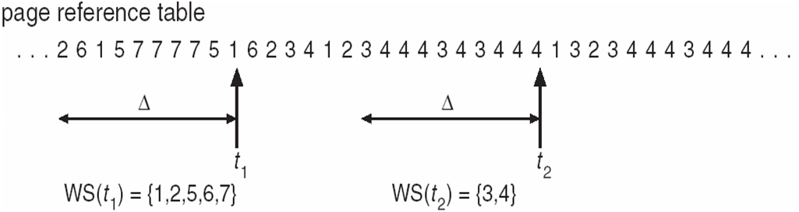
Working-Set Model (Cont.)
if D > m ⇒ Thrashing
Policy if D > m, then suspend or swap out one of the processes

Slide 35
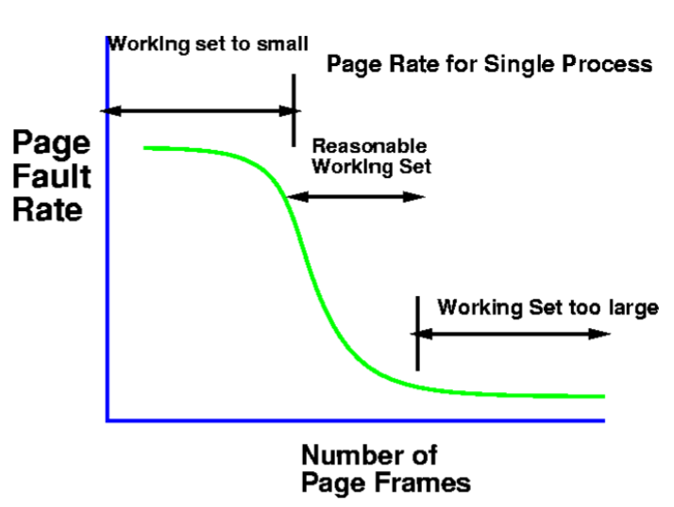
Working-Set Model (Cont.)

Slide 36
Keeping Track of the Working Set
Approximate with interval timer + a reference bit
Example: Δ = 10,000
  Timer interrupts after every 5000 time units
  Keep in memory 2 bits for each page
  Whenever a timer interrupts copy and sets the values of all reference bits to 0
  If one of the bits in memory = 1 ⇒ page in working set
Why is this not completely accurate?
Improvement = 10 bits and interrupt every 1000 time units

Slide 37
Page-Fault Frequency
More direct approach than WSS
Establish “acceptable” page-fault frequency (PFF) rate and use local replacement policy
  If actual rate too low, process loses frame
  If actual rate too high, process gains frame

Slide 38
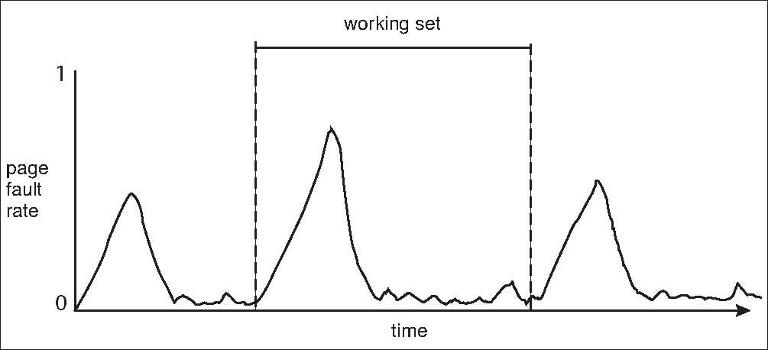
Working Sets and Page Fault Rates
Direct relationship between working set of a process and its page-fault rate
Working set changes over time
Peaks and valleys over time

Slide 39
Outline
1. Allocation of Frames
  Background
  Fixed & Variable allocations
  Equal & Proportional allocations
  Local & Global allocations
2. Thrashing
  Cause & Detection
  Solutions
  Working-Set Model
3. Allocating Kernel Memory
4. Other Issues

Slide 40
Allocating Kernel Memory
Treated differently from user memory
Often allocated from a free-memory pool
  Kernel requests memory for structures of varying sizes
  Some kernel memory needs to be contiguous
    i.e., for device I/O

Slide 41
Buddy System
Allocates memory from fixed-size segment consisting of physically-contiguous pages
Memory allocated using power-of-2 allocator
  Satisfies requests in units sized as power of 2
  Request rounded up to next highest power of 2
  When smaller allocation needed than is available, current chunk split into two buddies of next-lower power of 2
    Continue until appropriate sized chunk available
For example, assume 256KB chunk available, kernel requests 21KB
  Split into A_{L} _{and} A_{R} of 128KB each
    One further divided into B_{L} and B_{R} of 64KB
      One further into C_{L} and C_{R} of 32KB each – one used to satisfy request
Advantage – quickly coalesce unused chunks into larger chunk
Disadvantage - fragmentation

Slide 42
Buddy System Allocator

Slide 43
Slab Allocator
Alternate strategy
Slab is one or more physically contiguous pages
Cache consists of one or more slabs
Single cache for each unique kernel data structure
  Each cache filled with objects – instantiations of the data structure
When cache created, filled with objects marked as free
When structures stored, objects marked as used
If slab is full of used objects, next object allocated from empty slab
  If no empty slabs, new slab allocated
Benefits include no fragmentation, fast memory request satisfaction

Slide 44
Slab Allocation

Slide 45
Slab Allocator in Linux
For example process descriptor is of type struct task_struct
Approx 1.7KB of memory
New task -> allocate new struct from cache
  Will use existing free struct task_struct
Slab can be in three possible states
  Full – all used
  Empty – all free
  Partial – mix of free and used
Upon request, slab allocator
  Uses free struct in partial slab
  If none, takes one from empty slab
  If no empty slab, create new empty

Slide 46
Slab Allocator in Linux (Cont.)
Slab started in Solaris, now wide-spread for both kernel mode and user memory in various OSes
Linux 2.2 had SLAB, now has both SLOB and SLUB allocators
  SLOB for systems with limited memory
    Simple List of Blocks – maintains 3 list objects for small, medium, large objects
  SLUB is performance-optimized SLAB removes per-CPU queues, metadata stored in page structure

Slide 47
Outline
1. Allocation of Frames
  Background
  Fixed & Variable allocations
  Equal & Proportional allocations
  Local & Global allocations
2. Thrashing
  Cause & Detection
  Solutions
  Working-Set Model
3. Allocating Kernel Memory
4. Other Issues

Slide 48
Page Size
Sometimes OS designers have a choice
  Especially if running on custom-built CPU
Page size selection must take into consideration:
  Fragmentation
  Page table size
  Resolution
  I/O overhead
  Number of page faults
  Locality
  TLB size and effectiveness
Always power of 2, usually in the range 2¹² (4,096 bytes) to 2²² (4,194,304 bytes)
On average, growing over time

Slide 49
TLB Reach
TLB Reach - The amount of memory accessible from the TLB
TLB Reach = (TLB Size) X (Page Size)
Ideally, the working set of each process is stored in the TLB
  Otherwise there is a high degree of page faults
Increase the Page Size
  This may lead to an increase in fragmentation as not all applications require a large page size
Provide Multiple Page Sizes
  This allows applications that require larger page sizes the opportunity to use them without an increase in fragmentation

Slide 50
Program Structure
Program structure
  int[128,128] data;
  Each row is stored in one page
  Program 1
for (j = 0; j <128; j++)
for (i = 0; i < 128; i++)
data[i,j] = 0;
  128 x 128 = 16,384 page faults
  Program 2
  for (i = 0; i < 128; i++)
  for (j = 0; j < 128; j++)
  data[i,j] = 0;
  128 page faults

Slide 51
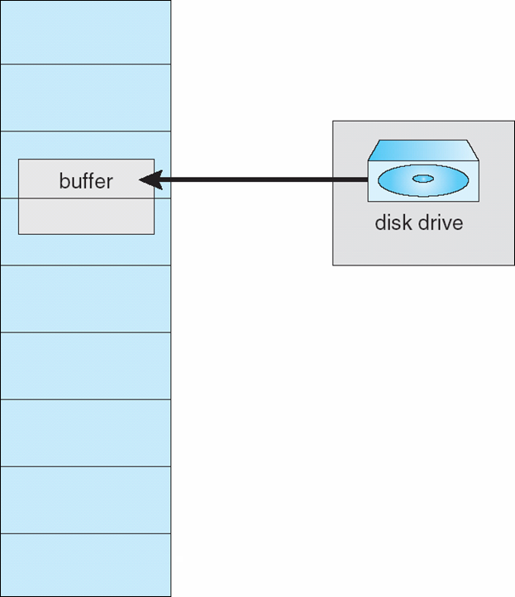
I/O interlock
I/O Interlock – Pages must sometimes be locked into memory
Consider I/O - Pages that are used for copying a file from a device must be locked from being selected for eviction by a page replacement algorithm
Pinning of pages to lock into memory

Slide 52
End of Chapter 10

