Slide 1
Lecture 21
File Management

Slide 2
Outline
1. File Concepts:
  Attributes, Operations, Types, Structure
2. Access Methods
  Sequential
  Random
3. Directory Structure
  Operations
  Types: single-level, tree-structured, acyclic-graph, general graph
4. File Allocation Methods
  Contiguous; Linked; Index
5. File Systems:
  Structures, Mounting, Protection, Implementation
6. Other Issues

Slide 3
Outline
  KEYWORDS: File, File Structure, File Attributes, File Operations, File Types, Sequential Access, Random Access, Mounting, Contiguous Allocation, Linked Allocation, Index Allocation.
HOMEWORK:
  1) Reading : Chapter 13,14,15, especially the summary.
  2) Make sure to understand and be able to explain every keyword from the list here and the ones which are printed bold in the text book.
  3) Important Questions:
  List disadvantages of using a single directory.
  Explain the purpose of the open and close operations.
  Give an example of an application in which data in a file should be accessed in the following order: a. Sequentially b. Randomly
  Consider a system that supports the strategies of contiguous, linked, and indexed allocation. What criteria should be used in deciding which strategy is best utilized for a particular file

Slide 4
Outline
  Consider a file currently consisting of 100 blocks. Assume that the file control block (and the index block, in the case of indexed allocation) is already in memory. Calculate how many disk I/O operations are required for contiguous, linked, and indexed (single-level) allocation strategies, if, for one block, the following conditions hold. In the contiguous-allocation case, assume that there is no room to grow in the beginning, but there is room to grow in the end. Assume that the block information to be added is stored in memory.
    a. The block is added at the beginning.
    b. The block is added in the middle.
    c. The block is added at the end.
    d. The block is removed from the beginning.
    e. The block is removed from the middle.
    f. The block is removed from the end.

Slide 5
Outline
1. File Concepts:
  Attributes, Operations, Types, Structure
2. Access Methods
  Sequential
  Random
3. Directory Structure
  Operations
  Types: single-level, tree-structured, acyclic-graph, general graph
4. File Allocation Methods
  Contiguous; Linked; Index
5. File Systems:
  Structures, Mounting, Protection, Implementation
6. Other Issues

Slide 6
File Concept
Contiguous logical address space
Types:
  Data
    numeric
    character
    binary
  Program
Contents defined by file’s creator
  Many types
    Consider text file, source file, executable file

Slide 7
File Attributes
Name – only information kept in human-readable form
Identifier – unique tag (number) identifies file within file system
Type – needed for systems that support different types
Location – pointer to file location on device
Size – current file size
Protection – controls who can do reading, writing, executing
Time, date, and user identification – data for protection, security, and usage monitoring
Information about files are kept in the directory structure, which is maintained on the disk
Many variations, including extended file attributes such as file checksum
Information kept in the directory structure

Slide 8
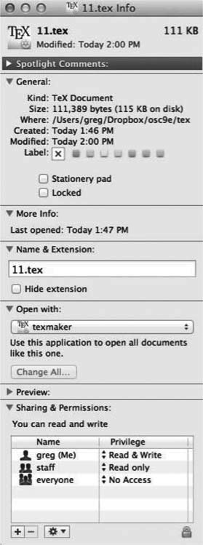
File info Window on Mac OS X

Slide 9
File Operations
File is an abstract data type
Create
Write – at write pointer location
Read – at read pointer location
Reposition within file - seek
Delete
Truncate
Open(F_{i}) – search the directory structure on disk for entry F_{i}, and move the content of entry to memory
Close (F_{i}) – move the content of entry F_{i} in memory to directory structure on disk

Slide 10
Open Files
Several pieces of data are needed to manage open files:
  Open-file table: tracks open files
  File pointer: pointer to last read/write location, per process that has the file open
  File-open count: counter of number of times a file is open – to allow removal of data from open-file table when last processes closes it
  Disk location of the file: cache of data access information
  Access rights: per-process access mode information

Slide 11
Open File Locking
Provided by some operating systems and file systems
  Similar to reader-writer locks
  Shared lock similar to reader lock – several processes can acquire concurrently
  Exclusive lock similar to writer lock
Mediates access to a file
Mandatory or advisory:
  Mandatory – access is denied depending on locks held and requested
  Advisory – processes can find status of locks and decide what to do

Slide 12
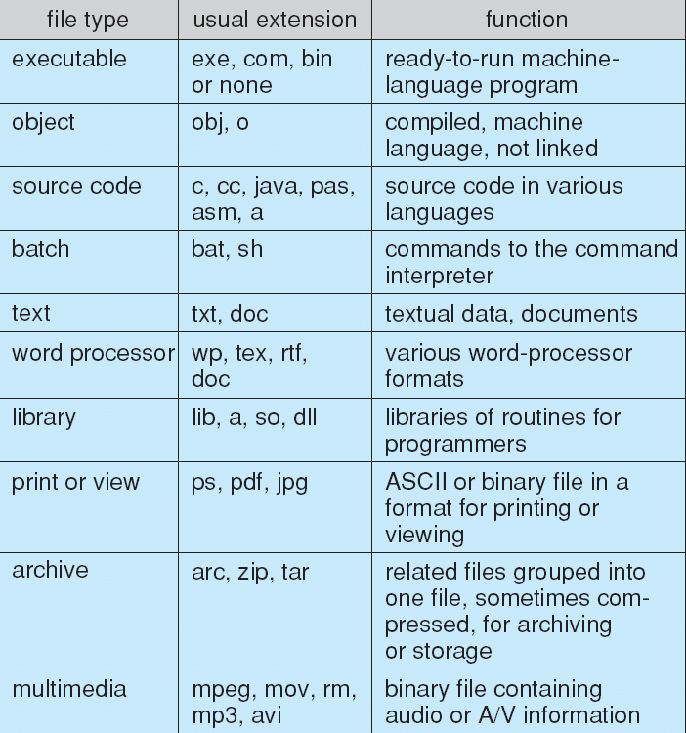
File Types – Name, Extension

Slide 13
Outline
1. File Concepts:
  Attributes, Operations, Types, Structure
2. Access Methods
  Sequential
  Random
3. Directory Structure
  Operations
  Types: single-level, tree-structured, acyclic-graph, general graph
4. File Allocation Methods
  Contiguous; Linked; Index
5. File Systems:
  Structures, Mounting, Protection, Implementation
6. Other Issues

Slide 14
File Structure
None - sequence of words, bytes
Simple record structure
  Lines
  Fixed length
  Variable length
Complex Structures
  Formatted document
  Relocatable load file
Can simulate last two with first method by inserting appropriate control characters
Who decides:
  Operating system
  Program

Slide 15
Outline
1. File Concepts:
  Attributes, Operations, Types, Structure
2. Access Methods
  Sequential
  Random
3. Directory Structure
  Operations
  Types: single-level, tree-structured, acyclic-graph, general graph
4. File Allocation Methods
  Contiguous; Linked; Index
5. File Systems:
  Structures, Mounting, Protection, Implementation
6. Other Issues

Slide 16
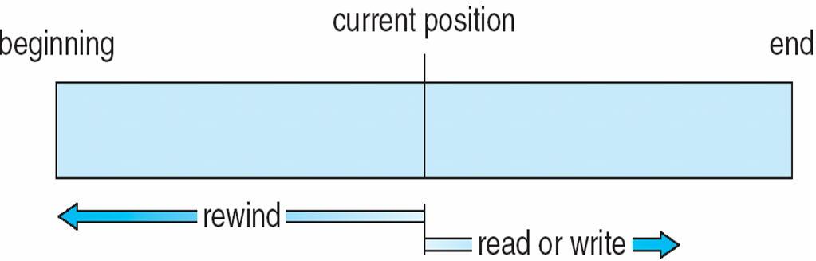
Sequential-access File

Slide 17
Access Methods
Sequential Access
read next
write next
reset
no read after last write
(rewrite)
Direct Access – file is fixed length logical records
read n
write n
position to n
read next
write next
rewrite n
n = relative block number
Relative block numbers allow OS to decide where file should be placed
  See allocation problem in Ch 12

Slide 18
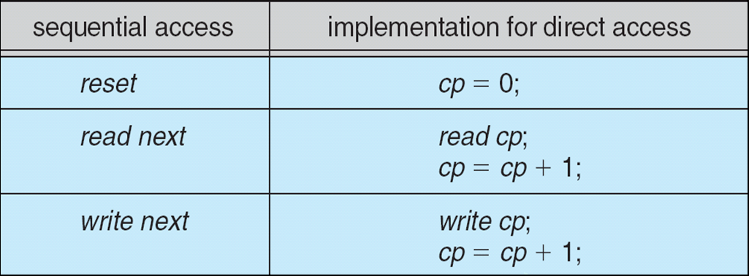
Simulation of Sequential Access on Direct-access File

Slide 19
Other Access Methods
Can be built on top of base methods
General involve creation of an index for the file
Keep index in memory for fast determination of location of data to be operated on (consider UPC code plus record of data about that item)
If too large, index (in memory) of the index (on disk)
IBM indexed sequential-access method (ISAM)
  Small master index, points to disk blocks of secondary index
  File kept sorted on a defined key
  All done by the OS
VMS operating system provides index and relative files as another example (see next slide)

Slide 20
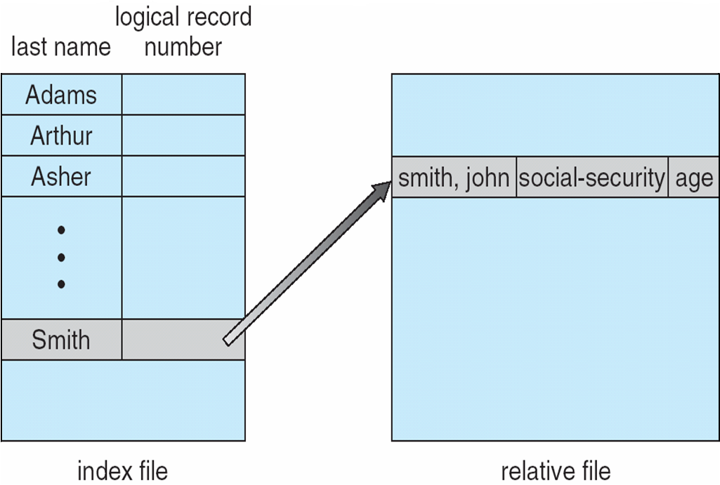
Example of Index and Relative Files

Slide 21
Outline
1. File Concepts:
  Attributes, Operations, Types, Structure
2. Access Methods
  Sequential
  Random
3. Directory Structure
  Operations
  Types: single-level, tree-structured, acyclic-graph, general graph
4. File Allocation Methods
  Contiguous; Linked; Index
5. File Systems:
  Structures, Mounting, Protection, Implementation
6. Other Issues

Slide 22
Directory Structure
A collection of nodes containing information about all files
Directory
Files
F 1
F 2
F 3
F 4
F n
Both the directory structure and the files reside on disk

Slide 23
Operations Performed on Directory
Search for a file
Create a file
Delete a file
List a directory
Rename a file
Traverse the file system

Slide 24
Directory Organization
The directory is organized logically to obtain
Efficiency – locating a file quickly
Naming – convenient to users
  Two users can have same name for different files
  The same file can have several different names
Grouping – logical grouping of files by properties, (e.g., all Java programs, all games, …)

Slide 25
Outline
1. File Concepts:
  Attributes, Operations, Types, Structure
2. Access Methods
  Sequential
  Random
3. Directory Structure
  Operations
  Types: single-level, tree-structured, acyclic-graph, general graph
4. File Allocation Methods
  Contiguous; Linked; Index
5. File Systems:
  Structures, Mounting, Protection, Implementation
6. Other Issues

Slide 26
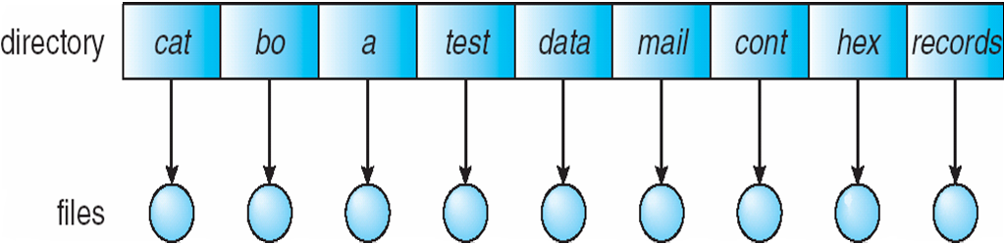
Single-Level Directory
A single directory for all users
Naming problem
Grouping problem

Slide 27
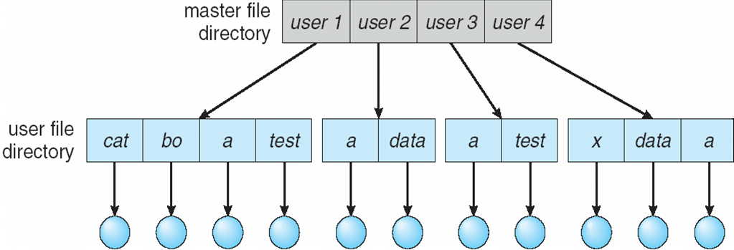
Two-Level Directory
Separate directory for each user
Path name
Can have the same file name for different user
Efficient searching
No grouping capability

Slide 28
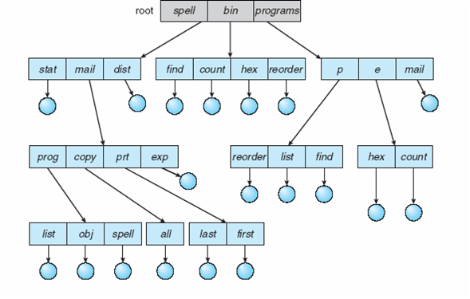
Tree-Structured Directories

Slide 29
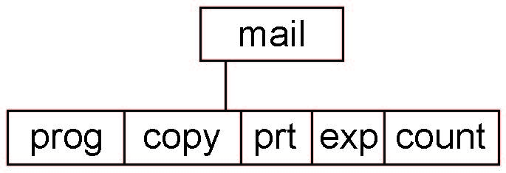
Tree-Structured Directories (Cont.)
Absolute or relative path name
Creating a new file is done in current directory
Delete a file
rm <file-name>
Creating a new subdirectory is done in current directory
  mkdir <dir-name>
  Example: if in current directory /mail
  mkdir count
Deleting “mail” ⇒ deleting the entire subtree rooted by “mail”

Slide 30
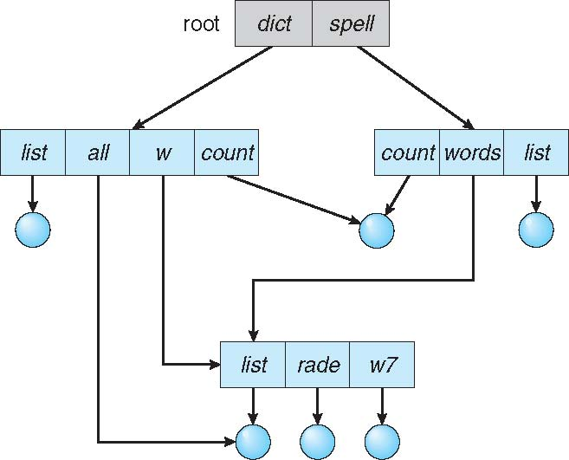
Acyclic-Graph Directories
Have shared subdirectories and files

Slide 31
Acyclic-Graph Directories (Cont.)
Two different names (aliasing)
If dict deletes list ⇒ dangling pointer
Solutions:
  Backpointers, so we can delete all pointers
  Variable size records a problem
  Backpointers using a daisy chain organization
  Entry-hold-count solution
New directory entry type
  Link – another name (pointer) to an existing file
  Resolve the link – follow pointer to locate the file

Slide 32
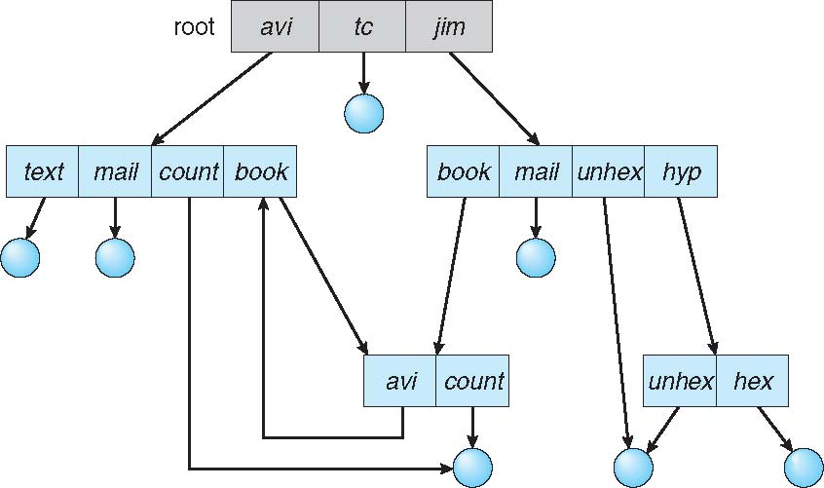
General Graph Directory

Slide 33
General Graph Directory (Cont.)
How do we guarantee no cycles?
  Allow only links to file not subdirectories
  Garbage collection
  Every time a new link is added use a cycle detection algorithm to determine whether it is OK

Slide 34
Outline
1. File Concepts:
  Attributes, Operations, Types, Structure
2. Access Methods
  Sequential
  Random
3. Directory Structure
  Operations
  Types: single-level, tree-structured, acyclic-graph, general graph
4. File Allocation Methods
  Contiguous; Linked; Index
5. File Systems:
  Structures, Mounting, Protection, Implementation
6. Other Issues

Slide 35
Allocation Methods - Contiguous
An allocation method refers to how disk blocks are allocated for files:
Contiguous allocation – each file occupies set of contiguous blocks
  Best performance in most cases
  Simple – only starting location (block #) and length (number of blocks) are required
  Problems include finding space for file, knowing file size, external fragmentation, need for compaction off-line (downtime) or on-line

Slide 36
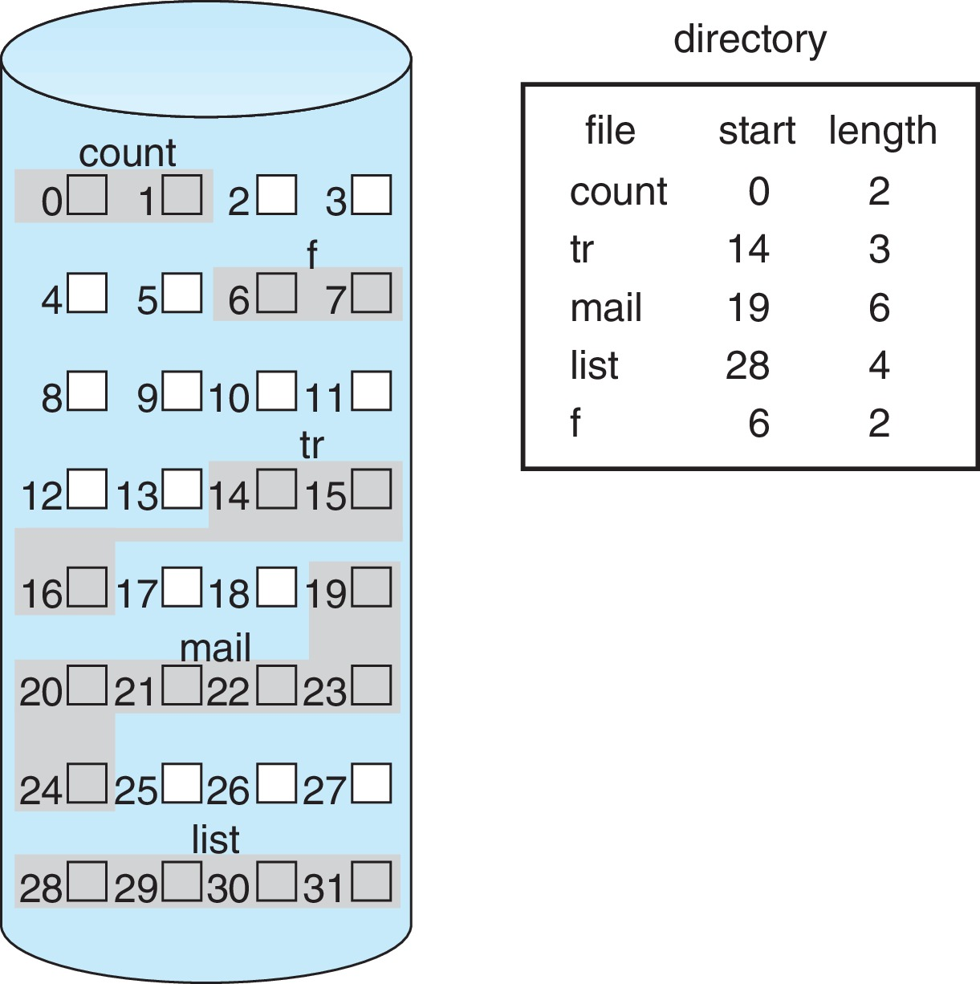
Contiguous Allocation
Mapping from logical to physical
Q
LA/512
R
  Block to be accessed = Q + starting address
  Displacement into block = R

Slide 37
Allocation Methods - Linked
Linked allocation – each file a linked list of blocks
  File ends at nil pointer
  No external fragmentation
  Each block contains pointer to next block
  No compaction, external fragmentation
  Free space management system called when new block needed
  Improve efficiency by clustering blocks into groups but increases internal fragmentation
  Reliability can be a problem
  Locating a block can take many I/Os and disk seeks

Slide 38
Linked Allocation
Each file is a linked list of disk blocks: blocks may be scattered anywhere on the disk
block =
pointer
Mapping
Q
LA/511
R
  Block to be accessed is the Qth block in the linked chain of blocks representing the file.
  Displacement into block = R + 1

Slide 39
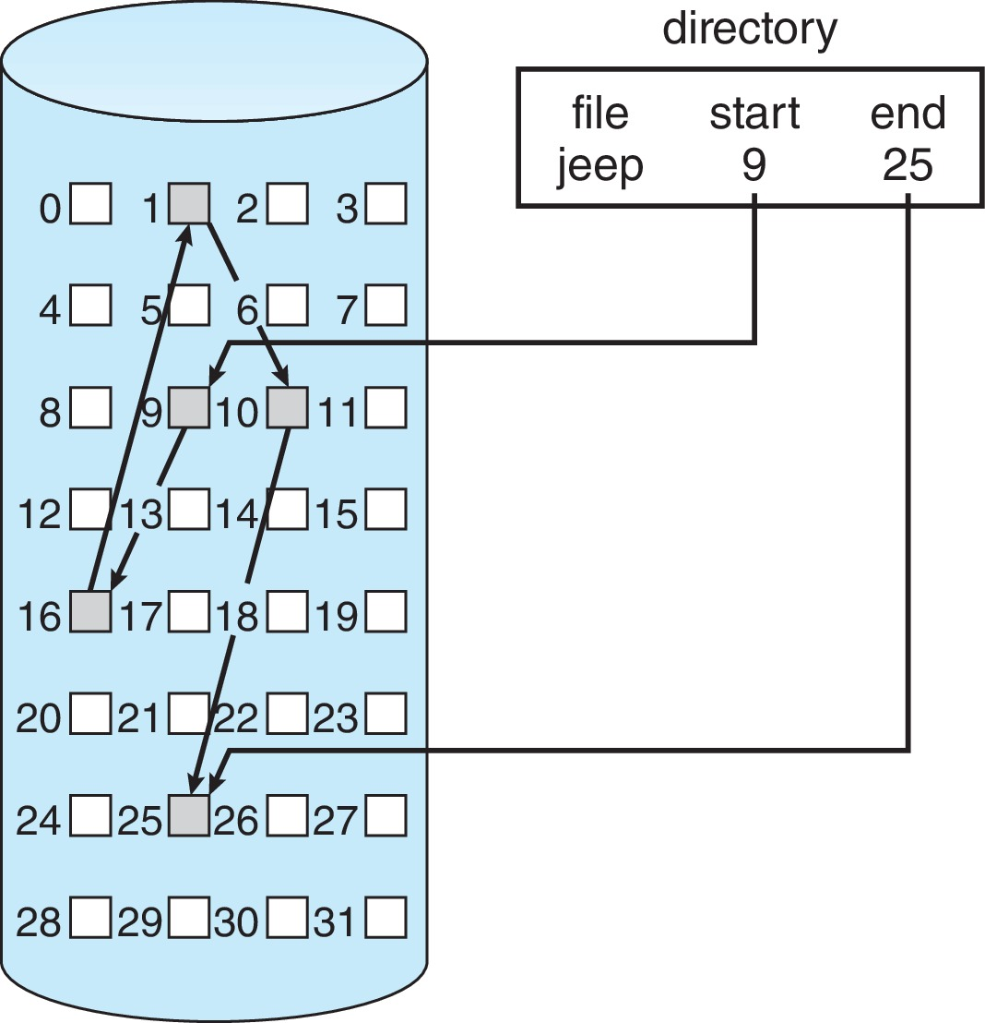
Linked Allocation

Slide 40
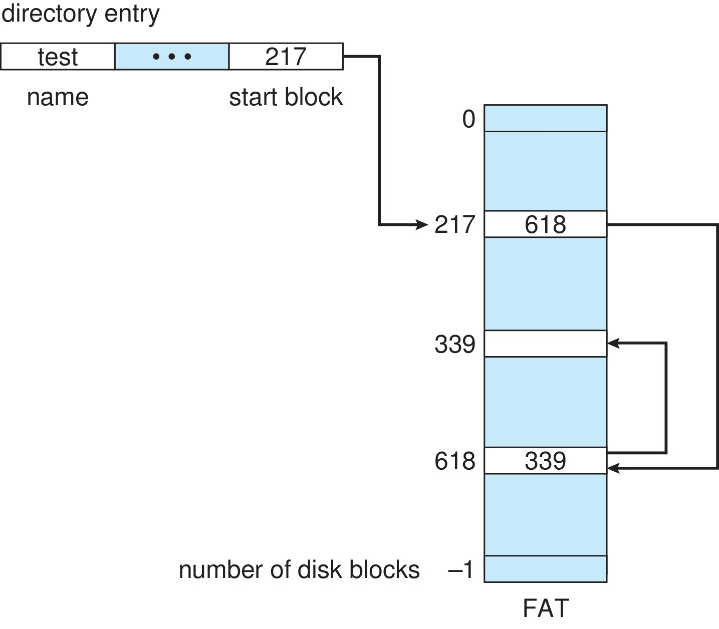
File-Allocation Table

Slide 41
Allocation Methods - Indexed
Indexed allocation
  Each file has its own index block(s) of pointers to its data blocks
Logical view

Slide 42
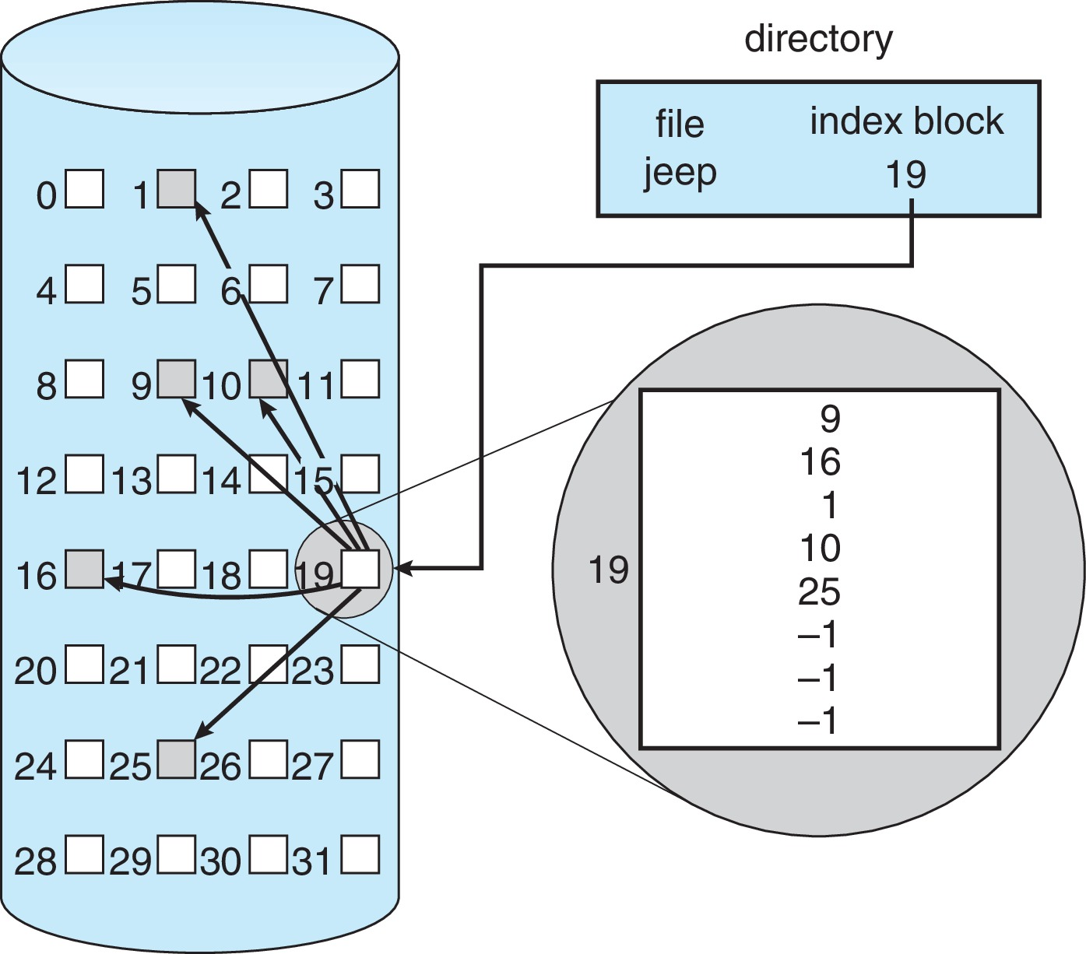
Example of Indexed Allocation

Slide 43
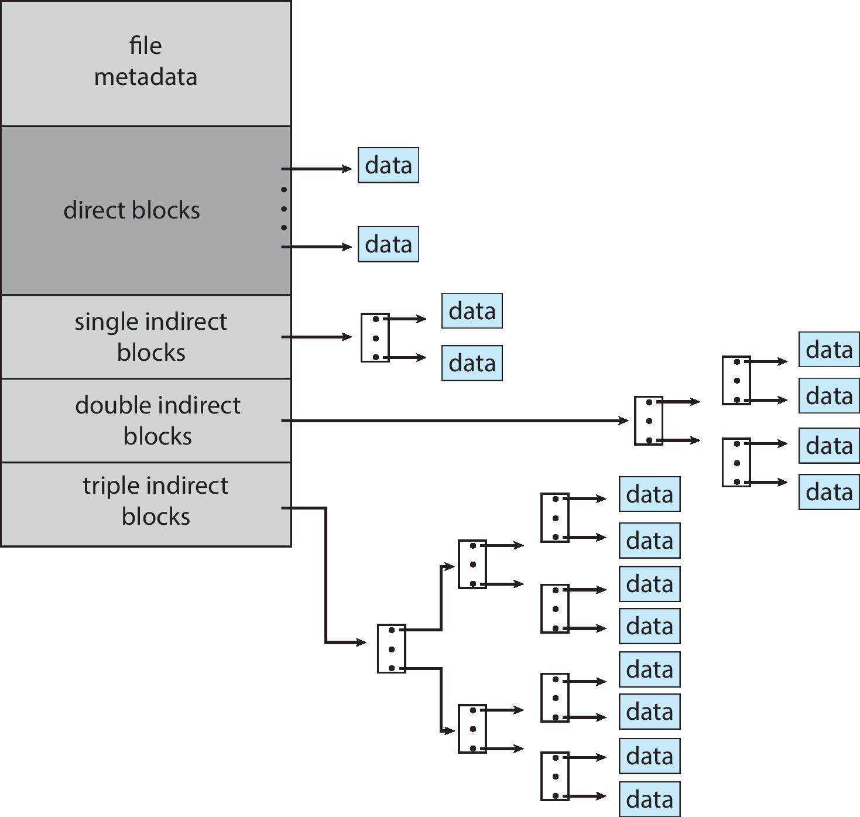
Combined Scheme: UNIX UFS
4K bytes per block, 32-bit addresses
More index blocks than can be addressed with 32-bit file pointer

Slide 44
Performance
Best method depends on file access type
  Contiguous great for sequential and random
Linked good for sequential, not random
Declare access type at creation -> select either contiguous or linked
Indexed more complex
  Single block access could require 2 index block reads then data block read
  Clustering can help improve throughput, reduce CPU overhead
For NVM, no disk head so different algorithms and optimizations needed
  Using old algorithm uses many CPU cycles trying to avoid non-existent head movement
  With NVM goal is to reduce CPU cycles and overall path needed for I/O

Slide 45
Performance (Cont.)
Adding instructions to the execution path to save one disk I/O is reasonable
  Intel Core i7 Extreme Edition 990x (2011) at 3.46Ghz = 159,000 MIPS
    http://en.wikipedia.org/wiki/Instructions_per_second
  Typical disk drive at 250 I/Os per second
    159,000 MIPS / 250 = 630 million instructions during one disk I/O
  Fast SSD drives provide 60,000 IOPS
    159,000 MIPS / 60,000 = 2.65 millions instructions during one disk I/O

Slide 46
Outline
1. File Concepts:
  Attributes, Operations, Types, Structure
2. Access Methods
  Sequential
  Random
3. Directory Structure
  Operations
  Types: single-level, tree-structured, acyclic-graph, general graph
4. File Allocation Methods
  Contiguous; Linked; Index
5. File Systems:
  Structures, Mounting, Protection, Implementation
6. Other Issues

Slide 47
File-System Structure
File structure
  Logical storage unit
  Collection of related information
File system resides on secondary storage (disks)
  Provided user interface to storage, mapping logical to physical
  Provides efficient and convenient access to disk by allowing data to be stored, located retrieved easily
Disk provides in-place rewrite and random access
  I/O transfers performed in blocks of sectors (usually 512 bytes)
File control block (FCB) – storage structure consisting of information about a file
Device driver controls the physical device
File system organized into layers

Slide 48
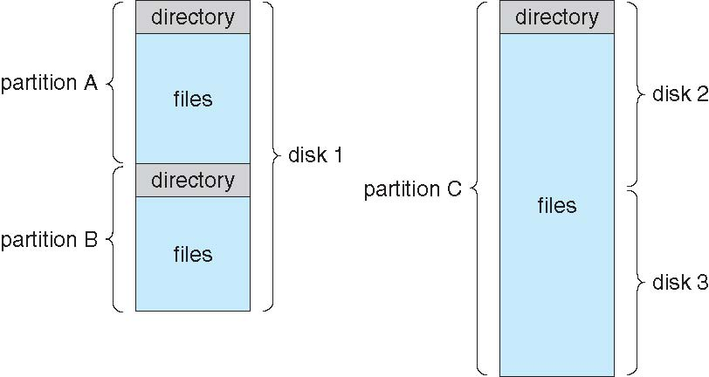
A Typical File-system Organization

Slide 49
Types of File Systems
We mostly talk of general-purpose file systems
But systems frequently have may file systems, some general- and some special- purpose
Consider Solaris has
  tmpfs – memory-based volatile FS for fast, temporary I/O
  objfs – interface into kernel memory to get kernel symbols for debugging
  ctfs – contract file system for managing daemons
  lofs – loopback file system allows one FS to be accessed in place of another
  procfs – kernel interface to process structures
  ufs, zfs – general purpose file systems

Slide 50
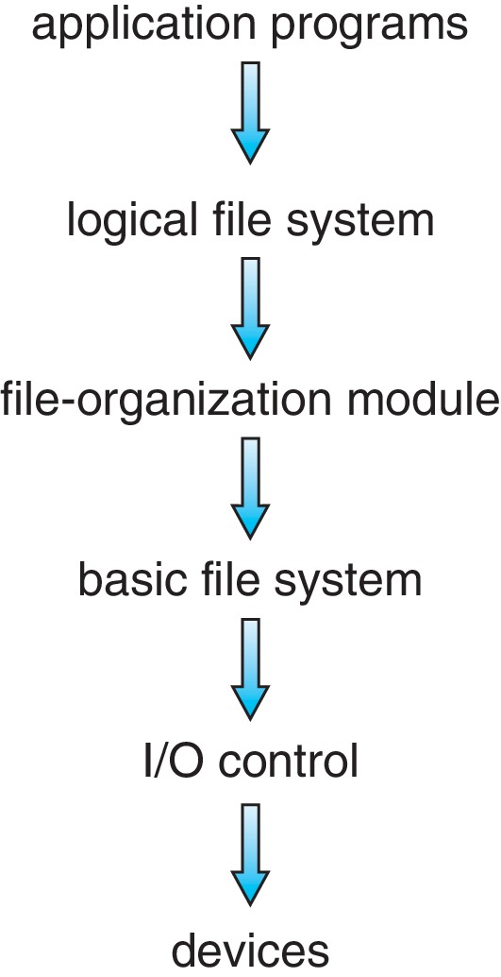
Layered File System

Slide 51
File System Layers
Device drivers manage I/O devices at the I/O control layer
  Given commands like “read drive1, cylinder 72, track 2, sector 10, into memory location 1060” outputs low-level hardware specific commands to hardware controller
Basic file system given command like “retrieve block 123” translates to device driver
Also manages memory buffers and caches (allocation, freeing, replacement)
  Buffers hold data in transit
  Caches hold frequently used data
File organization module understands files, logical address, and physical blocks
  Translates logical block # to physical block #
  Manages free space, disk allocation

Slide 52
File System Layers (Cont.)
Logical file system manages metadata information
  Translates file name into file number, file handle, location by maintaining file control blocks (inodes in UNIX)
  Directory management
  Protection
Layering useful for reducing complexity and redundancy, but adds overhead and can decrease performance
Logical layers can be implemented by any coding method according to OS designer

Slide 53
File-System Operations
We have system calls at the API level, but how do we implement their functions?
  On-disk and in-memory structures
Boot control block contains info needed by system to boot OS from that volume
  Needed if volume contains OS, usually first block of volume
Volume control block (superblock, master file table) contains volume details
  Total # of blocksblocks, block size, free block pointers or array, # of free
Directory structure organizes the files
  Names and inode numbers, master file table

Slide 54
Outline
1. File Concepts:
  Attributes, Operations, Types, Structure
2. Access Methods
  Sequential
  Random
3. Directory Structure
  Operations
  Types: single-level, tree-structured, acyclic-graph, general graph
4. File Allocation Methods
  Contiguous; Linked; Index
5. File Systems:
  Structures, Mounting, Protection, Implementation
6. Other Issues

Slide 55
File System Mounting
A file system must be mounted before it can be accessed
A unmounted file system (i.e., Fig. 11-11(b)) is mounted at a mount point

Slide 56
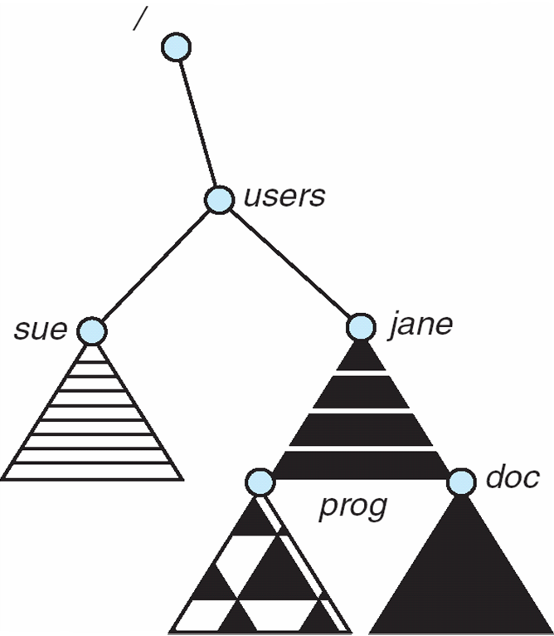
Mount Point

Slide 57
File Sharing
Sharing of files on multi-user systems is desirable
Sharing may be done through a protection scheme
On distributed systems, files may be shared across a network
Network File System (NFS) is a common distributed file-sharing method
If multi-user system
  User IDs identify users, allowing permissions and protections to be per-user
  Group IDs allow users to be in groups, permitting group access rights
  Owner of a file / directory
  Group of a file / directory

Slide 58
File Sharing – Remote File Systems
Uses networking to allow file system access between systems
  Manually via programs like FTP
  Automatically, seamlessly using distributed file systems
  Semi automatically via the world wide web
Client-server model allows clients to mount remote file systems from servers
  Server can serve multiple clients
  Client and user-on-client identification is insecure or complicated
  NFS is standard UNIX client-server file sharing protocol
  CIFS is standard Windows protocol
  Standard operating system file calls are translated into remote calls
Distributed Information Systems (distributed naming services) such as LDAP, DNS, NIS, Active Directory implement unified access to information needed for remote computing

Slide 59
File Sharing – Failure Modes
All file systems have failure modes
  For example corruption of directory structures or other non-user data, called metadata
Remote file systems add new failure modes, due to network failure, server failure
Recovery from failure can involve state information about status of each remote request
Stateless protocols such as NFS v3 include all information in each request, allowing easy recovery but less security

Slide 60
File Sharing – Consistency Semantics
Specify how multiple users are to access a shared file simultaneously
  Similar to Ch 5 process synchronization algorithms
    Tend to be less complex due to disk I/O and network latency (for remote file systems
  Andrew File System (AFS) implemented complex remote file sharing semantics
  Unix file system (UFS) implements:
    Writes to an open file visible immediately to other users of the same open file
    Sharing file pointer to allow multiple users to read and write concurrently
  AFS has session semantics
    Writes only visible to sessions starting after the file is closed

Slide 61
Outline
1. File Concepts:
  Attributes, Operations, Types, Structure
2. Access Methods
  Sequential
  Random
3. Directory Structure
  Operations
  Types: single-level, tree-structured, acyclic-graph, general graph
4. File Allocation Methods
  Contiguous; Linked; Index
5. File Systems:
  Structures, Mounting, Protection, Implementation
6. Other Issues

Slide 62
Protection
File owner/creator should be able to control:
  what can be done
  by whom
Types of access
  Read
  Write
  Execute
  Append
  Delete
  List

Slide 63
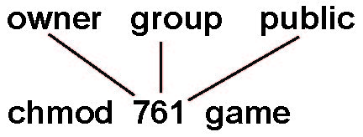
Access Lists and Groups
Mode of access: read, write, execute
Three classes of users on Unix / Linux
RWX
a) owner access 7 ⇒ 1 1 1
RWX
b) group access 6 ⇒ 1 1 0
RWX
c) public access 1 ⇒ 0 0 1
Ask manager to create a group (unique name), say G, and add some users to the group.
For a particular file (say game) or subdirectory, define an appropriate access.
Attach a group to a file
chgrp G game

Slide 64
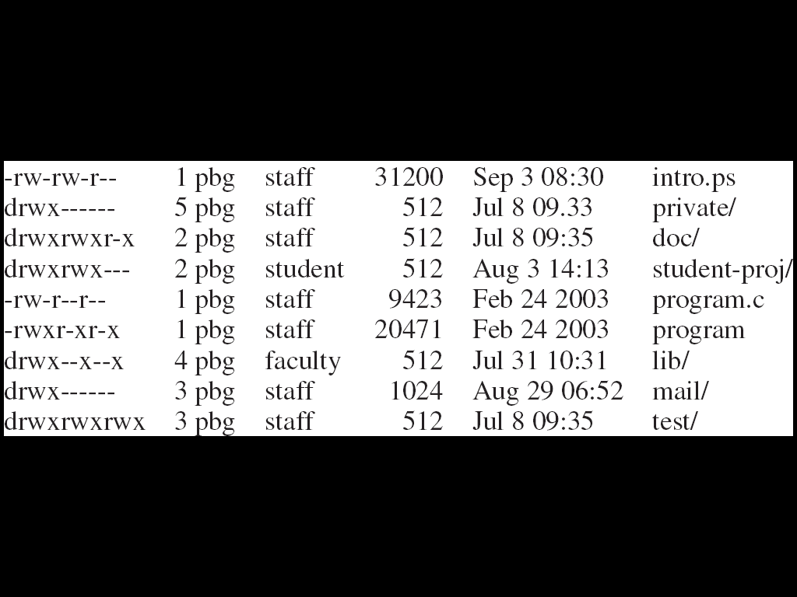
A Sample UNIX Directory Listing

Slide 65
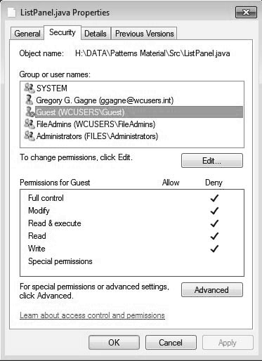
Windows 7 Access-Control List Management

Slide 66
Outline
1. File Concepts:
  Attributes, Operations, Types, Structure
2. Access Methods
  Sequential
  Random
3. Directory Structure
  Operations
  Types: single-level, tree-structured, acyclic-graph, general graph
4. File Allocation Methods
  Contiguous; Linked; Index
5. File Systems:
  Structures, Mounting, Protection, Implementation
6. Other Issues

Slide 67
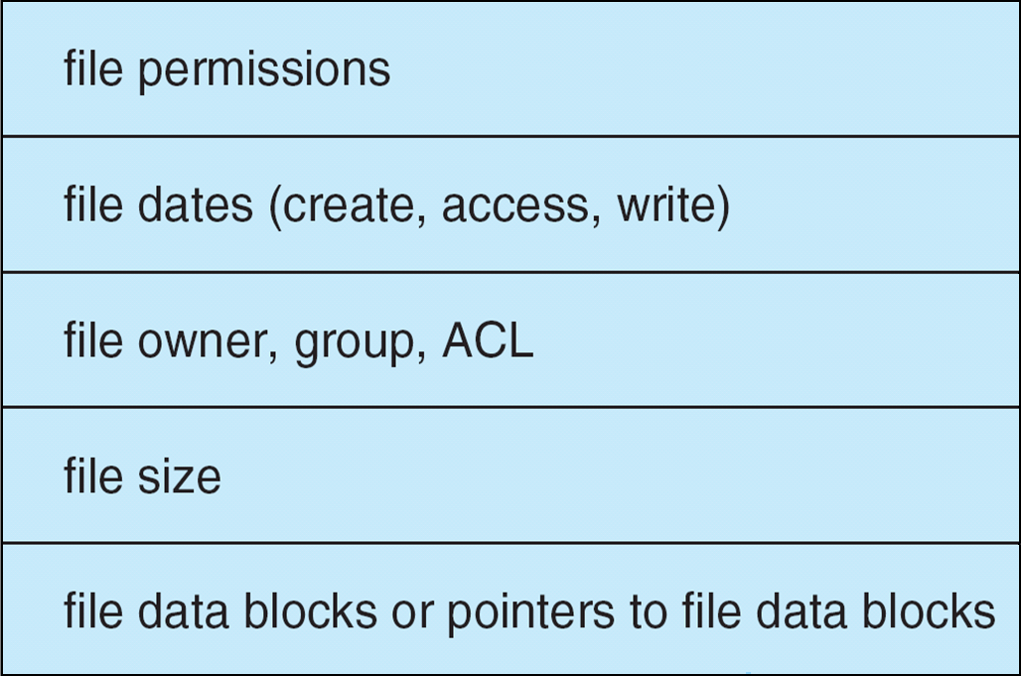
File-System Implementation
Per-file File Control Block (FCB) contains many details about the file
  typically inode number, permissions, size, dates
  NFTS stores into in master file table using relational DB structures

Slide 68
In-Memory File System Structures
Mount table storing file system mounts, mount points, file system types
system-wide open-file table contains a copy of the FCB of each file and other info
per-process open-file table contains pointers to appropriate entries in system-wide open-file table as well as other info
The following figure illustrates the necessary file system structures provided by the operating systems
Figure 12-3(a) refers to opening a file
Figure 12-3(b) refers to reading a file
Plus buffers hold data blocks from secondary storage
Open returns a file handle for subsequent use
Data from read eventually copied to specified user process memory address

Slide 69
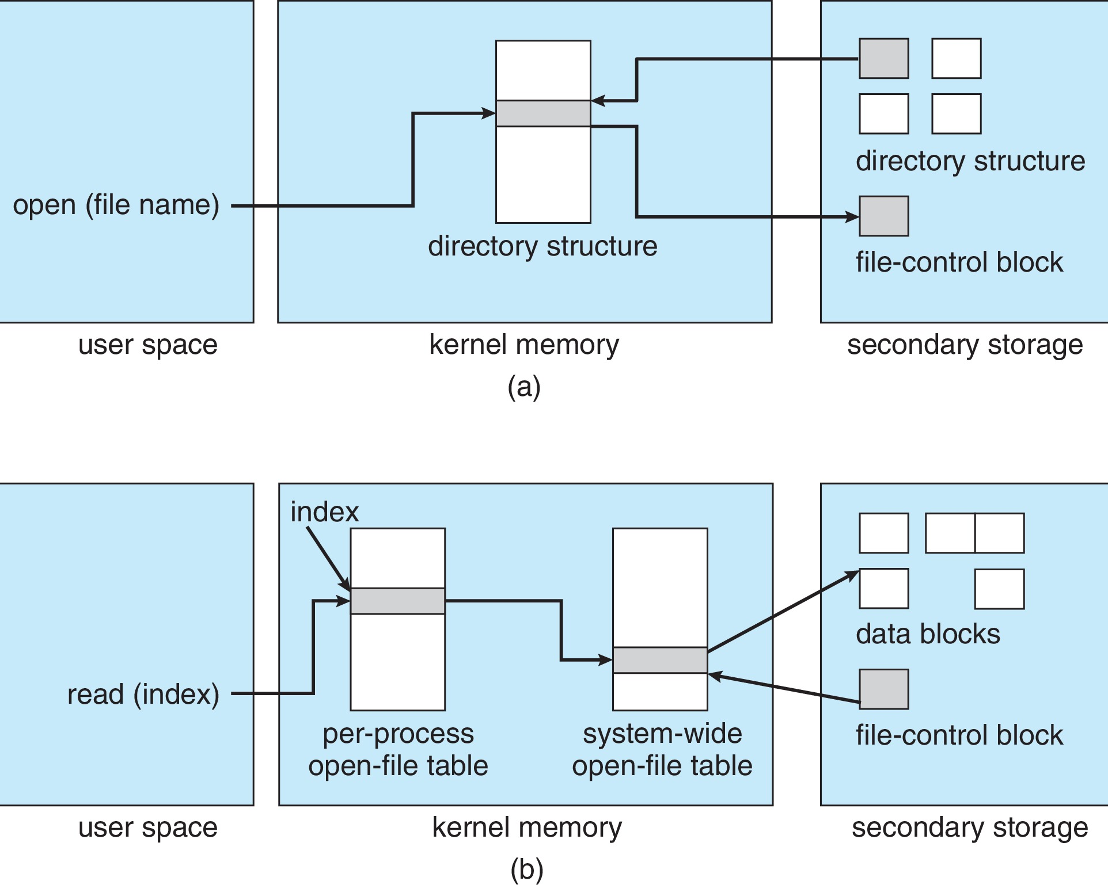
In-Memory File System Structures

Slide 70
Directory Implementation
Linear list of file names with pointer to the data blocks
  Simple to program
  Time-consuming to execute
    Linear search time
    Could keep ordered alphabetically via linked list or use B+ tree
Hash Table – linear list with hash data structure
  Decreases directory search time
  Collisions – situations where two file names hash to the same location
  Only good if entries are fixed size, or use chained-overflow method

Slide 71
Outline
1. File Concepts:
  Attributes, Operations, Types, Structure
2. Access Methods
  Sequential
  Random
3. Directory Structure
  Operations
  Types: single-level, tree-structured, acyclic-graph, general graph
4. File Allocation Methods
  Contiguous; Linked; Index
5. File Systems:
  Structures, Mounting, Protection, Implementation
6. Other Issues

Slide 72
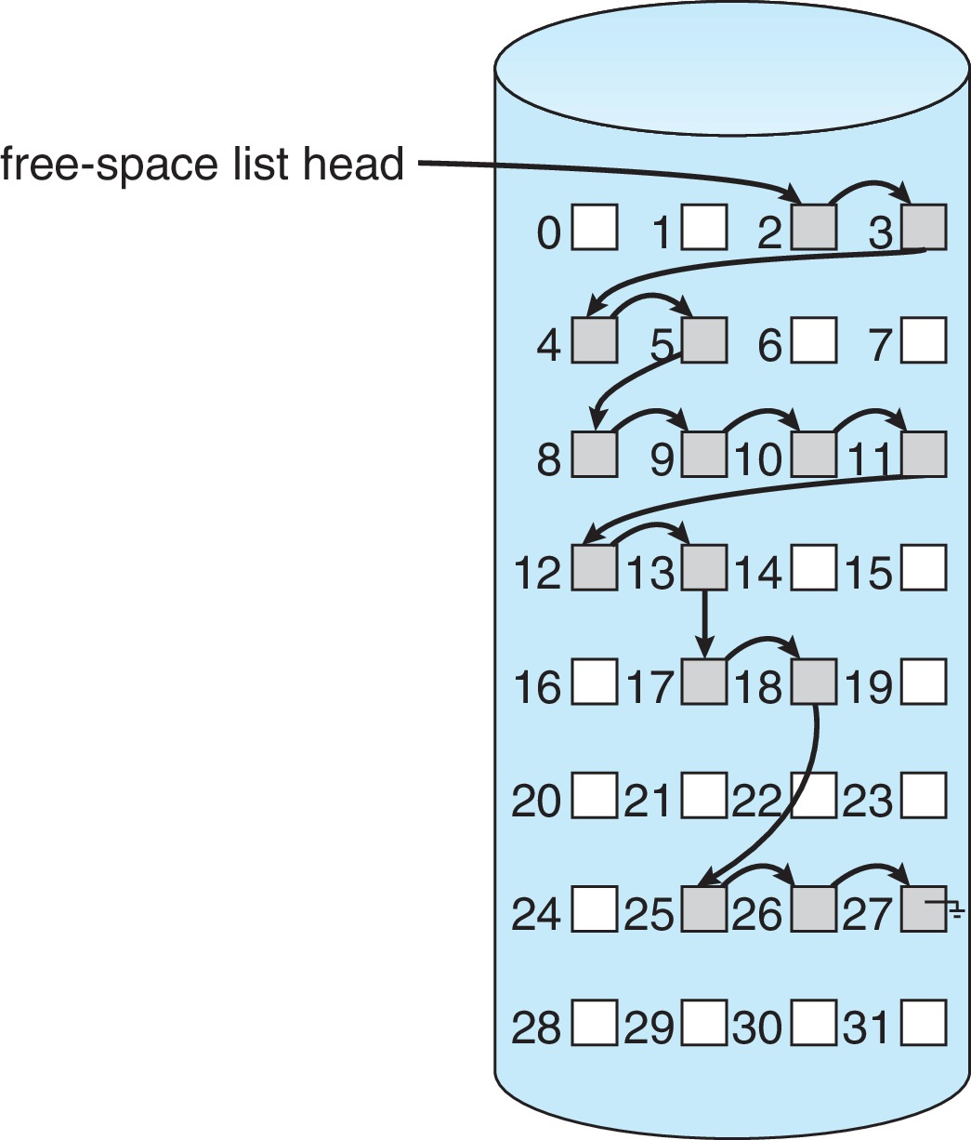
Linked Free Space List on Disk
Linked list (free list)
  Cannot get contiguous space easily
  No waste of space
  No need to traverse the entire list (if # free blocks recorded)

Slide 73
Free-Space Management
Grouping
  Modify linked list to store address of next n-1 free blocks in first free block, plus a pointer to next block that contains free-block-pointers (like this one)
Counting
  Because space is frequently contiguously used and freed, with contiguous-allocation allocation, extents, or clustering
    Keep address of first free block and count of following free blocks
    Free space list then has entries containing addresses and counts

Slide 74
Efficiency and Performance
Efficiency dependent on:
  Disk allocation and directory algorithms
  Types of data kept in file’s directory entry
  Pre-allocation or as-needed allocation of metadata structures
  Fixed-size or varying-size data structures

Slide 75
Efficiency and Performance (Cont.)
Performance
  Keeping data and metadata close together
  Buffer cache – separate section of main memory for frequently used blocks
  Synchronous writes sometimes requested by apps or needed by OS
    No buffering / caching – writes must hit disk before acknowledgement
    Asynchronous writes more common, buffer-able, faster
  Free-behind and read-ahead – techniques to optimize sequential access
  Reads frequently slower than writes

Slide 76
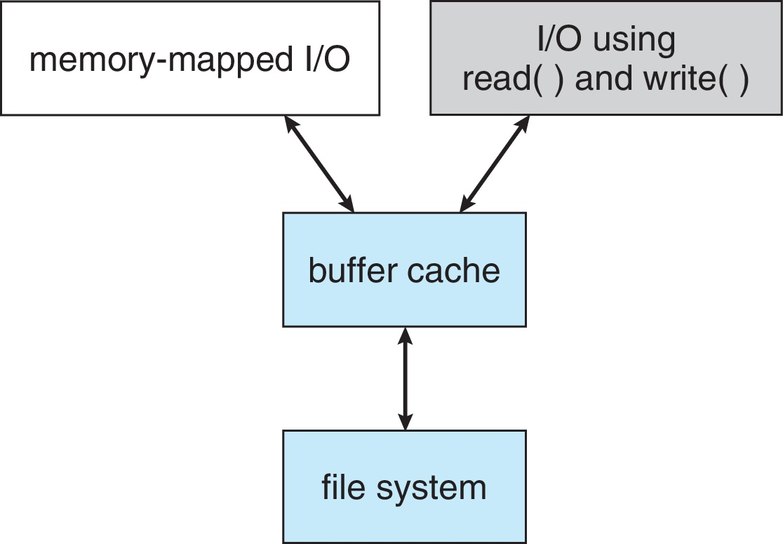
I/O Without a Unified Buffer Cache
A page cache caches pages rather than disk blocks using virtual memory techniques and addresses
Memory-mapped I/O uses a page cache
Routine I/O through the file system uses the buffer (disk) cache
This leads to the following figure

Slide 77
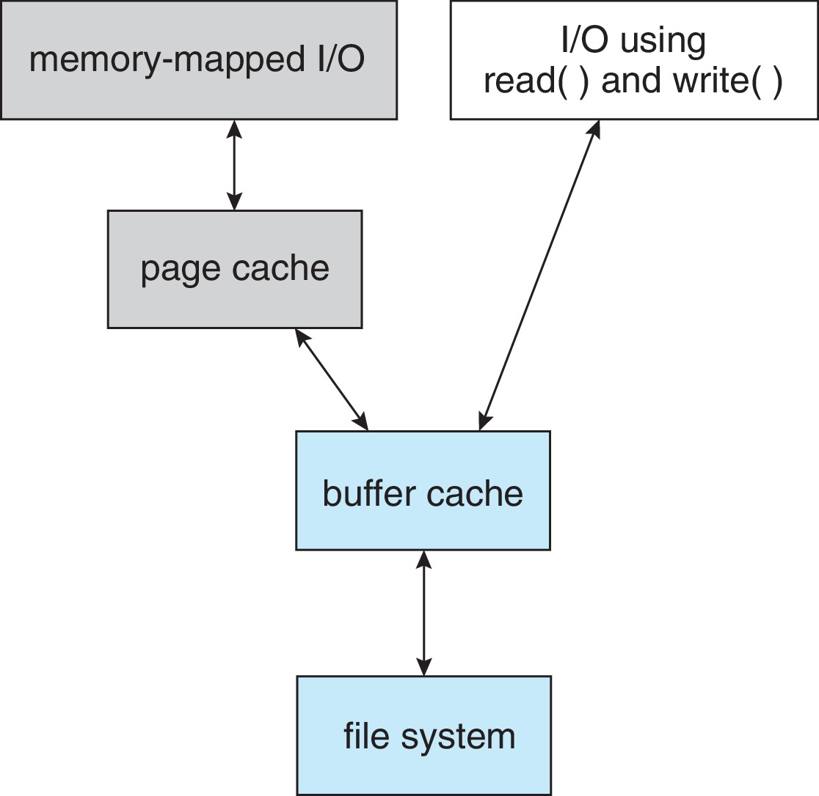
I/O Using a Unified Buffer Cache
A unified buffer cache uses the same page cache to cache both memory-mapped pages and ordinary file system I/O to avoid double caching
  But which caches get priority, and what replacement algorithms to use?

Slide 78
Recovery
Consistency checking – compares data in directory structure with data blocks on disk, and tries to fix inconsistencies
  Can be slow and sometimes fails
Use system programs to back up data from disk to another storage device (magnetic tape, other magnetic disk, optical)
Recover lost file or disk by restoring data from backup

Slide 79
Log Structured File Systems
Log structured (or journaling) file systems record each metadata update to the file system as a transaction
All transactions are written to a log
  A transaction is considered committed once it is written to the log (sequentially)
  Sometimes to a separate device or section of disk
  However, the file system may not yet be updated
The transactions in the log are asynchronously written to the file system structures
  When the file system structures are modified, the transaction is removed from the log
If the file system crashes, all remaining transactions in the log must still be performed
Faster recovery from crash, removes chance of inconsistency of metadata

