Slide 1
Lecture 27
Computer Networks

Slide 2
Outline
1. Overview
  Computer Networks
  Distributed Systems
  Network Devices
  Network Models
2. Network Protocols
3. Network Structure
  Network Topologies
  LAN
  WAN
4. Communication Structure
  Naming and Name Resolution
  Routing Strategies
  Packet Strategies
  Connection Strategies
  Contention
5. Robustness
  Failure Detection
  Reconfiguration
  Recovery from Failure

Slide 3
Outline
  KEYWORDS: IP address, Mac address, LAN, WAN, Naming, Name Resolution, routing, frame, packet, segment, ISO network model, UDP, TCP, TCP/IP, robustness, network topologies.
HOMEWORK:
  1) Reading : Chapter 19, especially the summary.
  2) Make sure to understand and be able to explain every keyword from the list here and the ones which are printed bold in the text book.
  3) Important Questions:
  Describe the ISO network model
  List and draw diagrams for all network topologies
  Compare NOS and DOS
  Compare hub, switch or router.
  Compare Frame, Packet, and Segment
  Compare TCP and UDP

Slide 4


What is a Computer Network ?
  Computer network = two or more computers(nodes) that are connected with each other, for sharing resources and so that data can be transferred between them.
  INTERNET = “network of networks”
Mobile network
Global ISP
Home network
Regional ISP
Institutional network

Slide 5
Internet Structure: Network of Networks
a packet passes through many networks!
local
ISP
Tier 3
ISP
local
ISP
local
ISP
local
ISP
Tier-2 ISP
Tier-2 ISP
Tier 1 ISP
Tier 1 ISP
Tier 1 ISP
Tier-2 ISP
Tier-2 ISP
Tier-2 ISP
local
ISP
local
ISP
local
ISP
local
ISP

Slide 6
Distributed Systems
A distributed system is a collection of loosely coupled nodes interconnected by a communications network
Nodes variously called processors, computers, machines, hosts
  Site is location of the machine, node refers to specific system
  Generally a server has a resource a client node at a different site wants to use

Slide 7
Distributed Systems (Cont.)
Nodes may exist in a client-server, peer-to-peer, or hybrid configuration.
  In client-server configuration, server has a resource that a client would like to use
  In peer-to-peer configuration, each node shares equal responsibilities and can act as both clients and servers
Communication over a network occurs through message passing
  All higher-level functions of a standalone system can be expanded to encompass a distributed system

Slide 8
Reasons for Distributed Systems
Resource sharing
  Sharing files or printing at remote sites
  Processing information in a distributed database
  Using remote specialized hardware devices such as graphics processing units (GPUs)
Computation speedup
  Distribute subcomputations among various sites to run concurrently
  Load balancing – moving jobs to more lightly-loaded sites
Reliability
  Detect and recover from site failure, function transfer, reintegrate failed site

Slide 9
Network-oriented Operating Systems
Two main types
Network Operating Systems
  Users are aware of multiplicity of machines
Distributed Operating Systems
  Users not aware of multiplicity of machines

Slide 10
Network Operating Systems (NOS)
Users are aware of multiplicity of machines
Access to resources of various machines is done explicitly by:
  Remote logging into the appropriate remote machine (ssh)
    ssh kristen.cs.yale.edu
  Transferring data from remote machines to local machines, via the File Transfer Protocol (FTP) mechanism
  Upload, download, access, or share files through cloud storage
Users must change paradigms – establish a session, give network-based commands, use a web browser
  More difficult for users

Slide 11
Distributed Operating Systems (DOS)
Users not aware of multiplicity of machines
  Access to remote resources similar to access to local resources
Data Migration – transfer data by transferring entire file, or transferring only those portions of the file necessary for the immediate task
Computation Migration – transfer the computation, rather than the data, across the system
  Via remote procedure calls (RPCs)
  Via messaging system

Slide 12
Distributed-Operating Systems (Cont.)
Process Migration – execute an entire process, or parts of it, at different sites
  Load balancing – distribute processes across network to even the workload
  Computation speedup – subprocesses can run concurrently on different sites
  Hardware preference – process execution may require specialized processor
  Software preference – required software may be available at only a particular site
  Data access – run process remotely, rather than transfer all data locally
Consider the World Wide Web

Slide 13
Design Issues of Distributed Systems
We investigate three design questions:
  Robustness – Can the distributed system withstand failures?
  Transparency – Can the distributed system be transparent to the user both in terms of where files are stored and user mobility?
  Scalability – Can the distributed system be scalable to allow addition of more computation power, storage, or users?

Slide 14
Outline
1. Overview
  Computer Networks
  Distributed Systems
  Network Devices
  Network Models
2. Network Protocols
3. Network Structure
  Network Topologies
  LAN
  WAN
4. Communication Structure
  Naming and Name Resolution
  Routing Strategies
  Packet Strategies
  Connection Strategies
  Contention
5. Robustness
  Failure Detection
  Reconfiguration
  Recovery from Failure

Slide 15
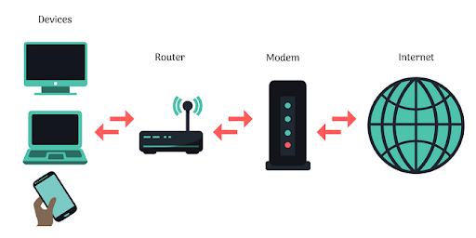
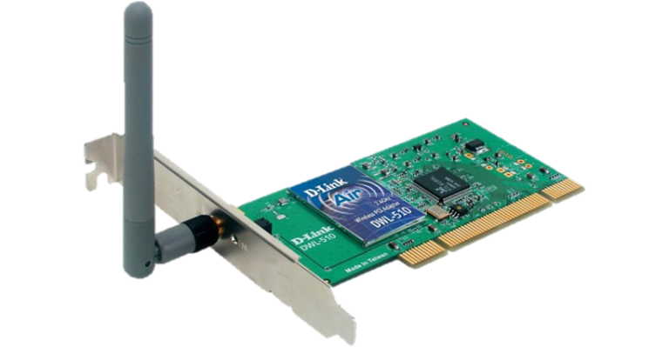
Network Devices
Network interface card (NIC), is also known as Ethernet card, network card, network adapter = a physical and data link layer device used by computers to connect to a network (Ethernet LAN)
Modem = a device is to convert digital signal into analog and vice versa, it has two components: modulator(converts digital data into analog data when the data is being sent by the computer) and demodulator(converts analog data signals into digital data when it is being received by the computer)

Slide 16
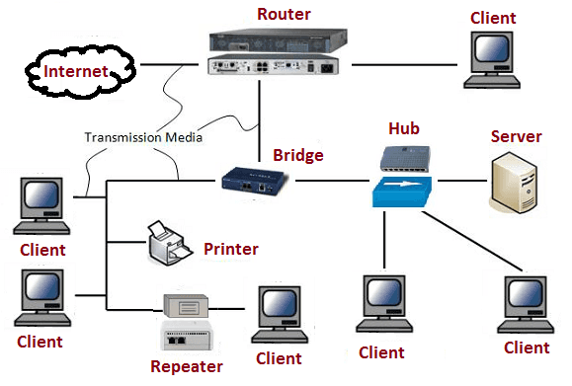
Network Devices
Bridge connects two or more networks of computers (LAN). Bridges can however handle network that follow the same protocol. Filtering, forwarding and blocking of frames are functions of bridges. Bridges offer much better performance than hub
Gateway connects two or more dissimilar networks. That is networks that use different protocols.
Repeater are used to extend transmissions so that the signal can cover longer distances or be received on the other side of an obstruction. It increases the power of a signal and retransmits it.

Slide 17
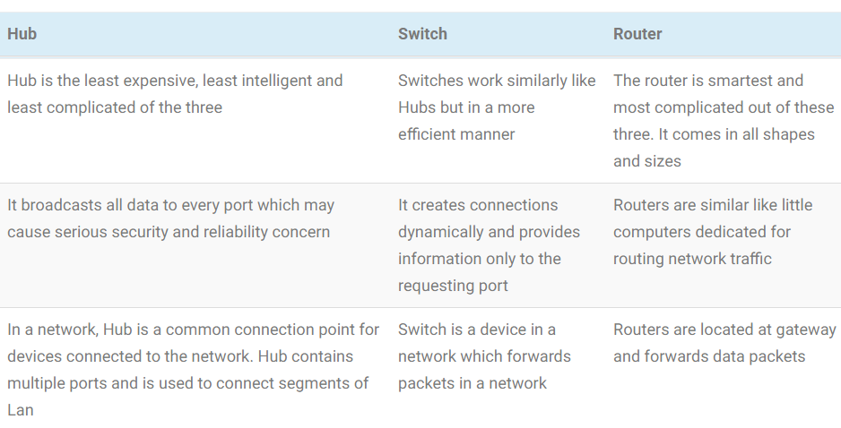
Network Devices
To connect computers to each other: hub, switch or router.

Slide 18
Outline
1. Overview
  Computer Networks
  Distributed Systems
  Network Devices
  Network Models
2. Network Protocols
3. Network Structure
  Network Topologies
  LAN
  WAN
4. Communication Structure
  Naming and Name Resolution
  Routing Strategies
  Packet Strategies
  Connection Strategies
  Contention
5. Robustness
  Failure Detection
  Reconfiguration
  Recovery from Failure

Slide 19
OSI Network Model
Logical communication between two computers, with the three lowest-level layers implemented in hardware

Slide 20
Analogy: Organization of air travel
ticket (purchase)
baggage (check)
gates (load)
runway takeoff
airplane routing
ticket (complain)
baggage (claim)
gates (unload)
runway landing
airplane routing
airplane routing
a series of steps

Slide 21
Analogy: Layering of airline functionality
ticket (purchase)
baggage (check)
gates (load)
runway (takeoff)
airplane routing
ticket (complain)
baggage (claim
gates (unload)
runway (land)
airplane routing
ticket
baggage
gate
takeoff/landing
airplane routing
airplane routing
airplane routing
departure
airport
intermediate air-traffic
control centers
arrival
airport
Layers: each layer implements a service
  via its own internal-layer actions
  relying on services provided by layer below

Slide 22
OSI Protocol Stack

Slide 23
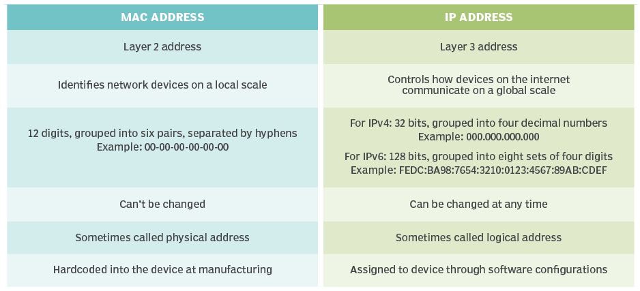
Device Address: MAC vs. IP

Slide 24
OSI Network Message

Slide 25
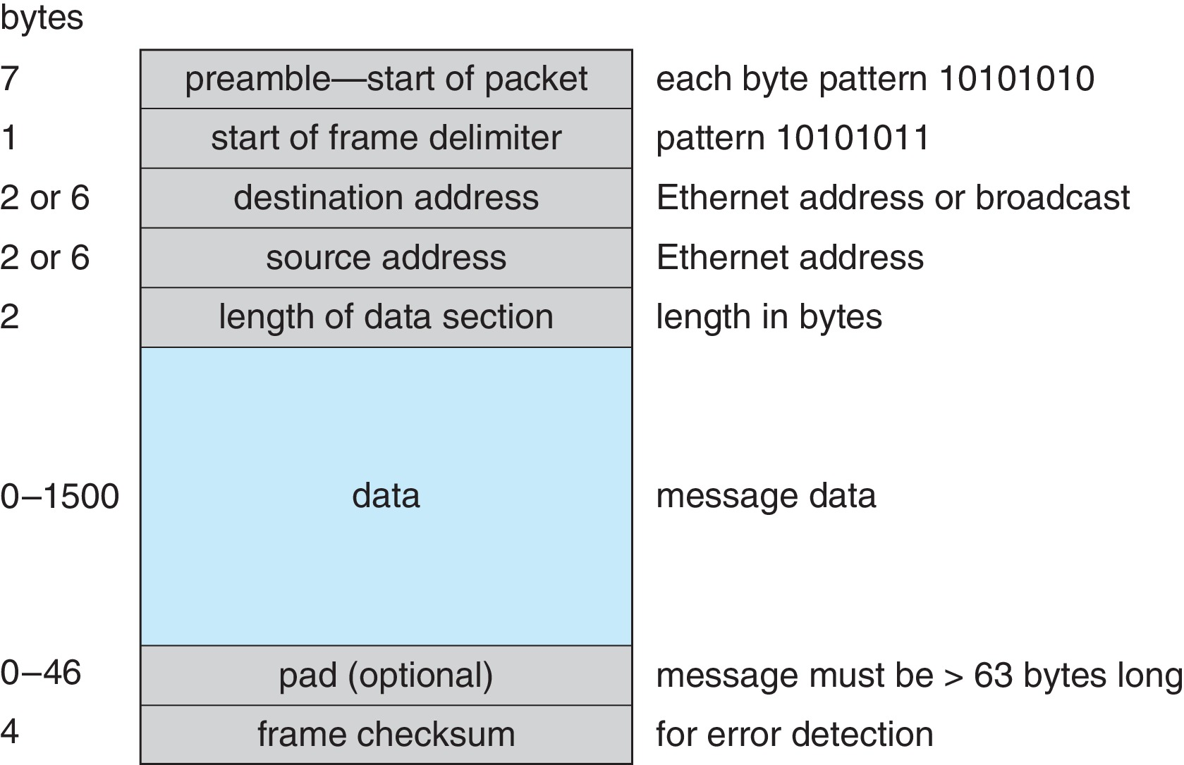
Ethernet Packet

Slide 26
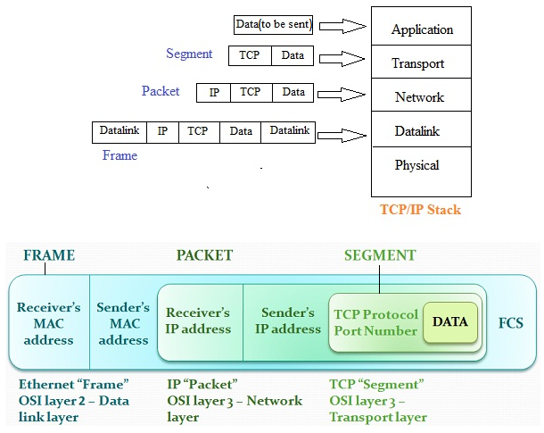
Frame, Packet, Segment

Slide 27
Outline
1. Overview
  Computer Networks
  Distributed Systems
  Network Devices
  Network Models
2. Network Protocols
3. Network Structure
  Network Topologies
  LAN
  WAN
4. Communication Structure
  Naming and Name Resolution
  Routing Strategies
  Packet Strategies
  Connection Strategies
  Contention
5. Robustness
  Failure Detection
  Reconfiguration
  Recovery from Failure

Slide 28


Network Protocols
Network protocols: define the formats and how data/messages are sent/received between computers.
Examples: TCP, IP, HTTP, Skype, Ethernet
a human protocol and a computer network protocol:
Hi
TCP connection
request
Hi
TCP connection
response
Got the
time?
Get http://www.awl.com/kurose-ross
2:00
<file>
time

Slide 29
Communication Protocols
The communication network is partitioned into the following multiple layers:
Layer 1: Physical layer – handles the mechanical and electrical details of the physical transmission of a bit stream
Layer 2: Data-link layer – handles the frames, or fixed-length parts of packets, including any error detection and recovery that occurred in the physical layer
Layer 3: Network layer – provides connections and routes packets in the communication network, including handling the address of outgoing packets, decoding the address of incoming packets, and maintaining routing information for proper response to changing load levels

Slide 30
Communication Protocols (Cont.)
Layer 4: Transport layer – responsible for low-level network access and for message transfer between clients, including partitioning messages into packets, maintaining packet order, controlling flow, and generating physical addresses
Layer 5: Session layer – implements sessions, or process-to-process communications protocols
Layer 6: Presentation layer – resolves the differences in formats among the various sites in the network, including character conversions, and half duplex/full duplex (echoing)
Layer 7: Application layer – interacts directly with the users, deals with file transfer, remote-login protocols and electronic mail, as well as schemas for distributed databases

Slide 31
Internet protocol stack
application: supporting network applications
  FTP, SMTP, HTTP
transport: process-process data transfer
  TCP, UDP
network: routing of datagrams from source to destination
  IP, routing protocols
link: data transfer between neighboring network elements
  PPP, Ethernet
physical: bits “on the wire”
application
transport
network
link
physical

Slide 32
ISO/OSI reference model
presentation: allow applications to interpret meaning of data, e.g., encryption, compression, machine-specific conventions
session: synchronization, checkpointing, recovery of data exchange
Internet stack “missing” these layers!
  these services, if needed, must be implemented in application
  needed?
application
presentation
session
transport
network
link
physical

Slide 33
Encapsulation
source
message
M
application
transport
network
link
physical
segment
H_{t}
M
H_{t}
datagram
H_{n}
H_{n}
H_{t}
M
frame
H_{l}
H_{n}
H_{t}
M
link
physical
switch
destination
H_{n}
H_{t}
M
network
link
physical
M
application
transport
network
link
physical
H_{l}
H_{n}
H_{t}
M
H_{n}
H_{t}
M
H_{t}
M
H_{n}
H_{t}
M
H_{l}
H_{n}
H_{t}
M
router

Slide 34
TCP/IP Example
Every host has a name and an associated IP address (host-id)
  Hierarchical and segmented
Sending system checks routing tables and locates a router to send packet
Router uses segmented network part of host-id to determine where to transfer packet
  This may repeat among multiple routers
Destination system receives the packet
  Packet may be complete message, or it may need to be reassembled into larger message spanning multiple packets

Slide 35
TCP/IP Example (Cont.)
Within a network, how does a packet move from sender (host or router) to receiver?
  Every Ethernet/WiFi device has a medium access control (MAC) address
  Two devices on same LAN communicate via MAC address
  If a system needs to send data to another system, it needs to discover the IP to MAC address mapping
    Uses address resolution protocol (ARP)
  A broadcast uses a special network address to signal that all hosts should receive and process the packet
    Not forwarded by routers to different networks

Slide 36
Transport Protocols UDP and TCP
Once a host with a specific IP address receives a packet, it must somehow pass it to the correct waiting process
Transport protocols TCP and UDP identify receiving and sending processes through the use of a port number
  Allows host with single IP address to have multiple server/client processes sending/receiving packets
  Well-known port numbers are used for many services
    FTP – port 21
    ssh – port 22
    SMTP – port 25
    HTTP – port 80
Transport protocol can be simple or can add reliability to network packet stream

Slide 37
User Datagram Protocol
UDP is unreliable – bare-bones extension to IP with addition of port number
  Since there are no guarantees of delivery in the lower network (IP) layer, packets may become lost
  Packets may also be received out-out-order
UDP is also connectionless – no connection setup at the beginning of the transmission to set up state
  Also no connection tear-down at the end of transmission
UDP packets are also called datagrams

Slide 38
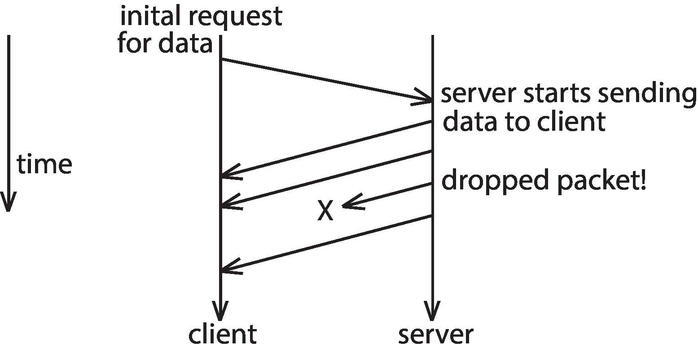
UDP Dropped Packet Example

Slide 39
Transmission Control Protocol
TCP is both reliable and connection-oriented
In addition to port number, TCP provides abstraction to allow in-order, uninterrupted byte-stream across an unreliable network
  Whenever host sends packet, the receiver must send an acknowledgement packet (ACK). If ACK not received before a timer expires, sender will resend.
  Sequence numbers in TCP header allow receiver to put packets in order and notice missing packets
  Connections are initiated with series of control packets called a three-way handshake
    Connections also closed with series of control packets

Slide 40
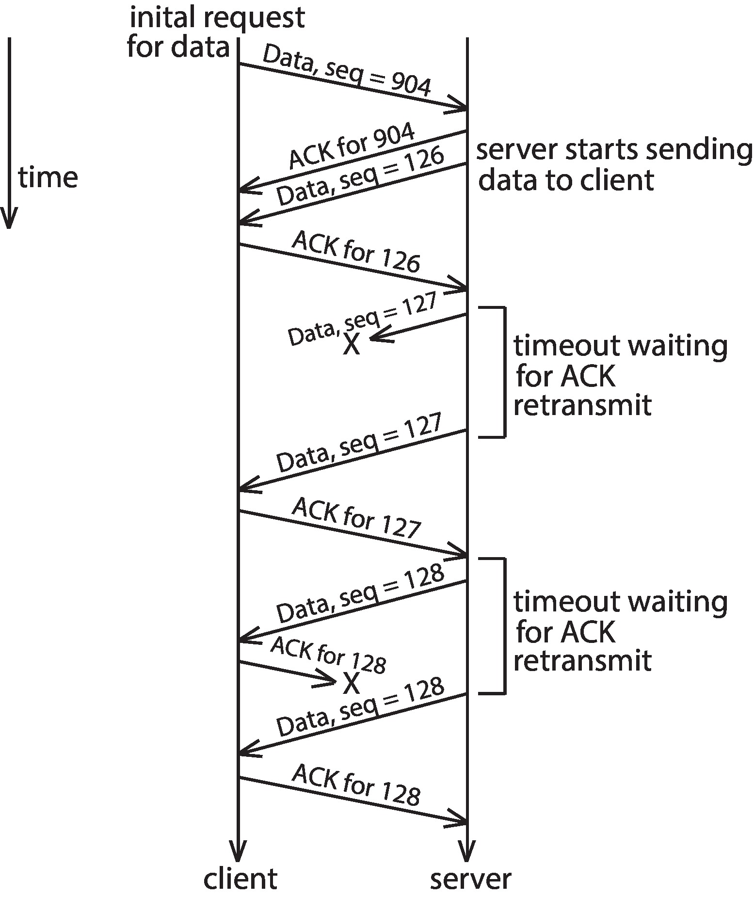
TCP Data Transfer Scenario

Slide 41
Transmission Control Protocol (Cont.)
Receiver can send a cumulative ACK to acknowledge series of packets
  Server can also send multiple packets before waiting for ACKs
  Takes advantage of network throughput
Flow of packets regulated through flow control and congestion control
  Flow control – prevents sender from overrunning capacity of receiver
  Congestion control – approximates congestion of the network to slow down or speed up packet sending rate

Slide 42
Outline
1. Overview
  Computer Networks
  Distributed Systems
  Network Devices
  Network Models
2. Network Protocols
3. Network Structure
  Network Topologies
  LAN
  WAN
5. Communication Structure
  Naming and Name Resolution
  Routing Strategies
  Packet Strategies
  Connection Strategies
  Contention
6. Robustness
  Failure Detection
  Reconfiguration
  Recovery from Failure

Slide 43
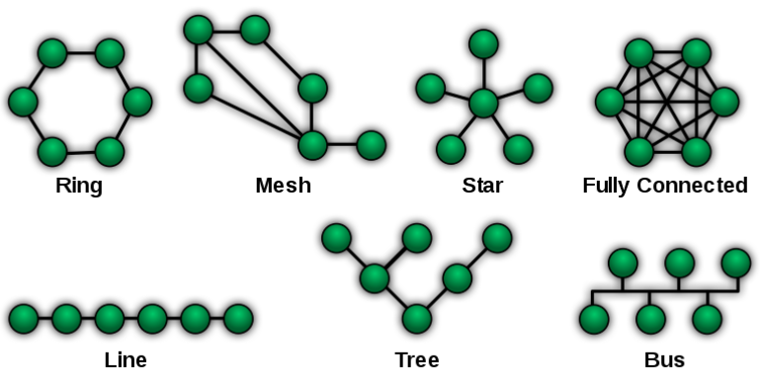
Network Topologies

Slide 44
Local-Area Network (LAN)
Local-Area Network (LAN) – designed to cover small geographical area
  Consists of multiple computers (workstations, laptops, mobile devices), peripherals (printers, storage arrays), and routers providing access to other networks
  Ethernet and/or Wireless (WiFi) most common way to construct LANs
    Ethernet defined by standard IEEE 802.3 with speeds typically varying from 10Mbps to over 10Gbps
    WiFi defined by standard IEEE 802.11 with speeds typically varying from 11Mbps to over 400Mbps.
    Both standards constantly evolving

Slide 45
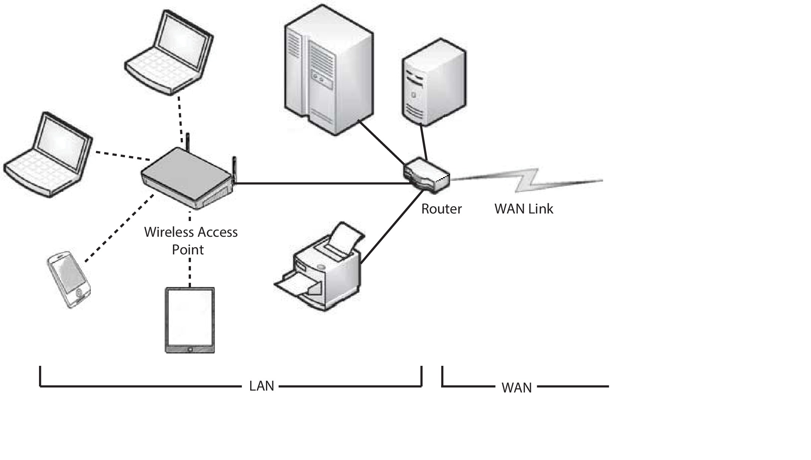
Local-Area Network (LAN)

Slide 46
Wide-Area Network (WAN)
Wide-Area Network (WAN) – links geographically separated sites
  Point-to-point connections via links
    Telephone lines, leased (dedicated data) lines, optical cable, microwave links, radio waves, and satellite channels
  Implemented via routers to direct traffic from one network to another
  Internet (World Wide Web) WAN enables hosts world wide to communicate
  Speeds vary
    Many backbone providers have speeds at 40-100Gbps
    Local Internet Service Providers (ISPs) may be slower
    WAN links constantly being upgraded
  WANs and LANs interconnect, similar to cell phone network:
    Cell phones use radio waves to cell towers
    Towers connect to other towers and hubs

Slide 47
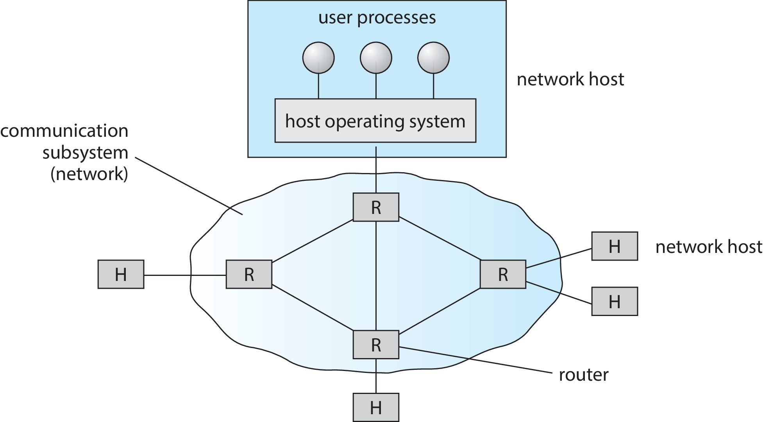
Wide-Area Network (WAN)

Slide 48
Outline
1. Overview
  Computer Networks
  Distributed Systems
  Network Devices
  Network Models
2. Network Protocols
3. Network Structure
  Network Topologies
  LAN
  WAN
4. Communication Structure
  Naming and Name Resolution
  Routing Strategies
  Packet Strategies
  Connection Strategies
  Contention
5. Robustness
  Failure Detection
  Reconfiguration
  Recovery from Failure

Slide 49
Communication Structure Issues
The designer of a communication network must address these issues:
Naming and name resolution. How do two processes locate each other to communicate?
Routing strategies. How are messages sent through the network?
Packet strategies. Are packets sent individually or as a sequence?
Connection strategies. How do two processes send a sequence of messages?
Contention strategies. How to avoid repeated collisions when several sites may want to transmit information over a link simultaneously?

Slide 50
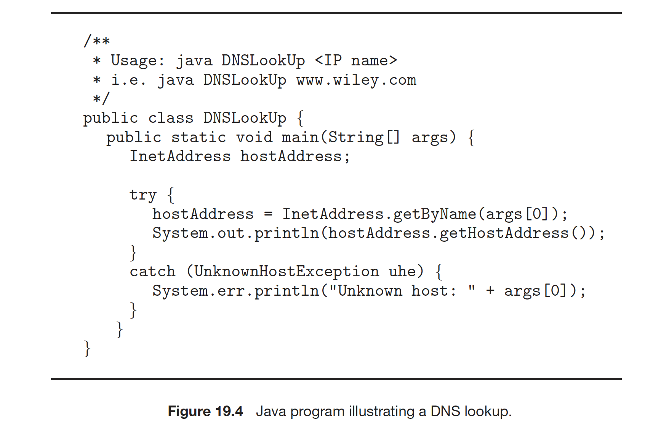
Naming and Name Resolution
Each computer system in the network has a unique name
Each process in a given system has a unique name (process-id)
Identify processes on remote systems by
      <host-name, identifier> pair
Domain name system (DNS) – specifies the naming structure of the hosts, as well as name to address resolution (Internet)

Slide 51
Naming Structures
Location transparency – file name does not reveal the file’s physical storage location
Location independence – file name does not need to be changed when the file’s physical storage location changes
In practice most DFSs use static, location-transparent mapping for user-level names
  Some support file migration (e.g. OpenAFS)
  Hadoop supports file migration but without following POSIX standards; hides information from clients
  Amazon S3 provides blocks of storage on demand via APIs, placing storage dynamically and moving data as necessary

Slide 52
Naming Schemes
Three approaches:
  Files named by combination of their host name and local name; guarantees a unique system-wide name. This naming scheme is neither location transparent nor location independent.
  Attach remote directories to local directories, giving the appearance of a coherent directory tree; only previously mounted remote directories can be accessed transparently
  Single global name structures spans all files in the system. If a server is unavailable, some arbitrary set of directories on different machines also becomes unavailable

Slide 53
Routing Strategies
  When a process at site A wants to communicate with a process at site B, how is the message sent?
  If there is only one physical path from A to B, the message must be sent through that path. However, if there are multiple physical paths from A to B, then several routing options exist.
  Each site has a routing table indicating the alternative paths that can be used to send a message to other sites.
  The table may include information about the speed and cost of the various communication paths, and it may be updated as necessary, either manually or via programs that exchange routing information.

Slide 54
Routing Strategies
The three most common routing schemes are fixed routing, virtual routing, and dynamic routing.
Fixed routing. A path(usually, the shortest) from A to B is specified in advance and does not change unless a hardware failure disables it.
Virtual routing. A path from A to B is fixed for the duration of one session. Different sessions involving messages from A to B may use different paths. A session could be as short as a file transfer or as long as a remote-login period.
Dynamic routing. The path used to send a message from site A to site B is chosen only while the message is being sent. Site A will decide which next node (usually whatever link is the least used at that particular time) to send the message to, let’s say site C. Once it reaches site C, then C it will decide which next node (path) to send the message to, let’s say site D, and so on. Eventually, a site will deliver the message to B.

Slide 55
Packet strategies
Messages generally vary in length. To simplify the system design, we commonly implement communication with fixed-length messages called packets, frames, or datagrams.
A communication implemented in one packet can be sent to its destination in a connectionless message. A connectionless message/packet can be:
unreliable, in which case the sender has no guarantee that, and cannot tell whether, the packet reached its destination.
reliable, an acknowledgement packet is returned from the destination indicating that the original packet arrived. (Of course, the return packet could be lost along the way.) If a message is too long to fit within one packet, or if the packets need to flow back and forth between the two communicators, a connection is established to allow the reliable exchange of multiple packets.

Slide 56
Connection Strategies
Circuit switching - A permanent physical link is established for the duration of the communication (i.e., telephone system).
Message switching - A temporary link is established for the duration of one message transfer (i.e., post-office mailing system).
Packet switching - Messages of variable length are divided into fixed-length packets which are sent to the destination.
  Each packet may take a different path through the network.
  The packets must be reassembled into messages as they arrive.
Circuit switching requires setup time, but incurs less overhead for shipping each message, and may waste network bandwidth.
Message and packet switching require less setup time, but incur more overhead per message.

Slide 57
Packet Switching vs. Circuit Switching
Packet switching allows more users to use network!
1 Mb/s link
each user:
  100 kb/s when “active”
  active 10% of time
circuit-switching:
  10 users
packet switching:
  with 35 users, probability > 10 active at same time is less than .0004
N users
1 Mbps link
Q: how did we get value 0.0004?

Slide 58
Contention
Several sites may want to transmit information over a link
simultaneously. Techniques to avoid repeated collisions include:
CSMA/CD - Carrier sense with multiple access (CSMA); collision detection (CD)
  A site determines whether another message is currently being transmitted over that link. If two or more sites begin transmitting at exactly the same time, then they will register a CD and will stop transmitting
  When the system is very busy, many collisions may occur, and thus performance may be degraded
CSMA/CD is used successfully in the Ethernet system, the most common network system

Slide 59
Contention (Cont.)
Token passing - A unique message type, known as a token, continuously circulates in the system (usually a ring structure)
  A site that wants to transmit information must wait until the token arrives
  When the site completes its round of message passing, it retransmits the token
  A token-passing scheme is used by some IBM and HP/Apollo systems
Message slots - A number of fixed-length message slots continuously circulate in the system (usually a ring structure)
  Since a slot can contain only fixed-sized messages, a single logical message may have to be broken down into a number of smaller packets, each of which is sent in a separate slot
  This scheme has been adopted in the experimental Cambridge Digital Communication Ring

Slide 60
Outline
1. Overview
  Computer Networks
  Distributed Systems
  Network Devices
  Network Models
2. Network Protocols
3. Network Structure
  Network Topologies
  LAN
  WAN
4. Communication Structure
  Naming and Name Resolution
  Routing Strategies
  Packet Strategies
  Connection Strategies
  Contention
5. Robustness
  Failure Detection
  Reconfiguration
  Recovery from Failure

Slide 61
Robustness
Hardware failures can include failure of a link, failure of a site, and loss of a message.
A fault-tolerant system can tolerate a certain level of failure
  Degree of fault tolerance depends on design of system and the specific fault
  The more fault tolerance, the better!
Involves failure detection, reconfiguration, and recovery

Slide 62
Failure Detection
Detecting hardware failure is difficult
To detect a link failure, a heartbeat protocol can be used
Assume Site A and Site B have established a link
  At fixed intervals, each site will exchange an I-am-up message indicating that they are up and running
If Site A does not receive a message within the fixed interval, it assumes either (a) the other site is not up or (b) the message was lost
Site A can now send an Are-you-up? message to Site B
If Site A does not receive a reply, it can repeat the message or try an alternate route to Site B

Slide 63
Failure Detection (Cont.)
If Site A does not ultimately receive a reply from Site B, it concludes some type of failure has occurred
Types of failures:
- Site B is down
- The direct link between A and B is down
- The alternate link from A to B is down
- The message has been lost
However, Site A cannot determine exactly why the failure has occurred

Slide 64
Reconfiguration and Recovery
When Site A determines a failure has occurred, it must reconfigure the system:
  If the link from A to B has failed, this must be broadcast to every site in the system
  If a site has failed, every other site must also be notified indicating that the services offered by the failed site are no longer available
When the link or the site becomes available again, this information must again be broadcast to all other sites

