Slide 1
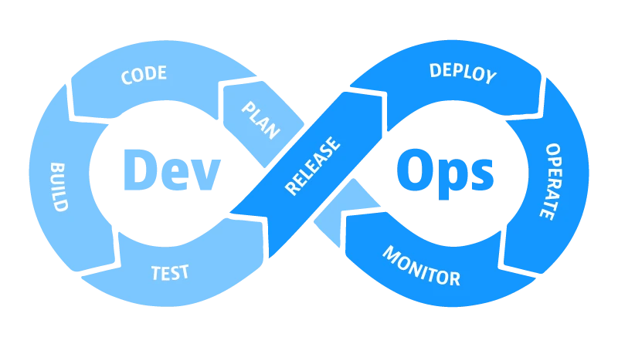
DEVOPS
Rachel Stowell DevOps Engineer @ IDEXX

Slide 2
What is DevOps?
Development
Operations
Dev
Ops
Software Engineers, Quality Assurance Engineers
IT, Database Administrators, Systems & Networking Administrators

Slide 3
Where it all began
Problem
Solution
Division between development and operations teams
Limited feedback with long cycle time
Slow time to market
Releasing unstable features
Combine all resources for the software development lifecycle into a single workflow
Eliminate waste and delays
Continuous improvement
Reduce risks by “shifting left”

Slide 4
Culture
Cross-team Collaboration
Communication
Continuous Improvement
Continuous Learning
Shared responsibility
Automation

Slide 5
Tooling
Version Control
Containerization
Continuous Integration
Artifact Management
Monitoring & Alerting
Automated Testing
Continuous Deployment
Infrastructure as Code

Slide 6
Version Control
Long term history of file changes
Can compare previous versions and roll back changes
Prevent conflicts when multiple developers are working on the same code base
Bitbucket, GitHub

Slide 7
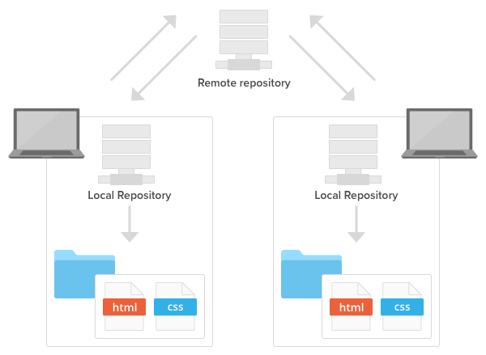
Version Control
Remote repository - hosted in BitBucket or GitHub
Local repository - local copy of the source code
Make changes (commits) locally, then push them to the remote repository

Slide 8
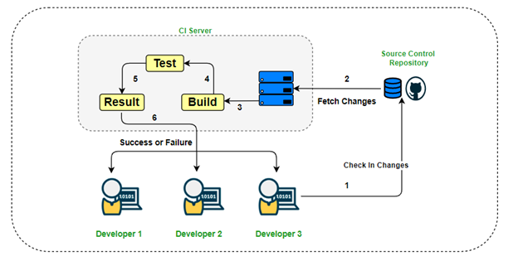
Continuous Integration
Merging code changes from multiple developers into a single project
Typically triggers an automated builds and runs unit tests
Code quality checks, static code analysis, security testing
Find and address bugs earlier in the development lifecycle
GitHub Actions, Jenkins, CircleCI, TravisCI

Slide 9
Continuous Delivery
Continuous Deployment
Changes automatically pushed to a staging/testing environment
Run user interface, load and performance tests
Manual deployment to production
Continuation of CI/CD
Changes automatically deployed to production after CI/CD

Slide 10
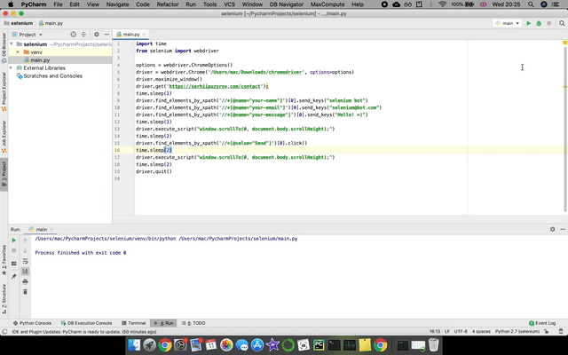
Automated Testing
API testing - relies on API within the software, bypasses user interface
User Interface testing - generated key strokes and simulated user events
Selenium and Puppeteer for automated web browser testing, JUnit & NUnit for API testing framework

Slide 11
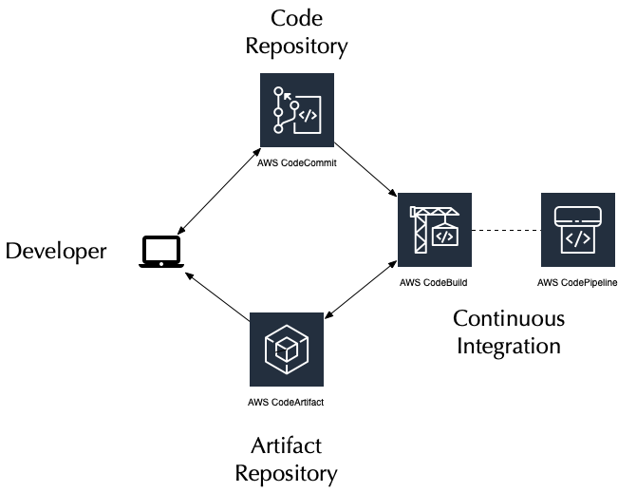
Artifact Management
Place to store artifacts from CI jobs
Can also be used to store build dependencies
Retention policies
Artifactory, DockerHub, AWS ECR, AWS CodeArtifact

Slide 12
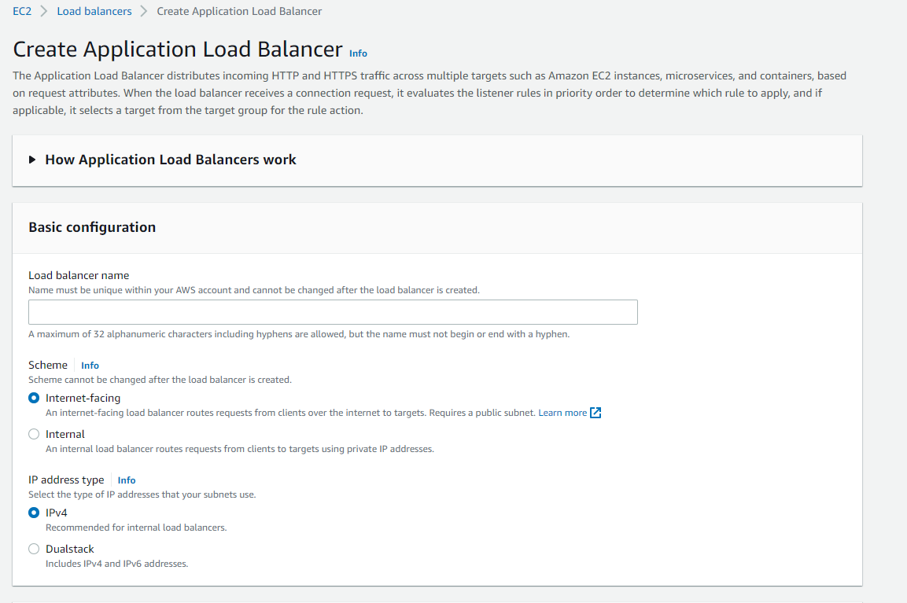
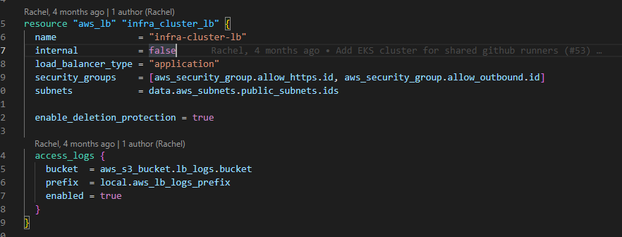
Infrastructure as Code
Provision servers and infrastructure through code instead of provisioning manually
Easier to track infrastructure changes
Prevents “snowflake” infrastructure
Terraform, AWS CloudFormation

Slide 13
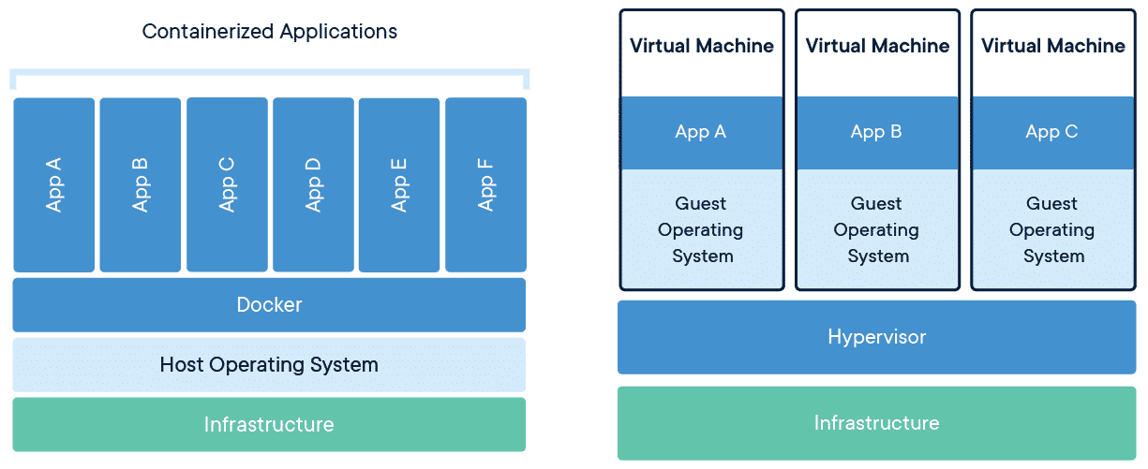
Containerization
Package software with dependencies and OS to run on any infrastructure
Lightweight and portable
Docker, Kubernetes

Slide 14
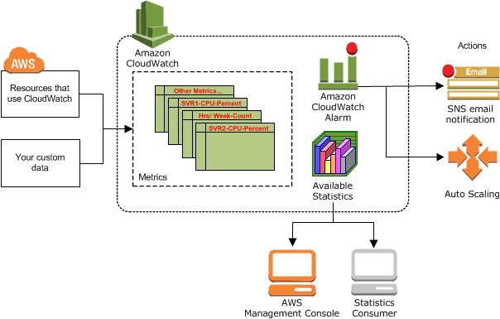
Monitoring & Alerting
Provide information regarding CPU/RAM usage
“Health Checks” to monitor application status
Can trigger alerts based on monitored metrics
AWS CloudWatch, Grafana, Prometheus

Slide 15
How to get started in DevOps
Projects
Certifications
Start-ups
Cloud
Linux
Scripting
Make a GitHub repository with a CI job
AWS DevOps, Docker Associate, Kubernetes Administrator
Looking to adopt DevOps from the beginning
Sign up for AWS and use the free tier to practice
Set up an Ubuntu VM or container to get comfortable using the command line
Bash, Python, PowerShell

Slide 16
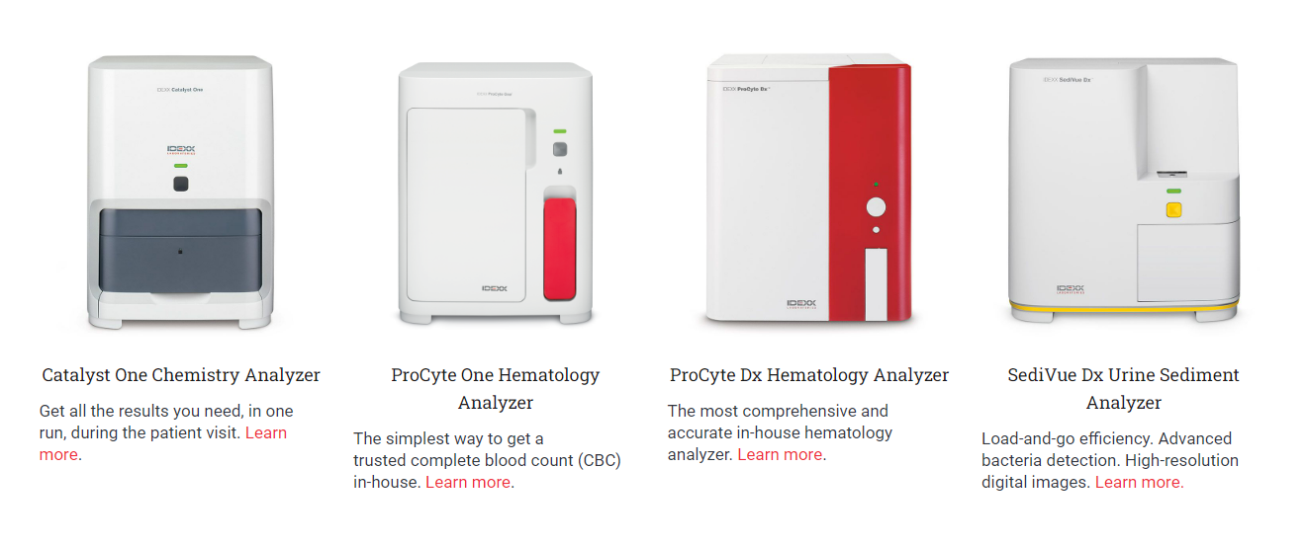
IDEXX LABORATORIES
Headquarters in Westbrook, Maine (near Portland)
Careers page - https://careers.idexx.com/us/en
LinkedIn - https://www.linkedin.com/company/idexx-laboratories
rachel-stowell@idexx.com, rrstowell@gmail.com, https://www.linkedin.com/in/rachelstowell/

